Slide 1

HW1
Std name : Shrouq Trad Al-Fuqaha’a
ID : 20208075
Supervisor : Dr. Ibrahim Abu Al-Haol

Slide 2
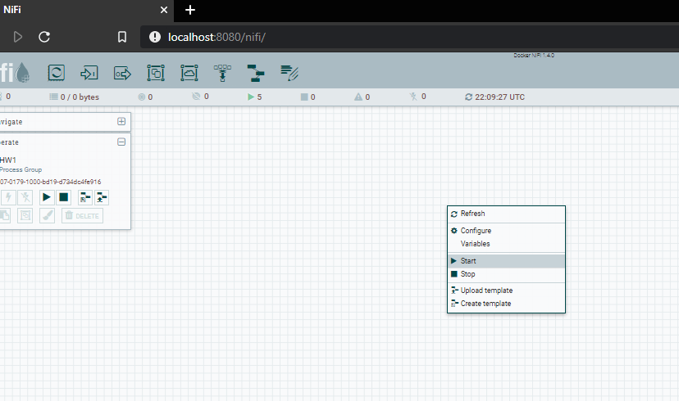
Click right in the space
And choose upload template

Slide 3
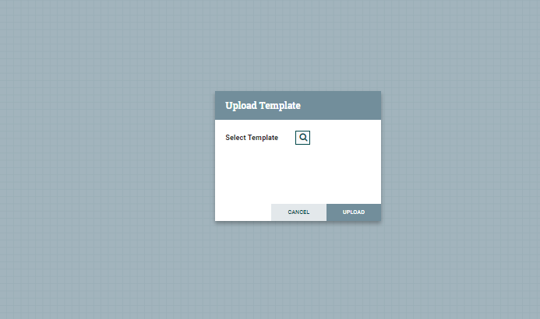
Click on the search button
And upload template

Slide 4
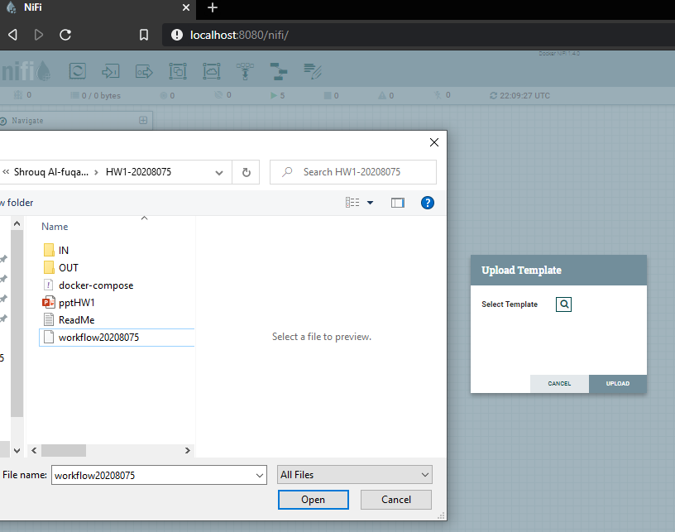

Slide 5
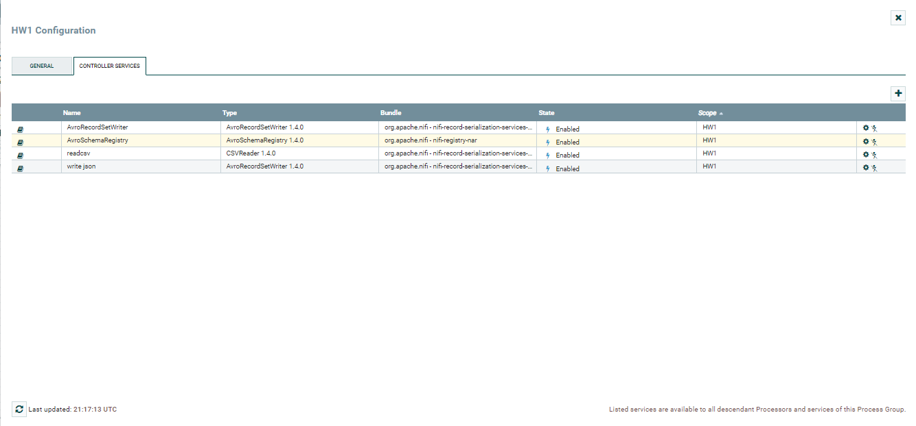
Here we want to enable Controller services

Slide 6
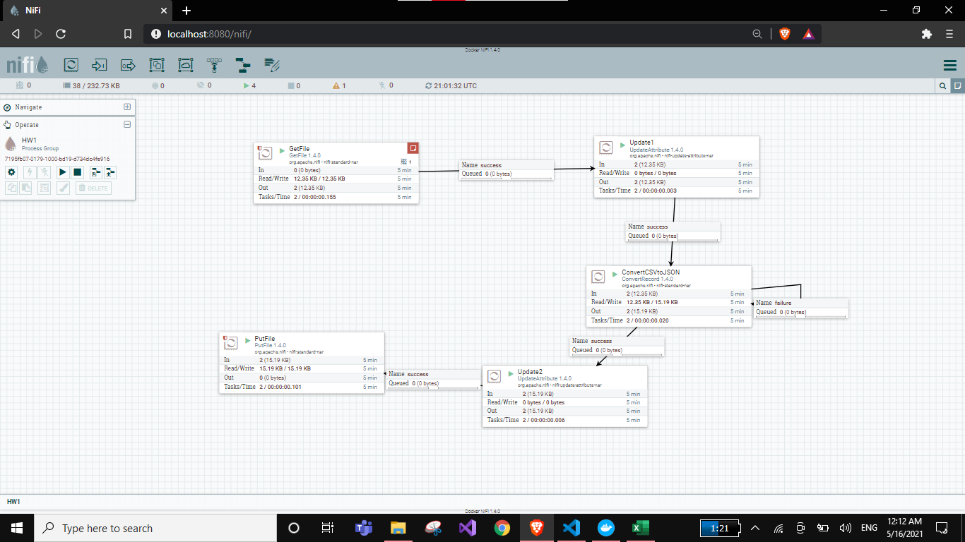
Our workflow

Slide 7
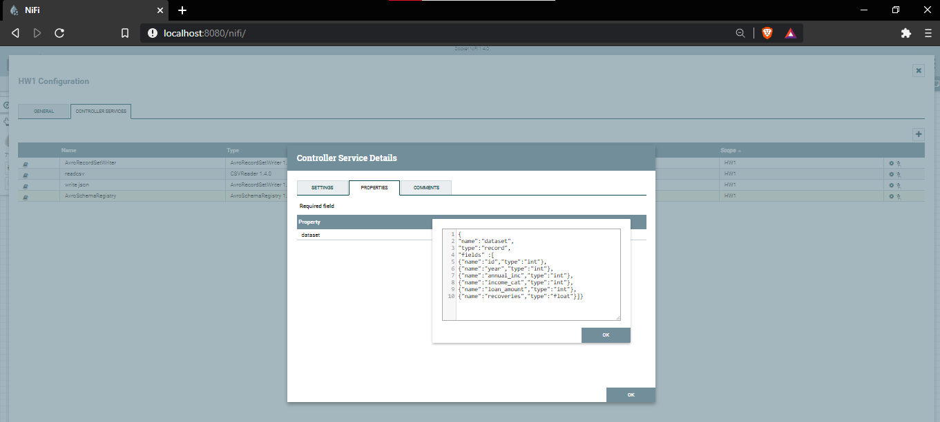
Double click on Get file process then go to properties
And write the schema for your dataset

Slide 8
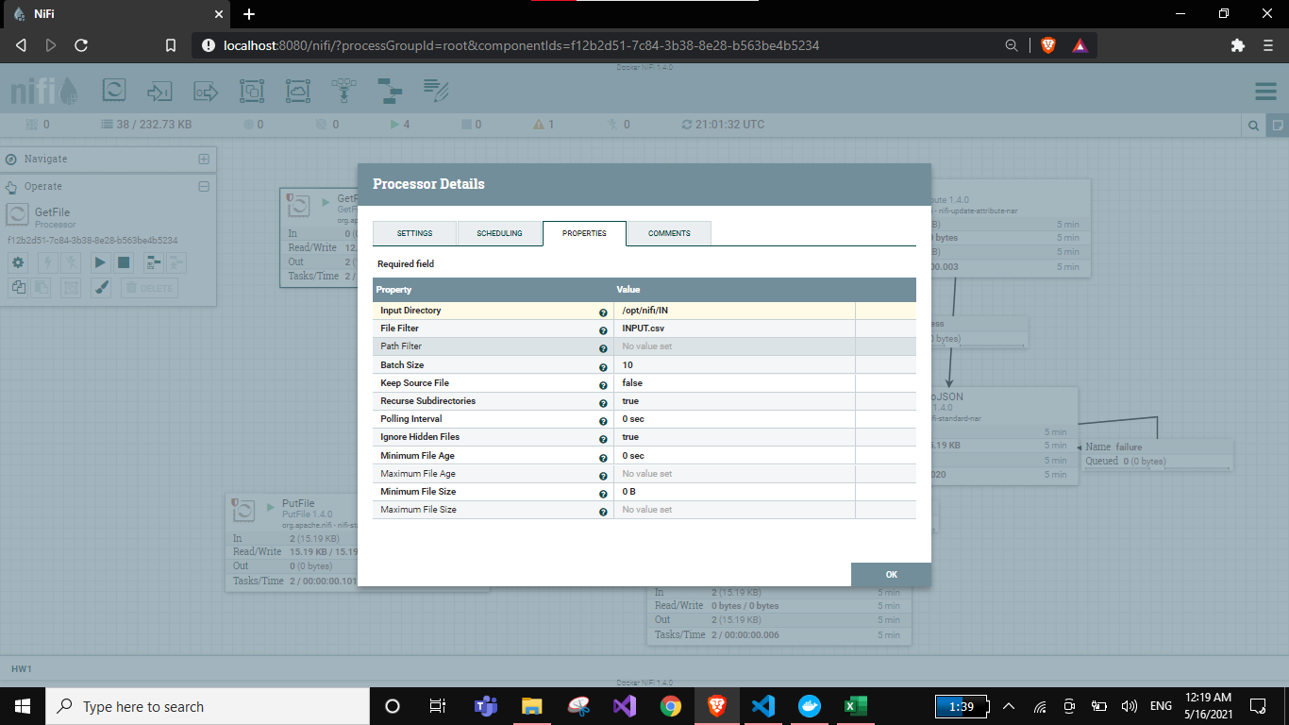
Click on Update1 process then go to properties write the path for input directory
And put in file filter your csv file

Slide 9
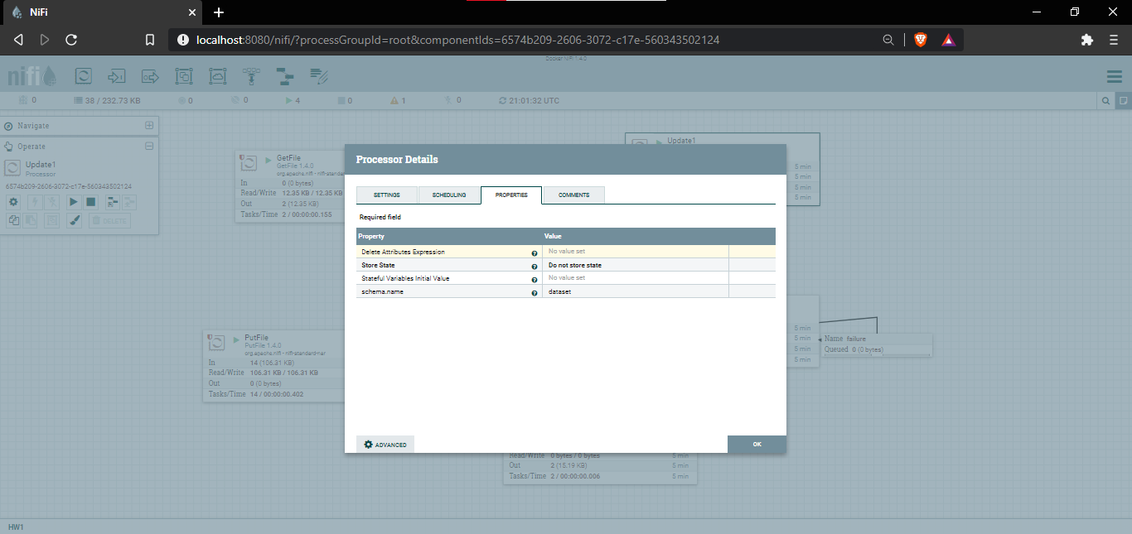
Click on the (convert CSV to Json) process and set your schema
to schema name

Slide 10
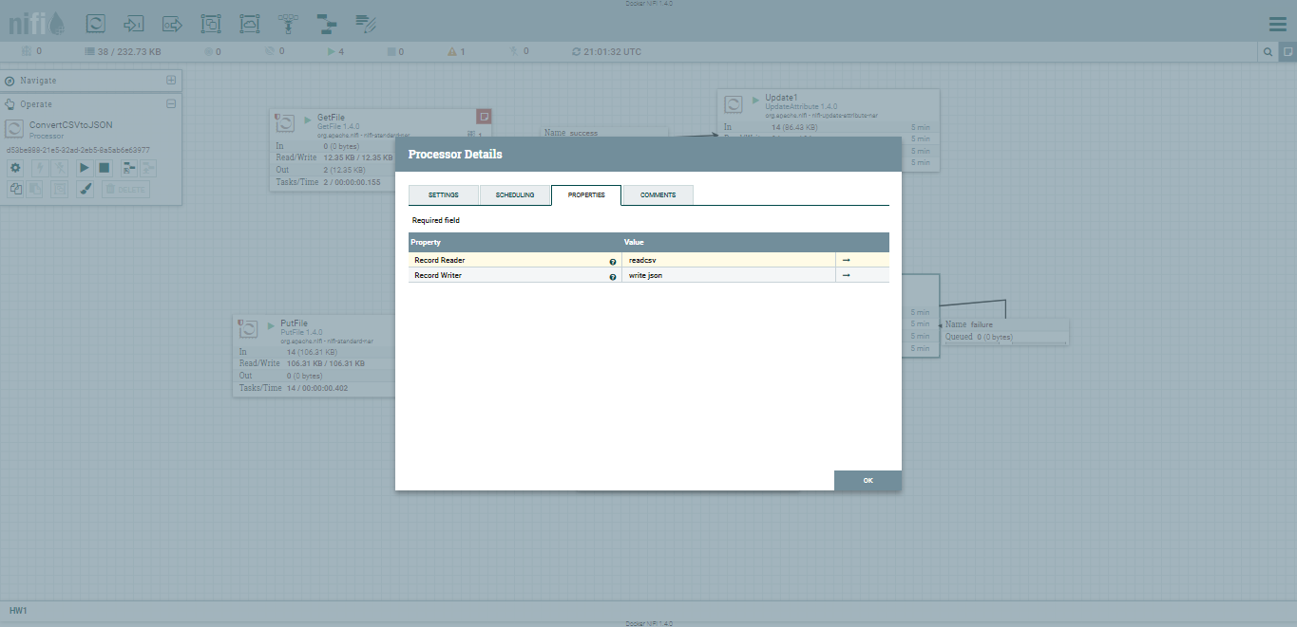
Click on Update2 process , set reader and writer property

Slide 11
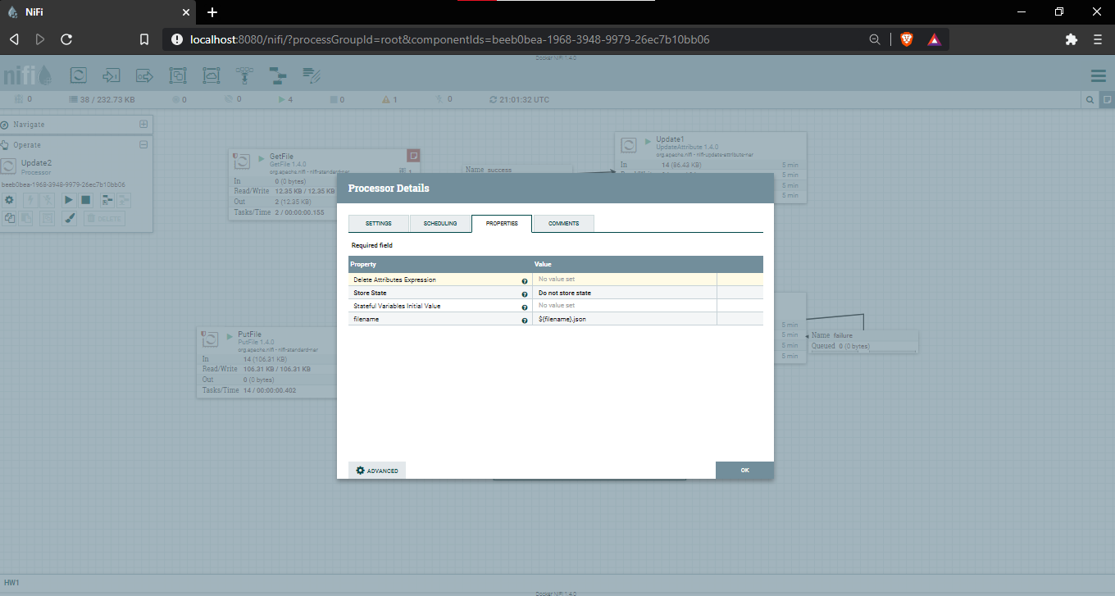
Click on put file to download JSON file converted from CSV

Slide 12
Thank you

