Slide 1

HW2
Std name : Shrouq Trad Al-Fuqaha’a
ID : 20208075
Supervisor : Dr. Ibrahim Abu Al-Haol

Slide 2
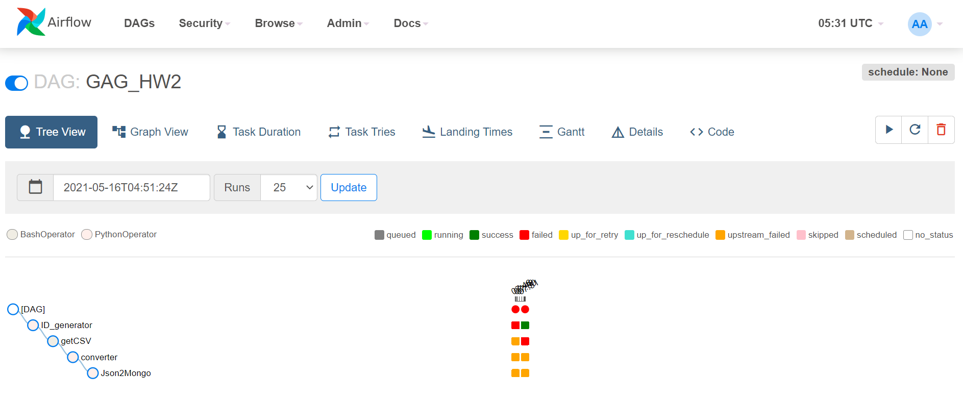

Slide 3
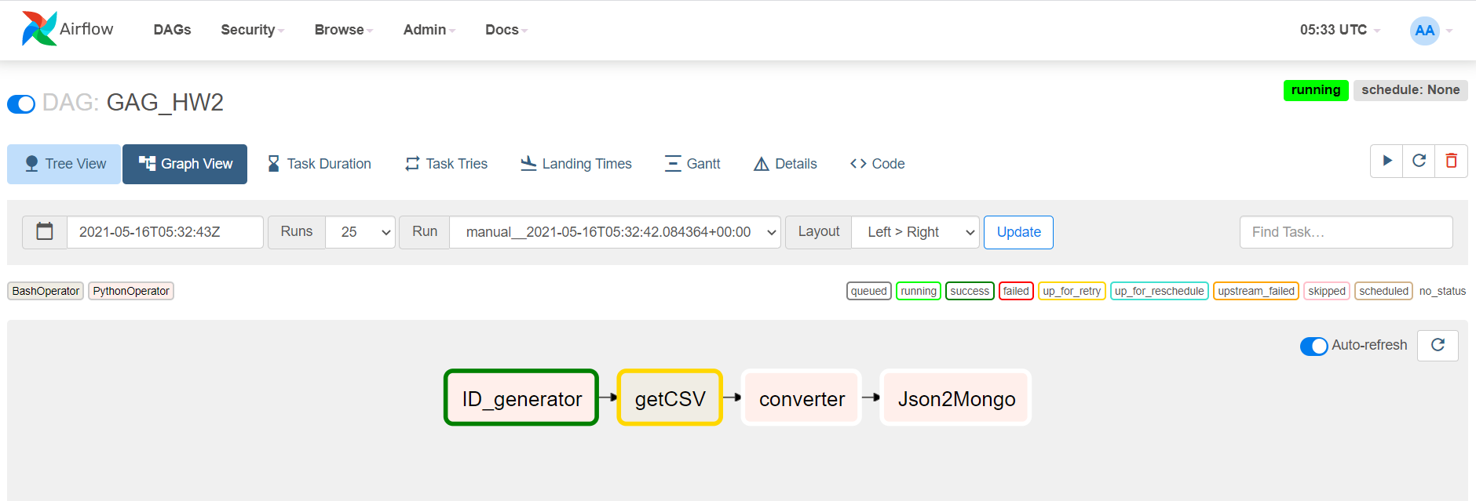

Slide 4
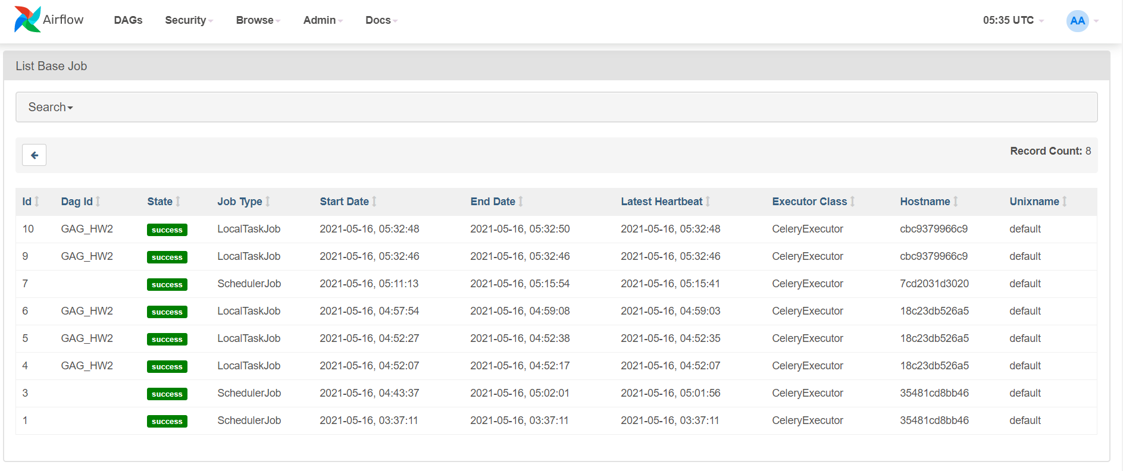

Slide 5
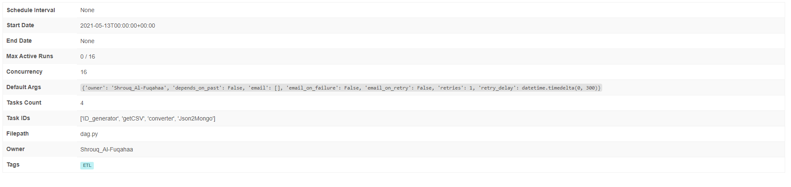
DAG detailed

