Slide 1
sexual
harassment
USING MACHINE LEARINING
Shorouk Khalid Batrah 1708298
Esraa Sultan ALZ ahrani 1706275

Slide 2
The Importance Of The Problem:
Proceeding from the importance of the mental health of the individual and considering that psychological security is an important human need to build the human personality. with the spread of social media controlling the psychological security of individuals has become difficult, and the most important matters that increase and affect negatively the psychological and social life of individuals issues of sexual harassment

Slide 3
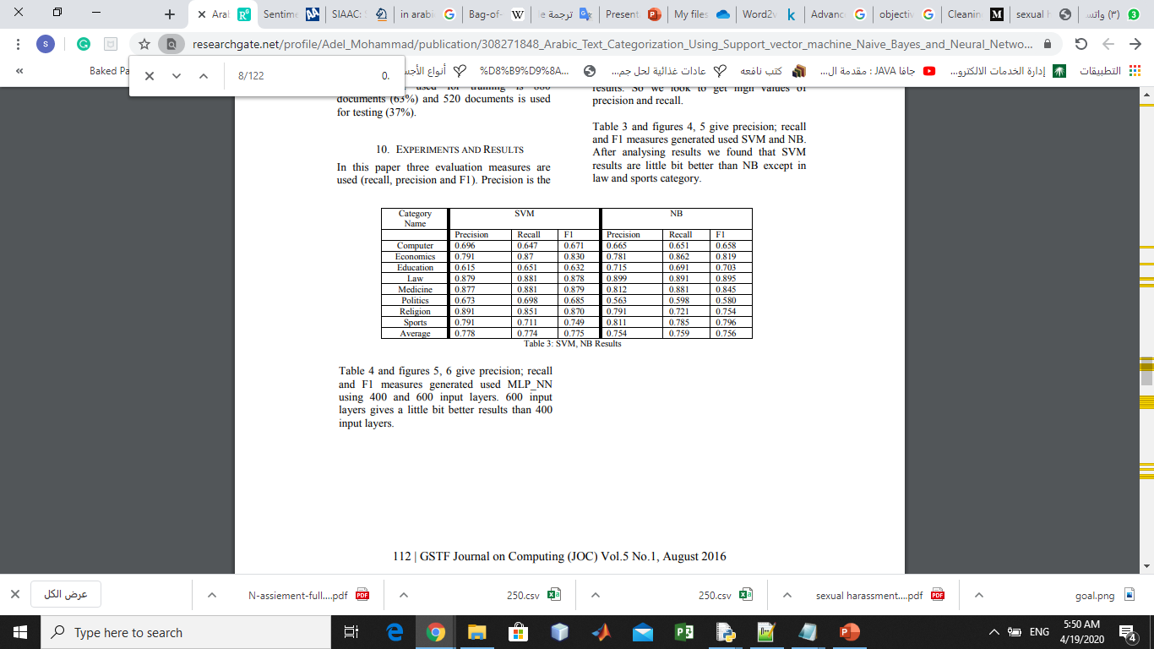
Short Summary Of The Related Work:
1-over 10,000 stories on sexual harassments, SVM report best performance on large data with an averaged accuracy of ~93%.
2-classifies reviewer comments in research article using SVM for short text with 86%, for accuracy .
3-The third paper implemented Naive Bayes SVM baseline model ,detect toxic comments with high accuracy Dev F1 68.33% Dev EM 87.57%
4-arabic document classification using svm and nive base ,Precision Recall F1 respectively SVM was slightly butter.
5-The NB classifier is used as multinomial classifier to detect five classes (sport, religion, economy, politics, and technology) in Arabic with 90% accuracy on twitter of user interest .

Slide 4
The methodology and why this method is better than other ML approaches for our problem:
The SVM usually used with short text but we see good results also in documentation and stories classifying which is a long text.
Naïve base is good classifier Arabic.
And we see close accuracy between these 2 methods when using it on the same data in Arabic so we decided to implement both methods and compare them by experiment.

Slide 5
Process:
Collect data and Labeling
Clean data
Feature Extraction
Build Naïve base & SVM
Result

Slide 6
The Results:
In result we tried 2 models using the three-way test, train validate on naïve base model and SVM model and we get
accuracy 0.89 using SVM
accuracy 0.94 using naïve base
And after this apply naïve base for the whole data including the validate
accuracy 0.96 using naïve base for general model

Slide 7
Limitation:
The limitation in the feature extraction method because it doesn't consider the context of the text so some time misclassified because of the dependency on the word only.
Naïve base Slower than SVM.

Slide 8
Future Research
Use new feature extraction method to recognize the words or sentences depend on context
Use some way to solve the problem of unbalanced data
Noisy data, for example, spelling mistakes, make data more difficult to interpret.

Slide 9
Thanks Any Question?

