Slide 1

Android 101
Super Duper Crash Course FTW

Slide 2
Prerequisites
Android Studio
https://developer.android.com/sdk/installing/studio.html
Java JDK
http://www.oracle.com/technetwork/java/javase/downloads/jdk7-downloads-1880260.htm
Open up Android Studio
Tools → Android → SDK Manager
Android SDK Build Tools 19.1 and 20

Slide 3
Disclaimer
I am not a Java geek
I am an Android and open source geek
I do Java because of Angry Birds
And stickers

Slide 4


The Basics
Based on Linux
Android stack
Linux kernel
Libraries & runtime (dalvik, libstreaming, libc)
Application framework (location services, battery services, resource manager)
Applications
Apps written using Java and XML
+

Slide 5

// TODO
Activities
Services
Intents
Layouts
Models
ArrayAdapters
Listeners
Debugging

Slide 6
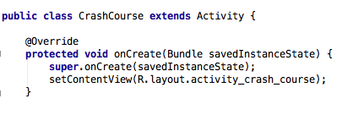
Activities
The activity displays the layout and provides the user interface

Slide 7
Services
Services run in the background, and do not have a user interface
Example services
Location
Notifications
Downloads
Updates

Slide 8
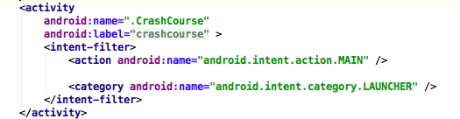
Intents
An intent launches an activity
Can be launched from the Android Manifest when app starts, OR from within the app

Slide 9
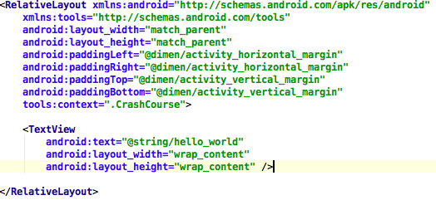
Layouts
XML
The layout holds the UI components

Slide 10

Models
Class that represents an object
Has its own variables and getter/setter functions
Example
Restaurant
id
name
address

Slide 11
ArrayAdapter<Restaurant>
Takes <Restaurant> data, and “adapts” it to a ListView
See RestaurantAdapter in the example
Key components
getView
holder

Slide 12

Listeners
Used to notify the application of specific events
Examples
onClick
onTouch
onLongClick
onKey

Slide 13
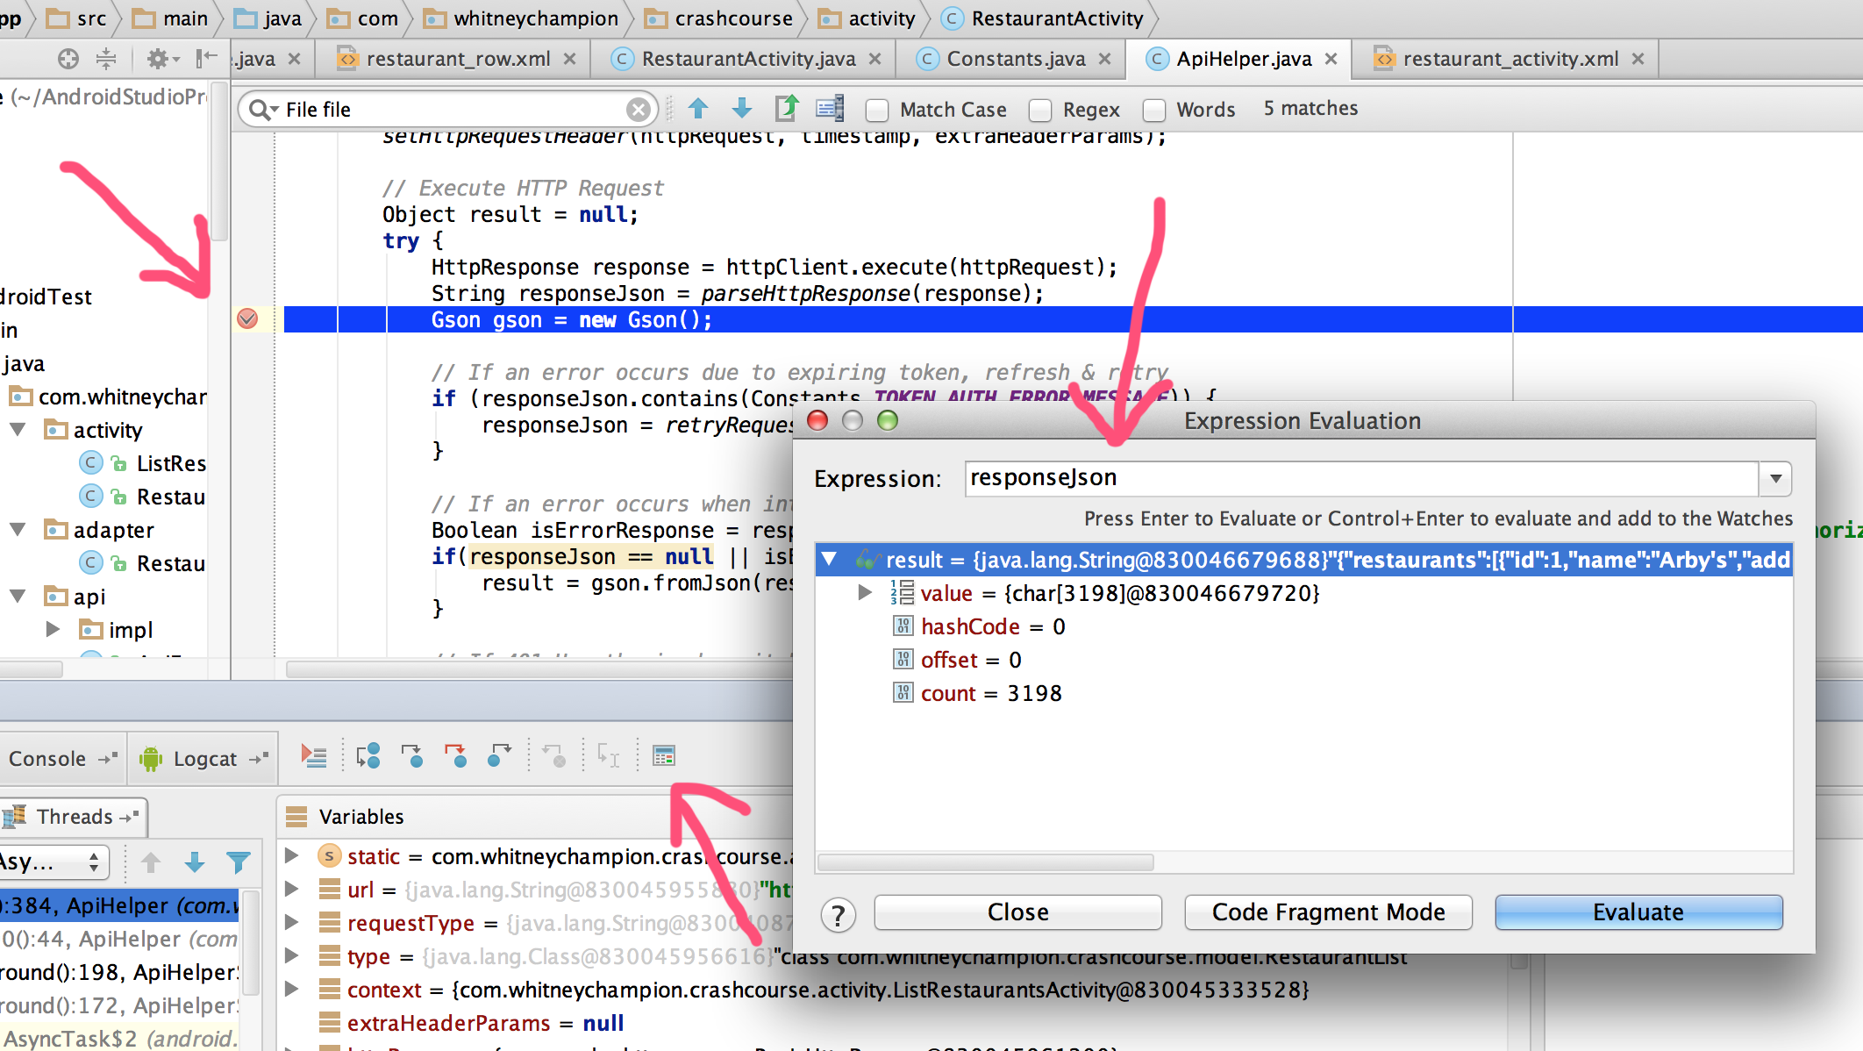
Debugging

Slide 14
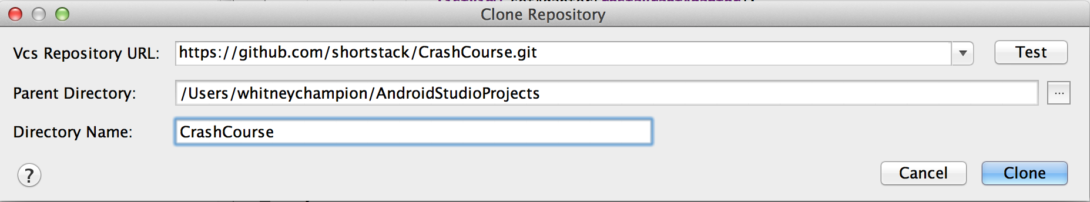
Importing Your Project
VCS → Checkout from Version Control
https://github.com/shortstack/CrashCourse.git

Slide 15
Lab
Goal:
Create a new activity and layout with a ListView
Make new activity the default activity on launch
(hint: Android Manifest)
Add another API endpoint
(hint: Constants.java)
Create a model from new endpoint data
Add a service to get data from new endpoint
Using provided API helper classes, display list of new endpoint data in ListView
http://shortstack.github.io/crashcourse/

