Slide 1
PCs, NCs, and NetPCs
Where Do We Go From Here?
Computer Associates International
May 1997 -- Acapulco CIO Conference
Peter S. Kastner
Group Vice President
Aberdeen Group, Inc.
One Boston Place
Boston, MA 02108 USA
617/723-7890

Slide 2


Agenda
Desktop business drivers
The PC, NC, NetPC choice dilemma
The Microsoft/Intel approach
The Network Computer approach
Where PCs and Network Computing are best suited

Slide 3

Desktop Business Drivers
Expanded internal communications (e.g., Intranets)
Expanded external communications (e.g., Extranets)
Just-in-time supply chain management
Globalization eliminates distances

Slide 4
New End User
Decision-Making Model
Analyze
Decide
Transact
Report
Notes:
EVERY surviving worker is a decision-maker
Use same terminal/workstation for DSS and OLTP
Realtime, online, right-now --- no 90-day batch lag time
We never architected our IS infrastructure to support this

Slide 5



Next Step:
Desktops for Everyone
Electronic mail
Intranet applications eliminate paper forms & promote workflow
Personal productivity applications
Data collection and transaction processing
Limited voice and video

Slide 6
The World Just Changed!
Network Computers (NCs) offer a new style of computing
  at lower cost, for more workers
Intel & Microsoft respond by changing the PC reference platform to the “NetPC”
  Obsoletes existing PCs
  Promises more manageability, at lower life cycle costs

Slide 7
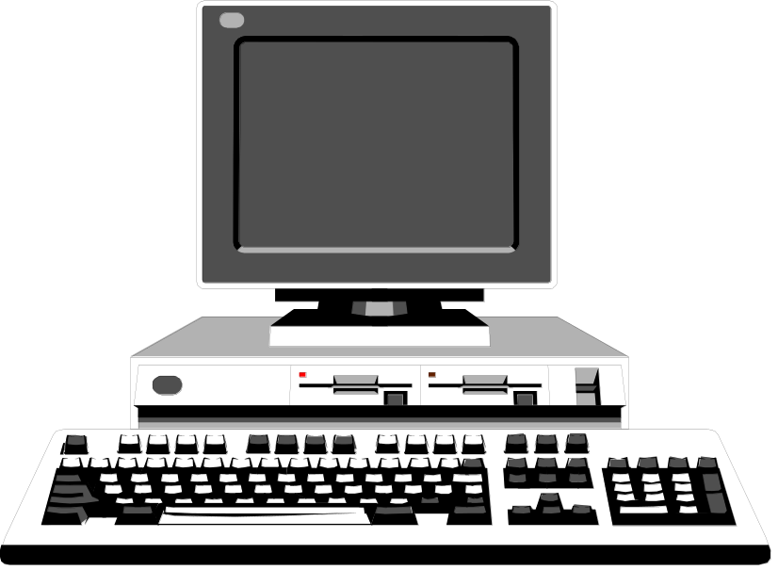
Why Change From
Today’s PCs?
Ask anybody. Client-server costs too much over desktop’s ownership life
Example: Microsoft’s 1997 Plans
  Office 97 in first quarter
  Windows 97 in third quarter -- whoops, 1998
Notes:
User training and “desktop twiddling”
Backup, recovery of desktop disasters
Help desk staffing
Yearly software upgrades -- implemented manually desk by desk …
Followed by retraining
Hardware obsolescence, depreciation and upgrades
Individual desktop software licenses and upgrades

Slide 8
Four PC Strategies
4
No change evolution
NetPC evolution
High-end PC/low-end NC revolution
Windows terminal fantasy

Slide 9
#1 No Change
Hardware costs fall towards $1,000
Performance of 133MHz Pentium is plenty
Software costs remain stable
Cost of ownership remains (too) high
Issues are known and solved with money

Slide 10
#2 NetPC Evolution
Microsoft / Intel solution: NetPC desktop
  Closed case -- no internal upgrades
  Intel microprocessor
  Microsoft’s new Windows 98 operating system or NT
  New “Zero Administration” tools
Wintel has a huge monopoly at stake
Note: Wintel created most of the client-server cost “mess”

Slide 11
Microsoft/Intel NetPC Issues
NetPC hardware is brand new
No ability for in-case hardware upgrades or add-ins, except PCMCIA cards
Operating system and administration tools are undelivered, unproven
COO economies only occur if you replace all your Wintel PC desktops

Slide 12
#3 High-end PC/
Low-end NC Revolution
Buy PCs for heavy computing users
Buy Network Computers for everyone else
The likely strategy for those who are changing

Slide 13
What is Network Computing?
Light-weight desktop, home or mobile appliance
Simple client OS runs Internet browser and Java
Networked with Internet standards
Heavy-weight server
  HTML and Web browsing for Internet and Intranet
  File and print serving, including Java applets
New generation of applications based on Java portability

Slide 14
Network Computer Hardware
Desktop minimalism
  No hard drive, local applications, user data
  Form factor of a hardcover book
  Closed-case -- no internal upgrades
  Runs Java applications and displays User Interface
Servers on steroids
  File serving user data, applications,
  desktop graphical look and feel
  Runs most application process functionality
  Works much harder than server in C-S environment

Slide 15
Network Computer Software
Desktop minimalism = fewer features
Real-time operating system in ROM supports
  Java virtual machine
  TCP/IP
  Browser & desktop user interface
  Administration tools
Runs Java applications downloaded from server or loaded into ROM
Optionally runs terminal and network emulation
  Microsoft Windows GUI
  3270/5250 front-end terminal emulation

Slide 16
Network Computing Issues
Where are the applications?
  Java-based office suites are just arriving from Corel, IBM/Lotus and Oracle
  Enterprise Application versions are 1998 and beyond from Baan, SAP, Oracle, Peoplesoft, etc.
Where are the development tools?
  Just arriving from numerous sources
  But middleware is generally lacking
Co-existence with Windows desktop applications
  Timesharing add-ons to NT Server from Citrix, Network Computing Devices, others
  Microsoft threatens to do own timesharing add-on

Slide 17
#4 Microsoft Windows Terminal
Graphics-only desktop for late 1998,
if ever
Not a viable strategy for 1997
Microsoft reaction to the good ideas
of NCs

Slide 18
Aberdeen Desktop
Strategies for Mid-1997
Dumb-terminal replacement -- NC immediately
Old PC 386/486 replacements -- NC or NetPC?
Light-duty office work -- hard choice of PC or NC
Dedicated application worker -- investigate NC
Heavy Internet/light office -- PC or NC
Heavy office/desktop analyst -- PC usually

Slide 19
Aberdeen Conclusions
Complications require strategic IT planning
Enormous market pressures to lower life-cycle costs and improve worker productivity
Network Computing has arrived.
NCs make sense for many users & applications
Beware of heavy desktop users who spend all day in Excel. An organizational/political issue.
Notes:
Buying desktops just got more complicated and
requires strategic IT planning
The Wintel desktop as we know it will change dramatically this year as enormous market pressures to lower life-cycle costs and improve worker productivity force Intel and Microsoft to react
Network Computing has arrived. NCs make sense immediately for dumb terminal replacements, occasional users, and probably dedicated transaction-processing users
Heavy desktop users who spend all day in Excel will organizationally fight the NC bitterly. Leave them alone.

