Slide 1
An Overview of Internet
Application Development
Computer Associates Sales Training -- June 1996
Peter S. Kastner
Vice President
Aberdeen Group, Inc.
One Boston Place
Boston, MA 02108
617/723/7890
Copyright Aberdeen Group - 1996
Notes:
1

Slide 2
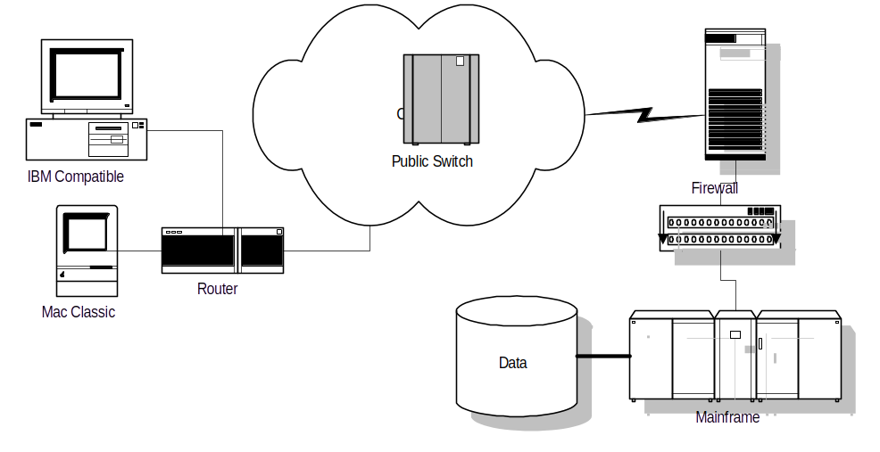
Internet/Intranet Components
Web
Server
Optional
“Thin Client” Web Browser (e.g., NetScape)
WAN or LAN using TCP/IP Protocol
HyperText Transport Protocol (HTTP) server
Common Gateway Interface (CGI) scripts
Firewall: ensure privacy of enterprise network
Application RDBMS

Slide 3
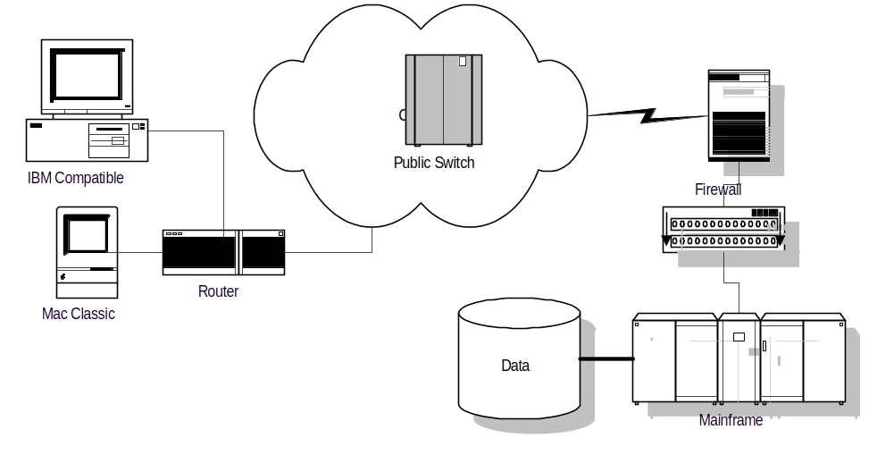
Client-Server vs. Internet Apps
Web
Server
Client-Server
  Application runs on the desktop
  Data is brought from the server to the desktop and displayed
  Lots of session-oriented computing (e.g., OLTP)
Internet
  Application runs on a server(s)
  Presentation display is done by the client’s browser
  No concept of a “session”

Slide 4
Current Internet Tools
Web / Browser
Common Gateway Interface (CGI)
Mail
FTP (File Transfer Protocol)
News Groups
Many Other Dinosaurs
Notes:
15

Slide 5
Web Browser Components
GUI presentation of text and graphics to end user
  Interpret HTML into presentation components
  Manage user navigation via links (i.e., Uniform Record Locators -- URLs -- such as http://www.blyth.com)
Keep track of users’ favorite URLs (e.g., bookmarks)
TCP/IP communications interface
Other functions
  Internet News reading and posting
  Internet e-mail
Proprietary add-ins like Java, RealAudio
So where is the transaction, business logic, and database?

Slide 6
Why Have Applications Using Browsers?
Advantages: “Client for the Masses”
  Low cost or no-cost
  Multi-platform
  “Thin client” = minimal configuration desktop
Disadvantages Today: “Not Baked”
  Woefully simple user interface (today)
  Lack of useful add-in standards (e.g., compatibility)
  Security is lacking
  Immaturity of development environments
  No ties to desktop productivity apps (e.g., MS Office, Omnis DBMS)

Slide 7
Web Browser Choices
Browsers are essentially free, but ...
Netscape sets the Web standards
  HTTP
  Secure-HTTP
  Secure Sockets Layer
  Java run-time engine
  Mail
  Groupware with Collabra acquisition
  Credit Card Processing
    with Mastercard, Visa, AMEX
    Clearing House Relationships
Notes:
17

Slide 8

Internet Browsers Become Just Another Client
Client-server applications will not go away!
Aberdeen tells users to demand tools that automatically deploy to both clients and Internet browsers

Slide 9
What is Java?
The emerging, de facto standard language for applications that run over the Internet
Developed by Sun Microsystems; licensed to most of the industry players (including Blyth)
A C++-based programming language for down-loadable Browser applets
  HTML request loads Applet from WebServer
  Runtime executes the Applet
  Java can also execute on the server
  Portable across many operating environments

Slide 10
Resist the Siren-song of Java
Java is C++ without the hand grenades
Java is immature, will change dramatically over time
Browsers will change faster than any other piece of software
Beware of transaction processing
Where are the controls, auditability, security?
Conclusion: most commercial apps are better off crafted from a powerful 4GL (e.g., OMNIS)

Slide 11
Java Programming is Problematic Today
Sole-source from Sun Microsystems
Few deployment platforms; fewer development platforms; one 3rd-party debugger
NO database access -- spec is not even out yet!
Lots of gotcha’s -- Truly immature
  No Dates before January 1, 1970
  No fixed decimal arithmetic (e.g., dollars and cents)
  Limited print formatting
  No multiple inheritance
  Requires multi-threading -- not in DOS or Mac OS
  No structures; limited, byte-oriented I/O
  Applet can only talk to its Mother’s Internet address
  Weekly bug-fix releases

Slide 12
Client-Server Has Advantages
Business Logic: client-side, server-side or both
Data: local or server-based databases -- or both
Presentation: Text, forms, windows -- whatever style is most ergonomic
Menus: Logical organization of functions
Transactions and sessions are supported
Decision support
Systems management
  Deployment
  Security
  etc.

Slide 13

The Future of Commerce is the Internet
http://www.aberdeen.com

Slide 14
Why Commerce
Not just for the money
Not just for marketing
Not just for sales
Fundamentally change your business !
Notes:
3
In Business on the Internet - A Whole New Approach, these business issues are investigated in depth. This session will look at the Tools used on the Internet to affect these changes

Slide 15
Opportunity & Growth
Internet commerce is growing at 400% per year
Worldwide sales of goods and services traded over the Internet will increase from $70 million in 1995 to $250 billion in 2000, a compounded growth rate of over 400%
Notes:
4

Slide 16
Adoption Curve of
Fortune 2000
Communications Medium
Internet ?
Business Change
1996 State of the Market
Not Connected
New Markets &
Approaches
E-mail
Static Web Site
Active Web Site
Notes:
34

Slide 17
Corporate Internet Planning Today
Internet -- the World Wide Web (WWW)
  Web for corporate presence
  Web for marketing collateral
  Web for publishing publicly available information
    Cisco saves 25,000 support telephone calls a month
Intranet -- An intra-company Internet
  Making enterprise information available to everybody who needs it via HTML publishing (instead of classic C-S app)
    Human Resources
    401K allocations
  Universal desktop via Browser
  Electronic mail
Notes:
35

Slide 18
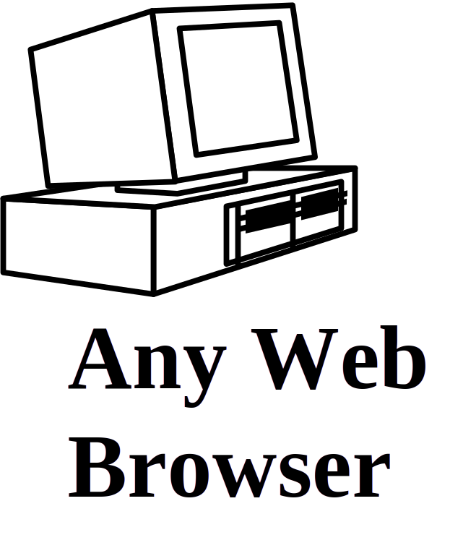

Intranet Leverage
Companies must leverage what they have:
HR
Mftg
Actg
Orders
Web Server
Internet/
Intranet
Notes:
39

Slide 19
Internet Commerce Today
% of Active Companies
(can do more than one)
Business Process
Catalogs / Malls (Web) 5%
Marketing Material (Web) 85%
Franchise Building (Free Software) 10%
Simple Communications (e-mail) 95%
Electronic Data Interchange 1%
Source: Aberdeen Group 1996
Notes:
19

Slide 20
Key Differences
Client-Server Application
Mission-Critical
Serious applications that run the business
Architecture choices (i.e., 2-Tier, 3-Tier)
Lots of databases and DB work
IT understands C-S basics and limitations
Internet Application
Extended Enterprise-wide
Trivial applications (but useful to many)
WebServer-to-lightweight Browser limits today
What’s a database?
IT novices in an immature environment

Slide 21
Conclusions
Internet growth and impact is incredible
Internet can change business fundamentals
If you don’t take the initiative -- your competitors will
The technology today is far from perfect --but it works!
CA has a clear vision for enhancing Unicenter and introducing Jasmine

