Slide 1
Digital Consumer Technology:
The Revolution Has Started
November 1, 2002
Aberdeen Group
Russ Craig
Research Director
Semiconductors
Peter Kastner
Executive Vice President and Chief Research Officer
Digital Consumer Technology Practice
Isaac Ro
Research Associate
Emerging Technologies Intelligence Group
Notes:
Intro

Slide 2
Agenda
Digital Consumer Technology (DCT) Context
Discussion Topics
  Mobile Convergence Devices
  Media Servers
  Home Networking
DCT Service
Questions
Notes:
Aberdeen has been analyzing the Digital Consumer Technology area for a year.
Today, we’ll share with you our context or world-view for the revolutionary growth of digital technology into traditional consumer electronics spaces.
Next, my colleagues will share a top-level overview of key issues we are evaluating in three of the DCT areas that we follow:
First, Mobile devices such as PDAs and phones
Second, the battleground is the Home. We’ll look at home media servers, a big step in feature/functionality for the home PC, and
Third, the alley cat-fight over how to move data and content around the home.
Before taking your questions, we’ll outline our DCT service as one way that industry suppliers can work with Aberdeen Group in this uncharted but huge worldwide market.

Slide 3
Digital Consumer Technology Context
productivity
Home
communications
business process transformation
collaboration
knowledge management
brainstorming
web services
enterprise
mobile conversation
video meetings
phone meeting
email
travel
life enrichment
smb
social expression
community programs
leisure
micro
stress
reduction
mobile
surfing
conversation
instant messaging
email
consumers
finances
calendars
photo sharing
community involvement
memories
scrapbooks
hobbies
digital TV
music
movies
games
entertainment
hobbies
do
connect
create
entertain
work
Notes:
Information technology, driven by digital electronics, now permeates the lives of about 1/3rd of the world’s population – literally billions of people. We’ve gone past the business-only use of Information Technology to bring computing out of our productivity-driven offices into our life-on-the-go and into our homes and leisure. This has created entire new categories of products, each with their own food chains. For example, 20 million digital cameras, photo printing, Adobe’s Photoshop to modify the photos, and email to Grandma.
More and more non-work time is spent with digital consumer technology, creating significant mass markets. But high bandwidth is necessary to drive the information content-laden business and home applications, the reason many have bemoaned the slow adoption of broadband to the homes in the U.S to date. But note the reports of Comcast this week that cable broadband is doing very nicely. In fact, a 20M household broadband base is likely in the U.S. by next Christmas.
And that home-centric mass market will drive a faster collision between traditional Consumer Electronics companies and the PC-centric digital electronics universe.

Slide 4
DCT: The Players
Today there are two distinct worlds that are converging which provide DCT products: the CE world and the PC world.
CE
Future
PC
PC
Functions
in CE
Devices
CE
Functions
in PC
Devices
A Broad Spectrum
of Possibilities
Notes:
The collision of traditional Consumer Electronics such as TVs, stereos, VCRs and cameras is already colliding like two galaxies. The forces of physics are in play, causing previously insulated such as the Japanese CE Companies like Sony to reevaluate their separate-division go-to-market models, looking for synergy and added margin dollars. Likewise, the corporate-IT-centric PC companies have realized there is revenue growth in the consumer market, but at the cost of profit margins. Dell is an example of a newcomer here, and HP is an example of an IT company trying to drive product synergy around the HP and Compaq brands.
And everybody has to rethink their entire product supply chain. That’s why Aberdeen is looking at the Digital Consumer Technology space on a holistic basis: from silicon to out-of-box experience.

Slide 5



DCT: Illustrative End-User Scenarios
Big
Screen
TV
Telephone
802.11x Laptop
Remote
Control
Home PC
PNA Network
Bluetooth
PC
Bluetooth
802.11x
Printer
Audio
Speaker
Bluetooth
Camera
802.11x
Wireless
Links
Tablet PC
HomePlug
Network
802.11x
Phone/
Cable
Wires
Gateway
Entertainment
Server
Ultra Wide
Band
Links
PC
HDMI
Cable
Wireless
Links
Outlet
Bluetooth Car
AberdeenGroup
Notes:
2-3 years ago, one PC and an AOL dial-up account was considered “good enough”. Maybe Junior has a game console.
Not in 2003. There are multiple PCs which need Internet access all the time. Media Servers, which we will drill down on with Russ Craig momentarily, are a choice for content storage and as an Internet gateway. The home becomes – and should be thought of – as a distributed IT site without an IT department. There’s the need for routers, gateways, wired and wireless personal networks, local area networks, and WAN connections.
There are multiple choices for consumers – and remember that consumers are confused by multiple choices. For example, take TV video recording:
The VCR is on the way to the sanitary landfill.
DVD recorders are a year away from mass market pricing
Tivo is a $200 Linux PC with no monitor. A dedicated DCT device. Like an xBox.
Hauppaugue, ATI, nVidia and others make TV tuner cards and PVR software, turning the home PC into a Tivo without the monthly subscription.
But how do I get the recorded show from the PC or living room to the bedroom? With TV-like plug-and-play?
First, we think home networking by many means will proliferate.
Second, no one form-factor or approach will predominate. There is no single “right way” to home computing.
Third, there will be substantial consumer confusion.
Fourth, there is no architecture to build on.
Fifth, the home is a $100 billion market worth attacking.

Slide 6
DCT Industry Structure
Integrated Circuits
Systems
Manufacture
Fabricate
Manufacture
Fabricate
Systems
Systems
Sell
Design
Package
Sell
End
Design
Package
Systems
Test
Software
Systems
Users
Test
Software
Direct Sales
Integrated Device Manufacturer
OEM
Systems
Web Sales
Intellectual
Property
System Software
Vendor
Company
Fabless
Contract
Semiconductor
Manufacturer
Company
VAR
Foundry
Systems
VAD
PC/CE
Packaging
Sell
Systems
Company
Retail
Test Company
Notes:
Aberdeen tracks the silicon to consumer point-of-sale food chain, along with the underlying technologies and standards. For example, Intel’s strong adoption of 802.11b and a in it’s notebook and access point reference designs ensures widespread of both wireless technologies, while Sharp’s LCD panel with embedded digital circuitry suggest how designs might minimize chip-count in future devices, driving costs ever lower.
Aberdeen has written extensively on the emergence of the PRC as the next global DCT manufacturing battleground.
We also track how emerging product categories effect existing ones. One good example is how Sharp’s and Samsung’s LCD prowess is taking shelf space at Best Buy from Sony in high-end TVs.

Slide 7
Who Will be the Winners?
These six categories of players start from very different competitive positions but identical motivation…grab the prize.
CE
Future
PC
Broadband companies
Point product CE companies
Game companies
PC/Peripheral companies
Display companies
Software Companies
Semiconductor companies
  IP
  Devices
Other enabling technology
New Entrants
Notes:
Aberdeen loosely clusters DCT companies into six categories:
Broadband companies with set-top boxes
PC and peripheral companies
Point-product CE companies such as Sony
Game companies such as Nintendo and Microsoft
Display companies including TVs, CRTs and LCD panels
Consumer software companies such as Pinnacle, SnapStream, and Sonic
There are both established companies and new entrants circling around the market.

Slide 8
Who Will be the Winners?
Established Suppliers
Consumer Electronics
Broadband (Bb) Connectivity and Service Providers
Bb Set-Top Boxes
Games
Display
Software
New Entrants
-Bb Gateways
-Home Networking
$
R&D
Emerging
Technology Life Cycle
Growing
Mature
Phase 1
Phase 2
Phase 3
Phase 4
Notes:
Well-known CE and IT companies are competing and cooperating with new entrants. For example, there are dozens of 802.11 WiFi products today, with more coming. Next-generation range-enhancing products just reaching the market will get there silicon from old-timer Texas Instruments as well as new-comers Atheros and Cognio.
We see no reason why history won’t repeat itself: the DCT winners will come from the companies who have the right vision, are focused, build a brand, design for the needs of the consumer market, and are able to crank out with ruthless supply-chain management a succession of products.
With that introduction, let’s turn the microphone over to Isaac Ro, the Aberdeen analyst who follows Mobility Computing.

Slide 9
Agenda
Digital Consumer Technology (DCT) Context
Discussion Topics
  Mobile Convergence Devices
  Media Servers
  Home Networking
DCT Service
Questions

Slide 10
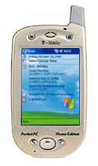
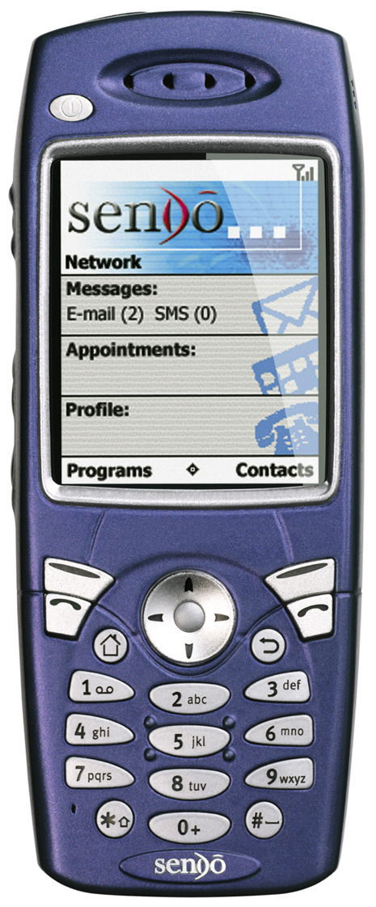
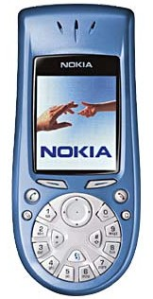
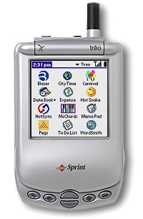
Mobile Devices are Rapidly Diversifying
Mobile devices are highly personal items
  There is no ideal convergence device
What’s Hot
  Picture Messaging (MMS)
  Flat-rate data plans
What’s Not
  Non-wireless organizers
  Per MB billing

Slide 11
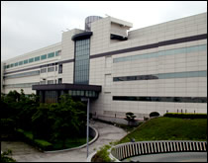
The Economics of Handset Manufacturing
Building handsets is no longer
black magic
PC makers are increasingly competing with established phone makers
Rapid innovation is shortening the product life cycle
Shrinking margins increasingly require the use of contract manufacturers

Slide 12






Network Operators Are Still the Gatekeepers
Flat-rate data plans are here
Focus on MMS and Gaming applications
Consolidation in North America is imminent
True 3G networks are still 3+ years from becoming a reality

Slide 13
Agenda
Digital Consumer Technology (DCT) Context
Discussion Topics
  Mobile Convergence Devices
  Media Servers
  Home Networking
DCT Service
Questions

Slide 14
Desired Media Server Functionality
TV Video Recorder and Playback
Music Library
  Rip and Burn
  Drive Analog and Digital Music Players
Photo and Home Video Library/Authoring Tools
Import of Legacy Content (Videos, CDs, DVDs)
Commercial Content Rental and Purchase
Ability to Access and Play Content from Anywhere in and Around the Home, and Take it with you

Slide 15

Media Servers Emerge
Many usage models
  General purpose
  PC + media
  Media-centric PC
  Closet rack-mount
  Next to the TV/stereo
  Combinations of above
Assumption: mass-market minimizes component duplication (e.g., disk drives in TiVo)
Placement drives network topology
PVRs are prototypical but insufficient
Purpose Built: HP Media Center (Freestyle)
Intel Media PC Reference Design
Sony Cocoon
Set Top Box Accessory Media Centers in Design
Notes:
Issues:
No single media server usage model will prevail
Headless server for the TV room. Needs very small form-factor, networking.
DRM for take-away recordings
Cost: 3.0+ GHz for simultaneous recording and high-quality viewing
Very high capacity storage and optical storage
Appliance-like user interface

Slide 16

Media Servers: A Key Trade-Off
2001 Sopranos
in Storage

Slide 17

Media Servers: A Key Trade-Off
User Selects
Episode
2001 Sopranos
in Storage

Slide 18

Media Servers: A Key Trade-Off
User Views
Episode on PC
2001 Sopranos
in Storage

Slide 19
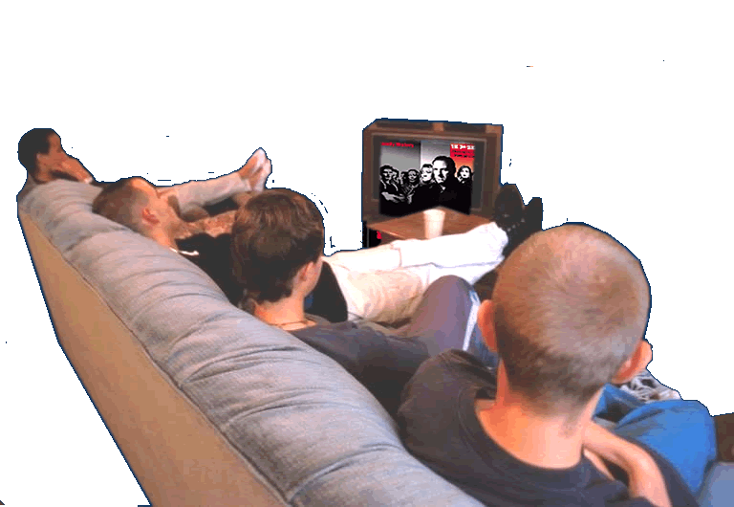
Media Servers: A Key Trade-Off
Remote-control Users
Select Episode on TV Interface
Home Network
2001 Sopranos
in Storage

Slide 20
Media Servers: A Key Trade-Off
Media Server Streams Program
to TV via Network
Home Network
2001 Sopranos
in Storage

Slide 21
Media Center Requirements
“Fair Use” Digital Rights Management
CONSUMER USER INTERFACE and Applications
Large Mass Store
CD/DVD Red/Blue Read/Write Drive
Encoding for Audio and Video Legacy Content
Search Engine for Indexing and Retrieval
Multiple Interlaced Output Streams
QoS Management
Wireless Connectivity

Slide 22
Agenda
Digital Consumer Technology (DCT) Context
Discussion Topics
  Mobile Convergence Devices
  Media Servers
  Home Networking
DCT Service
Questions

Slide 23
Home Networking: Let Me Count the Ways
Bluetooth
802.11b
802.11a
802.11g
Ultra Wide Band
Home PNA
HomePlug
Home RF
Ethernet
HDMI Cable
X10
Voice
Audio
Video
WAN/Internet data and access
LAN connectivity
Security

Slide 24
Mindset: A Home is a Small Business Location
Multiple computing devices
LAN and WAN access
Security, data management, maintenance, virus protection, firewall, caching/proxy server … all the requirements of any business
… With no professional IT department
Notes:
Home networks and servers need to be designed with the same mindset that goes into best-of-breed small business products.
This creates an enormous opportunity for service providers to lease the hardware, software, and services.
Our mindset cries out for creative packaging and home digital appliances.

Slide 25
Longer Term a Home Networking
Architecture Will Emerge
Consumer User Interface for Configuration
and Security Management
Gateway/Firewall/Router/Remote
Management Capability
Cordless Phones/VOIP
Multiple Channels of Simultaneous:
  Music
  Data
  Streaming Video
Digital Transmission Rights Protection
Notes:
What do we think the architecture will evolve from?
Over what time frame?
What are the key building-block standards?
Consumer UI: what’s wrong with HTML in a browser? That’s what everybody is using today.

Slide 26
Networking Technology Applicability Varies
Philips 1394 over
802.11a with DTCP*
Home RF+802.11A*
Home PNA (Phone)
Home Plug (Power)
Ethernet Cable
Proprietary*
HDMI Cable
BlueTooth*
802.11b*
802.11a*
UWB*
Voice
  Toll Quality
  VOIP
Data
Content
  MPEG3 Audio
  MPEG2/4 Video
  HDTV
  HDCP
  DTCP
Gaming
√
√
√
√
√
√
√
√
√
√
√
√
√
√
√
√
√
√
√
√
?
√
√
√
√
√
√
√
√
√
√
√
√
√
√
√
√
√
√
√
√
√
√
√
√
√
√
√
√
√
√
√
√
√
√
√
* Wireless

Slide 27
5 Gigahertz Will be the Spectrum of Choice, BUT
QoS issues in 802.11a for streaming video
Need better distances provided by second-and third-generation silicon
Need to minimize transmitted power at required link bandwidth to reduce potential interference
Need to automatically identify and minimize impact of sources of interference
Notes:
Non-US? Still 5GHz?
We assume prices will decline into today’s 802.11b range

Slide 28
Agenda
Digital Consumer Technology (DCT) Context
Discussion Topics
  Mobile Convergence Devices
  Media Servers
  Home Networking
DCT Service
Questions

Slide 29
DCT Practice Services
Custom Consulting
Retainer package including
  Presentation of summary trends and strategy review
  Continuous information bulletins/InSights
  Quarterly update via webcast
  Add-on competitive analysis
  Bundled consulting days
  Analyst access

Slide 30
Why Aberdeen Group?
Integrated viewpoint
  Silicon to out-of-box experience
Strategic and Business-Process Perspective
  Focus on what leads to success
Deep technology understanding married to pragmatic understanding of consumer buying behavior and usability
DCT research and consultative analysis

Slide 31
Agenda
Digital Consumer Technology (DCT) Context
Discussion Topics
  Mobile Convergence Devices
  Media Servers
  Home Networking
DCT Service
Questions

Slide 32
Thanks For Attending
Digital Consumer Technology:
The Revolution Has Begun
For Inquiries Contact
Peter Kastner
  Call: (617) 854–5221
  e-Mail: kastner@aberdeen.com
  You may download the presentation from today’s web cast at http://www.aberdeen.com/ab_company/researchareas/dctwebinar.htm
Visit Aberdeen Group at
www.aberdeen.com

