Slide 1
Aberdeen Group
Corporate Background

Slide 2
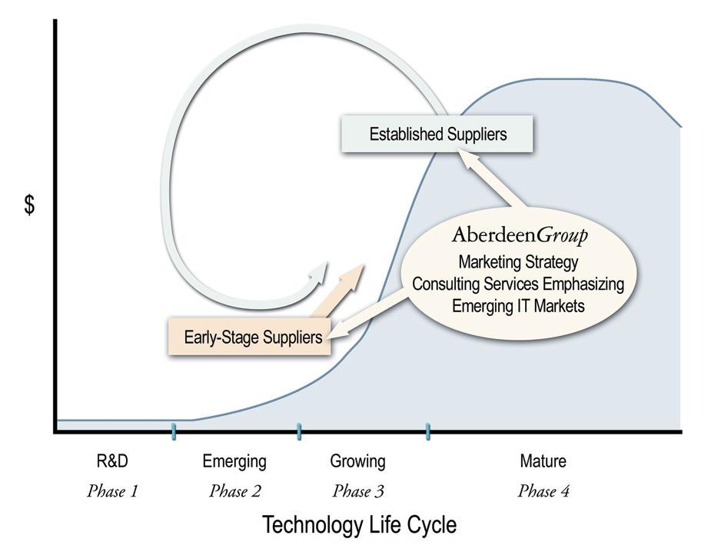
Aberdeen’s Market Positioning

Slide 3
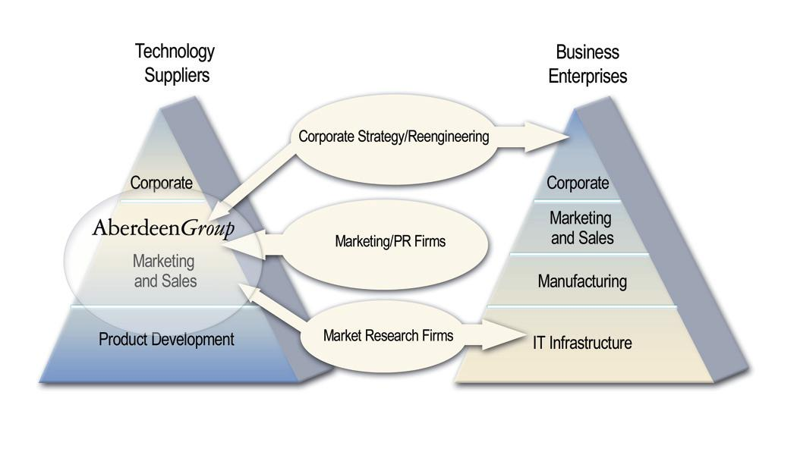
Aberdeen’s Competitive Landscape

Slide 4
Aberdeen Overview
IT Supplier Executives
aberdeen.com
aggregation
Webcasts,
Conferences,
and Seminars
e-Learning
Private Equity
Services
Field Sales
AberdeenGroup
Marketing Consulting
Supplier Meetings
Practice Areas
Emerging
Market Intelligence
Surveys and
Field Instruments

