Slide 1
Aberdeen’s Market Analysis Service -- Internal Presentation
Presented
June 2001

Slide 2
Description
14 Market Segments/12 Months
Qualitative and Quantitative Data combined with Analysis
Access to Aberdeen Experts
Focus is on emerging markets and rapid-growth segments within existing markets
Geographic Breakdown

Slide 3
Qualitative Data and Analysis
Definition and Key Findings
Market Evolution
Market Participants
Product Functionality and Implementation Evolution
Supplier Profiles and Analysis

Slide 4
Quantitative Data and Analysis
Overall Segment Size and Growth Forecast: 2001 to 2005
Market Share Numbers
Geographic Breakdown
Analysis of Data

Slide 5
Access to Aberdeen Experts
Ad hoc telephone inquiries
Assigned Account Manager
On-site custom consulting days (optional)

Slide 6
Topics Covered: July 2001 - June 2002
Application Service Providers
Collaborative Product Commerce
CRM
Data Knowledge Solutions
Enterprise Application Integration (EAI)
Enterprise Applications
e-Sourcing
Internet Infrastructure

Slide 7
Topics Covered: July 2001 - June 2002
Managed Services Providers
Professional Services
Security Solutions
Storage Management Systems
Supply Chain Management
Wireless Infrastructure Technologies

Slide 8
Standard Subscription
5-user electronic license to Qualitative Data (w/ print capability)
1 hard copy of Qualitative Data
5-user electronic license to Quantitative Data (w/ print capability)
1 hard copy of Quantitative Data
Raw Quantitative Data in Excel Spreadsheet
Two hours/month of ad hoc telephone inquiry
Assigned Account Manager

Slide 9
Value to Aberdeen Clients
Identify new opportunities in emerging markets
  Know which suppliers have the advantage
Data combined with Analysis
Single access point to all of Aberdeen
Partner with a company whose business is consulting -- not subscription sales
  We builds one-to-one relationships with clients
  Turn data and findings into actionable strategies for clients

Slide 10
Methodology -- Quantitative
Macroeconomic GDP Data
  Size
  State of Economic Development
  Industrial Composition
  Relationship with the U.S.
  Real Growth Rate
Financial Data from Suppliers
User Interviews
Data Analyzed by Aberdeen’s Senior Industry Experts

Slide 11
Methodology -- Qualitative
Thought Leadership of Aberdeen Analysts
Primary Data via Surveys
  Users
  Suppliers
On-going Dialog with Market Players
On-site Supplier Briefings
User Case Studies

Slide 12
Creation Process
Advance Questions Provided to Analyst
Associate Researches Potential Suppliers
Structured Interview
(4 Hours)
Surveys Created by ETI/D. Wright
Surveys Reviewed by Analyst (2 Hours)
Surveys Administered by Associates
Quant. Info Applied to D. Wright Model
Survey and Interview Data Placed in New Report Models
Reports Reviewed by Analyst (12 Hours)
Reports Edited
Reports Produced

Slide 13
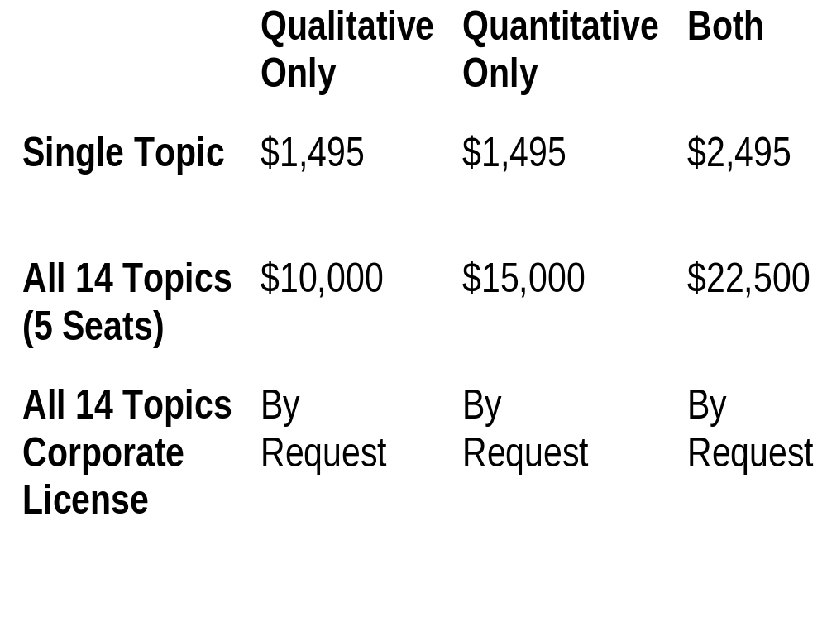
Pricing

Slide 14
Relationship to Traditional Reports
Planned Schedule vs. Ad Hoc Approach (Traditional Reports)
Existing Subscribers get Qualitative Data included for remainder of their contract
  Quantitative Subscription = $10,000 extra
New Pricing Model
  All Quantitative = $15,000
  All Qualitative = $10,000
  All Traditional Reports = $10,000
  All Three = $30,000
  Add $5,000 for other Pubs. (e.g. White Papers)

Slide 15
Purchasing Options
MAS Service = A = $22,500
Traditional Report Subscription = B = $10,000
Pubs (WP, Profiles) = C = $7,500
  A + B = $30,000
  A + C = $$27,500
  B + C = $15,000
  A + B + C = $35,000

Slide 16
Sales Strategy
IT Spending Report as a free enticement
Telesales and Field Sales identify prospects and schedule sales calls
David Wright/Hugh Bishop and Sales conduct on-site call
Analyst available for 15-minute validation conference call ($250 cash bonus for closed deals)

Slide 17
Sales Resources
Presentation - Done
Product Sheets - Printing
  Deliverables
  Topics and Schedules
  Methodology
Proposal - Done
IT Spending Report - Done
ASP Quantitative - Printing
ASP Qualitative - Final Writing
Web Delivery Page - First Version Done
Web Marketing Page - To Do

Slide 18
What the Analyst Contributes
2 to 2-1/2 days of structured engagement time
Overall perspective on their respective market
Review of qualitative and quantitative data and findings before they are published
15 minutes of telephone time for sales
Ad hoc questions from clients

Slide 19
What ETI/David Wright Contribute
Product Development
  Methodology
  Quantitative Model
  Macroeconomic Data
  Qualitative Data Model and Format
  Development of Structured Interview
  New Delivery Mechanisms (Web)

Slide 20
What ETI/David Wright Contribute
Project Execution
  Management of Structured Interview
  Assembly and validation of baseline quantitative and qualitative data from suppliers, users and investors
  Writing and Production of client deliverables

Slide 21
What ETI/David Wright Contribute
Sales and Marketing
  Marketing and sales collateral
  Outbound marketing activities
  Telesales team
  Field sales training and coordination
  On-site sales calls
  IT Spending Report as sales enticement

Slide 22
What ETI/David Wright Contribute
Contract Fulfillment
  Delivery of data and analysis -- electronic and print
  Coordination of ad hoc inquiries
  Development and maintenance of new Web-based delivery solution

Slide 23
What the Analyst Gets
Access to all data for custom consulting engagements
Relationships and sales opportunities with a new set of Aberdeen clients
All custom consulting revenue
Gross Margin transfers and direct cash payments from the MAS program

Slide 24
Analyst Compensation
$2,000 Cash payment up-front
15% of Revenues as GM transfer
  Revenues from a specific title -- direct to individual analyst(s)
  Revenues from service -- pool shared in equal parts
25% - 75% of Profile Sales Revenues
$250 cash payment for participating in a successful sales call
$150 cash payment for 1 hour of telephone inquiry

Slide 25
What Sales Gets
Full Booking Credit
Will double credit Field Sales/Telesales for cooperation

Slide 26
Why ETI and David Wright
Commitment to a Schedule
Lower-cost resources for gathering baseline data
Investment in Methodology and Research Resources
Investment in Sales and Marketing Resources
Investment in new delivery mechanisms

Slide 27
Key Differentiators
One-on-one relationship with Aberdeen Experts
Focus on the business impact of technology change
  What will actually sell
Quantitative Numbers grounded in Macroeconomic Analysis

Slide 28
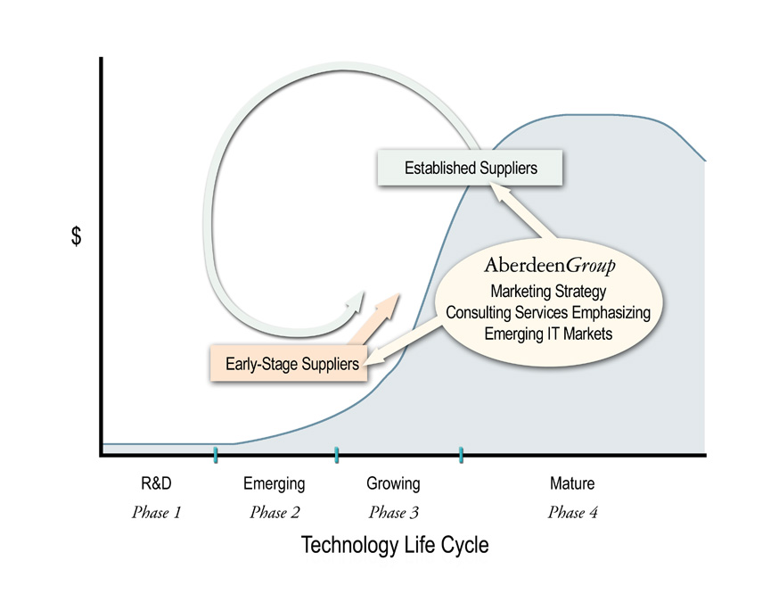
Aberdeen Group provides information-technology suppliers with consulting, customized marketing, and market strategy advice that emphasizes emerging IT markets.
Aberdeen’s Positioning

