Slide 1
Cyclistic Bike Usage Analysis
Comparing Annual Members vs Casual Riders

Slide 2
Key Findings
• Annual members use bikes more frequently on weekdays • Casual riders tend to use bikes more on weekends • Average ride duration for members is shorter compared to casual riders

Slide 3
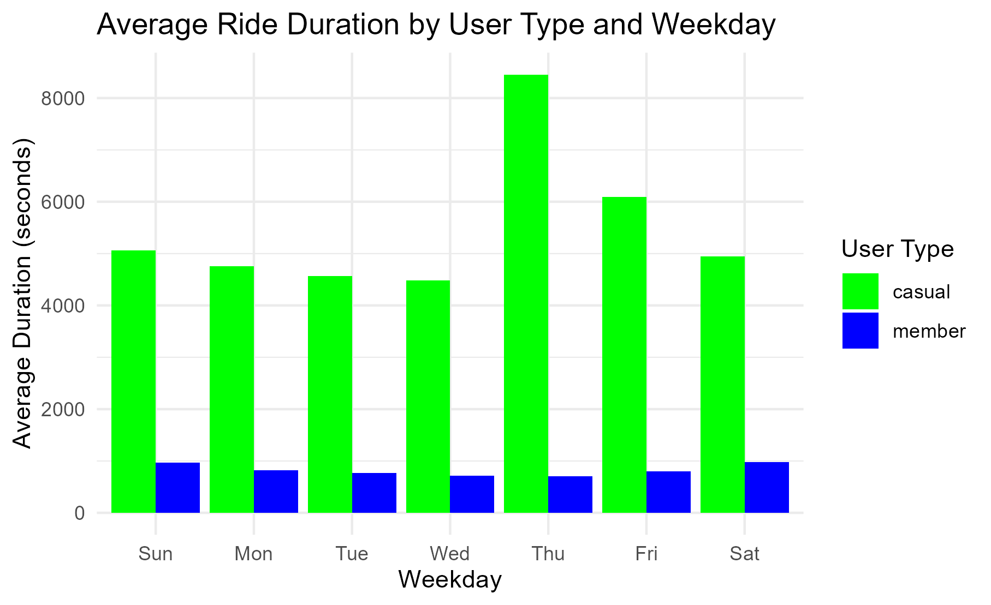
Average Ride Duration by User Type
Here is the average ride duration plot:
Comparison of ride durations for Annual members vs Casual riders on different weekdays

Slide 4
Additional Insights
• Casual riders are more likely to take longer rides • Ride duration tends to be shorter in the mornings for both groups • Peak usage times for casual riders are evenings and weekends

