Slide 1


Mobile App Market Insights
Steve Horvath, Dongkyu Yun, Abdullah Sher, Matt Migala, Elizabeth Klink
July 10th, 2019

Slide 2
Understand market trends to advise developers on new product development
Objective: research Google Play and Apple mobile app data gathering insights that can help first time developers build and deploy a successful mobile app in the market.
Questions:
Which indicators define success in the mobile app market?
What type of app will be successful in the market?
What type of mobile app is feasible to deploy in the market?
Ease/timeline?
Differences in software provider?

Slide 3
Raw data sets retrieved from Kaggle
Apple
Google Play
CSV files
Snapshot of data in time
Future analysis: historical data to evaluate how market trends have changed overtime

Slide 4
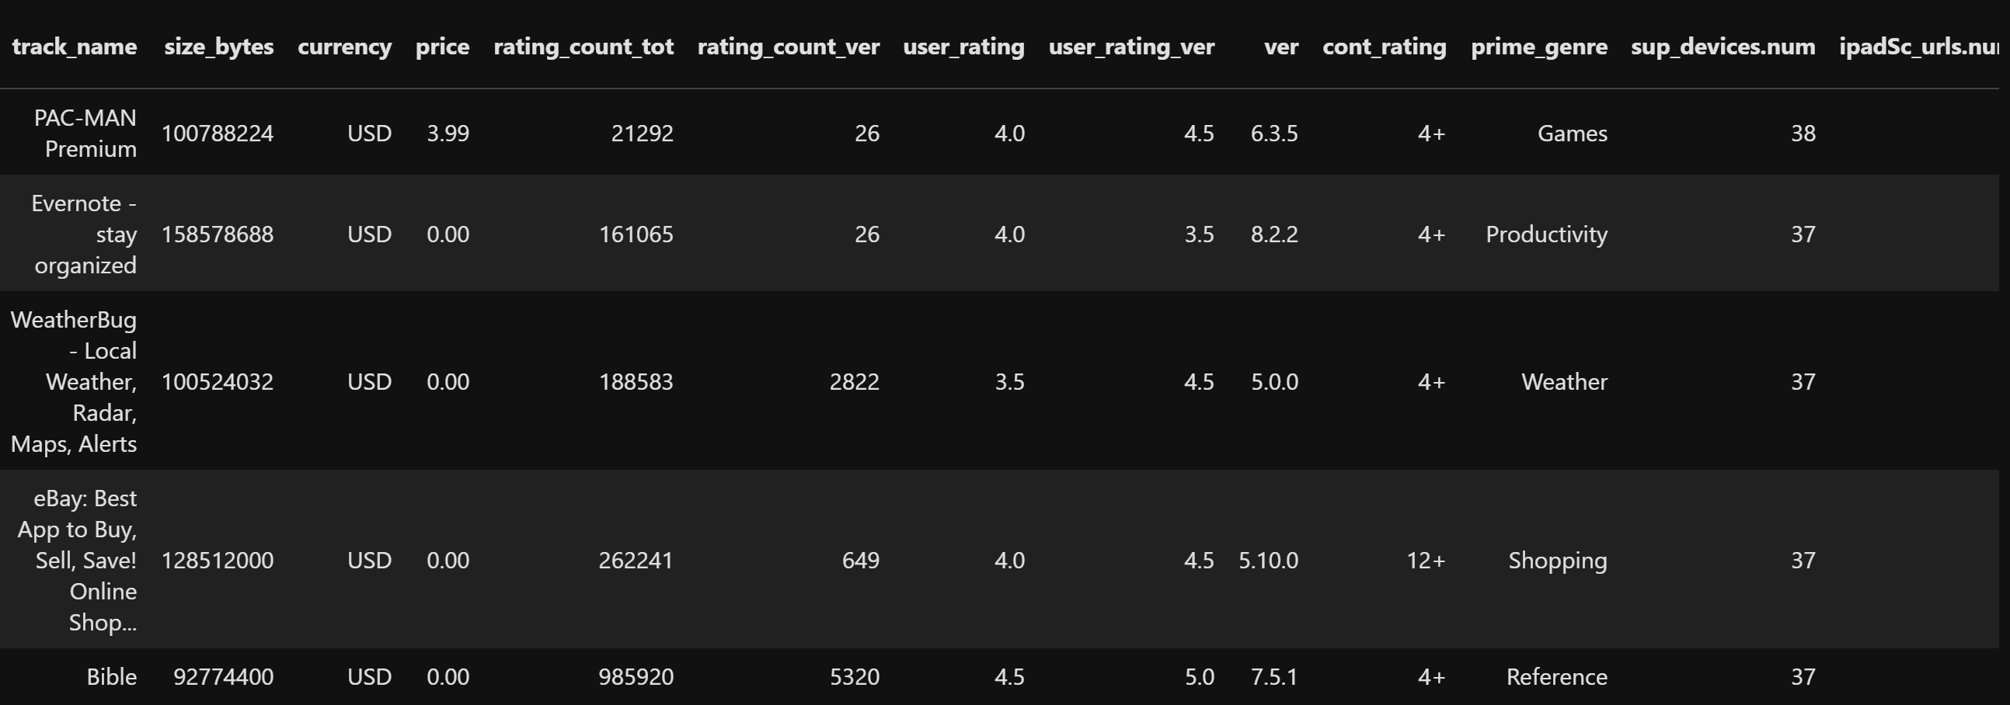
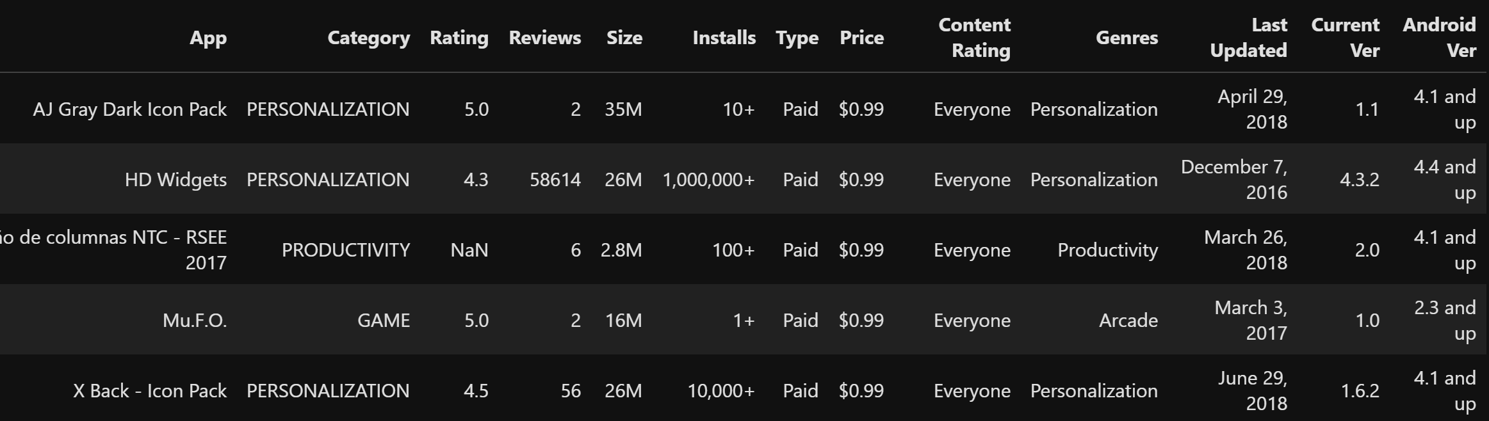
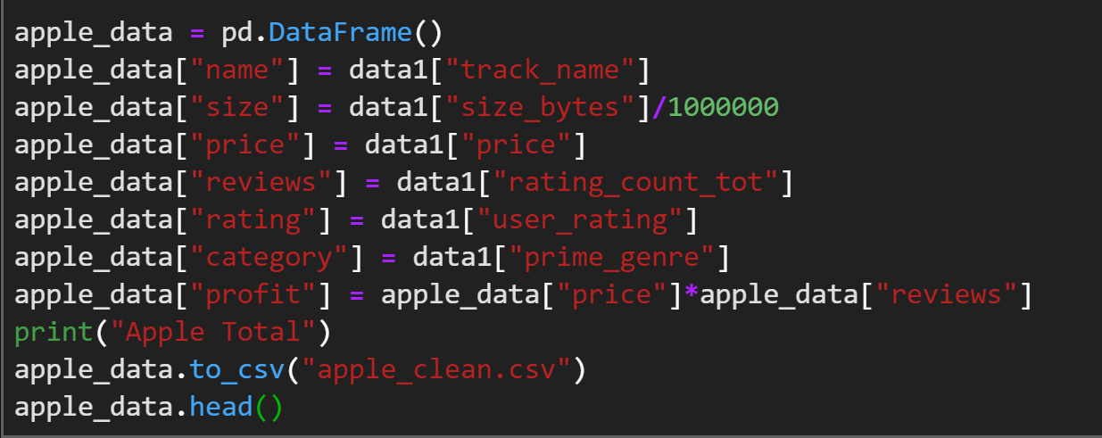
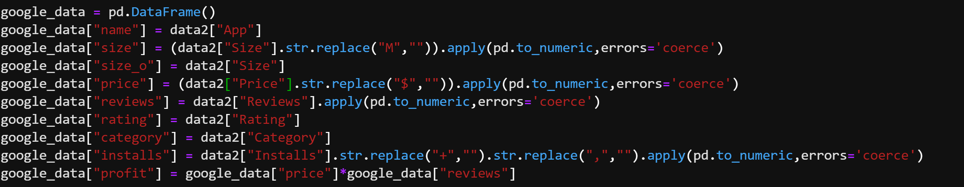
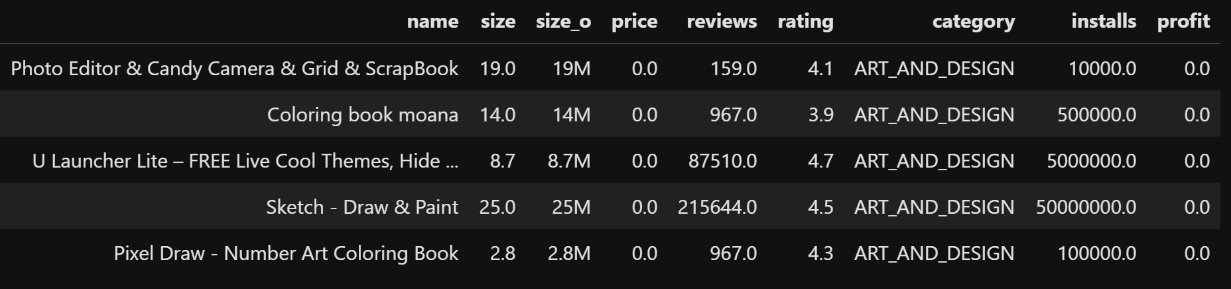
Cleaning Data
Apple
Google

Slide 5
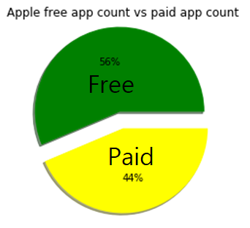
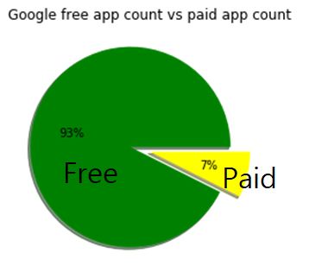
Data Exploration
Significant difference between two data,
Why? Maybe because apple users are more likely to spend money on apps? Proof of iPhone price? Stricter process to upload apps?
Because of significance lead us to combine two datasets to account to look from more general perspective

Slide 6
Merged Data
After extracting apps that exist in both markets, ended up with 328 applications.
There were some difference in app information(some free in Apple but cost money on Google, etc)
Averaged numbered data to look at general trend.

Slide 7
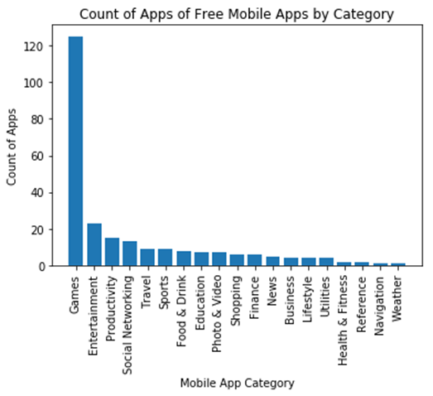
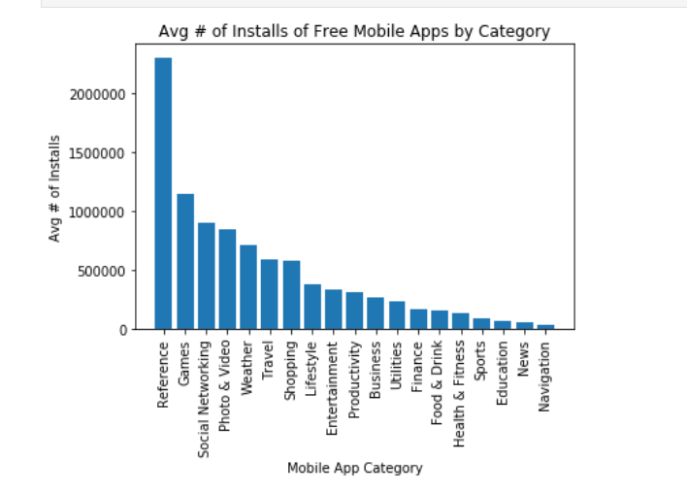


Average Installs & Count Free Mobile Apps by Category
# of app installs=
Google - # of installs
Apple - # of users who left a rating

Slide 8
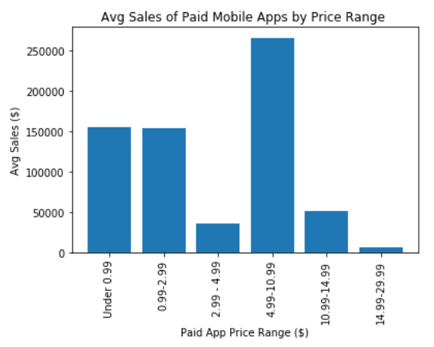
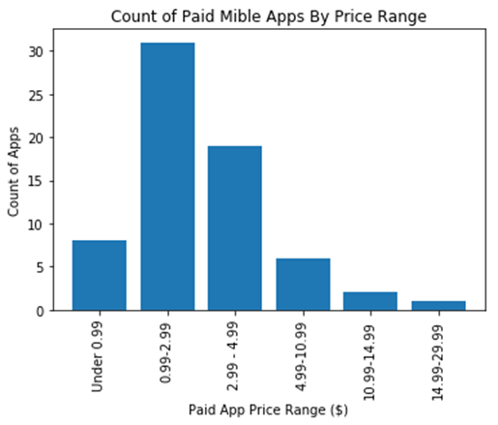
Count and Avg Sales by Price Range
Calculated sales revenue =
# of installs or ratings * app price
Free apps assumption – sales generated through # of downloads and advertising

Slide 9
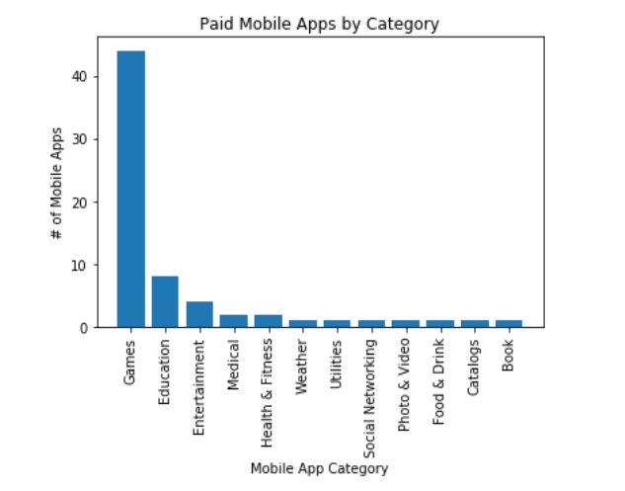
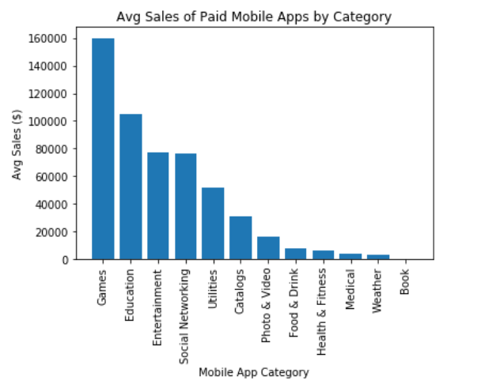

Which Paid mobile apps are leading in the market?
Gaming apps dominate the market, both in volume and estimated sales revenue
Insights into end-user demand
Competition
New product opportunities

Slide 10
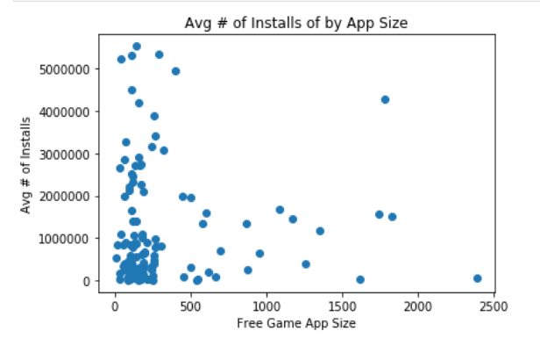
The feasibility of deploying a mobile app
Size of mobile app
Larger distribution of Apple apps are available at a premium, driven by higher development costs and end-user willing to pay more
End-user experience
Notes:
Insights in the user-experience

Slide 11

Mobile App market trends
Findings:
There is a high demand of Gaming mobile apps
End-users are willing to pay a premium
Smaller app sizes are preferable
Apple users are more likely to pay for an app
Recommend to keep price low to influence an increase in installations
Game apps are king

Slide 12
What’s next?
Difficulties that arose?
Different data values between the 2 data sets
Additional questions that came up?
Advertising Revenue – understand the advertising sales/app if free
Historical data – trends overtime
Mobile use increase?
Mobile genres change YoY?
What research would you do next?
Qualitative market research – demographics of end-user
Cost to build an app – resource/time/product roadmap

