Slide 1
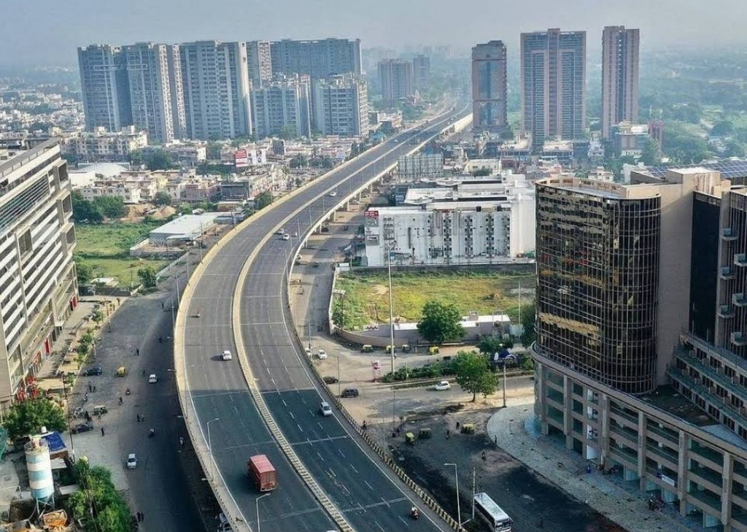
Introduction to Ahmedabad’s Transportation Problem
Sectoral City Profile – Transportation

Slide 2
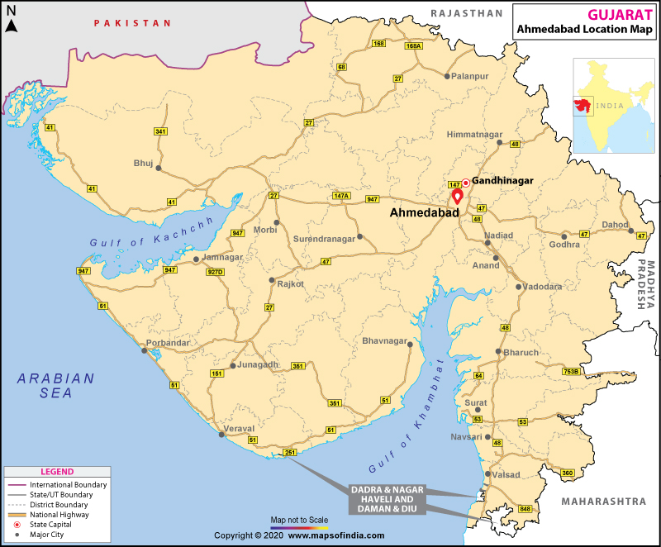
Overview of Ahmedabad: Brief introduction (population, economic activity)
Transportation Challenges:
Traffic Congestion: Increasing vehicle numbers.(Data: Ahmedabad has over 40 lakh registered vehicles as of 2023, growing at 9% per year.)
Air Pollution: Vehicles contribute to 20-25% of Ahmedabad’s air pollution.(Data: Ahmedabad’s AQI averages over 150 during peak times, much of it attributed to transportation.)
Limited Public Transit Options: Low percentage of public transport users.Data: Only 15-20% of trips are made using public transport.

Slide 3
Current Status of Metro in Ahmedabad
Ahmedabad Metro Phases:
Phase 1(Completed): 26.7 km, 32 stations. Usage: Around 1.1 lakh passengers daily (as of 2023). Cost: ₹10,733 crore ($1.45 billion).
Phase 2(Upcoming): 28.26 km expansion. Metro Benefits:Speed: 80 km/h (reducing travel time by 30-40%). Capacity: One metro train can accommodate 800-1,200 passengers. Environmental Impact: Reduction in CO2 emissions by 30,000 tons annually.

Slide 4
Current Status of City Bus Transportation in Ahmedabad
Ahmedabad BRTS (Bus Rapid Transit System):
Length: 96.5 km of dedicated corridors.
Ridership: ~1.35 lakh passengers per day.
Bus Fleet: 300+ buses in service.
Operational Cost: ₹100-150 crore annually.
AMTS (Ahmedabad Municipal Transport Service) Length: 700 km of routes, 700 buses.
Ridership: 1.2 lakh daily passengers.
Challenges: Aging buses, frequent delays, poor connectivity to remote areas.
Environmental Impact: BRTS contributes less pollution than regular vehicles but is still not emission-free.

Slide 5
Metro vs. City Bus Transportation Model Comparison
Metro
City Bus
₹250-300 crore/km
800-1,200 passengers
80 km/h
Underground/elevated tracks
Lower carbon footprint
Maintenance Cost: High
Fixed routes, expensive to expand
Long-term solution for high-density areas
₹15
Train 60-80 passengers/bus-20 crore/km (BRTS)
20-25 km/h (due to traffic)
Road-based (dedicated lanes for BRTS)
fully electric Some pollution (diesel/CNG buses)
Maintenance Cost: Moderate
More flexible, easier to add routes
Better for low-medium density areas

Slide 6
Ridership and Financials
Metro Ridership Growth: Expected to increase to 3-4 lakh passengers daily by 2030.
City Bus Ridership Decline: BRTS and AMTS saw a 10% drop due to preference for personal vehicles.
Financial Comparison:
Metro: Higher initial investment but lower per-passenger cost in the long run (after break-even).
City Bus: Lower upfront investment but higher operational costs per passenger.

Slide 7
Proposal and Recommendations
Long-Term Recommendation: Prioritize Metro for High-Density Corridors:
Phase 2 Metro Expansion: Focus on high-traffic corridors. Integrated Metro and Bus Systems: Unified ticketing and better connectivity between bus and metro stations.
Cost-Benefit: Metro has a higher initial investment but more sustainable for long-term needs of growing city population.
Short-Term Recommendation: Focus on City Bus System:
Expand Bus Fleets and Routes: Especially to underserved areas. Improve Bus Frequency: To reduce waiting times.
Dedicated Bus Lanes: To avoid traffic and improve efficiency.
Eco-friendly Buses: Transition to electric or hybrid buses.
Cost-Benefit: BRTS is 10x cheaper per km than Metro, making it ideal for quick expansions.

Slide 8
Conclusion
Balancing Short-term and Long-term Solutions:
City bus services are flexible and can address current transport issues quickly, but a robust metro system is needed for the future.
Data-Driven Planning: Combining the best features of both modes (bus for flexibility, metro for capacity) will ensure efficient transport solutions.

Slide 9
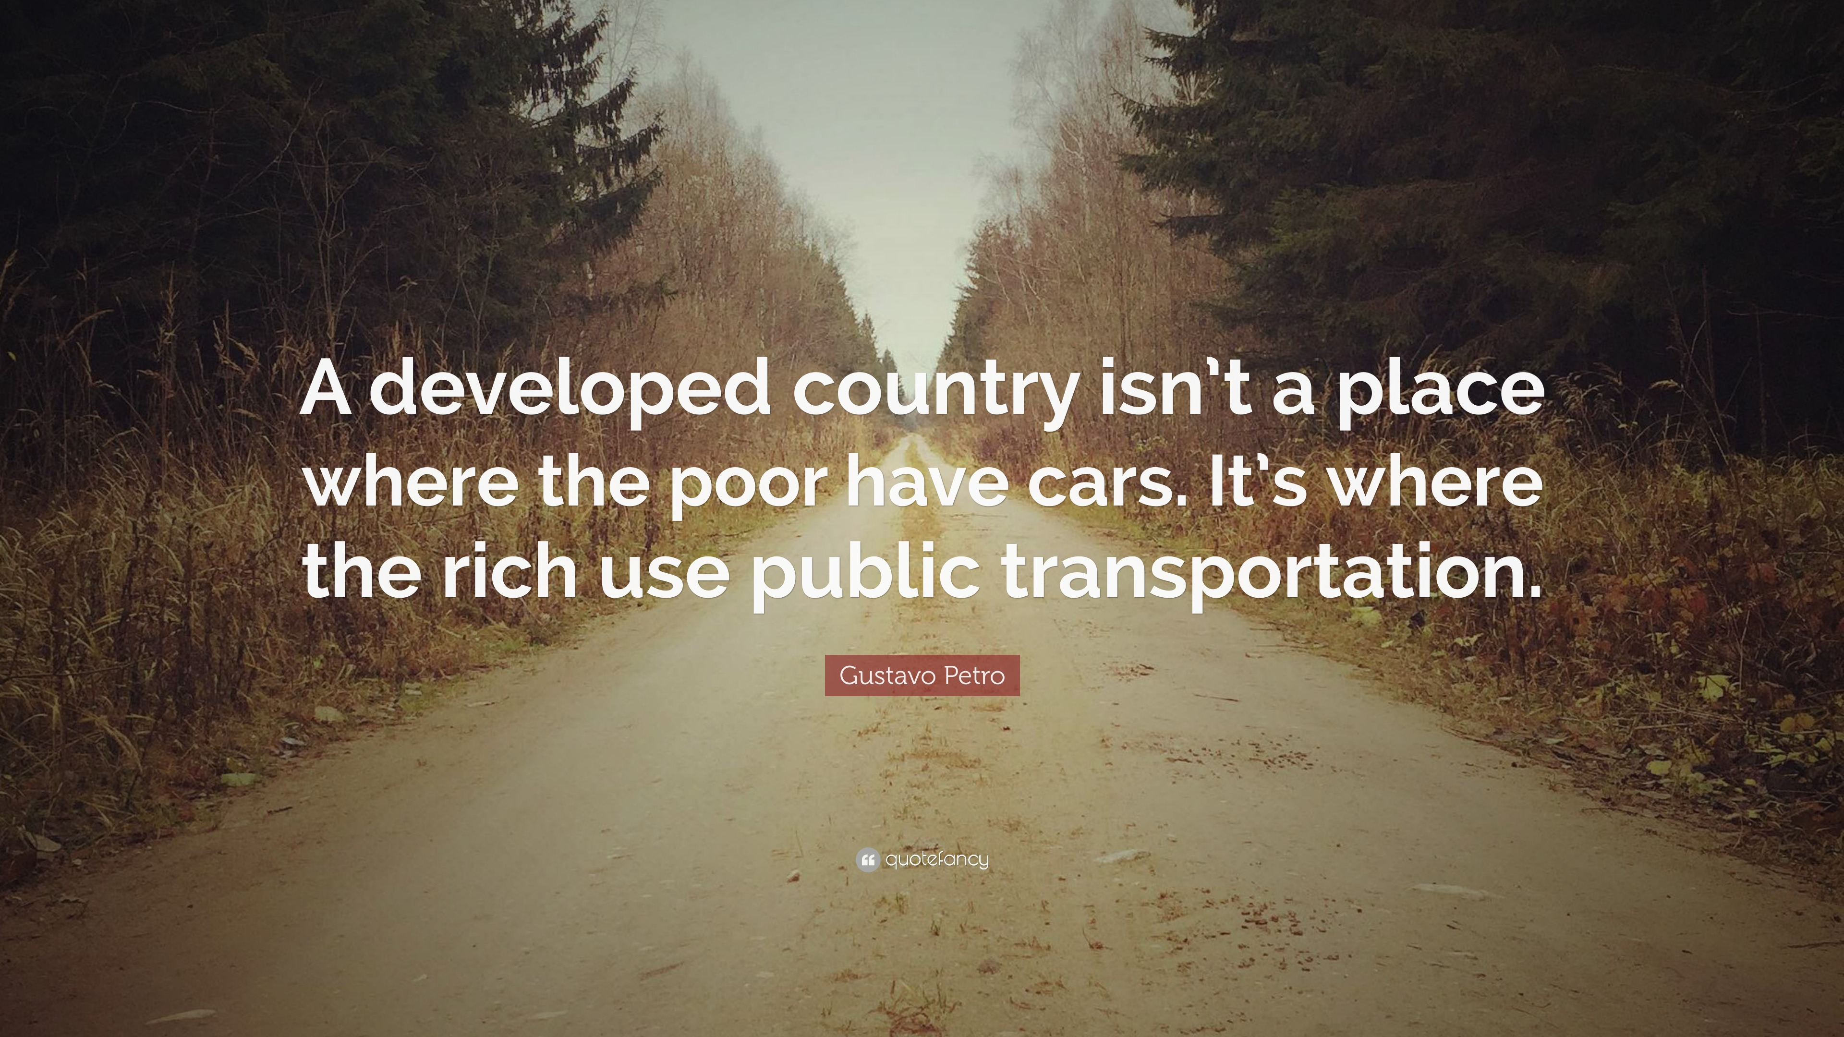
-----------------------Thank you----------------------

