Slide 1

Project Stellar
Investment Brief
kelpglobal.com

Slide 2
BUSINESS OVERVIEW
Business Overview:
Key Select Customers
The at a Glance
■ Two advanced manufacturing facilities encompassing 350,000 sq. ft. of production area
Thales
2,368
■ Highly skilled workforce of 2,368 professionals with deep domain expertise in high-reliability electronics
Employees
Defence Research and Development Organisation (DRDO)
2
■ Global operational footprint with a presence in India, France, North America, and across Asia
Manufacturing Units
■ Recognized for innovation and excellence with accolades from Forbes Asia and IESA-NASSCOM
Leading Global Aerospace OEMs
350,000
Production Area (Sq. Ft.)
Growth led through its growing product portfolio and offering solutions to diverse sectors
Tier-1 Automotive Suppliers
Certifications
Strategic Electronics
Electronics Manufacturing Solutions (EMS)
ISO
CMMI
Engineering & After Sales Services
Passenger Information Systems
Space Technology & Communications Solutions
Strictly Private & Confidential – Prepared by Kelp M&A Team

Slide 3
KEY FINANCIAL METRICS
₹ 11554.2 Cr
9.5%
8.4%
₹ 129.1 Cr
Latest Revenue
Revenue CAGR
EBITDA Margin
Latest PAT
Strictly Private & Confidential – Prepared by Kelp M&A Team

Slide 4
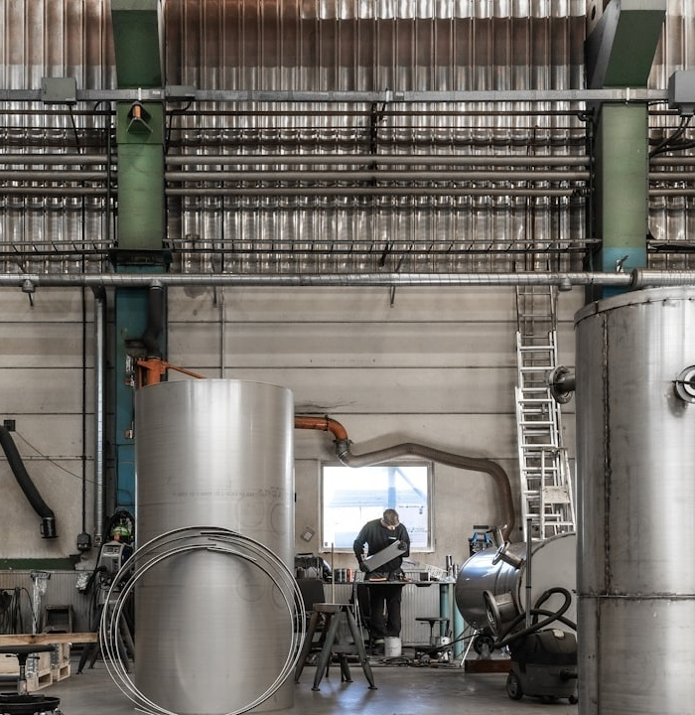
INVESTMENT HIGHLIGHTS
High-Barrier Defense & Aerospace Focus
Strategically positioned to capitalize on the India manufacturing sector's projected growth to $768.28 billion by 2035, specifically targeting high-margin, mission-critical electronics for defense and space where entry barriers are exceptionally high.
H
33-Year Technical Moat
Leveraging over three decades of precision engineering expertise and a 350,000 sq. ft specialized production footprint to deliver complex, build-to-spec systems that meet rigorous aerospace and space-grade quality standards.
3
Strategic Global Partnerships
Deeply embedded in the global supply chain through long-term collaborations with Tier-1 leaders like Thales and critical government bodies like DRDO, ensuring high customer stickiness and multi-year project visibility.
S
Diversified Global Delivery Model
Operating a de-risked business model with a physical presence across North America, Europe, and Asia, allowing the company to capture the 6.75% CAGR in the global engineering services market while providing localized support to international OEMs.
D
Full-Lifecycle Value Proposition
Offers a unique 'Design-to-After-Sales' turnkey solution across flexible engagement models, providing a significant competitive edge over pure-play EMS providers and creating high-value synergies for strategic acquirers.
F
Strictly Private & Confidential – Prepared by Kelp M&A Team

Slide 5
Important Notice & Disclaimer
Strictly Private & Confidential. This presentation is prepared by Kelp Global exclusively for the intended recipient and may not be reproduced or distributed without prior written consent. This document is for informational purposes only and does not constitute an offer to sell or a solicitation of an offer to buy any securities. While all information is obtained from sources believed to be reliable, Kelp Global makes no representation or warranty regarding its accuracy or completeness.
Strictly Private & Confidential – Prepared by Kelp M&A Team

