Slide 1

Project Swift
Investment Brief
kelpglobal.com

Slide 2


BUSINESS OVERVIEW
The Company is a premier logistics and supply chain management player specializing in express distribution and integrated transportation solutions. It operates an extensive network across India, serving a diverse B2B client base in sectors such as e-commerce, automotive, and chemicals. Core capabilities include tech-enabled real-time tracking, sophisticated warehousing management, and specialized supply chain optimization with over three decades of operational expertise.
AT A GLANCE
344M+
31
Packages Delivered
Years in Operation
25,310+
■ Extensive pan-India network covering major industrial hubs and commercial centers across the country
Tons CO2 Saved
■ Advanced technology integration providing real-time tracking and end-to-end supply chain visibility
KEY CUSTOMERS
■ Diverse service portfolio catering to high-growth sectors including E-commerce, Pharma, and Automotive
■ Strong commitment to sustainability with over 25,310 tons of CO2 emissions saved through optimized operations
ECU WORLDWIDE
PRODUCT SEGMENTS
PALUCK
FCL MARINE AGENCIES
Express Distribution
Supply Chain Solutions
CERTIFICATIONS
Warehousing
Tech-Enabled Logistics
Strictly Private & Confidential – Prepared by Kelp M&A Team

Slide 3
KEY FINANCIAL METRICS
₹ 15100.1 Cr
2.8%
4.3%
₹ -186.2 Cr
Latest Revenue
Revenue CAGR
EBITDA Margin
Latest PAT
Strictly Private & Confidential – Prepared by Kelp M&A Team

Slide 4
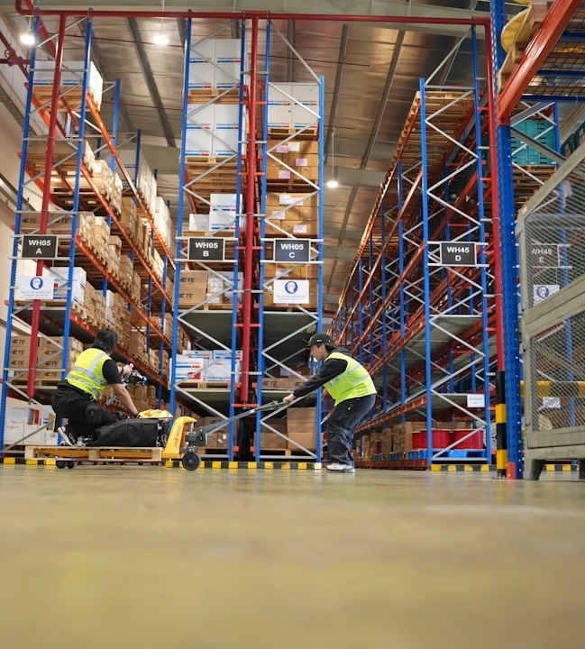




INVESTMENT HIGHLIGHTS
Dominant Position in High-Growth 3PL and Cold Chain Segments
Tech-Enabled Operational Excellence and ESG Leadership
The firm is strategically positioned to capitalize on the Indian 3PL market, valued at $17.12B with a 9% CAGR, and the specialized cold chain sector growing at 9.72%, driven by rising demand in the Pharma and FMCG verticals.
With over 30 years of institutional expertise, the firm leverages advanced real-time tracking and a proprietary sustainability framework that has mitigated over 25,310 tons of CO2 emissions, creating a significant competitive moat and high barrier to entry.
Deep-Rooted Enterprise Relationships Across Diverse Verticals
Capitalizing on India’s $429B Logistics Transformation
The Company maintains exceptional customer stickiness through integrated B2B solutions for mission-critical sectors including Chemicals, Automotive, and Electronics, serving a blue-chip client base with specialized express distribution and supply chain requirements.
As the national logistics market scales toward a projected $429B by 2034, the firm is poised to benefit from structural shifts toward organized logistics, multimodal integration, and regulatory tailwinds favoring established pan-India players.
Strictly Private & Confidential – Prepared by Kelp M&A Team

Slide 5
Important Notice & Disclaimer
Strictly Private & Confidential. This presentation is prepared by Kelp Global exclusively for the intended recipient and may not be reproduced or distributed without prior written consent. This document is for informational purposes only and does not constitute an offer to sell or a solicitation of an offer to buy any securities. While all information is obtained from sources believed to be reliable, Kelp Global makes no representation or warranty regarding its accuracy or completeness.
Strictly Private & Confidential – Prepared by Kelp M&A Team

