Slide 1

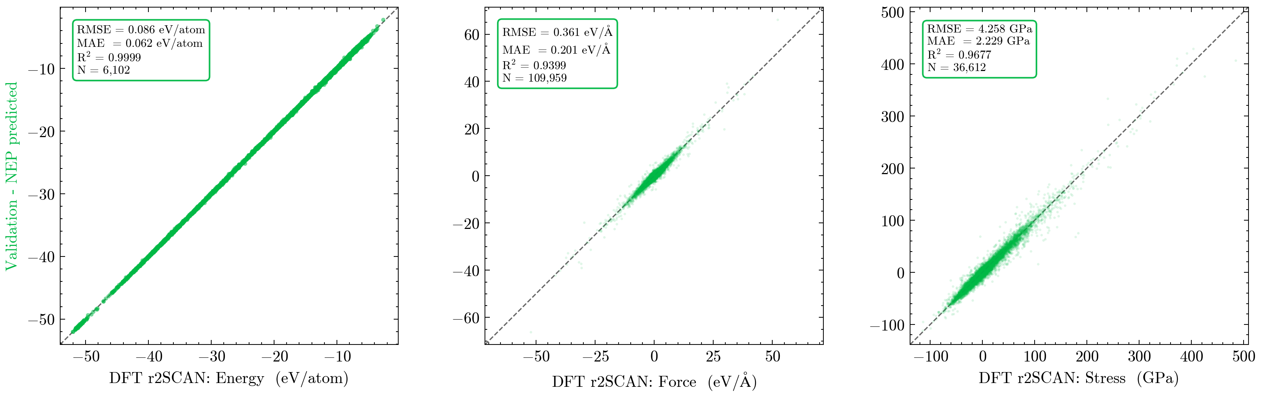
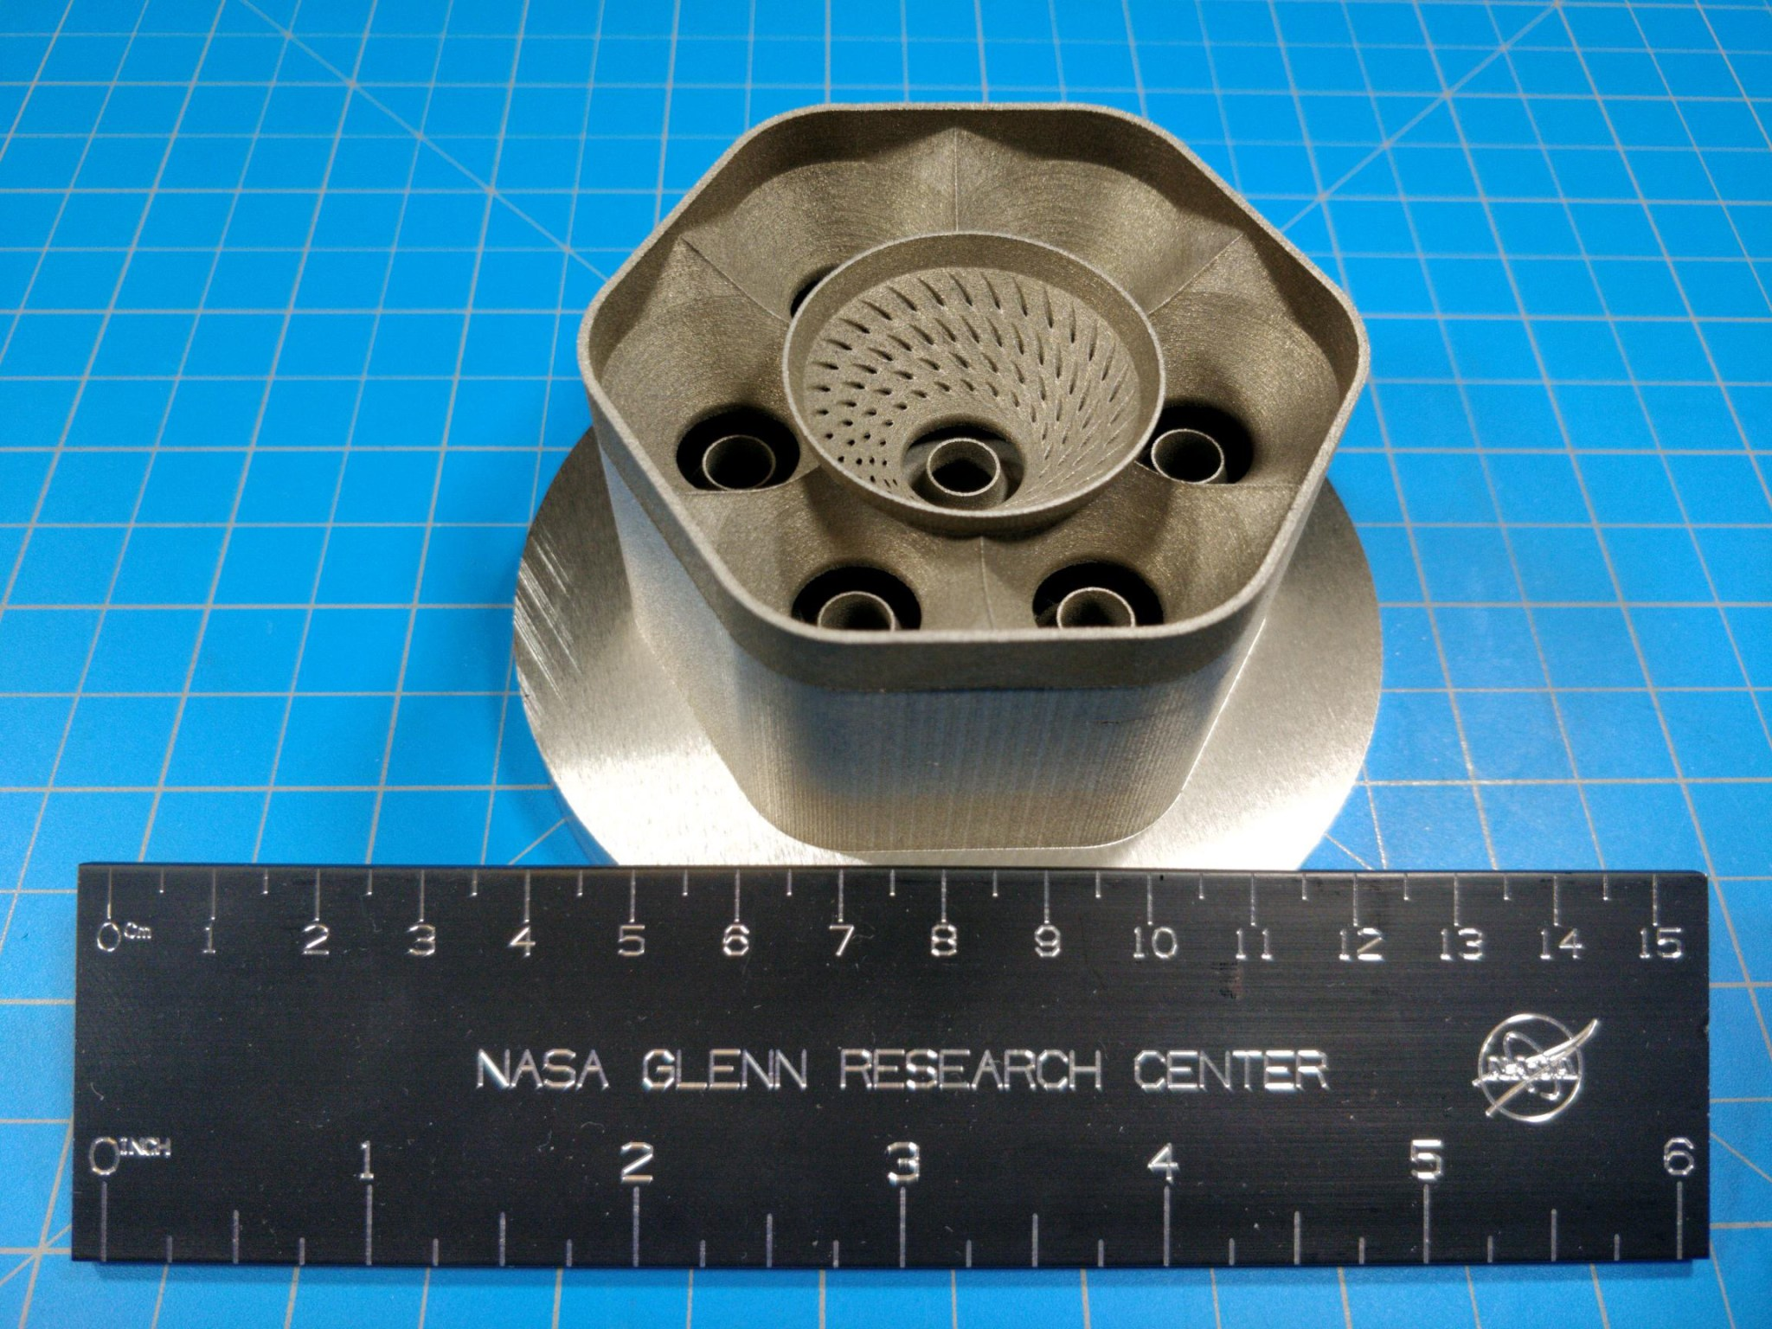
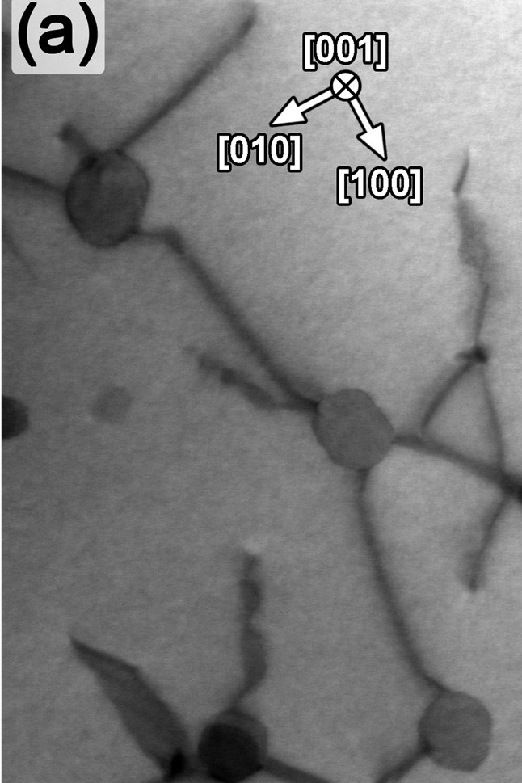
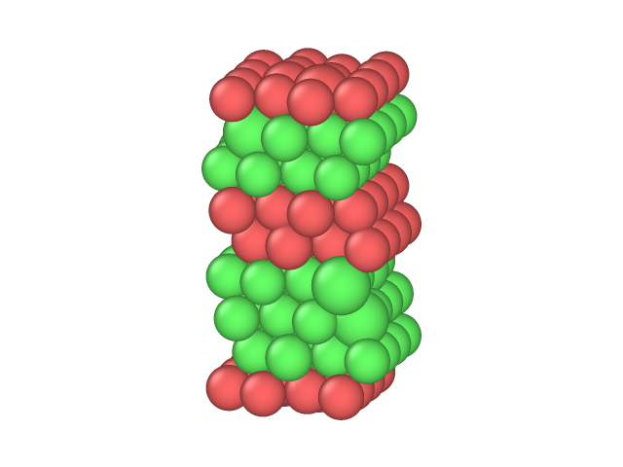
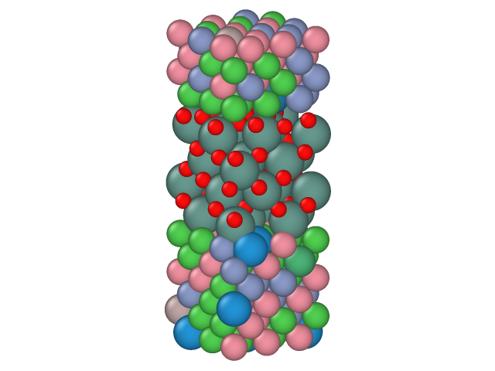
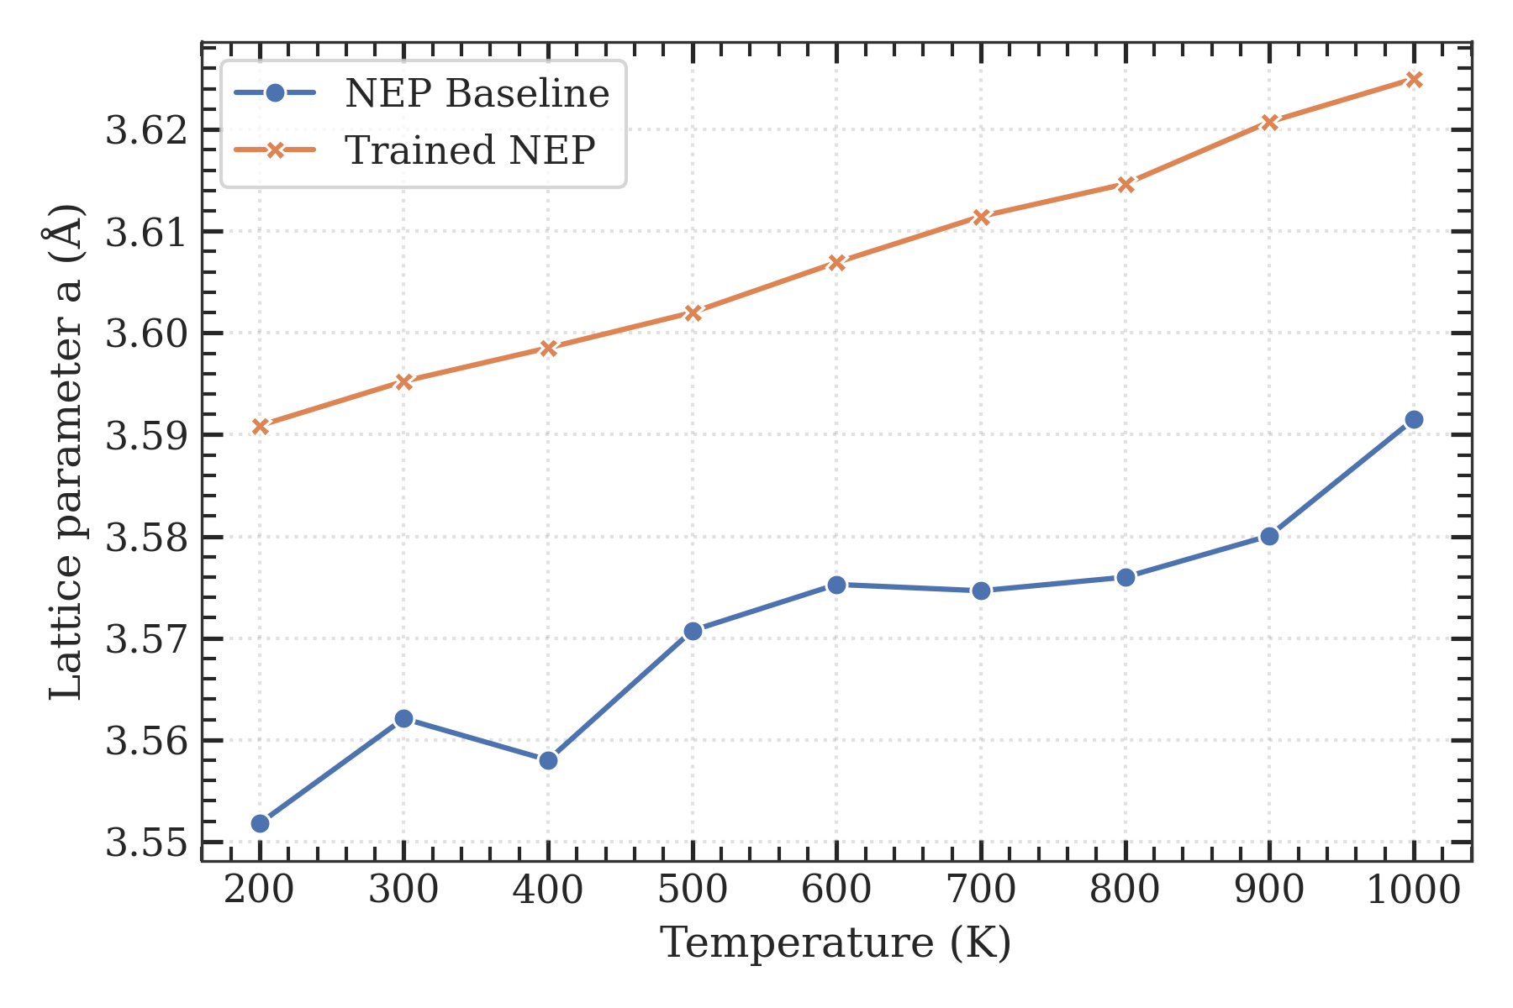
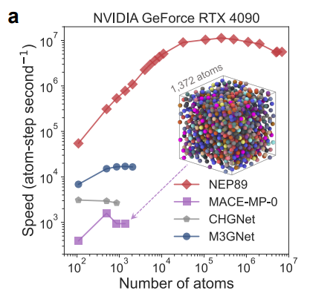
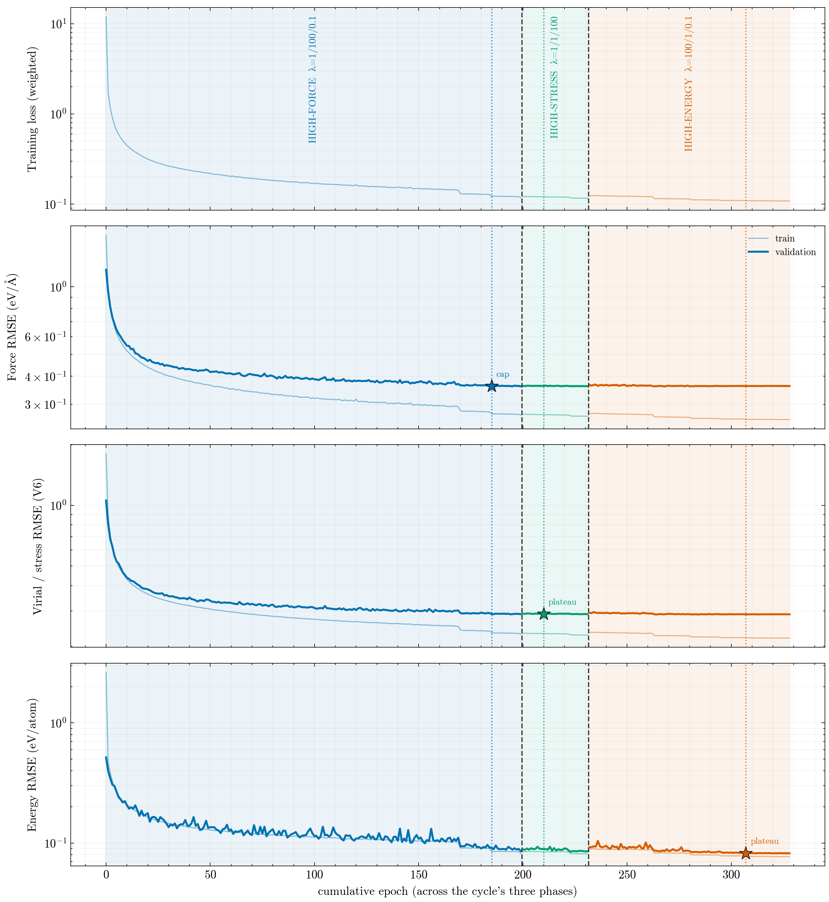


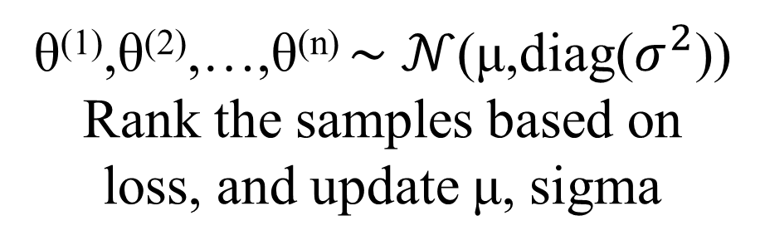
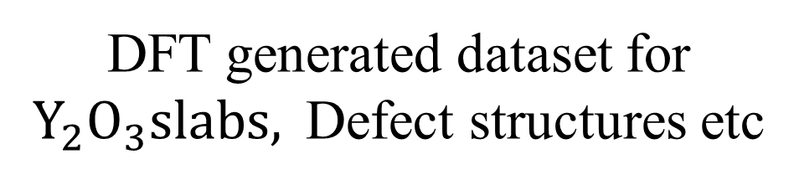
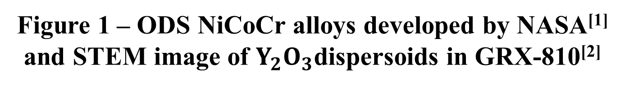
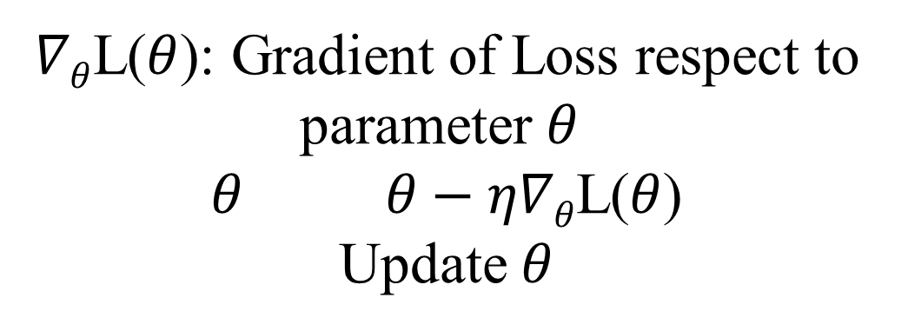
Machine Learning Interatomic Potential for NiCoCr-based alloys
Sho Sakaue, Will Lee, Nutth Tuchinda, Suhas Eswarappa Prameela
I. Introduction
Pre-training
Fine-tuning
MatPES
MP-ALOE
Final trained Potential
General open-source DFT dataset
NEP potential
Figure 5 – Parity plots between DFT and trained NEP in energy, force, and stress
Figure 1 – ODS NiCoCr alloys developed by NASA^{[1]} and STEM image of $Y_{2}O_{3}$dispersoids in GRX-810^{[2]}
MatPES: high-quality, low-noise, PES dataset with balanced-coverage
MP-ALOE: broad, active-learning PES data focusing on off-equilibrium structures
Machine Learning Interatomic potentials (MLIPs) are data driven method achieving accuracy comparable to DFT while it is much less expensive.
Universal-MLIPs (U-MLIPs) are MLIPs pretrained on large and diverse datasets so they can cover across many atomic compositions and elements.
NiCoCr-based alloys are attractive since they have shown incredible creep resistance and high temperature mechanical performance^{[3]}.
However, their chemically complicated structures make them challenging for MLIPs to model accurately.
Research Gap: Although U-MLIPs can cover diverse structures, they still struggle to learn large and complex atomic systems with multiple interactions.
DFT generated dataset for $Y_{2}O_{3}slabs,$Defect structures etc
Figure 2 – Workflow of pre-training and fine-tuning of NEP model
III. Model
NEP (Neuroevolutional Potential) model is one of the most efficient MLIPs, which has unique architecture and optimization method.
Architecture: They have fixed non-trainable functions in descriptor layer where the model capture geometric relationship from each atom to neighbors followed by 1 layer feedforward neural network, which allows NEP potential to do computation really fast.
Optimization method: NEP model usually use SNES optimization method, which is derivative free and population-based black-box optimization, which is slow. TorchNEP is using same NEP architecture, but replace SNES to analytical gradient-based optimization, which is faster.
Figure 6 – Comparison of change in lattice constant over temperature between NEP89 base model and trained model
V. Conclusions & Next steps
Once DFT calculation for fine-tuning dataset is done, we will train NEP model, and do validation.
Since DFT calculations takes time, and limited to small system with around 100 atoms, we need to carefully select structures that covers diversity, and have broad representation.
Therefore, we need to figure out the method to sample representative small pieces of structures for one’s interesting structures. This will be the gap we would like to fill in next step.
Goal: build model that can capture behavior of NiCoCr-based alloys accurately .
Figure 3 – Time efficiency of NEP89 in MD^{[6]}
II. Methods
iid
$∇θ$L($θ$): Gradient of Loss respect to parameter $θ$
$θ θ−η∇θ$L($θ$)
Update $θ$
θ⁽¹⁾,θ⁽²⁾,…,θ^{(n)} ∼ $𝒩$(μ,diag($σ^{2}$))
Rank the samples based on loss, and update μ, sigma
We selected NEP version 4 model^{[4]}, and pretrained it on two open-source major Potential Energy Surface(PES) datasets, MatPES and MP-ALOE.
For the optimization method of NEP model, we used gradient based optimization instead of SNES(separable neural evolutional strategy) for a faster convergence of training using TorchNEP^{[5]}.
After that, fine-tune the model with the dataset we generate including yttria slabs and various defects structures
Composition of NiCoCr based alloys used in this study
Major elements: Ni, Co, Cr
Minor elements: W, Re, Nb, Ti, Al, O, Yi
SNES
Gradient based
VI. Acknowledgement
IV. Results
DFT computation for fine-tuning is now under process.
Pre-training of NEP model on MATPES and MP-ALOE went well, and converged within 300 epochs.
It showed good results in parity plots in figure 4, especially trained model has less error in forces than NEP potential with SNES.
I ran comparison test of change in lattice constant of bulk NiCoCr-based alloy between NEP89 model and out trained model and Our model showed more valid thermal expansion.
This work is supported by UROP from the office of Undergraduate Research at the University of Utah awarded to Sho Sakaue.
Thanks to Naveen Dinujaya for helping me this project.
Figure 4 – Training history of NEP model with torch NEP
References
[1] NASA, “NASA’s New Material Built to Withstand Extreme Conditions,” NASA, 2022. https://www.nasa.gov/aeronautics/nasas-new-material-built-to-withstand-extreme-conditions/
[2] M. Heczko, “Microstructural origins of high-temperature properties of 3D printable CrCoNi-based ODS multi-principal element alloys,” Acta Materialia, 2026. https://doi.org/10.1016/j.actamat.2026.122102
[3] J. Smith et al., “A 3D printable alloy designed for extreme environments,” Nature, 2023. https://doi.org/10.1038/s41586-023-05893-0
[4] K. Song et al., “General-purpose machine-learned potential for 16 elemental metals and their alloys,” Nature Communications 15 (2024) 10208. https://doi.org/10.1038/s41467-024-54554-x
[5] W. Wu et al., “TorchNEP: Ultra-Efficient and Accurate Training of Neuroevolution Potentials,” arXiv (2026). https://doi.org/10.48550/arXiv.2606.19557
[6] T. Liang et al., “NEP89: Universal neuroevolution potential for inorganic and organic materials across 89 elements,” Nature Computational Science (2026). https://doi.org/10.1038/s43588-026-01009-6

