Slide 1
Telecom Customer
Churn Prediction
Group Tango | AI/ML Capstone Project | Tutor: Dami
Dataset: Maven Analytics Telecom Customer Churn | 7,043 Customers | Kaggle

Slide 2
Problem & Objective
The Problem
Our Objective
Keeping a customer costs 5 to 7 times less than gaining a new one
Revenue is lost to churn that a prediction model could have caught
Without data, retention goes to the wrong customers
Build a model that predicts who will leave
Compare two models and pick the best one
Identify what drives churn
Apply responsible AI throughout

Slide 3
Dataset & Data Cleaning
7,043
38
26.5%
0
Customers
Features
Churn Rate
Duplicates
Source: Maven Analytics / IBM Cognos | Kaggle | Public Domain
Data Cleaning
Missing values filled logically: "No Offer", "No Internet", "No Phone" or zero
Churn Category and Reason columns dropped: They only exist after churn happens (data leakage)
120 rows had negative Monthly Charge: Clipped to zero

Slide 4
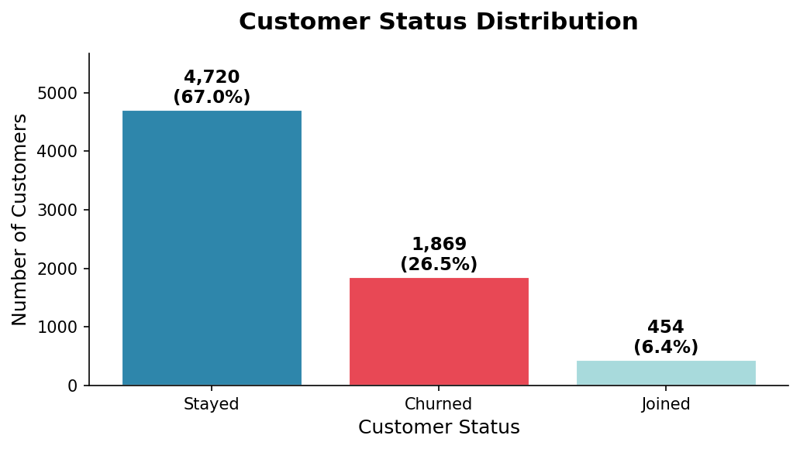
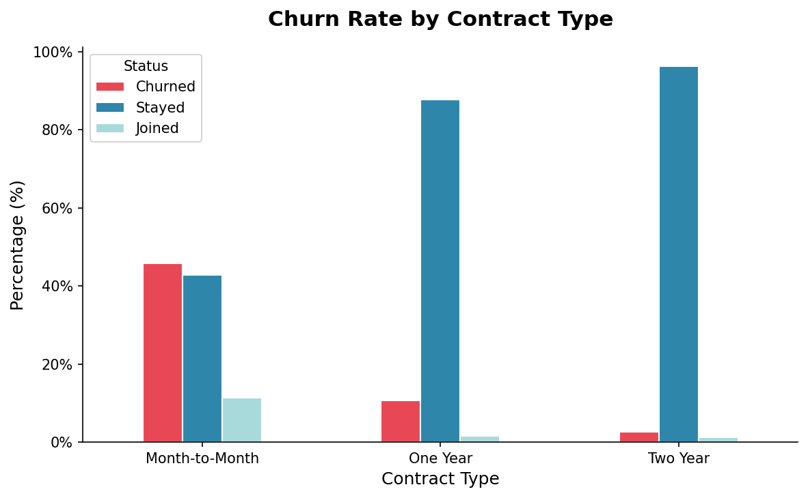
Exploratory Data Analysis
Key Insights
26.5% of customers churned: Significant enough to build a prediction model for
Month-to-month customers churn far more: Longer contracts mean stronger loyalty

Slide 5
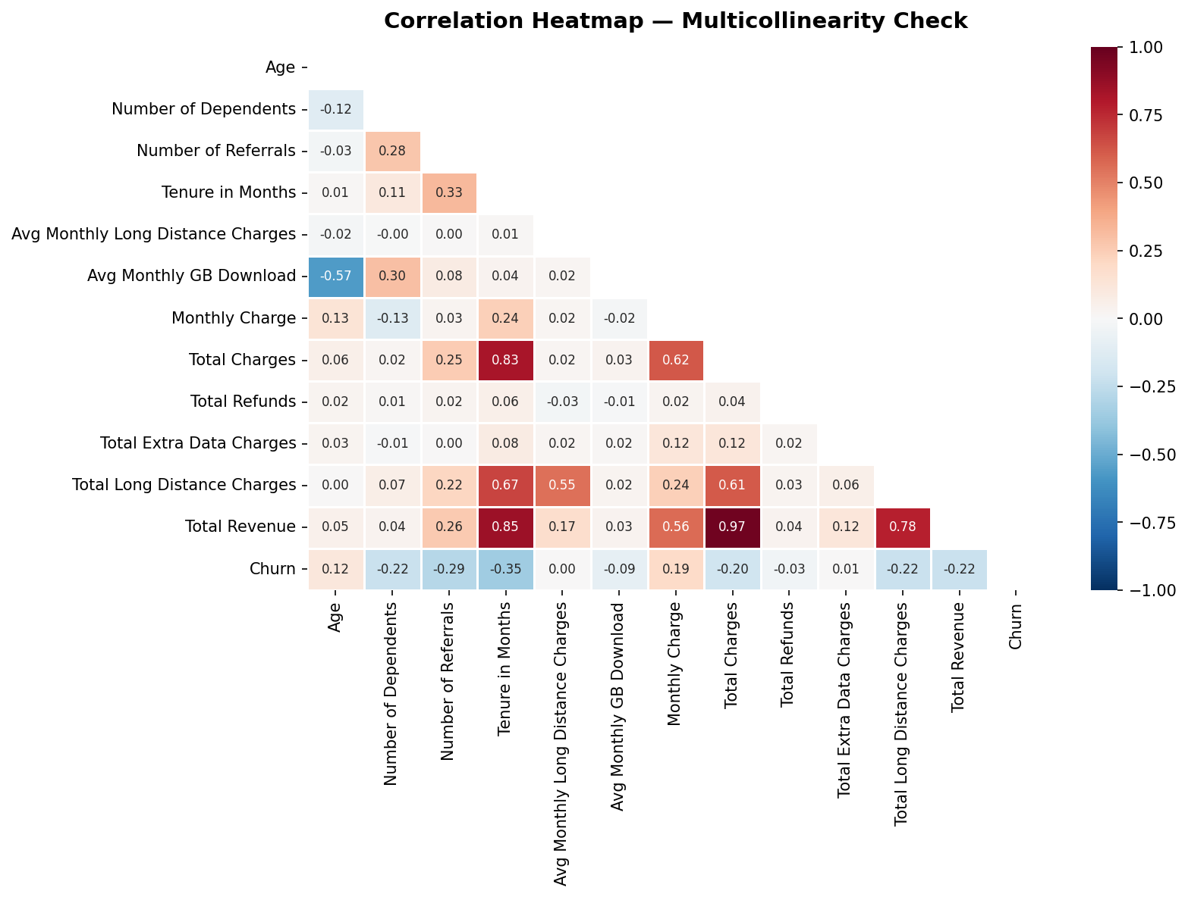
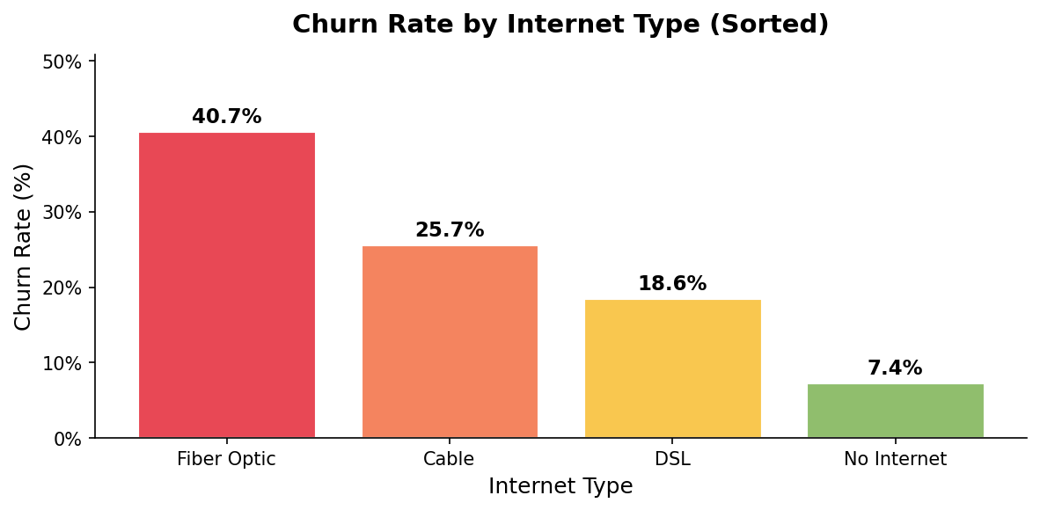
Correlation & Feature Insights
What the data shows us
Total Charges and Total Revenue nearly identical. Dropped Total Charges
Longer tenure = lower churn
Higher monthly charge = higher churn
Fibre Optic customers churn most

Slide 6
Feature Engineering, Encoding & Scaling
Revenue Per Month
Service Count
Is Senior
Total Revenue ÷ Tenure
Average spend per month
Number of add-ons subscribed
Measures engagement depth
Age 65 and above = 1
Tests age-related churn risk
One-Hot Encoding
Standardisation ✓
Text columns converted to 0 or 1 columns so the model can read them. No false ranking is imposed on categories that have no natural order.
Scales all numbers to the same range. Fitted on training data only to avoid leaking test information into the model.

Slide 7
Data Split & Model Training
70%
15%
15%
4,930 records
1,056 records
1,057 records
TRAINING
VALIDATION
TEST
Model learns here
Model comparison
Final result only
Models Trained
Random Forest
Logistic Regression
100 decision trees combined. Handles complex patterns. Gives feature importance scores.
Simpler linear model. Easy to interpret. Used as our comparison baseline.

Slide 8
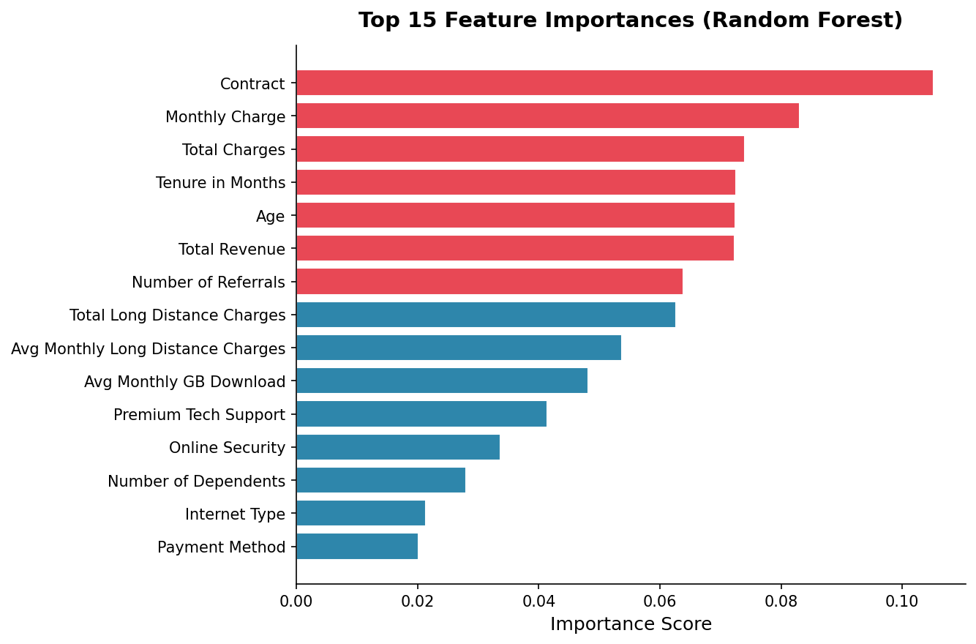
Results: Performance Metrics & Feature Importance
Metric
Random Forest
Logistic Regression
Top drivers:
Test Accuracy
81.84%
81.84%
AUC (ROC)
0.881
0.884
Precision (Churned)
0.68
0.65
Recall (Churned)
0.60
0.68 ✓
F1-Score (Churned)
0.64
0.67 ✓
Logistic Regression recommended. It catches more actual churners (Recall 0.68 vs 0.60)

Slide 9
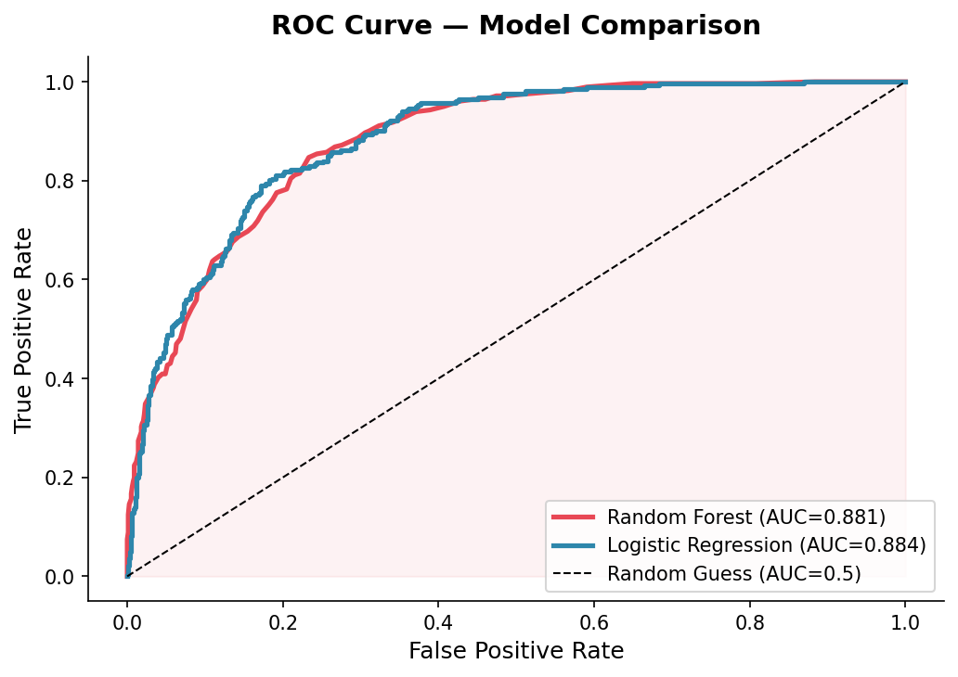
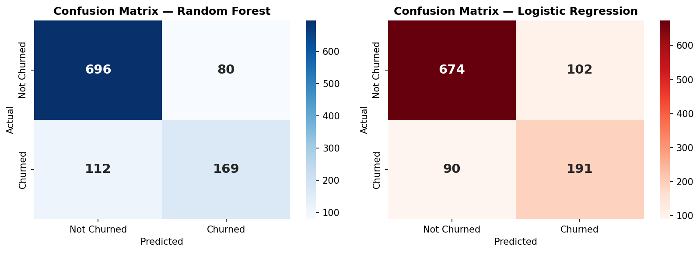
Model Evaluation & Key Business Insights
AUC above 0.88 for both models. A missed churner (False Negative) is the most costly error for any business.
Key Business Insights
Most churn happens in the first 12 months. Invest early in new customers
Referral customers rarely leave. A referral programme directly reduces churn

Slide 10
Ethics, Conclusion & Recommendations
Transparent
Fair
Accountable
Contextual
Public data
No real personal info
Gender checked
Not used as predictor
Human review
before any action
Dataset is US-based
African data differs
Conclusion & Recommendations
Deploy Logistic Regression: It catches the most churners and is easy to explain
Focus retention efforts on new customers in their first 12 months
Investigate why Fibre Optic customers leave despite paying the most
Never act on model predictions alone, always involve a human reviewer
Re-train the model every 6 months and run a fairness check each time

