Slide 1
Project GoGreen
Group 83

Slide 2
Tools
PostgreSQL
Heroku
JSON and GSON
BrighterPlanet
JavaFX

Slide 3
Application: Homescreen
TBA

Slide 4
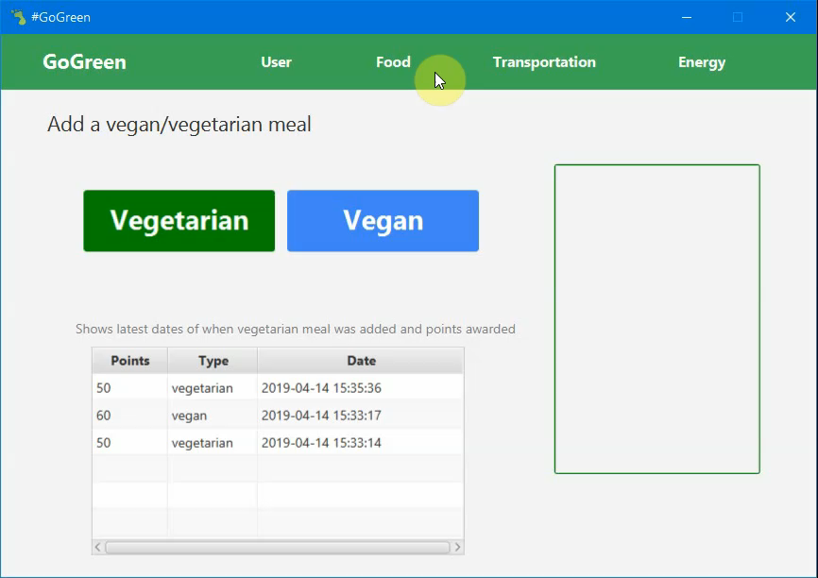
Application: Vegetarian Meal

Slide 5
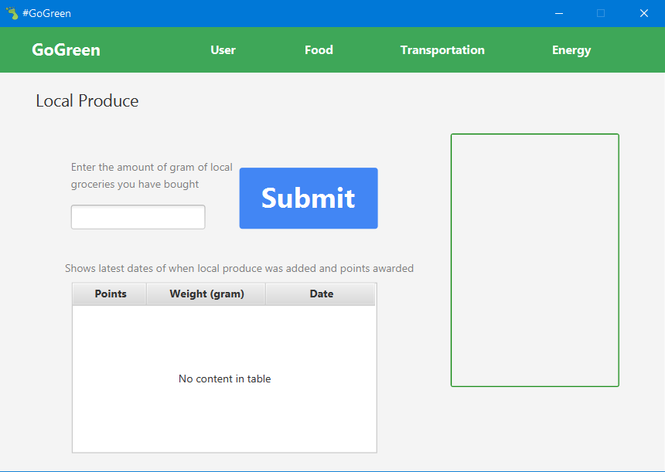
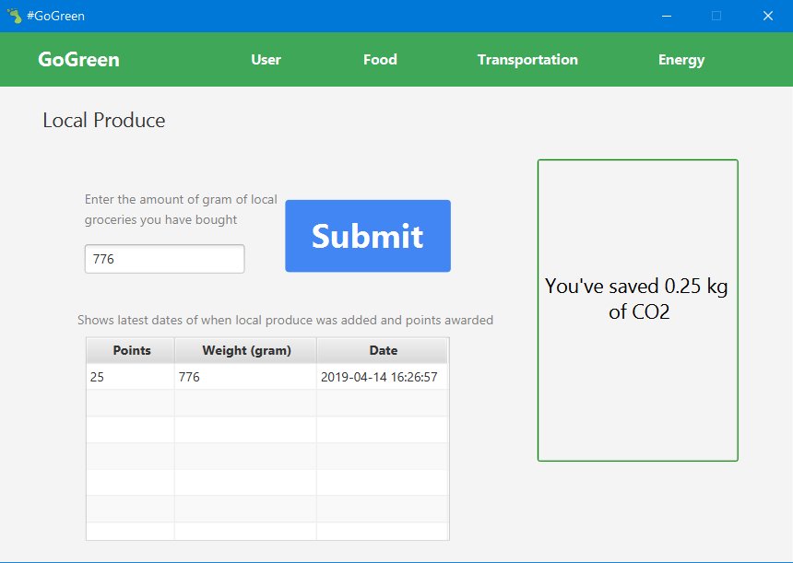
Application: Local Produce

Slide 6
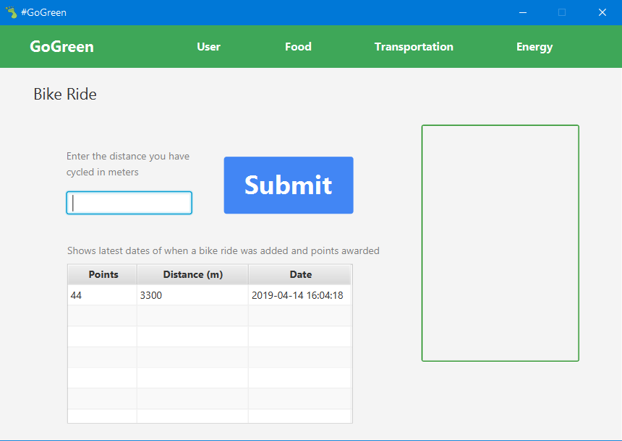

Application: Bike Ride

Slide 7
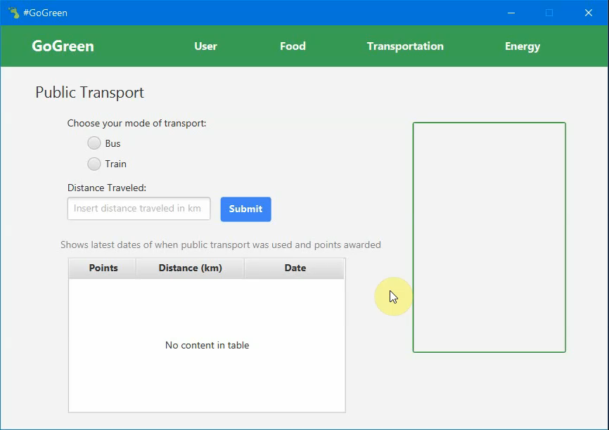
Application: Public Transport

Slide 8
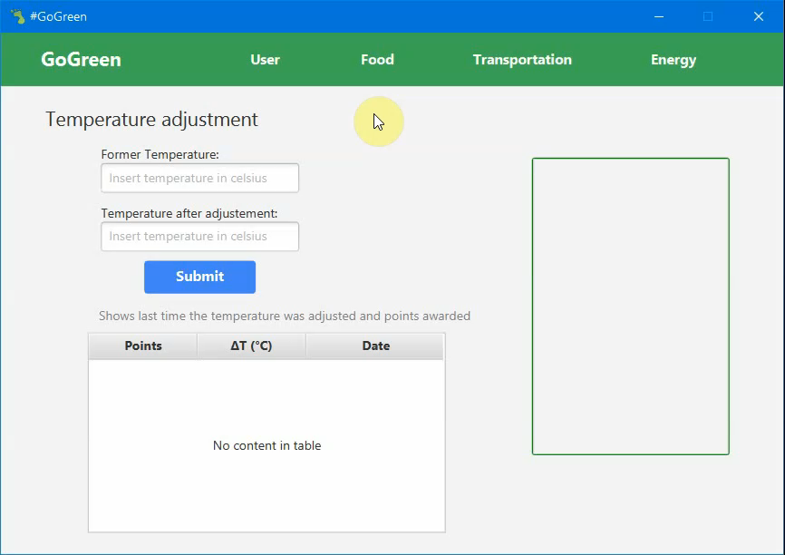
Application: Temperature

Slide 9
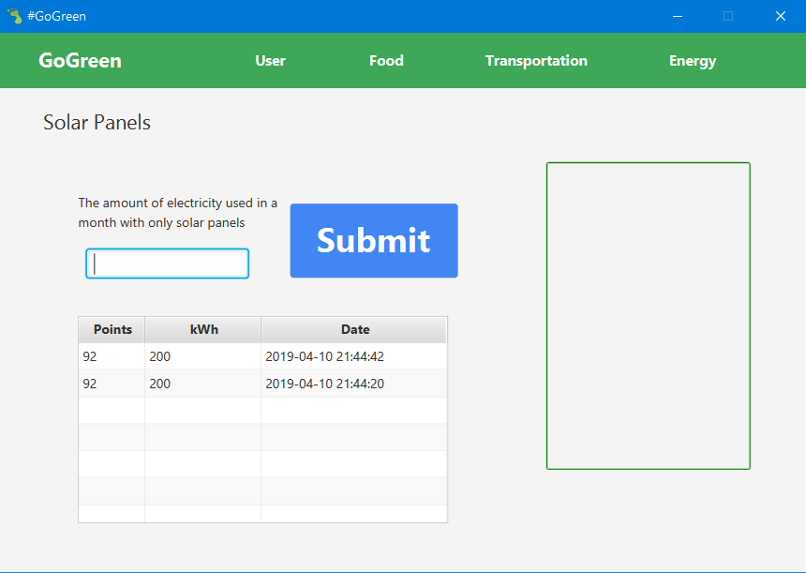
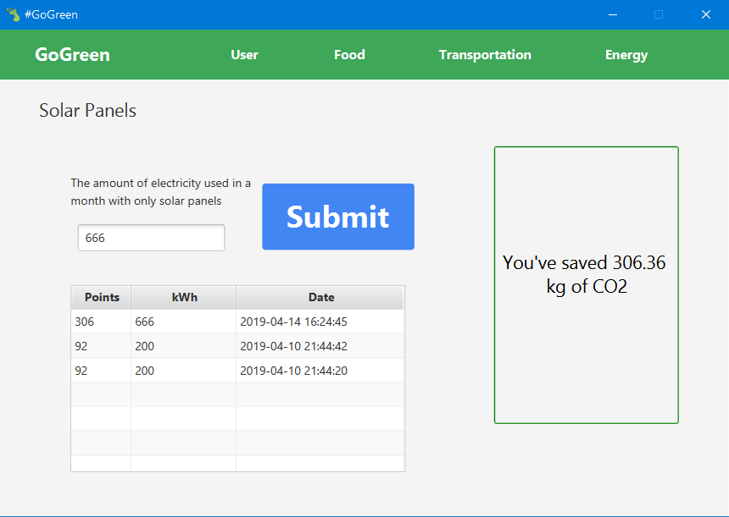
Application: Solar Panels

Slide 10
Application: Stats
TBA

Slide 11
Application: Achievements
TBA

Slide 12
Application: Personal Settings
TBA

Slide 13
Security
Example 1
Example 2
Example 3
Etc

Slide 14
Reflection
Ambiguity
Little experience
Communication
Improvement

