Slide 1
Project GoGreen
Group 83

Slide 2
Tools
PostgreSQL
Heroku
JSON and GSON
BrighterPlanet
JavaFX

Slide 3
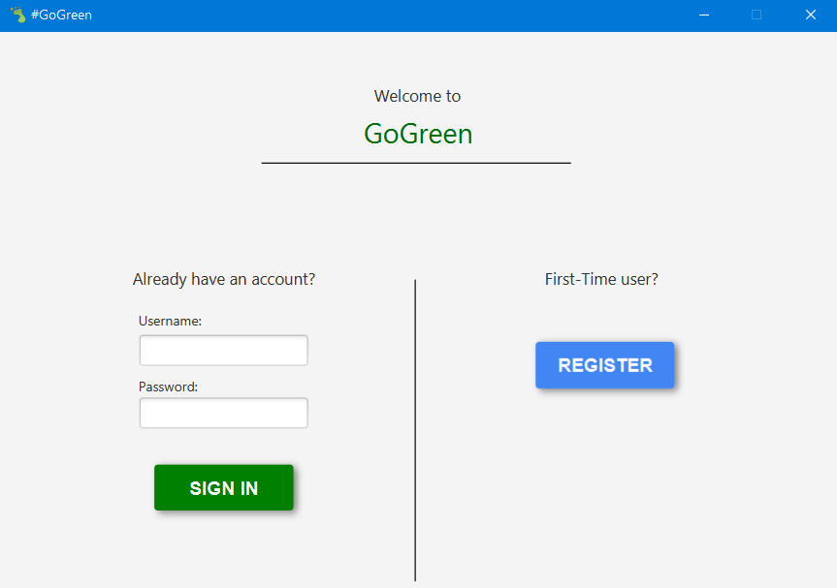
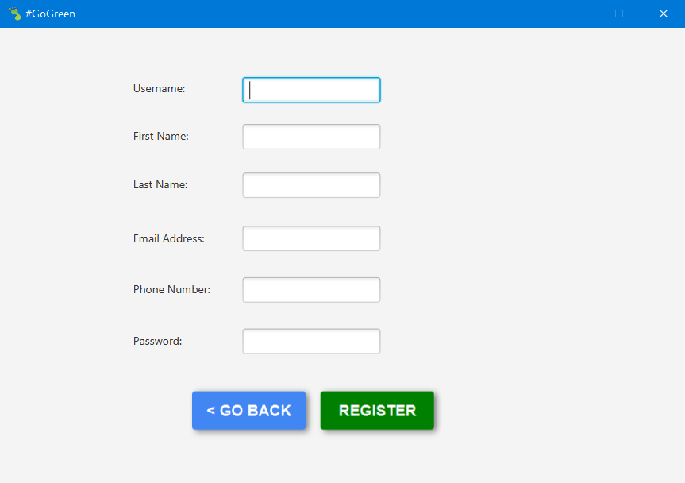
Application: Homescreen

Slide 4
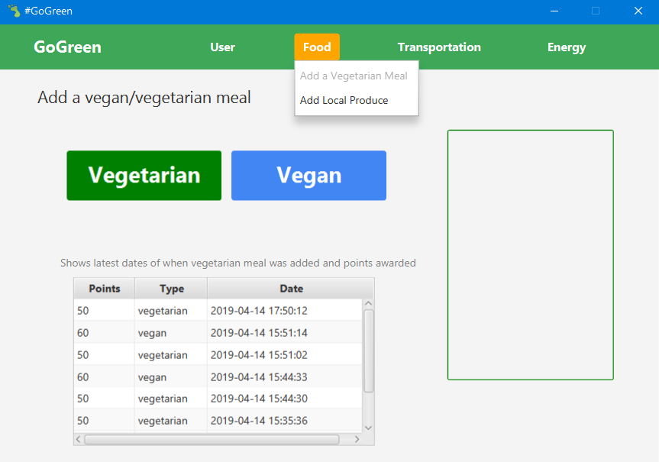
Application: Menu

Slide 5
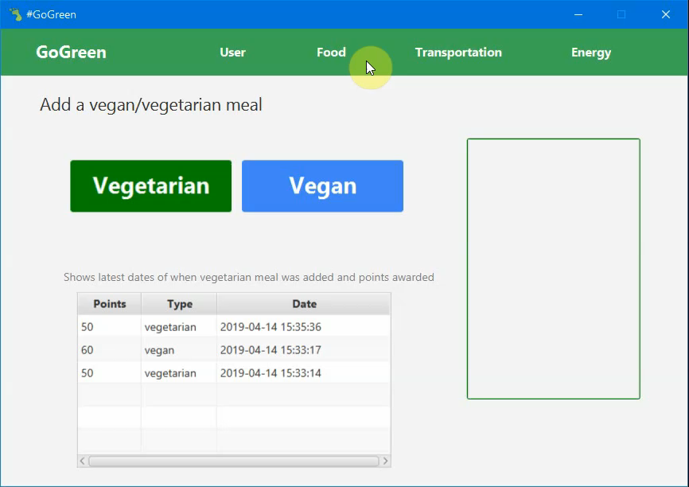
Application: Vegetarian Meal

Slide 6
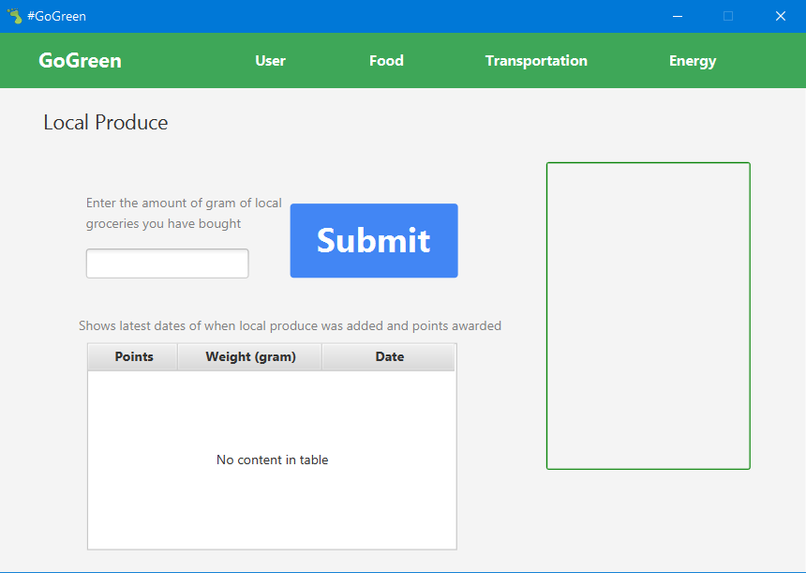
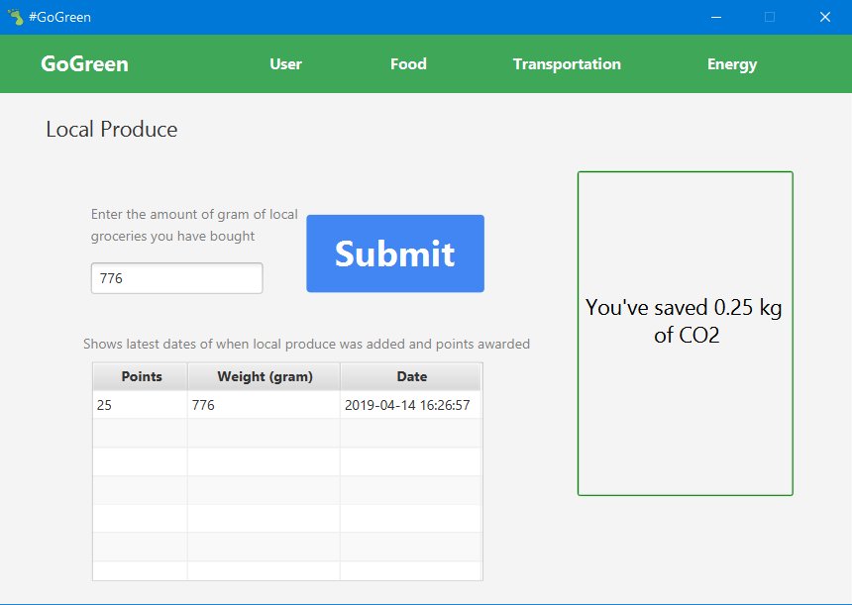
Application: Local Produce

Slide 7
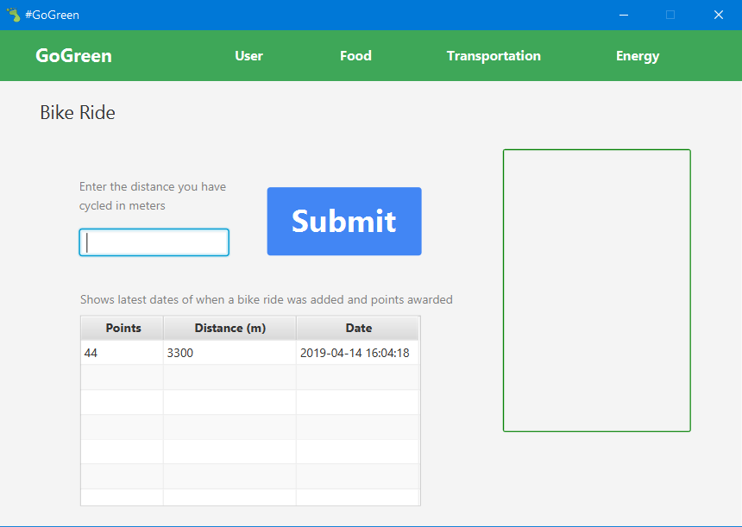

Application: Bike Ride

Slide 8
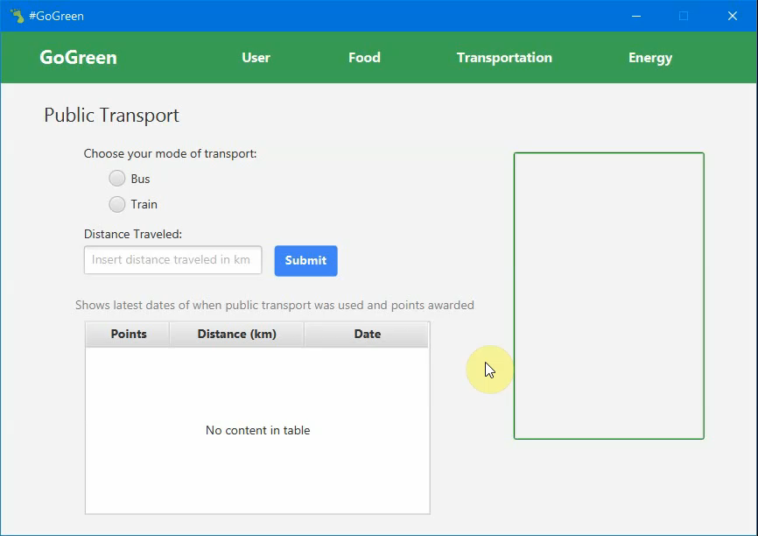
Application: Public Transport

Slide 9
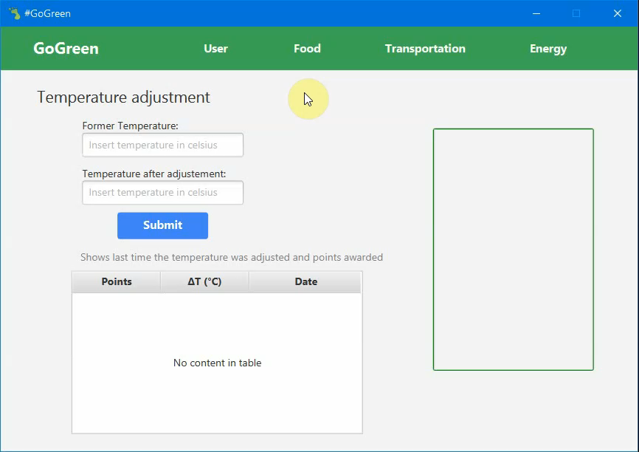
Application: Temperature

Slide 10
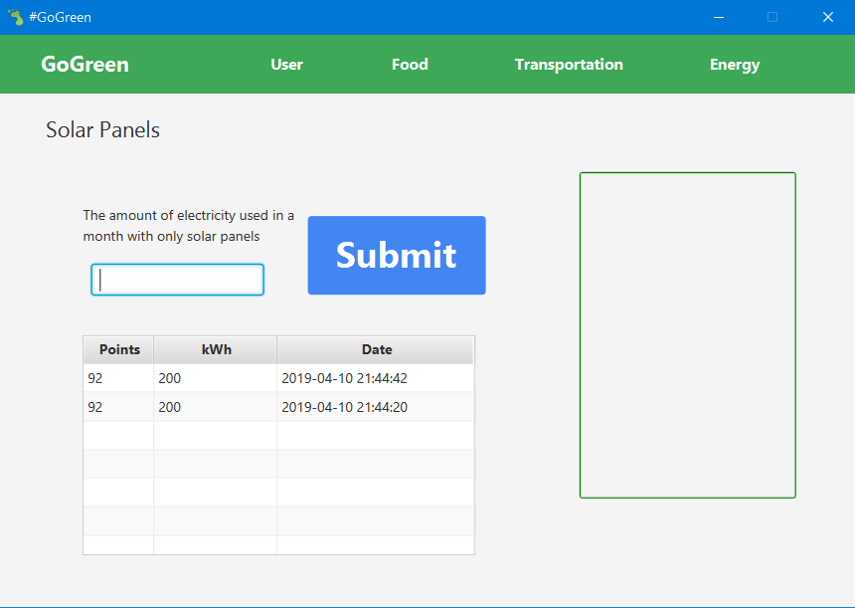
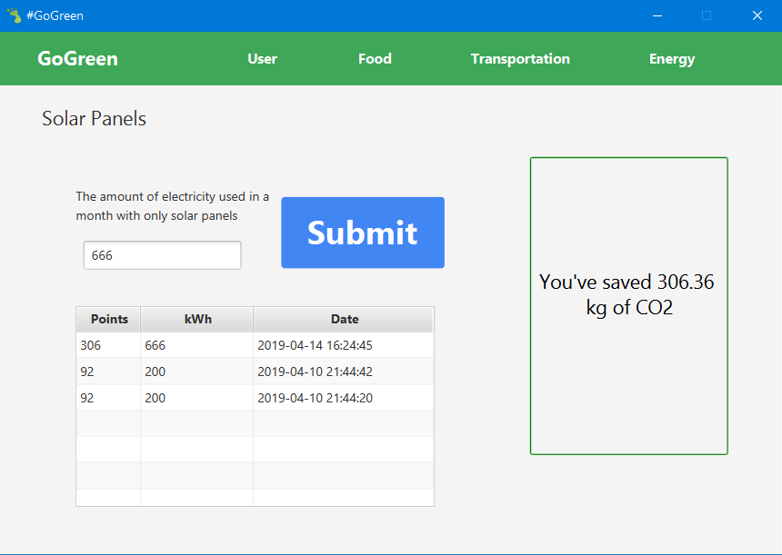
Application: Solar Panels

Slide 11
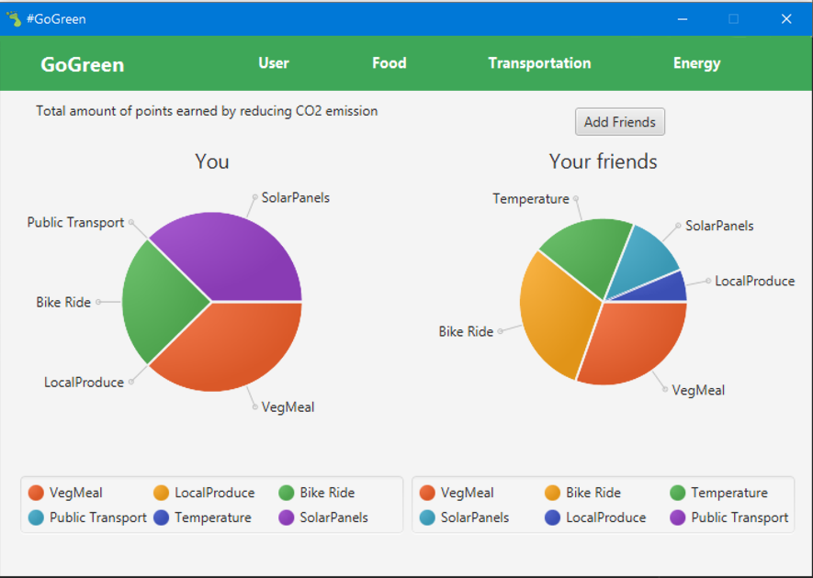
Application: Stats

Slide 12
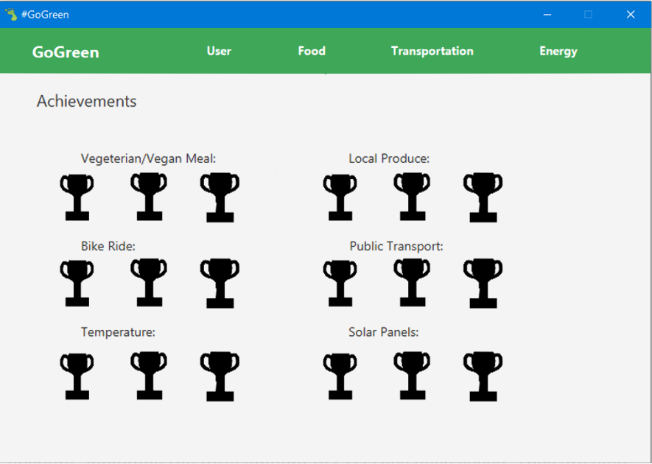
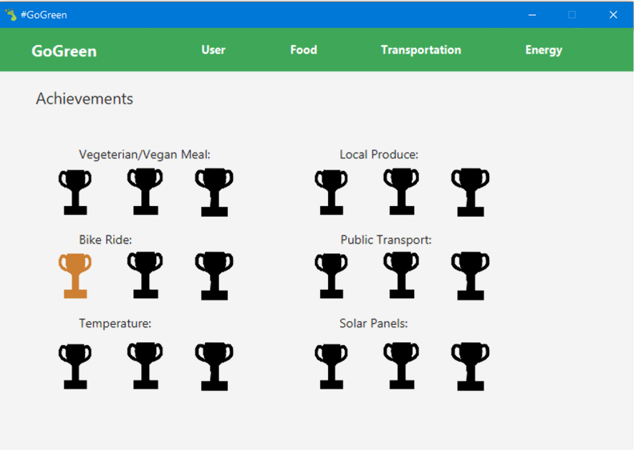
Application: Achievements

Slide 13
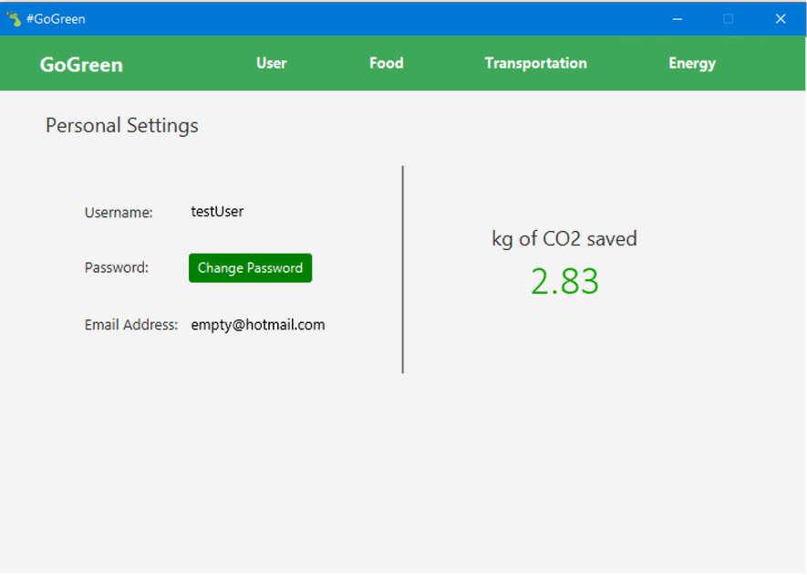
Application: Personal settings

Slide 14
Security
Hashed passwords
Prepared statement
Input validation

Slide 15
Reflection
Ambiguity
Little experience
Communication
Improvement

