Slide 1
Research Proposal
Spiking ConvNeXt U-Net for Kvasir-SEG Polyp Segmentation

Slide 2
Background
ConvNeXt is a modern CNN architecture inspired by Vision Transformers.
Spiking Neural Networks (SNNs) can reduce energy consumption.
Goal: investigate a spiking version for medical image segmentation.

Slide 3
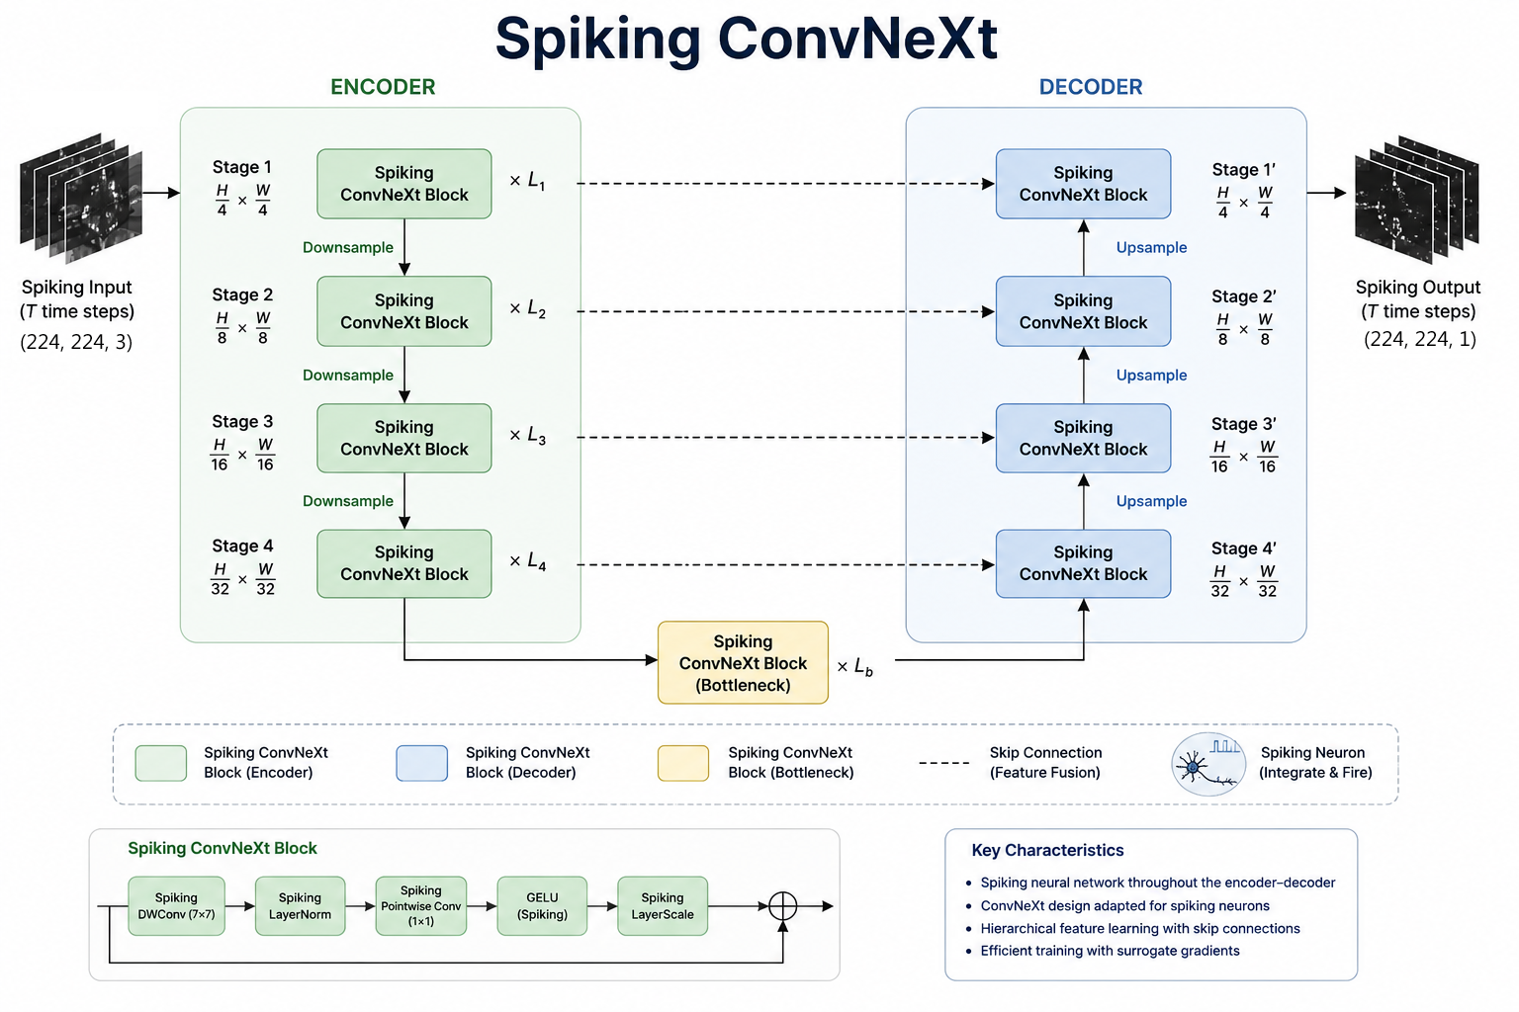

Slide 4
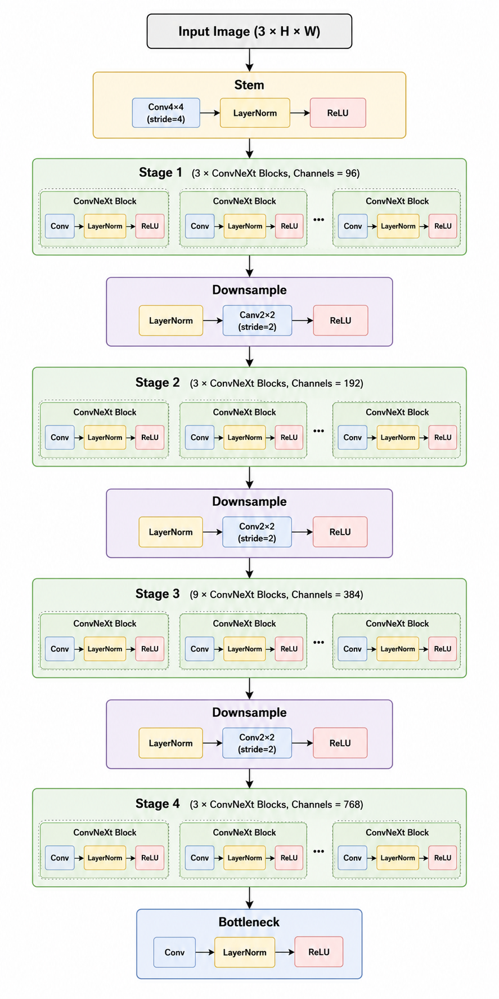
Proposed Architecture
U-Net architecture
Encoder: ConvNeXt-Tiny (~27M params)
Decoder: ConvNeXt-Tiny-style blocks (~27M params)
Estimated total: ~55M parameters

Slide 5
Dataset
Kvasir-SEG
1000 annotated polyp images
Binary segmentation task
High variability in size, shape, illumination

Slide 6
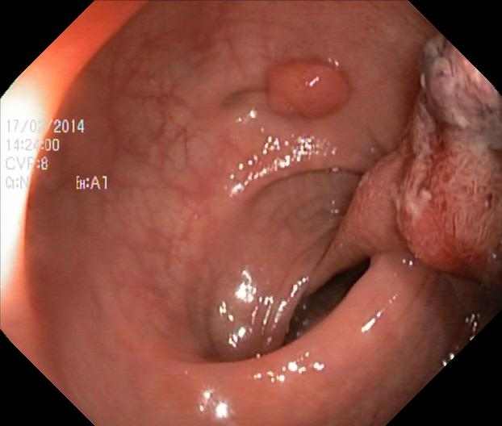

Dataset Examples

Slide 7
Comparison with Proposed Model
Proposed Spiking ConvNeXt U-Net:
• ConvNeXt-Tiny Encoder ≈ 27M
• ConvNeXt-based Decoder ≈ 27M
• Total ≈ 55M parameters
Comparable to recent SOTA model sizes.

Slide 8
State-of-the-Art ANN Models on Kvasir-SEG
Representative high-performing models:
• PraNet (~30.5M params)
• Polyp-PVT (~25.1M params)
• FCBFormer (~52.9M params)
• CTHP (~47.1M params)
• SSFormer-L (~66M params)

Slide 9
Research Risk: Dataset Size vs Model Size
Kvasir-SEG contains only 1000 images.
A 55M-parameter model may overfit if trained from scratch.
Key question:
Can a large spiking model generalize well on a small medical dataset?

Slide 10
Recommended Strategy
• Heavy data augmentation
• Regularization and early stopping
• Consider lightweight decoder (3–10M params)
• Compare ANN and SNN versions fairly

Slide 11
Experiments
Baseline ConvNeXt U-Net
Spiking ConvNeXt U-Net
Metrics: Dice, IoU, Precision, Recall
Test acc of Kvasir-Seg on Unet-like vgg 70% (ANN)

Slide 12
Expected Contributions
Evaluate SNNs for medical segmentation.
Analyze parameter-efficiency trade-offs.
Compare ANN vs SNN segmentation.

Slide 13
Conclusion
Model is promising but dataset size is a major challenge.
Architecture and training strategy should address overfitting.

