Slide 1
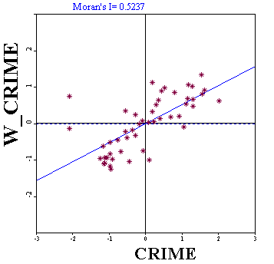
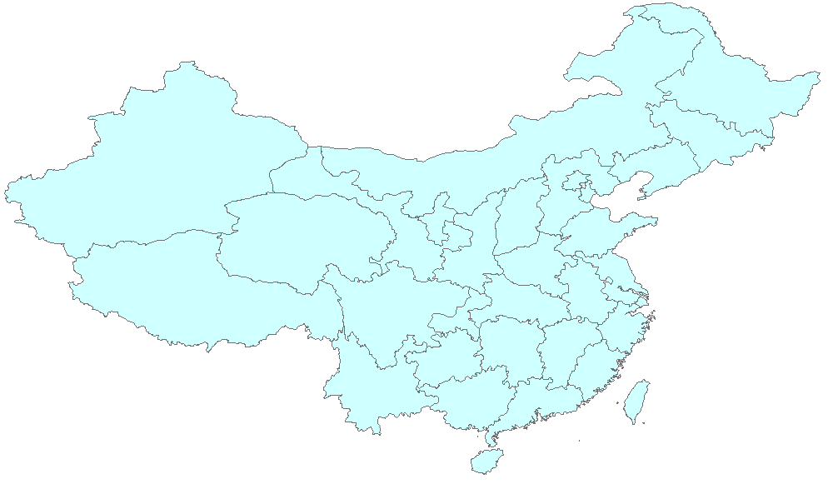
Global Measures of
Spatial Autocorrelation
China
Briggs Henan University 2010

Slide 2
Last Time
The concept of spatial autocorrelation.
  “Near things are more similar than distant things”
The use of the weights matrix W_{ij} to measure “nearness”
The difficulty of measuring “nearness”
  This was a surprise!
This Time
Measures of Spatial Autocorrelation
  Join Count Statistic
  Moran’s I
  Geary’s C
  Getis-Ord G statistic
Briggs Henan University 2010

Slide 3

Global Measures and Local Measures
Global Measures
  A single value which applies to the entire data set
    The same pattern or process occurs over the entire geographic area
    An average for the entire area
Local Measures
  A value calculated for each observation unit
    Different patterns or processes may occur in different parts of the region
    A unique number for each location
China
An equivalent local measure can be calculated for most global measures
Briggs Henan University 2010

Slide 4
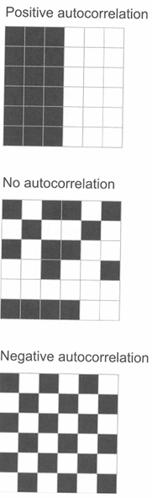
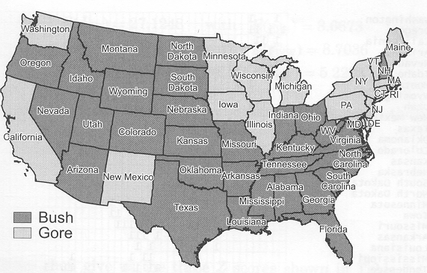
Join (or Joins or Joint) Count Statistic
Polygons only
binary (1,0) data only
  Polygon has or does not have a characteristic
  For example, a candidate won or lost an election
Based on examining polygons which share a border
  Do they have the same characteristic or not?
Border same
on each side
Border not the same
on each side
Requires a contiguity matrix for polygons
Briggs Henan University 2010

Slide 5
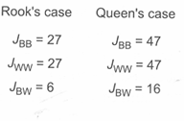
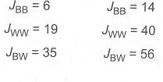
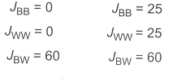
Join (or Joint or Joins) Count Statistic
Uses binary (1,0) data
  Shown here as B/W (black/white)
Measures the number of borders (“joins”) of each type (1,1), (0,0), (1,0 or 0,1) relative to total number of borders
For 6 x 6 matrix, border totals are:
  60 for Rook Case
  110 for Queen Case
Small number of BW joins (6 only for rook)
Large proportion of BB and WW joins
Different numbers of BW, BB and WW joins
Large number of BW joins
Small number of BB and WW joins
Briggs Henan University 2010

Slide 6
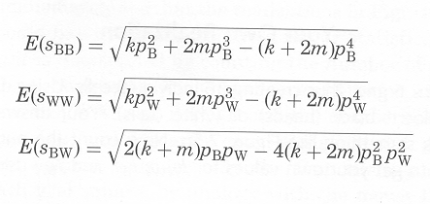
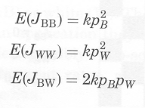


Join Count: Test Statistic
Test Statistic given by: Z= Observed - Expected
SD of Expected
Expected = random pattern generated by tossing a coin in each cell.
Expected given by:
Standard Deviation of Expected (standard error) given by:
Where: k is the total number of joins (neighbors)
p_{B} is the expected proportion Black, if random
p_{W} is the expected proportion White
m is calculated from k according to:
Note: the formulae given here are for free (normality) sampling. Those for non-free (randomization) sampling are substantially more complex. See Wong and Lee 1st ed. p. 151 compared to p. 155. Se next slide for explanation.
Briggs Henan University 2010

Slide 7
A Note on Sampling Assumptions: applies to most tests for spatial autocorrelation
Test results depend on the assumption made regarding the type of sampling:
  Free (or normality) sampling
    Analogous to sampling with replacement
    After a polygon is selected for a sample, it is returned to the population set
    The same polygon can occur more than one time in a sample
  Non-free (or randomization) sampling
    Analogous to sampling without replacement
    After a polygon is selected for a sample, it is not returned to the population set
    The same polygon can occur only one time in a sample
The formulae used to calculate the test statistic (particularly the standard error) are different for each
  Generally, the formulae are substantially more complex for free sampling—unfortunately, it is also the more common situation!
  Assuming free sampling requires knowledge about larger trends from outside the region or access to additional information within the region in order to estimate parameters.
Briggs Henan University 2010

Slide 8
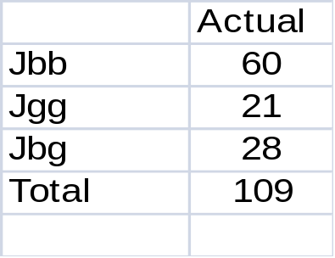
Gore/Bush Presidential Election 2000
Is there evidence of clustering by State?
Use Join Count to answer this question!
Many BB joins
total number of joins = 109
= sum of neighbors/2 in the sparse contiguity matrix
= number of 1s/2 in the full contiguity matrix for US States
(see slides from SA Concepts lecture)
Briggs Henan University 2010

Slide 9
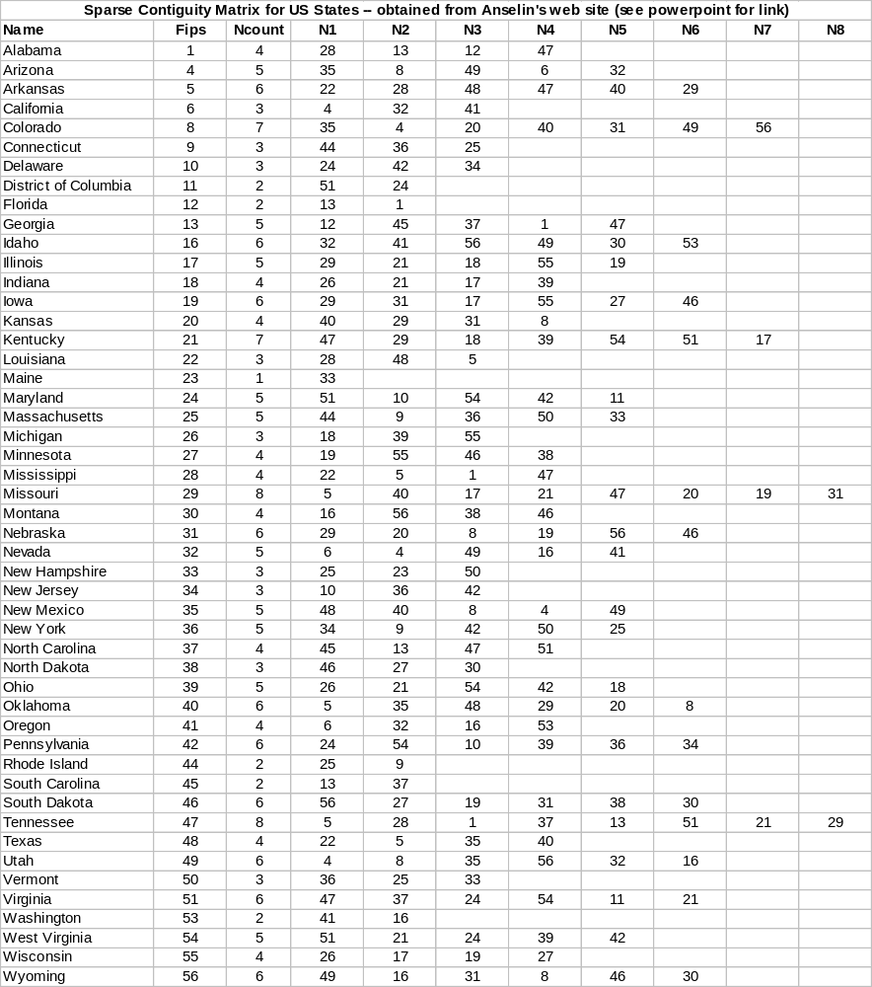

Queens Case Sparse Contiguity Matrix for US States
Ncount is the number of neighbors for each state
Equals number of 1s in a row of full contiguity matrix
Sum of Ncount is 218
Number of common borders (joins) =
ncount / 2 = 109
N1, N2… FIPS codes for neighbors
Briggs Henan University 2010

Slide 10
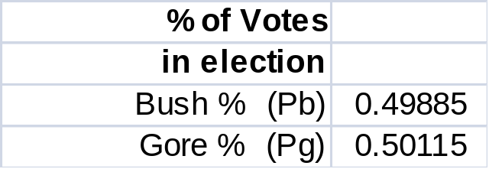
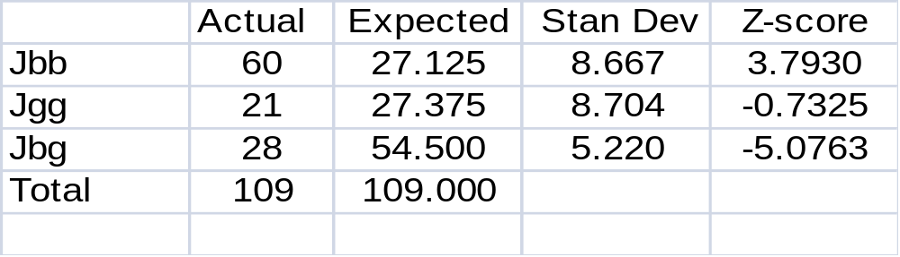
Join Count Statistic for Gore/Bush 2000 by State
The expected number of joins is calculated based on the proportion of votes each received in the election (for Bush = 109*.499*.499=27.125)
K = 109= total number of joins
There are far more Bush/Bush joins (actual = 60) than would be expected (27)
  Since test score (3.79) is greater than the critical value (2.54 at 1%) result is statistically significant at the 99% confidence level (p <= 0.01)
  Strong evidence of spatial autocorrelation—clustering
There are far fewer Bush/Gore joins (actual = 28) than would be expected (54)
  Since test score (-5.07) is greater than the critical value (2.54 at 1%) result is statistically significant at 99% confidence level (p <= 0.01)
  Again, strong evidence of spatial autocorrelation—clustering
Actual calculations available in spatstat.xls spreadsheet (JC-%vote tab)
Briggs Henan University 2010

Slide 11
Moran’s I
The most common measure of Spatial Autocorrelation
Use for points or polygons
  Join Count statistic only for polygons
Use for a continuous variable (any value)
  Join Count statistic only for binary variable (1,0)
Varies on a scale between –1 through 0* to + 1
*technically it is:
–1/(n-1)
-1
0
+1
high negative spatial autocorrelation
no spatial autocorrelation*
high positive spatial autocorrelation
Can also use it as an index for dispersion/random/cluster patterns.
Dispersed Pattern
Random Pattern
Clustered Pattern
UNIFORM/
DISPERSED
CLUSTERED
Briggs Henan University 2010

Slide 12
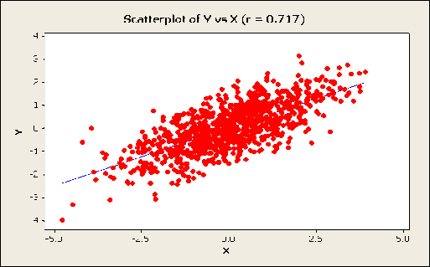
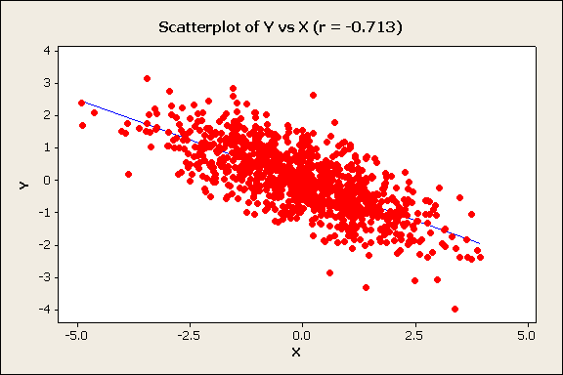
Moran’s I and Correlation Coefficient r
Differences and Similarities
Correlation Coefficient r
Relationship between two variables
r = 0.71
r = -0.71
or
Income
Quantity
Education
Price
Moran’s I
Involves one variable only
Correlation between variable, X, and the “spatial lag” of X formed by averaging all the values of X for the neighboring polygons
Grocery Store Density Nearby
Crime in nearby area
r = 0.71
r = -0.71
Crime Rate
Grocery Store Density
Briggs Henan University 2010

Slide 13
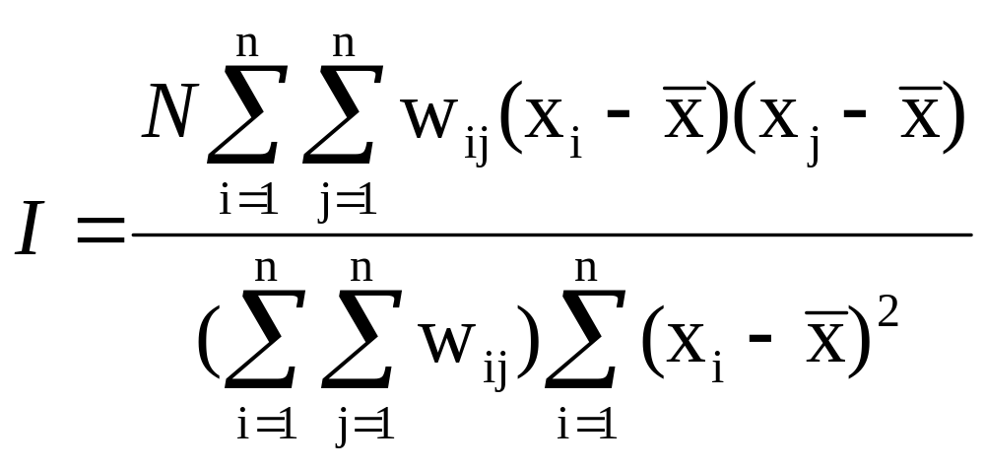

Formula for Moran’s I
Where:
N is the number of observations (points or polygons)
is the mean of the variable
X_{i} is the variable value at a particular location
X_{j} is the variable value at another location
W_{ij} is a weight indexing location of i relative to j
Briggs Henan University 2010

Slide 14
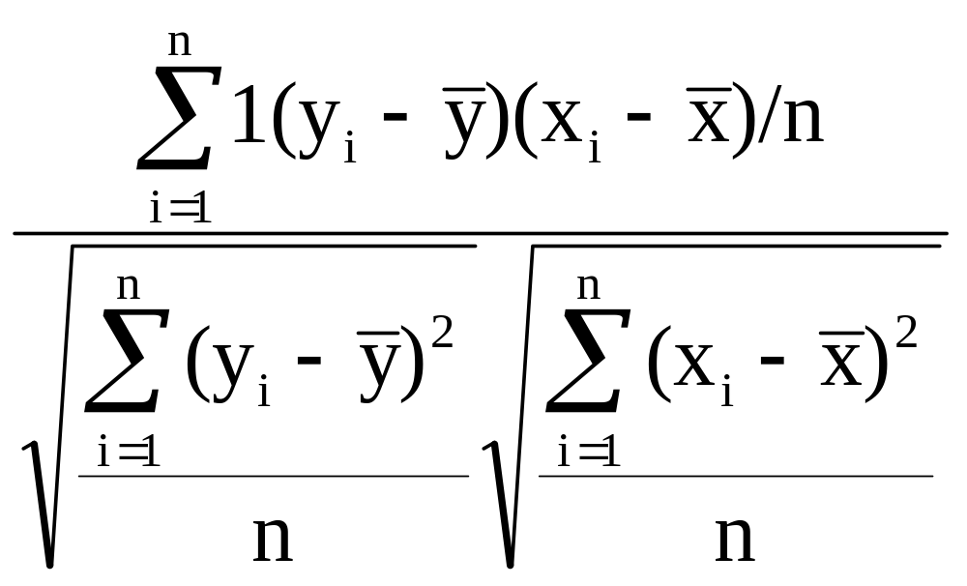
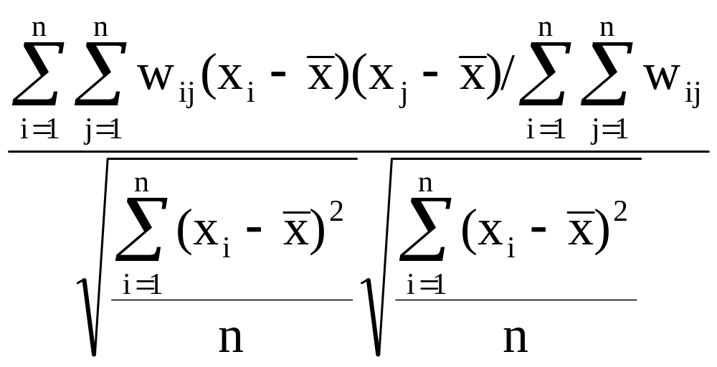
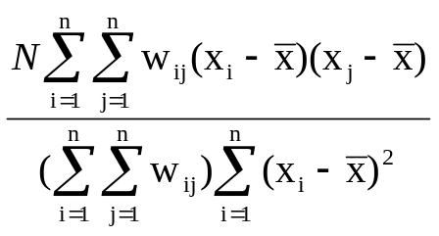
Correlation
Coefficient
Note the similarity of the numerator (top) to the measures of spatial association discussed earlier if we view Yi as being the Xi for the neighboring polygon
(see next slide)
=
Spatial
auto-correlation
Briggs Henan University 2010

Slide 15
Correlation
Coefficient
Spatial weights
Yi is the Xi for the neighboring polygon
=
Moran’s I
Briggs Henan University 2010

Slide 16
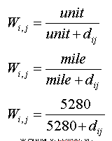
Adjustment for Short or Zero Distances
If an inverse distance measure is used, and distances are very short, then w_{ij} becomes very large and distorts I.
An adjustment for short distances can be used, usually scaling the distance to one mile.
The units in the adjustment formula are the number of data measurement units in a mile
In the example, the data is assumed to be in feet.
With this adjustment, the weights will never exceed 1
If a contiguity matrix is used (1or 0 only), this adjustment is unnecessary
Briggs Henan University 2010

Slide 17
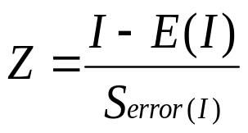
Statistical Significance Tests for Moran’s I
Based on the normal frequency distribution with
E(I) = -1/(n-1)
Again, there are two different formula for calculating the standard error
  The free sampling or normality method
  The nonfree sampling or randomization method
These formulae are complicated!
  They are in Lee and Wong 1st Ed. p. 82 and 160-1
In either case, the statistical test is carried out in the same way
Where: I is the calculated value for Moran’s I
from the sample
E(I) is the expected value if random
S is the standard error
Briggs Henan University 2010

Slide 18
Test Statistic for Normal Frequency Distribution
*technically –1/(n-1)
2.5%
2.5%
1%
–1/(n-1)
1.96
2.54
Reject null
-1.96
0
Reject null at 5%
Null Hypothesis: no spatial autocorrelation
*Moran’s I = 0
Alternative Hypothesis: spatial autocorrelation exists
*Moran’s I > 0
Reject Null Hypothesis if Z test statistic > 1.96 (or < -1.96)
---less than a 5% chance that, in the population, there is no
spatial autocorrelation
---95% confident that spatial auto correlation exits
Reject null at 1%

Slide 19
Null Hypothesis: no spatial autocorrelation
*Moran’s I = 0
Alternative Hypothesis: spatial autocorrelation exists
*Moran’s I > 0
Reject Null Hypothesis if Z test statistic > 1.96 (or < -1.96)
---less than a 5% chance that, in the population, there is no
spatial autocorrelation
---95% confident that spatial auto correlation exits
Briggs Henan University 2010

Slide 20
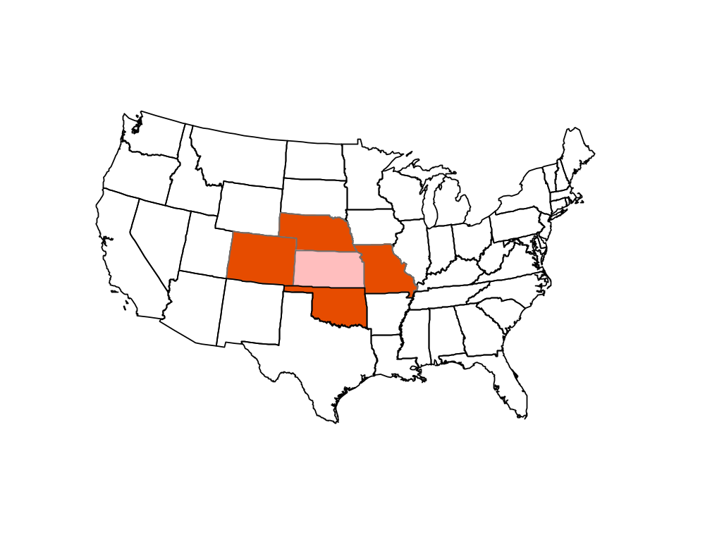
Moran Scatter Plots
Moran’s I can be interpreted as the correlation between variable, X, and the “spatial lag” of X formed by averaging all the values of X for the neighboring polygons
We can then draw a scatter diagram between these two variables (in standardized form): X and lag-X (or W_X)
Lag X_{i}
is average of these
X_{i}
Least squares “best fit” line to the points.
The slope of this regression line is Moran’s I
(will discuss Regression later)
Briggs Henan University 2010

Slide 21
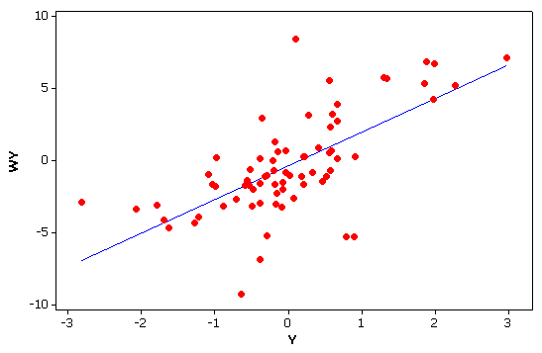
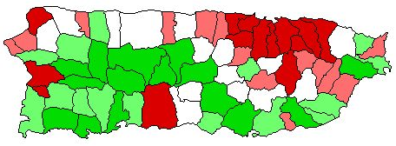
Moran Scatterplot: example
Moran’s I = 0.49
Scatterplot of X vs. Lag-X
The slope of the regression line is Moran’s I
Lag-X
High surrounded by high
Low surrounded by low
X
Population density in Puerto Rico
GISC 7361 Spatial Statistics

Slide 22
Moran’s I for rate-based data
Moran’s I is often calculated for rates, such as crime rates (e.g. number of crimes per 1,000 population) or infant mortality rates (e.g. number of deaths per 1,000 births)
An adjustment should be made, especially if the denominator in the rate (population or number of births) varies greatly (as it usually does)
Adjustment is know as the EB adjustment:
  see Assuncao-Reis Empirical Bayes Standardization Statistics in Medicine, 1999
GeoDA software includes an option for this adjustment
Briggs Henan University 2010

Slide 23
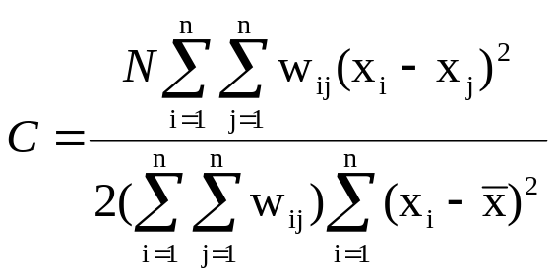
Geary’s C (Contiguity) Ratio
Calculation is similar to Moran’s I,
  For Moran, the cross-product is based on the deviations from the mean for the two location values
  For Geary, the cross-product uses the actual values themselves at each location
Interpretation is very different, essentially the opposite!
Geary’s C varies on a scale from 0 to 2
  0 indicates perfect positive autocorrelation/clustered
  1 indicates no autocorrelation/random
  2 indicates perfect negative autocorrelation/dispersed
Can convert to a -/+1 scale by: calculating C* = 1 - C
Moran’s I usually used!
Briggs Henan University 2010

Slide 24
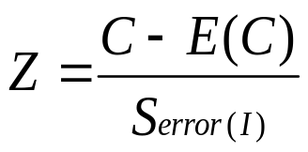
Statistical Significance Tests for Geary’s C
Similar to Moran
Again, based on the normal frequency distribution with
however, E(C) = 1
Again, there are two different formulations for the standard error calculation
  The randomization or nonfree sampling method
  The normality or free sampling method
The actual formulae for calculation are in Lee and Wong, 1st Ed. p. 81 and p. 162
Where: C is the calculated value for Geary’s C
from the sample
E(C) is the expected value if no
autocorrelation
S is the standard error
Briggs Henan University 2010

Slide 25
Hot Spots and Cold Spots
What is a hot spot?
  A place where high values
  cluster together
What is a cold spot?
  A place where low values
  cluster together
e.g. high crime area
e.g. low crime area
Moran’s I and Geary’s C cannot distinguish them
  They only indicate clustering
  Cannot tell if these are hot spots, cold spots, or both
Briggs Henan University 2010

Slide 26
Getis-Ord General/Global G-Statistic
The G statistic distinguishes between hot spots and cold spots. It identifies spatial concentrations.
  G is relatively large if high values cluster together
  G is relatively low if low values cluster together
The General G statistic is interpreted relative to its expected value
  The value for which there is no spatial association
  G > (larger than) expected value ➔ potential “hot spots”
  G < (smaller than) expected value ➔ potential “cold spots”
A Z test statistic is used to test if the difference is statistically significant
Calculation of G based on a neighborhood distance within which cluster is expected to occur
Getis, A. and Ord, J.K. (1992) The analysis of spatial association by use of distance statistics Geographical Analysis, 24(3) 189-206
Briggs Henan University 2010

Slide 27
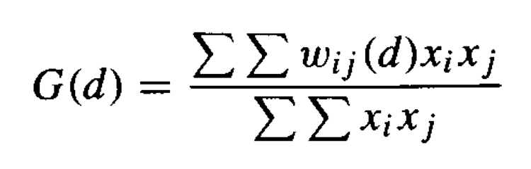
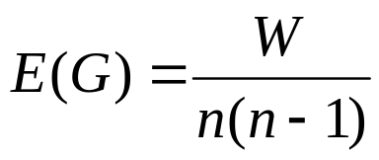
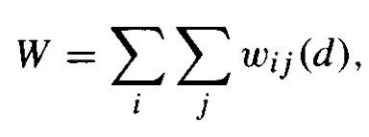
Calculating General G
Begins by identifying a distance band, d, within which clustering occurs
Actual Value for G is given by:
the terms in the numerator (top) are calculated “within a distance ring (d),” and are then divided by totals for the entire region to create a proportion
  if nearby x values are both large (indicating “hot” spot), the numerator (top) will be large
  If they are both small (indicating “cold” spot), the numerator (top) will be small
Expected value for G (if no concentration) is given by:
Where:
d is neighborhood distance
W_{ij} weights matrix has only 1 or 0
1 if j is within d distance of i
0 if its beyond that distance
Thus any point beyond distance d has a value of zero and therefore is excluded
d
Number of points within distance band d
where
Total number of points in study region
Briggs Henan University 2010

Slide 28
Comments on General G
General G will not show negative spatial autocorrelation
Should only be calculated for ratio scale data
  data with a “natural” zero such as crime rates, birth rates
Although it was defined using a contiguity (0,1) weights matrix, any type of spatial weights matrix can be used
  ArcGIS gives multiple options
There are two global versions: G and G*
  G does not include the value of X_{i} itself, only “neighborhood” values
  G* includes X_{i} as well as “neighborhood” values
Briggs Henan University 2010

Slide 29
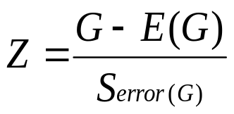
Testing General G
The test statistic for G is normally distributed and is given by:
The next slide shows the results for running General G on Anselin’s Columbus crime data
  This data is not good, but is very common since Anselin uses it in his original LISA article and in the examples in the GeoDA documentation
  The geographic coordinates are completely arbitrary
with
Calculation of the standard error is complex. See Lee and Wong 1st pp 164-167
or Getis and Ord 1992 for formulae.
Briggs Henan University 2010

Slide 30
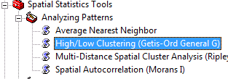
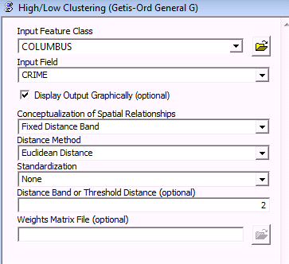
General/Global G in ArcGIS
Shapefile containing polygon or point data
Variable to analyze
Different options available for specifying cluster neighborhood
--simple distance band selected, as described in lecture
Options for measuring distance
--straight line (Euclidean)
--city block
Size of neighborhood distance band
Briggs Henan University 2010

Slide 31
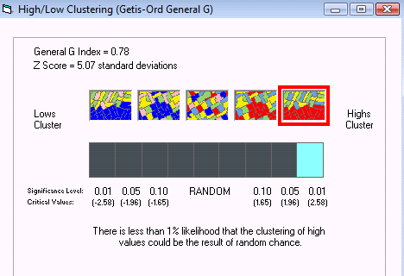
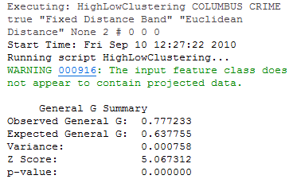
General/Global G in ArcGIS: results
Observed G = .777
Expected G = .637
Observed > Expected >> “Hot spots”
Z score: 5.067 > 1.96 >> significant
But where are the hot spots?
For this we use Local Statistics
Briggs Henan University 2010

Slide 32
What have we learned today?
Difference between global and local measures of spatial autocorrelation
How to calculate and interpret some global measures
  Join Count Statistic
    Used for binary (0,1) data only
  Moran’s I
    The most common global measure of spatial autocorrelation
  Geary’s C
    interpretation almost opposite of Moran’s I, but not used very often
  Getis-Ord G statistic
    Identifies hot spots or cold spots
Next Time:
local measures of spatial autocorrelation
Briggs Henan University 2010

Slide 33
Challenge for You
Calculate Moran’s I and/or General G for some appropriate variables in the China provinces data set
Use ArcGIS or GeoDA software
Briggs Henan University 2010

Slide 34
References
O’Sullivan and Unwin Geographic Information Analysis New York: John Wiley, 1st ed. 2003, 2nd ed. 2010
Jay Lee and David Wong Statistical Analysis with ArcView GIS New York: Wiley, 1st ed. 2001 (all page references are to this book), 2nd ed. 2005
  Unfortunately, these books are based on old software (Avenue scripts used with ArcView 3.x) and no longer work in the current version of ArcGIS 9 or 10.
Ned Levine and Associates CrimeStat III Washington: National Institutes of Justice, 2010
  Available as pdf
  download from: http://www.icpsr.umich.edu/NACJD/crimestat.html
Briggs Henan University 2010

Slide 35
Briggs Henan University 2010

