Slide 1
SSD performance
simulation with FEMU
Shiyue Hou
Ziting liu

Slide 2
Outline
Introduction
Characteristics of FEMU
Simulation & Implementation
Evaluation

Slide 3
Introduction
SSDs:
High throughput, low response time.
Apply NVMe protocol to adopt Multiple – queen concept to enable high throughput and low latency for IO request.
HDD:
Lower in cost and are practical for data that does not need to be accessed frequently, such as backups of photos, videos or business files.
Apply SATA protocol, which only a single request port to the OS.
They are available in two common form factors: 2.5 inch (commonly used in laptops) and 3.5 inch (desktop computers).

Slide 4
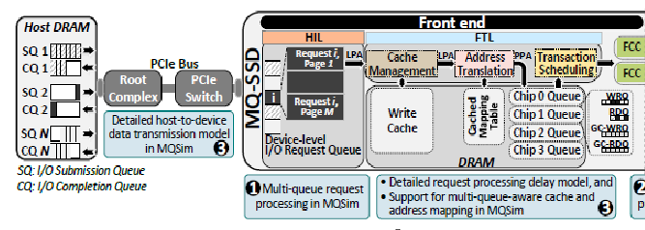
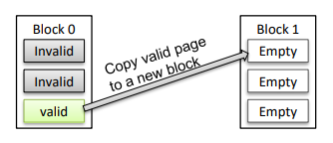
SSDs Architecture
[1]
Front End: control and management units
Host-Interface Logic (HIL): provide higher IO performance to the host
SATA protocol: conventional SSDs
NVM Express (NVMe) protocol: designed to alleviate the bottlenecks of SATA [90], and to enable scalable, high-bandwidth, and low-latency communication over the PCIe bus
Flash Translation Layer (FTL)
Executes on a microprocessor within the SSD, performing I/O requests and flash management procedures
Wear-leveling: arranges data so that write/erase cycles are distributed evenly among all of the blocks in the device (evenly distribute write at all of SSDs blocks)
Garbage collection (GC): An optimize machine to release invalid block
Notes:
OS have a queue depth to control SQ and CQ.
SATA only have one submission/completion queue.
NVMe have multiple submission/completion queue.
Handling an I/O request in the FTL:
1. when the HIL selects a request from the SQ, it inserts the request into a device-level queue
2. the HIL breaks the request down into multiple flash transactions
3.

Slide 5
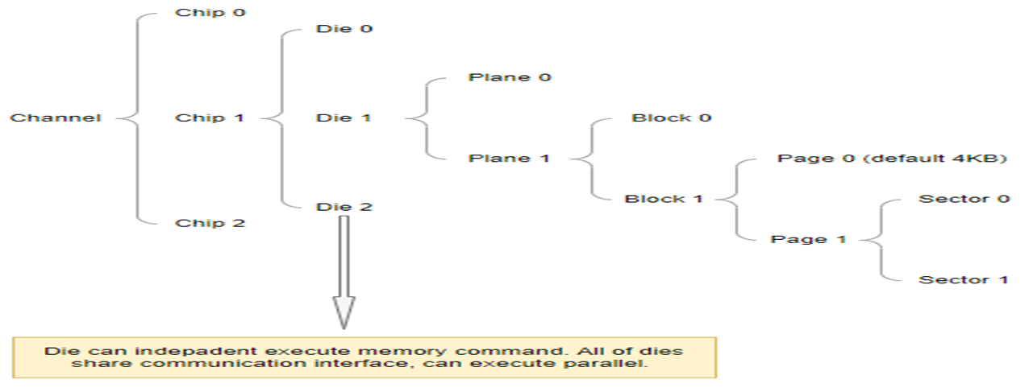
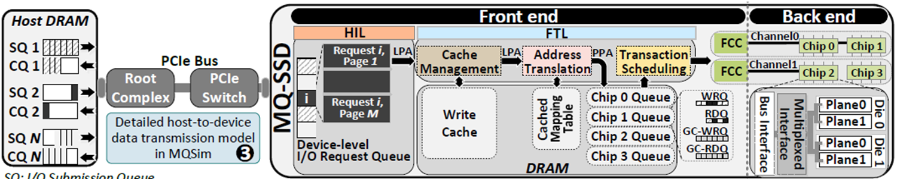
Back End: Storage Device

Slide 6
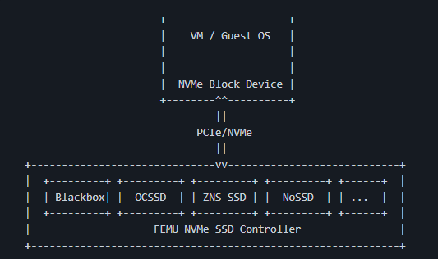
Characteristics of FEMU
NVMe SSD Emulator, Based upon QEMU/KVM
Application + Guest OS + FEMU
FEMU supports emulating different types of SSDs:
Whitebox Mode - host side FTL
Blackbox Mode - FTL managed by the device
[2]

Slide 7
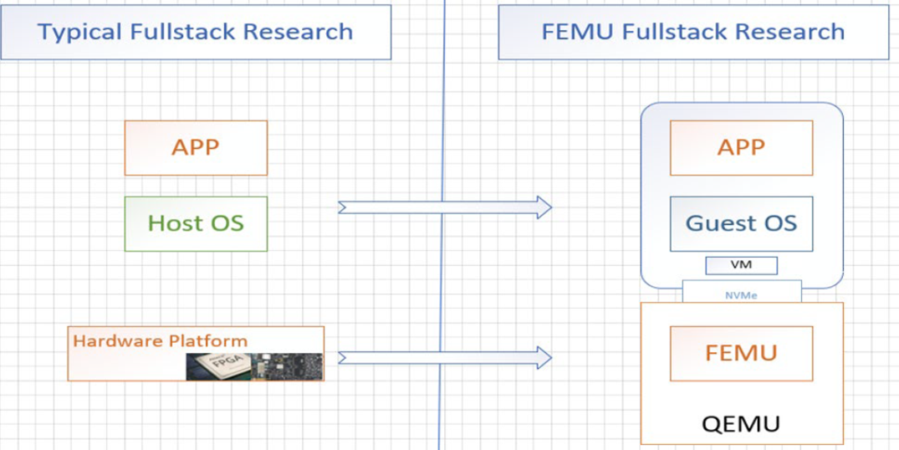
FEMU Architectures

Slide 8
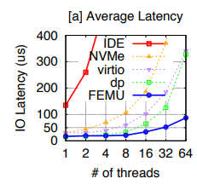
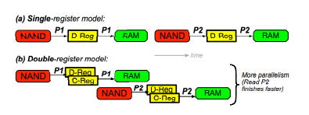
Scalability [1]
I/O operation in QEMU causes expensive VM-exit
Shared memory between Guest OS & FEMU
RAM-backed storage in heap
[1]
Accuracy [1]
Base delay mechanism of 50µs to every IO + overhead
Basic delay model with single page register
Accurate delay emulation of OpenChannel SSD
Non-uniform page latency model
[1]

Slide 9
Usability & Extensibility
FTL and GC schemes:
White-box vs. black-box mode ☆
Multi-device support for flash-array research
Extensible OS-SSD NVMe commands
Page-level latency variability
Distributed SSDs
Page-level fault injection
Limitations: DRAM size

Slide 10
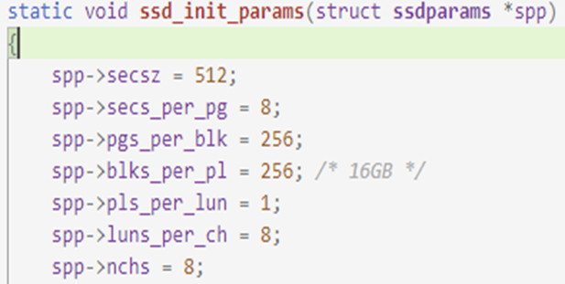

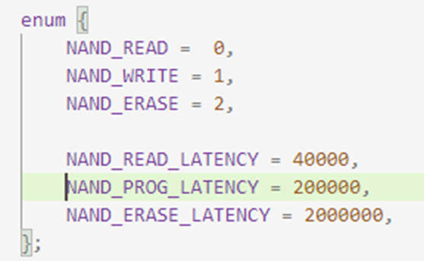
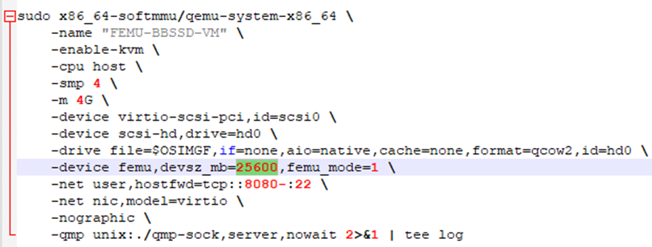
FEMU Configuration
Backend – Source code (hw/block/femu/ftl/ftl.c)
Frontend – user customization
FEMU-SSD-size + VM-DRAM-size + 2-4GB (Host-OS) <= Total-DRAM-size-in-your-Host

Slide 11
Simulation
Generate various IO type workloads with FIO & Another Benchmark (TBD)
Evaluate & Compare the I/O performance
ioengine : How jobs issue I/O
runtime : Terminate after this time
readwrite : I/O pattern
threads : Child process or POSIX thread
numjobs : How many clone of this job
bs : Block size
size: Total size of file I/O
thinktime: Stall between each job
[3]

Slide 12
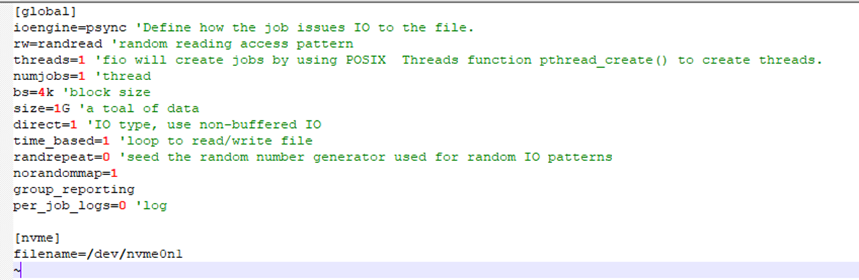
IO Benchmarks – Flexible IO Tester (FIO)
Resource: https://fio.readthedocs.io/en/latest/fio_doc.html
Flexible IO Tester (Fio) is a benchmarking and workload simulation tool for Linux/Unix
Fio is highly tunable and widely used for storage performance benchmarking
FIO input sample:

Slide 13
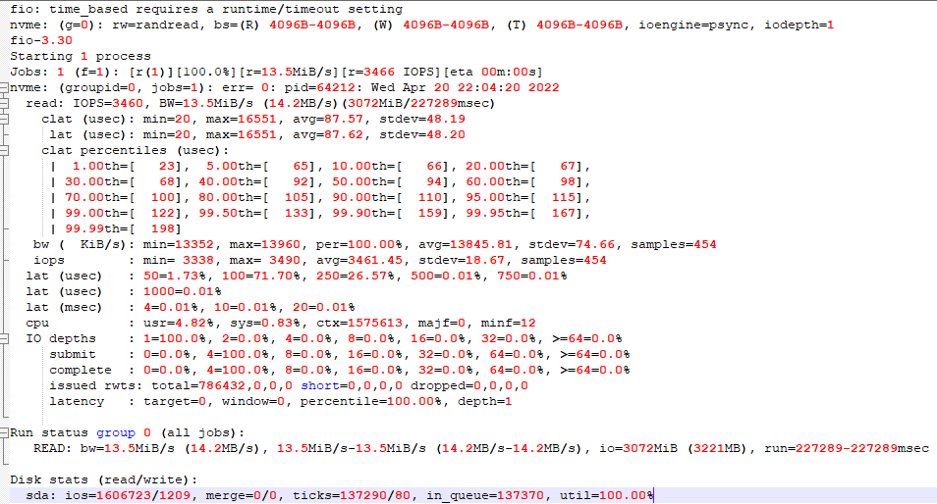
fio output

Slide 14
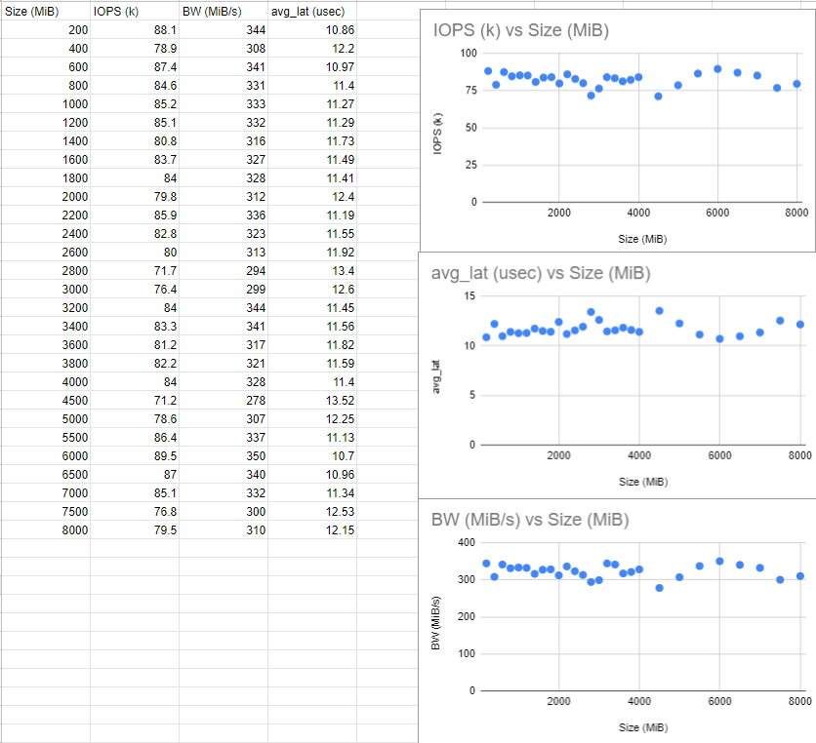
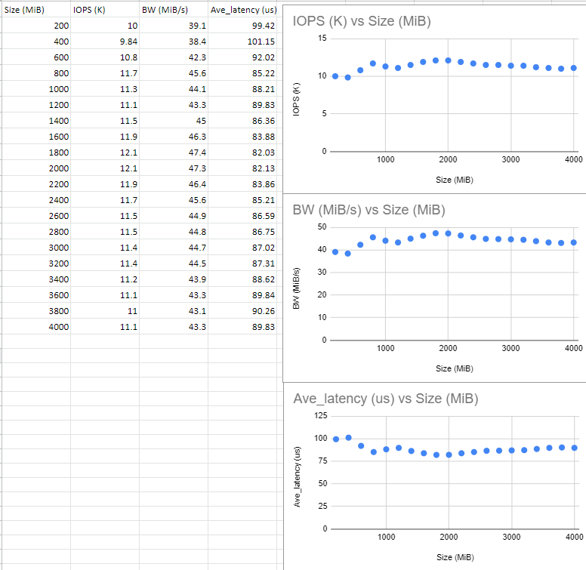
FEMU vs Real SSD: Changing Workload Size
Result: When increase the workload size, The IOPS, Average Latency and BW is stable. Because the FEMU and SSDs capacity can handle the workload IO request.

Slide 15
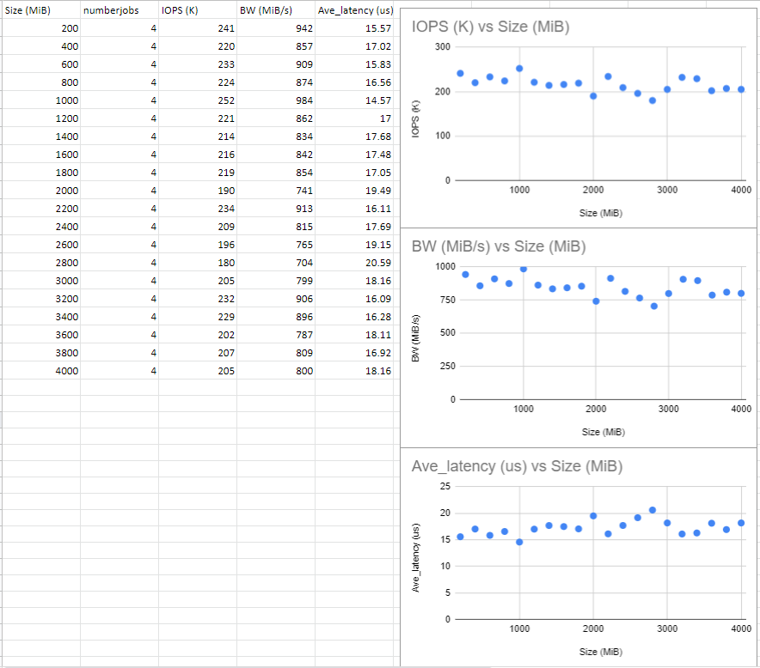
FEMU Change Numberjob
Result: When increase the number of thread, the IOPS and BW increase. Average Latency is Relative stable. Because the FEMU can handle more IO request at the same time.

Slide 16
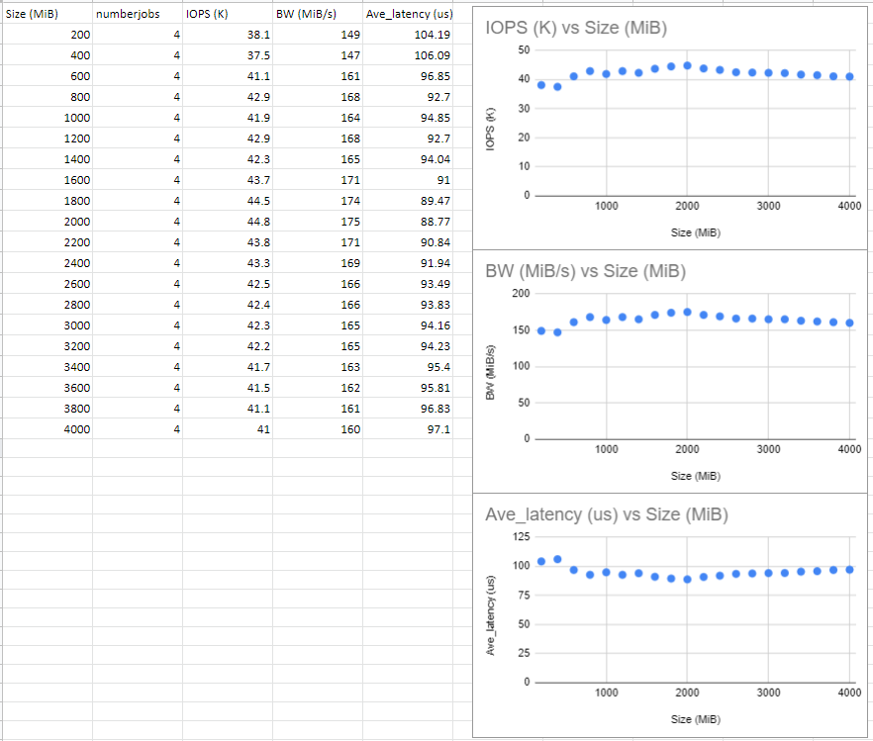
Real SSD Change Numberjob
Result: When increase the number of thread, the IOPS and BW increase. Average Latency is decause. Because the SSDs can handle more IO request at the same time.

Slide 17
FEMU vs Real SSD: Added parameter Numjobs
Result: At default parameter set up for FEMU and real device. FEMU and real SSDs trends are similar. But the FEMU performance is better than real SSDs

Slide 18
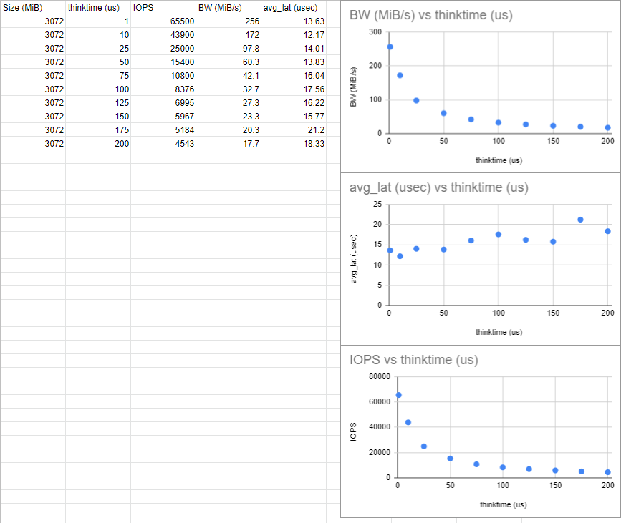
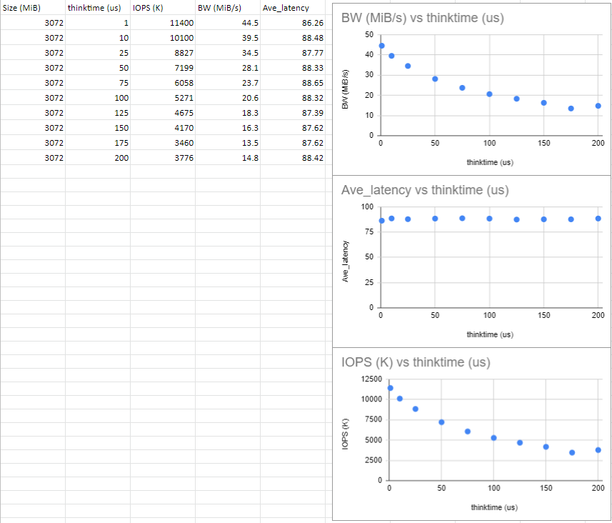
FEMU vs Real SSD： Added parameter Thinktime
Result: When increase the interarrival time, FEMU and real SSDs trend are same. BW and IOPS will decrease, the average latency is increase.

Slide 19
Reference:
Li, Huaicheng, Mingzhe Hao, Michael Hao Tong, Swaminathan Sundararaman, Matias Bjørling, and Haryadi S. Gunawi. "The {CASE} of {FEMU}: Cheap, accurate, scalable and extensible flash emulator." In 16th USENIX Conference on File and Storage Technologies (FAST 18), pp. 83-90. 2018.
Tavakkol, Arash, Juan Gómez-Luna, Mohammad Sadrosadati, Saugata Ghose, and Onur Mutlu. "{MQSim}: A Framework for Enabling Realistic Studies of Modern {Multi-Queue}{SSD} Devices." In 16th USENIX Conference on File and Storage Technologies (FAST 18), pp. 49-66. 2018.
https://fio.readthedocs.io/en/latest/fio_doc.html

Slide 20
Thank
You

Slide 21
