Slide 1
SSD performance
simulation with FEMU
The CASE of FEMU: Cheap, Accurate, Scalable and Extensible Flash Emulator
Huaicheng Li, Mingzhe Hao, Michael Hao Tong, Swaminatahan Sundararaman† , Matias Bjørling‡ , Haryadi S. Gunawi

Slide 2
Introduction
SSDs:
High throughput, low response time.
Apply NVMe protocol to adopt Multiple – queen concept to enable high throughput and low latency for IO request.
HDD:
Lower in cost and are practical for data that does not need to be accessed frequently, such as backups of photos, videos or business files.
Apply SATA protocol, which only a single request port to the OS.
They are available in two common form factors: 2.5 inch (commonly used in laptops) and 3.5 inch (desktop computers).

Slide 3
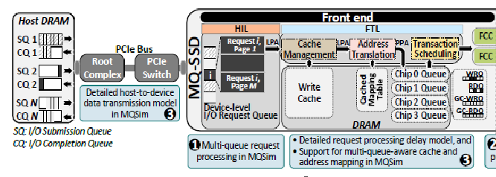
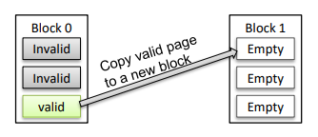
SSDs Architecture
Front – end: control and management units
Host-Interface Logic (HIL): provide higher IO performance to the host
SATA protocol: conventional SSDs
NVM Express (NVMe) protocol: designed to alleviate the bottlenecks of SATA [90], and to enable scalable, high-bandwidth, and low-latency communication over the PCIe bus
Flash Translation Layer (FTL)
Executes on a microprocessor within the SSD, performing I/O requests and flash management procedures
Wear-leveling: arranges data so that write/erase cycles are distributed evenly among all of the blocks in the device
Garbage collection (GC):
Notes:
OS have a queue depth to control SQ and CQ.
SATA only have one submission/completion queue.
NVMe have multiple submission/completion queue.
Handling an I/O request in the FTL:
1. when the HIL selects a request from the SQ, it inserts the request into a device-level queue
2. the HIL breaks the request down into multiple flash transactions
3.

Slide 4
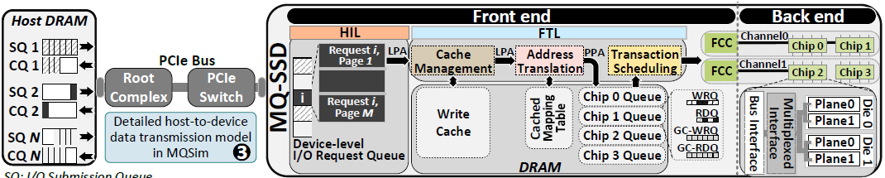
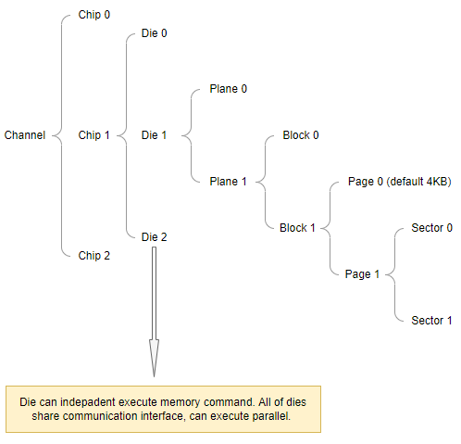
Back – end: Device

Slide 5
Characteristic of FEMU
Briefly speaking, FEMU is a fast, accurate, scalable, and extensible NVMe SSD Emulator. Based upon QEMU/KVM, FEMU is exposed to Guest OS (Linux) as an NVMe block device (e.g. /dev/nvme0nX).
Cheap: FEMU is open sourced and has proven it’s ability in several top OS and storage conferences.
Accurate: can be used in as a drop-in replacement for OpenChannel SSD. Prototyping SSD-related kernel changes can be done without a real device.
Scalable: can accuratly emulate 32 parallel channels/chips, without unintended queueing delays.

Slide 6
Introduce on FEMU
FEMU is exposed to Guest OS (Linux) as an NVMe block device
FEMU supports emulating different types of SSDs:
Whitebox Mode (OCSSD) - (a.k.a. Software-Defined Flash (SDF), or OpenChannel-SSD) with host side FTL (e.g. LightNVM or SPDK FTL)
Blackbox Mode (BBSSD) - with FTL managed by the device (like most of current commercial SSDs). A page-level mapping based FTL is included.
ZNS mode (ZNSSD), exposing NVMe Zone interface for the host to directly read/write/append to the device following certain rules.
NoSSD mode, emulating a as-fast-as-possible NVMe device with sub-10 microsecond latency. This is to emualte SCM-class block devices such as Optane or Z-NAND SSDs.

Slide 7
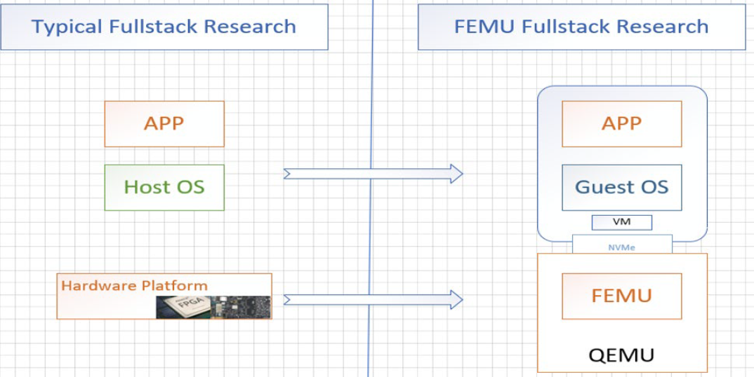
FEMU Architectures

Slide 8
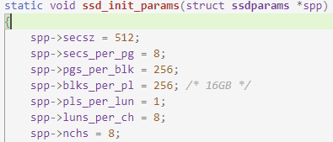

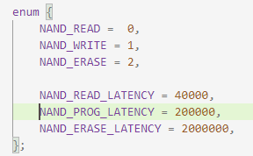
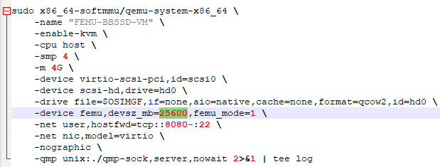
FEMU Configuration
Backend – Source code (hw/block/femu/ftl/ftl.c)
Frontend – user customization
FEMU-SSD-size + VM-DRAM-size + 2-4GB (Host-OS) <= Total-DRAM-size-in-your-Host
Notes:
logical unit number
Each FEMU NVMe SSD is entire backed by DRAM for accurate NAND timing emulation. Suppose you want to emulate a 16GB SSD, then you need to make sure you have at least 16GB free DRAM for FEMU to use. Remember to reserve enough DRAM for your host OS as well, which usually needs at least 2-4GB, as well as your guest VM (e.g., -m 4G).
Overall, make sure FEMU-SSD-size + VM-DRAM-size + 2-4GB (Host-OS) <= Total-DRAM-size-in-your-Host.

Slide 9
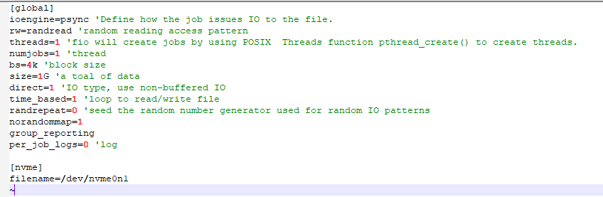
IO Benchmarks – Flexible IO Tester (FIO)
Resource: https://fio.readthedocs.io/en/latest/fio_doc.html
Flexible IO Tester (Fio) is a benchmarking and workload simulation tool for Linux/Unix
Fio is highly tunable and widely used for storage performance benchmarking
FIO input sample:

Slide 10
Simulation Process
Generate various IO type workloads with FIO, flexible I/O tester. Workloads are test files, which can be used to test the performance of storage devices
Use the workload we just created to evaluate the performance of SSD emulator.
Compare the I/O performance of the SSD with different types of workloads.

Slide 11
Results
To find the relationship between workload types and I/O performance of the SSD.
And hopefully find ways to improve I/O speeds.

