Slide 1
Final Project
University of Minnesota Data Visualization and Analytics Bootcamp - Cohort #4
Members: Yue Cheng, William Oliver, Sue Vang, Davis Oberle, Joaquin Valdes, Shoua Chang
Using machine learning to predict wine quality
Notes:
Joaquin

Slide 2
Agenda
Introduction & Value Proposition
Dataset Overview
Data Cleaning
Variable Analysis with Tableau
Prediction Models
Limitation and Future Analysis
Conclusion
Notes:
Joaquin

Slide 3
Value Proposition
A winery can use these models to understand and improve wine quality
A wine retailer can use these models to understand what consumers may want to purchase
A restaurant can use these models to understand what to recommend to customers
Notes:
Pearl

Slide 4
Dataset Overview
This database was created to identify a high quality or a low quality wine, based upon properties of the wine. The dataset consists of 12 properties of 6497 samples collected from the north of Portugal. Due to privacy and logistic issues, only physicochemical (inputs) and sensory (the output) variables are available (e.g. there is no data about grape types, wine brand, wine selling price, etc.). The data were collected from May/2004 to February/2007 using only protected designation of origin samples that were tested at the official certification entity (CVRVV).
Reference: P. Cortez, A. Cerdeira, F. Almeida, T. Matos and J. Reis. Modeling wine preferences by data mining from physicochemical properties. In Decision Support Systems, Elsevier, 47(4):547-553, 2009.
Notes:
Pearl

Slide 5
Data Cleaning
No missing values
Target column = Quality score
Dropping this column from test / split datasets
Convert Quality Score to Binary for Low(0) and High(1)
0 - 6: Low Quality scores
7+: High Quality scores
Notes:
Pearl

Slide 6
Variable Analysis
The following properties of each kind of wine are measured and included within the CSV:
fixed acidity (g(tartaric acid)/dm3)
volatile acidity(g(acetic acid)/dm3)
citric acid(g/dm3)
residual sugar(g/dm3)
chlorides(g(sodium chloride)/dm3)
free sulfur dioxide(mg/dm3)
total sulfur dioxide (mg/dm3)
density(g/cm3)
pH
sulphates(g(potassium sulphate)/dm3)
alcohol(vol.%)
quality(score between 0 and 10)
color: red(0) or white(1)
quality high/low: quality high(1) or quality low(0)
Notes:
Pearl

Slide 7
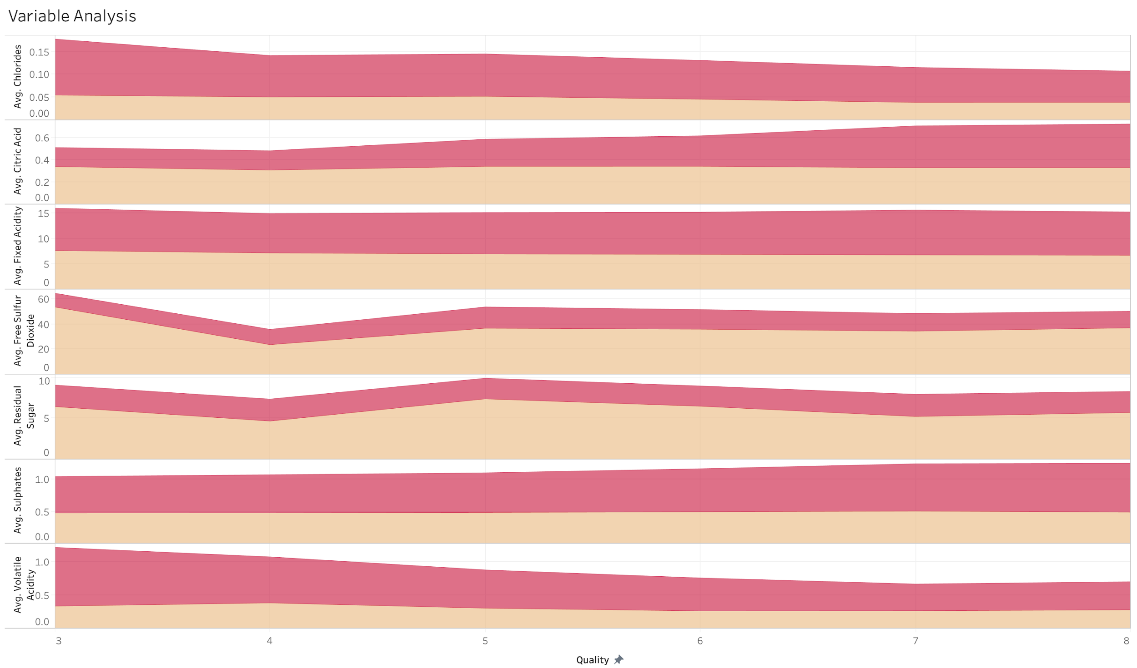
Variable Analysis with Tableau (cont’d)
Pre modeling variable plotting indicates some variance for each quality score (discrete measures).
No variable stands out to have strong correlation.
Red (red wine)
Yellow (white wine)
Notes:
Joaquin & Sue

Slide 8
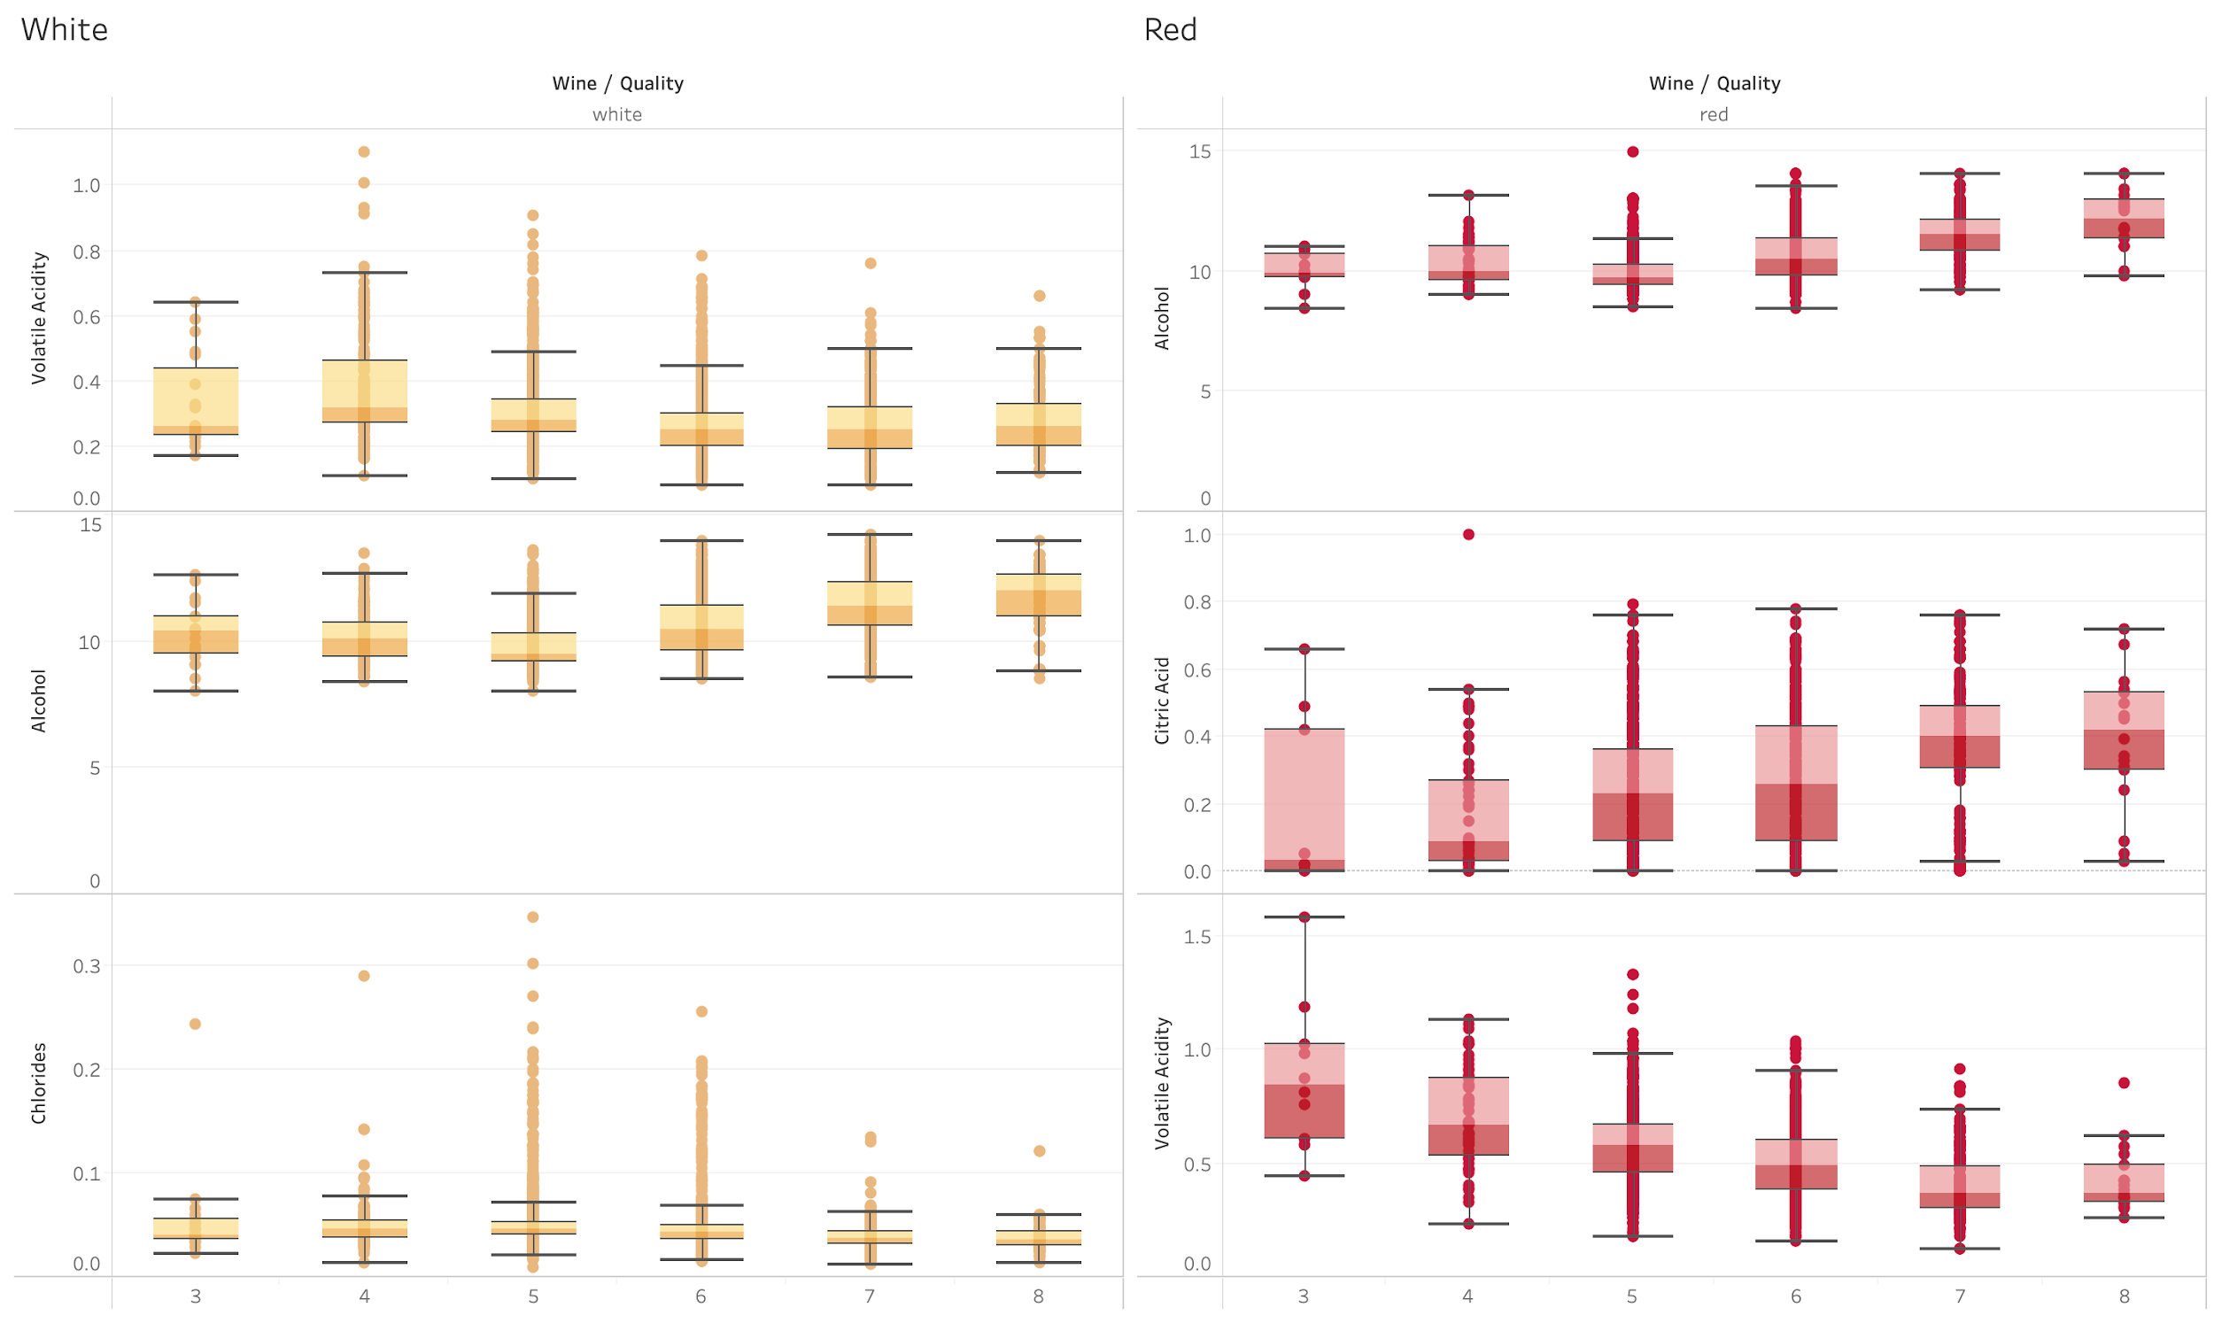
Variable Analysis with Tableau (cont’d)
Notes:
Joaquin & Sue

Slide 9
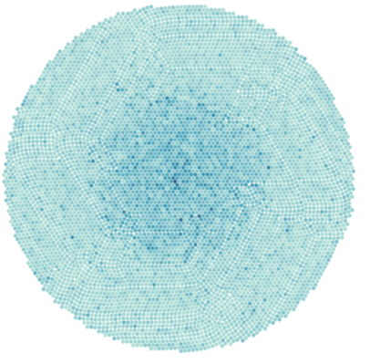
Variable Analysis with Tableau (cont’d)
Trying to predict wine quality without ML models is like throwing a dart at the graph to the right, saying where you land is the wine and wine quality prediction.
Bubble chart from tableau with all variables
Notes:
Joaquin & Sue

Slide 10

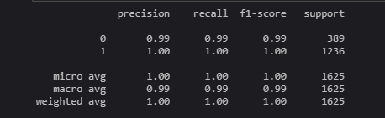
SVM
SVM determines the "best" line to divide data points, which is the line that leaves the biggest gap between itself and the points = maximum margin hyperplane

Slide 11
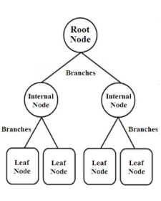
Decision Tree
Flowchart-like diagram where each branch represents a choice between a number of alternatives, and each leaf represents a decision.
Some of the benefits of using Decision Trees are:
Typically, they are fairly straightforward to conceptualize than other models
Decision Trees can handle both continuous and categorical variables.
Decision trees require relatively little effort from users for data preparation.
Decision Trees are usually robust to outliers and can handle them automatically.
Notes:
William

Slide 12
Decision Tree (cont’d)
There are two Types of Decision Trees: Classification and Regression
Classification Trees - These are considered as the default kind of decision trees. They are used to separate a dataset into different classes based on the target variable. These are generally used when the target variable is categorical in nature (e.g., True or False)
Regression Trees - These are used when the target variable is continuous or numerical. These are generally used in predictive types of problems instead of classification.
Unlike Classification Trees which places decisions into classes, Regression Trees decisions are determined by the strength of the relationship between one dependent (Target) variable and a series of independent (Predictor) variables.
Since our target variable (Quality) was numerical (Raw scores 3-9), the Regression Tree was chosen to predict the outcomes.
Notes:
William

Slide 13
Decision Tree (cont’d)
Used train_test_split function, trained on .80 of feature variables and tested on remaining .20.
Used DecisionTreeRegressor function from Sklearn to build the tree.
Results:
The Mean Absolute Error (MAE) simplest measure of forecast accuracy
MAE is the average difference between the actual and predicted scores. Since our MAE of .47 is fairly small and less than 10 percent of the Mean (5.8), this means that our algorithm did a pretty good job at predicting quality scores.
Notes:
William

Slide 14
Random Forest
Random Forest is a model made up of many decision trees, obtain prediction from each tree, and determine important features
Avoids overfitting, which can be a problem with a single decision tree
Notes:
Davis

Slide 15
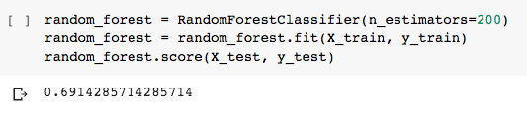
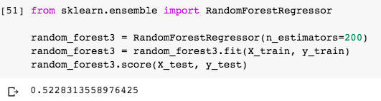
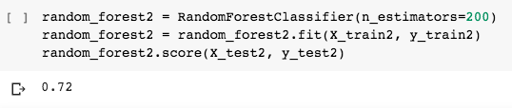
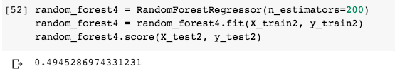
Random Forest
White Wine Random Forest Score
Red Wine Random Forest Score
Notes:
Davis

Slide 16
Random Forest
White Wine Feature Importance
variable | white | red
alcohol | 0.1376673848 | 0.1147012768
sulphates | 0.1069961316 | 0.08034079182
volatile_acidity | 0.1034115339 | 0.1005767147
total_sulfur_dioxide | 0.1025145003 | 0.09205744976
density | 0.09409231754 | 0.1051915255
chlorides | 0.08323920252 | 0.08440889351
residual_sugar | 0.07690400042 | 0.08763656443
citric_acid | 0.0764473709 | 0.07944191606
fixed_acidity | 0.07512141842 | 0.07575352806
pH | 0.07476206935 | 0.08505461389
free_sulfur_dioxide | 0.06884407032 | 0.09483672539
mean accuracy | 0.6914285714 | 0.72
Notes:
Davis

Slide 17
Random Forest
Red Wine Feature Importance
variable | red | white
alcohol | 0.1147012768 | 0.1376673848
density | 0.1051915255 | 0.09409231754
volatile_acidity | 0.1005767147 | 0.1034115339
free_sulfur_dioxide | 0.09483672539 | 0.06884407032
total_sulfur_dioxide | 0.09205744976 | 0.1025145003
residual_sugar | 0.08763656443 | 0.07690400042
pH | 0.08505461389 | 0.07476206935
chlorides | 0.08440889351 | 0.08323920252
sulphates | 0.08034079182 | 0.1069961316
citric_acid | 0.07944191606 | 0.0764473709
fixed_acidity | 0.07575352806 | 0.07512141842
mean accuracy | 0.72 | 0.6914285714
Notes:
Davis

Slide 18
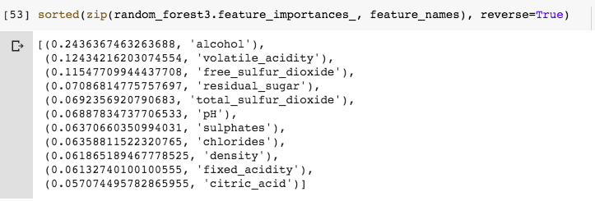
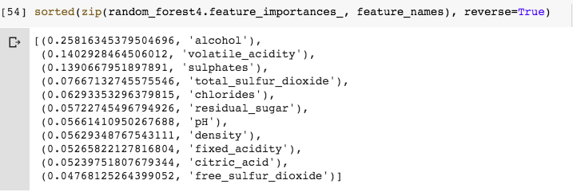
Random Forest

Slide 19
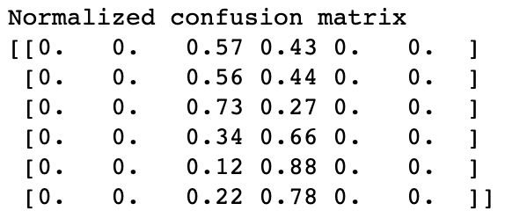
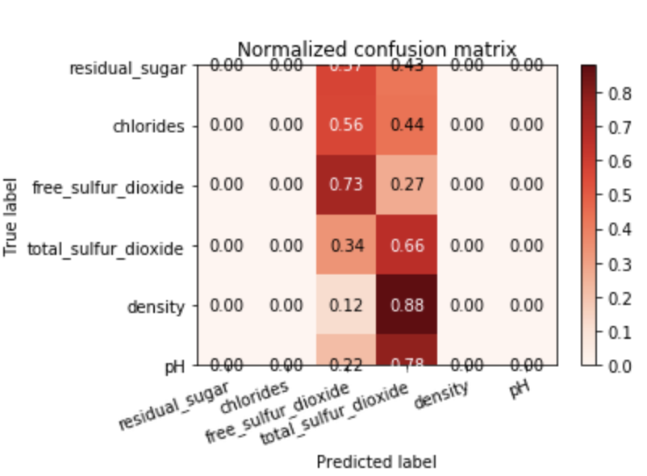
Confusion Matrix
Confusion Matrix is a performance measurement for machine learning classification.
Notes:
Shoua

Slide 20
Logistic Regression
The data was split into two parts: training (50%) and testing (50%).
The model was able to predict accuracy:
Training Data Score: 0.8180418719211823
Testing Data Score: 0.811942136041859
Notes:
Pearl

Slide 21
Limitations and Future Analysis
Limitations:
>7000 rows of data of each 12 variables
Dataset is a little older and does not include recent data
Future Analysis:
Similar analysis to other alcoholic beverages to diversify the dataset
Notes:
Shoua

Slide 22
Conclusion
Models used are
SVM
Decision Tree
Random Forest
Confusion Matrix
Logistic Regression (Best one for this dataset in terms of accuracy)
Alcohol and volatile acidity seems to be two of the more important factors in determining wine quality
Notes:
Shoua

