Slide 1
9008 suppl

Slide 2
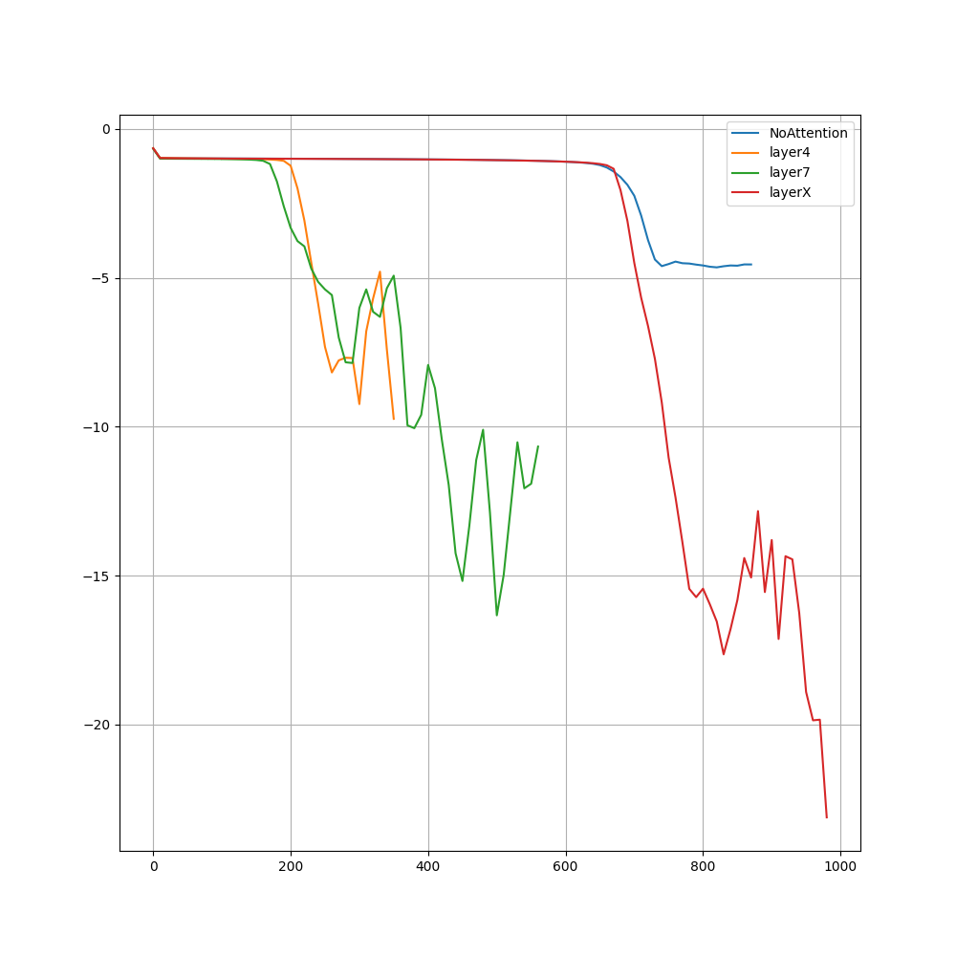
BertApproximation Experiment. Exploded because division by zero

Slide 3
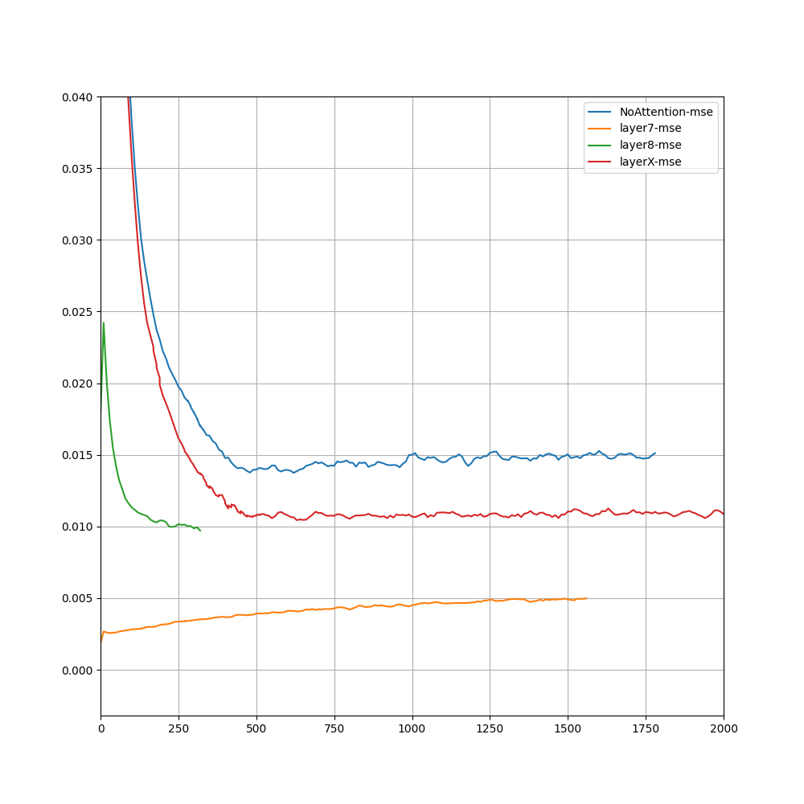
BertApprox

Slide 4
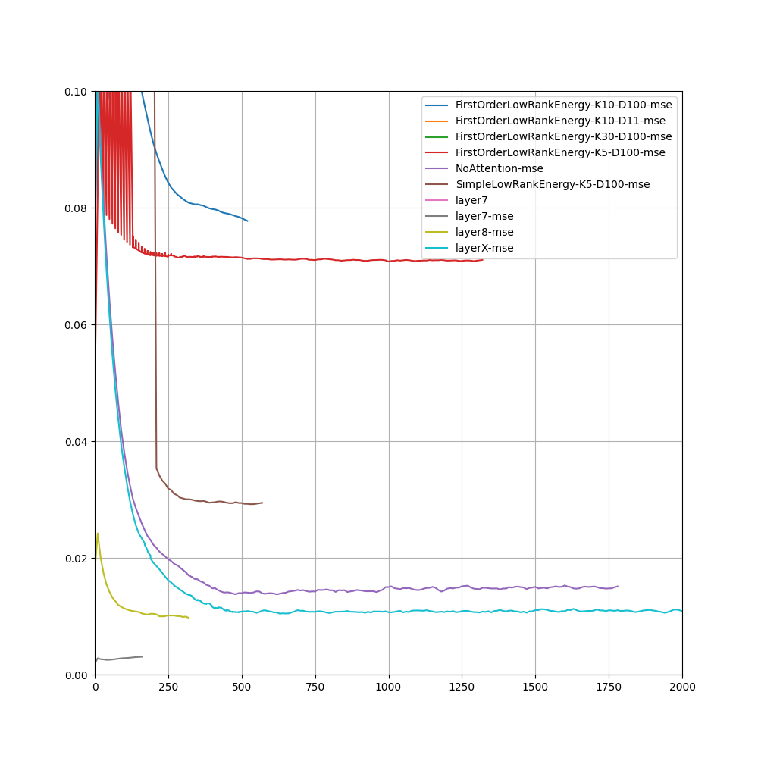

Slide 5
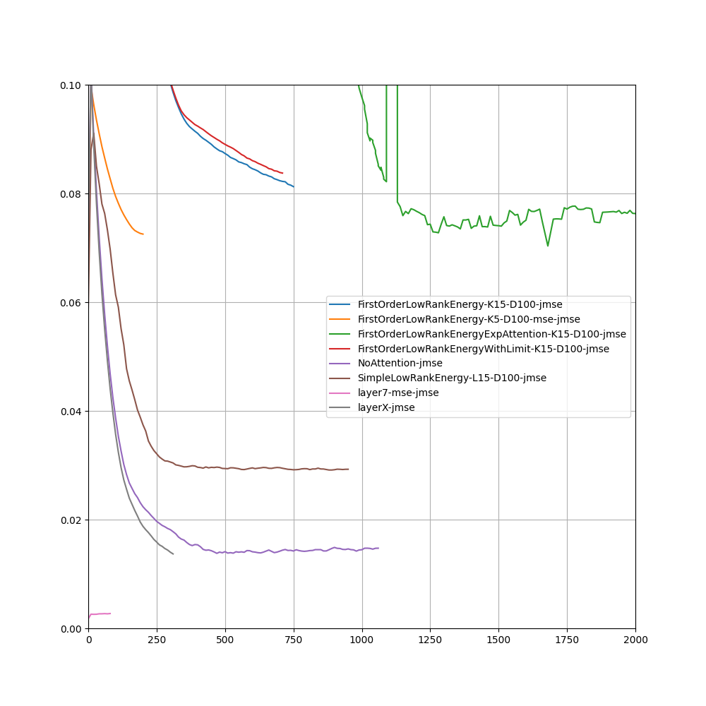
Mimicing Layer7->Layer8

Slide 6
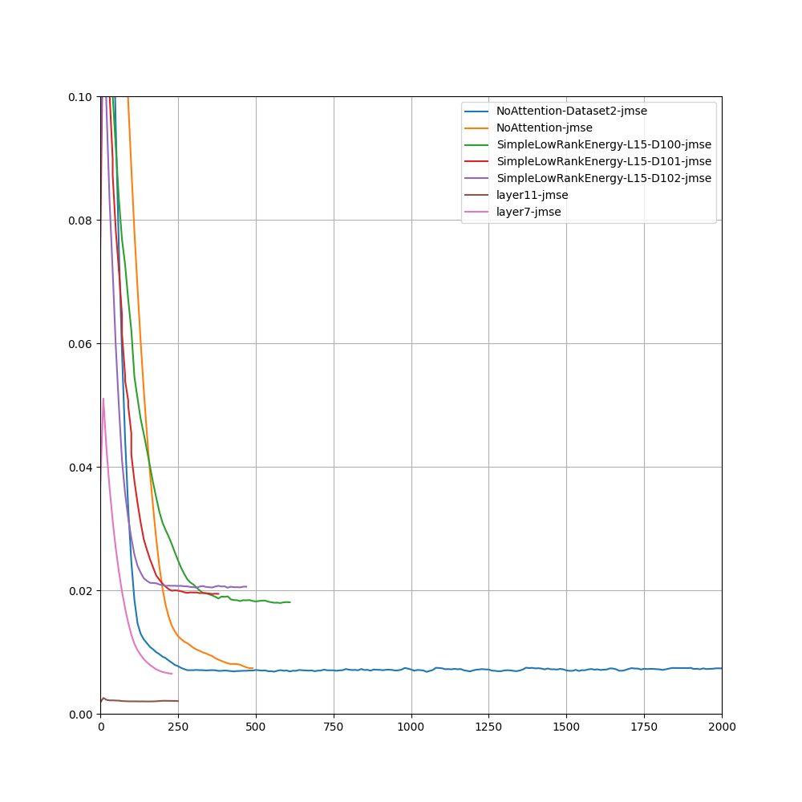
Layer11->Layer12

Slide 7
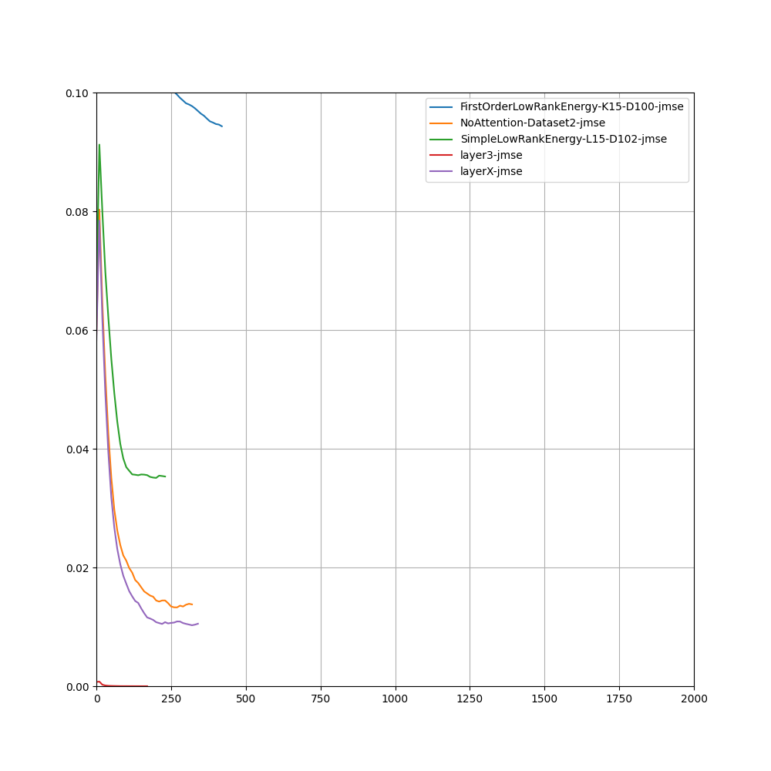
Mimicing Layer3->Layer4

Slide 8
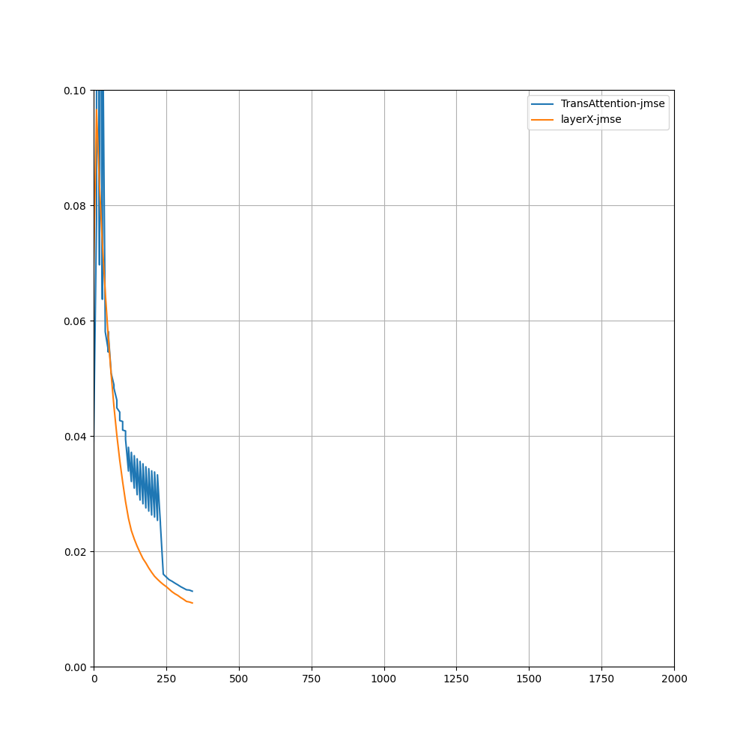
Mimicing Layer3->Layer4

Slide 9
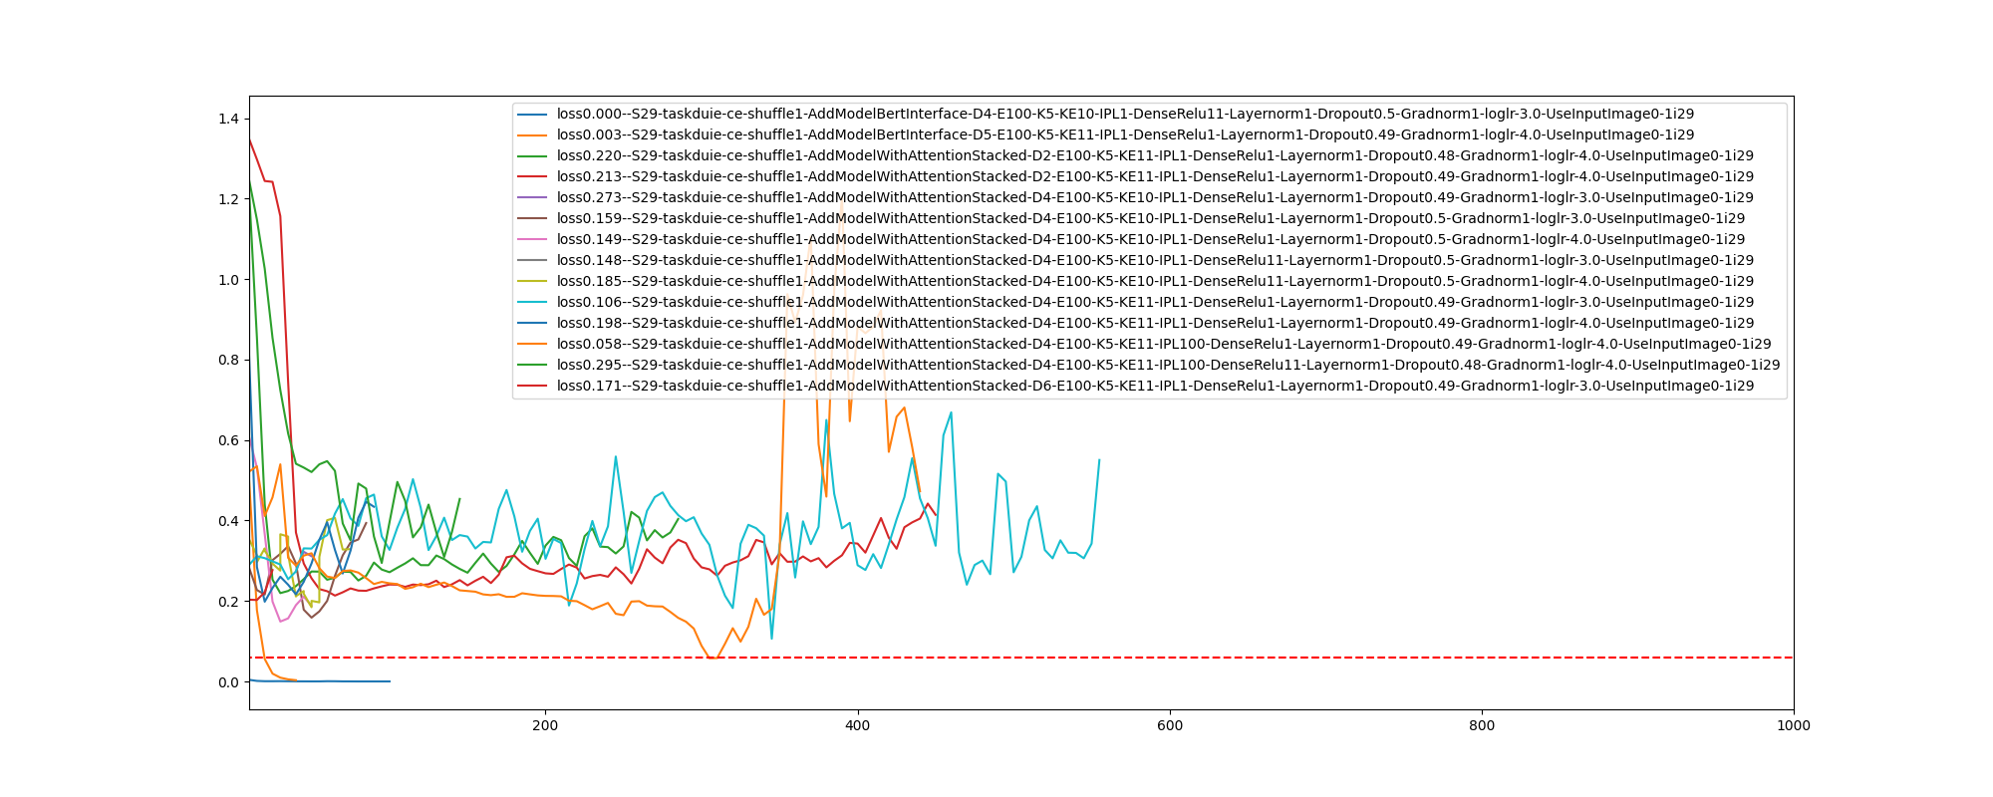
Contrastive loss on DUIE transformer with transiently great performance

Slide 10
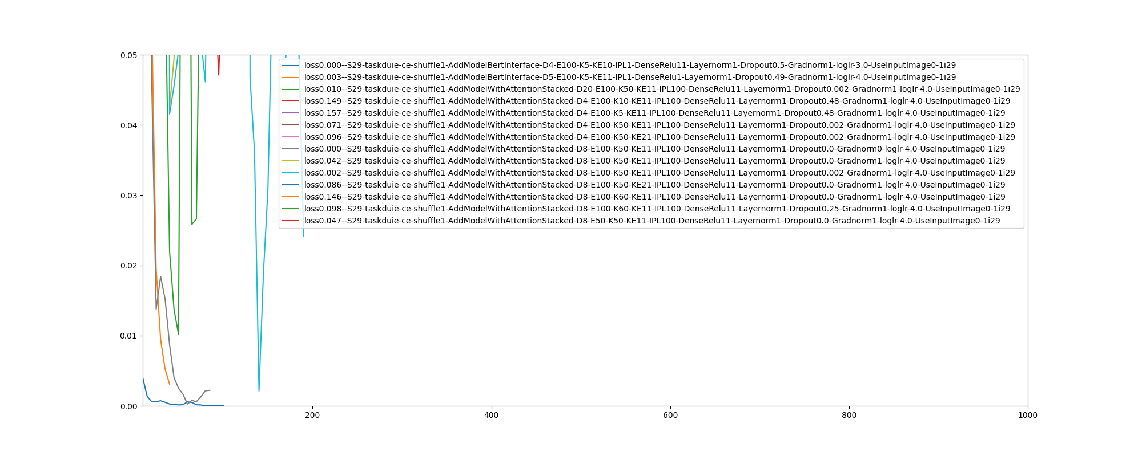
DenseRelu11 + Gradnorm0 + Dropout0.0 shows great speed and performance

