Slide 1
Sturctured Randomness and novelty in reinforcement learning

Slide 2
Random Network Distillation https://arxiv.org/pdf/1810.12894.pdf
1. Assess states novelty by training a predictor network against a random target network.
2. If the target network is identity, then it is easy to learn the mapping.
3. The target network encodes some prior about the data. Calculating this error maybe equivalent to minimising Wasserstein distance between two distribution.
4. The minised error = Ee( || targ(x) - pred(x)||^2 )
5. The original target is to promoting exploration of novel state. But in fact the novelty is high if data is dissimilar under random theta and sampled theta,which is weird.
6. If the \theta is instead a variational autoencoder, I dont see how this method is superior. Autoencoder learns to reconstruct input and is a more direct way of achiving the requirement.
7. Novelty is structured randomness

Slide 3
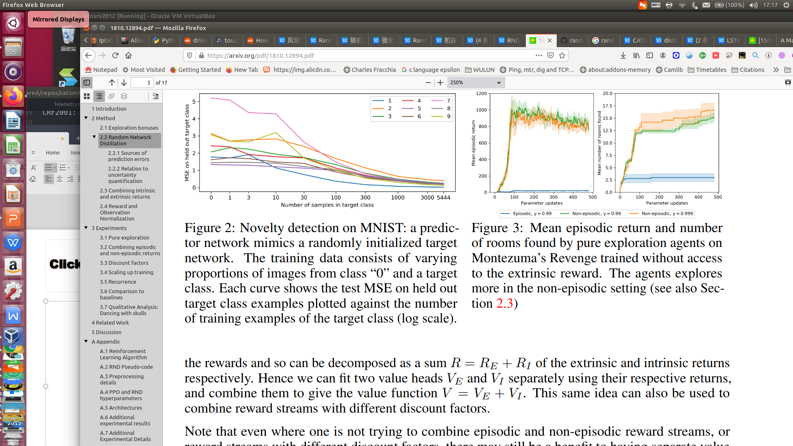
Novelty is educated guess/ structured randomness
Unstructured randomness is
in-efficient. The randomness
must be guided with a motivation
or hypothesis.

Slide 4
Randomized Prior Functionsfor Deep Reinforcement Learning https://arxiv.org/pdf/1806.03335.pdf

