Slide 1
GPT-2 language model

Slide 2
GPT objective
maximise next word given last K as context

Slide 3
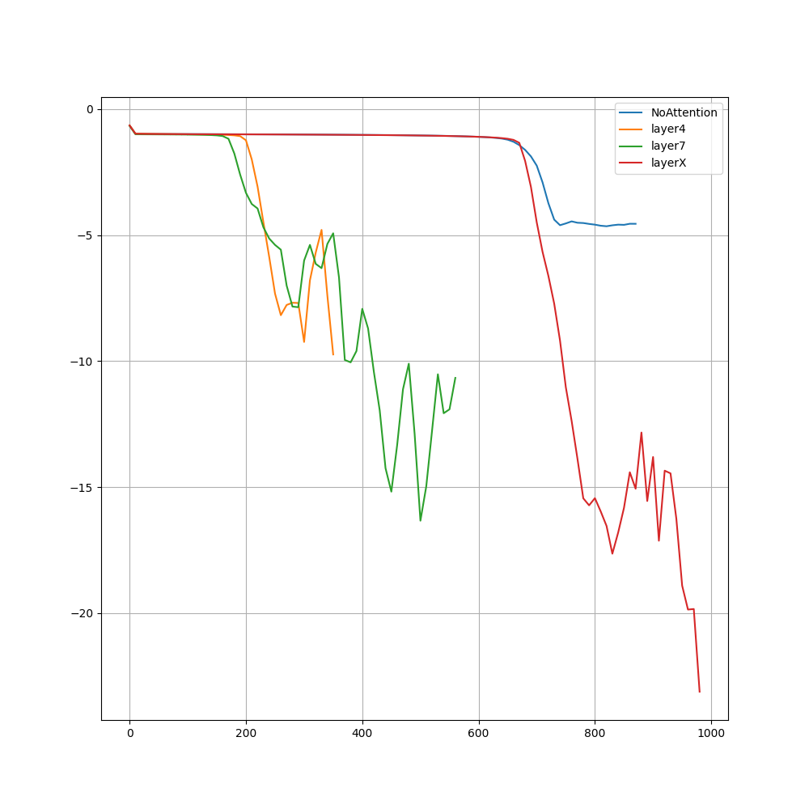
BertApproximation Experiment

