Slide 1
Lab Meeting
Feng Geng
2019.02.10

Slide 2
Update on cold-responsive genes.
Meta analysis of transcriptome data

Slide 3
Update on cold-responsive genes

Slide 4
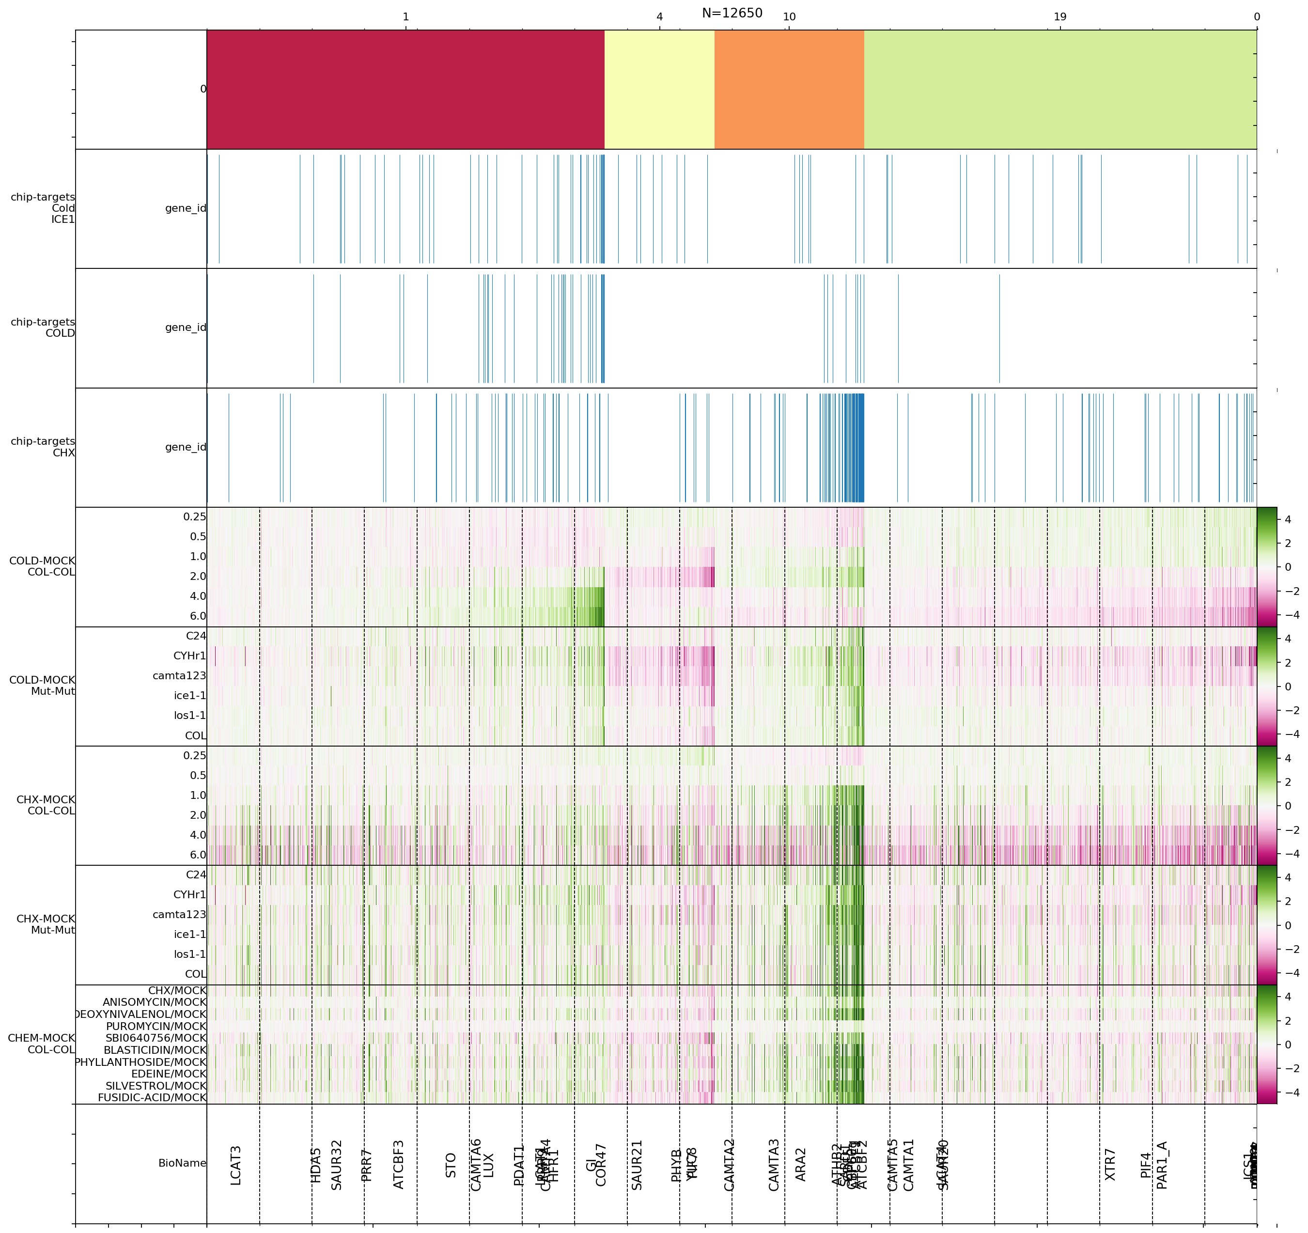
cold-responsive
peaks
CHX induces an early response (1.0hr onwards)
This response is early but transient in cold treatment
CHX-responsive
peaks
cold-treated
timecourse
cold-treated
mutants
CHX-treated timecourse
CHX-treated mutants
chemical-treated WT

Slide 5
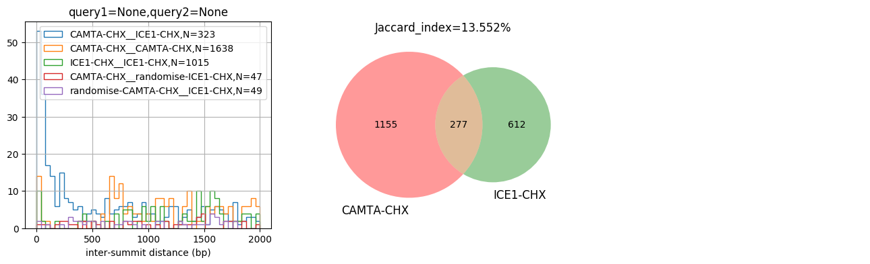
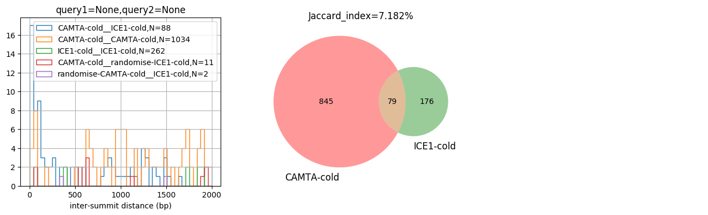

Slide 6
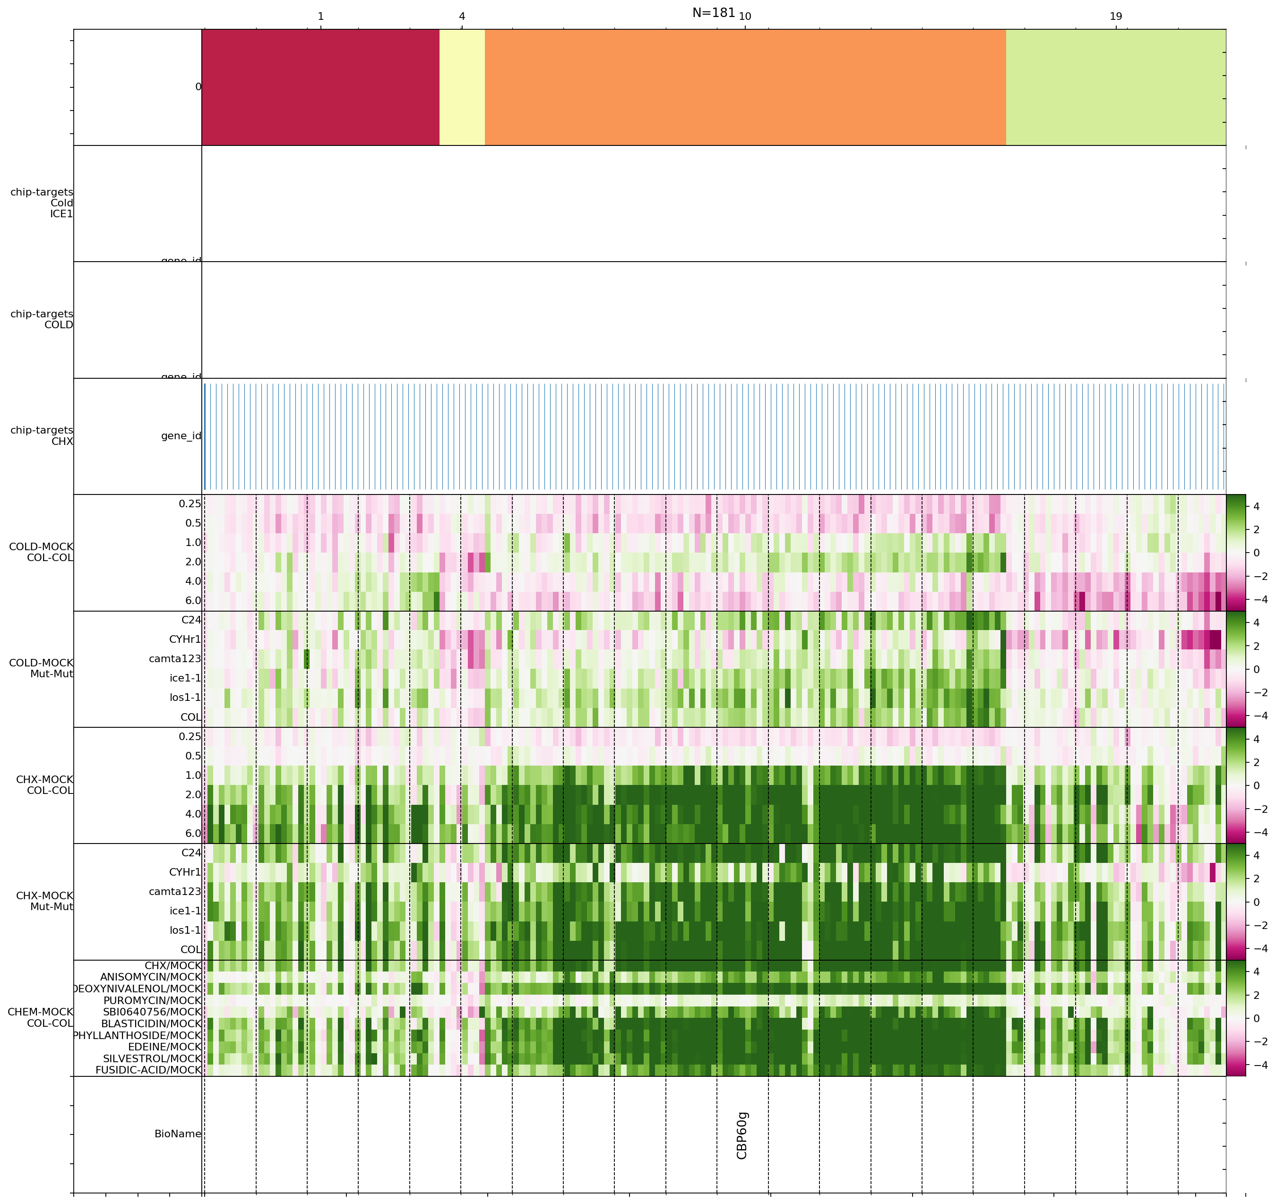
cold-responsive
peaks
A closer look at the CHX target
CYHr1-1.0hr, ANISOMYCIN-1.0hr
PUROMYCIN-1.0hr
shows a reduced response
GO term: response to organonitrogen compound
CHX-responsive
peaks
cold-treated
timecourse
cold-treated
mutants
CHX-treated timecourse
CHX-treated mutants
chemical-treated WT

Slide 7
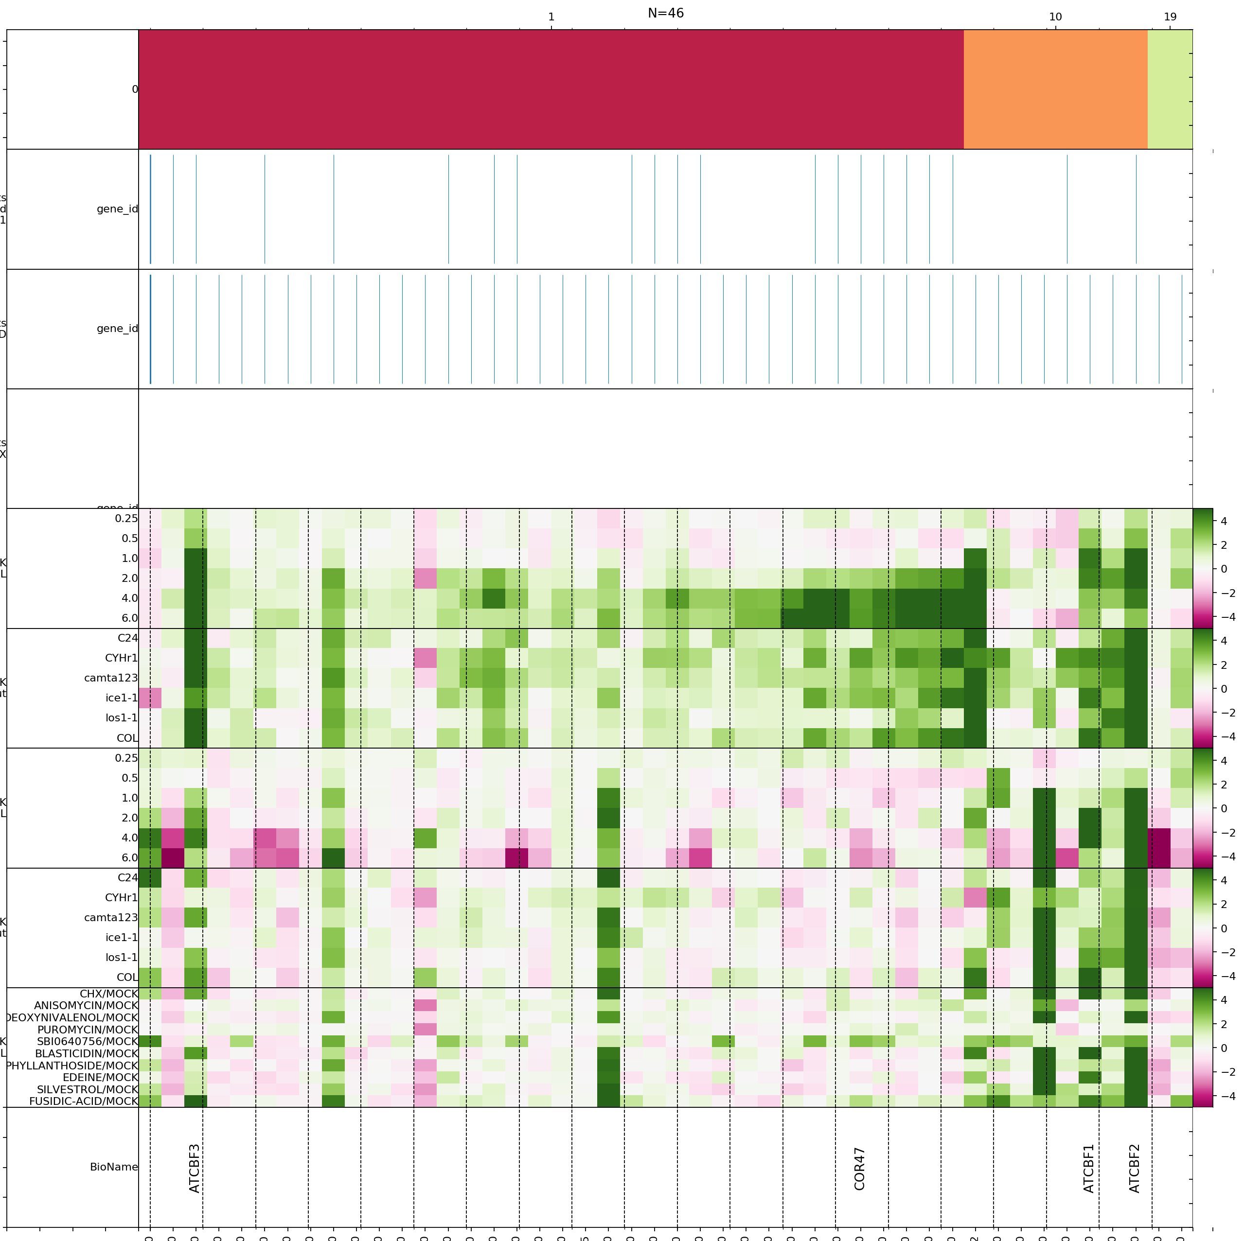
cold-responsive
peaks
A closer look at the cold targets
los1-1__1.0hr
shows a reduced response
Go-term: response to cold, cold acclimation
CHX-responsive
peaks
cold-treated
timecourse
cold-treated
mutants
CHX-treated timecourse
CHX-treated mutants
chemical-treated WT

Slide 8
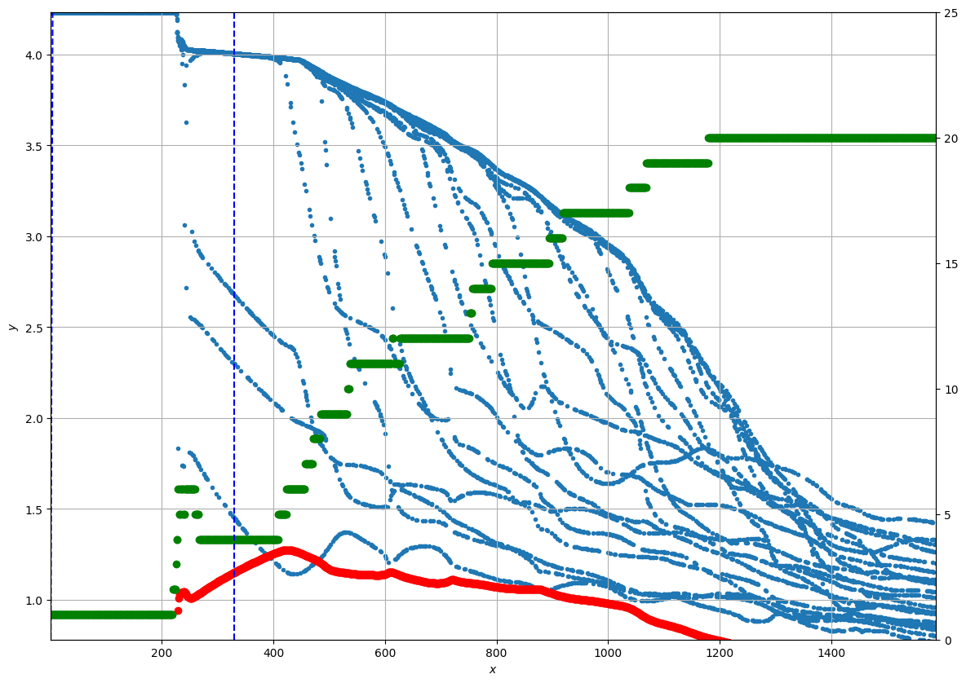
(blue):Average entropy of a cluster
(green): number of active cluster
Concentration of component distributions

Slide 9
Meta analysis of transcriptome data
Species: Arabidopsis thaliana
558 in-house mapped transcriptomes
(test set)
770 external transcriptomes from ArrayExpress
(training set)

Slide 10
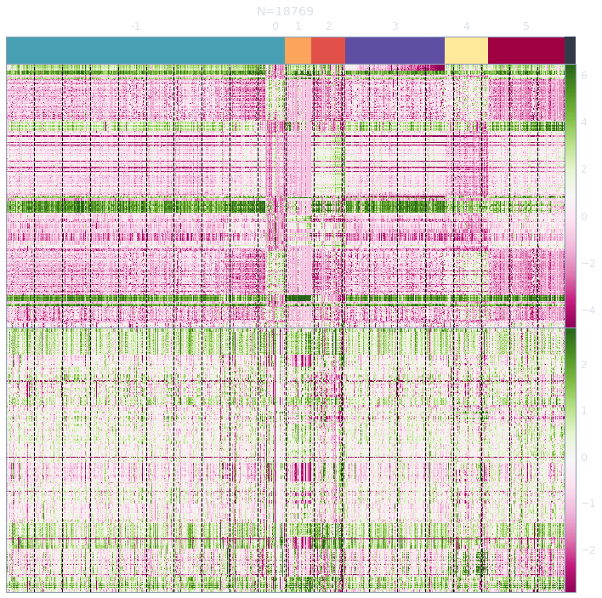
Training set
(external)
test set
(in house)

Slide 11
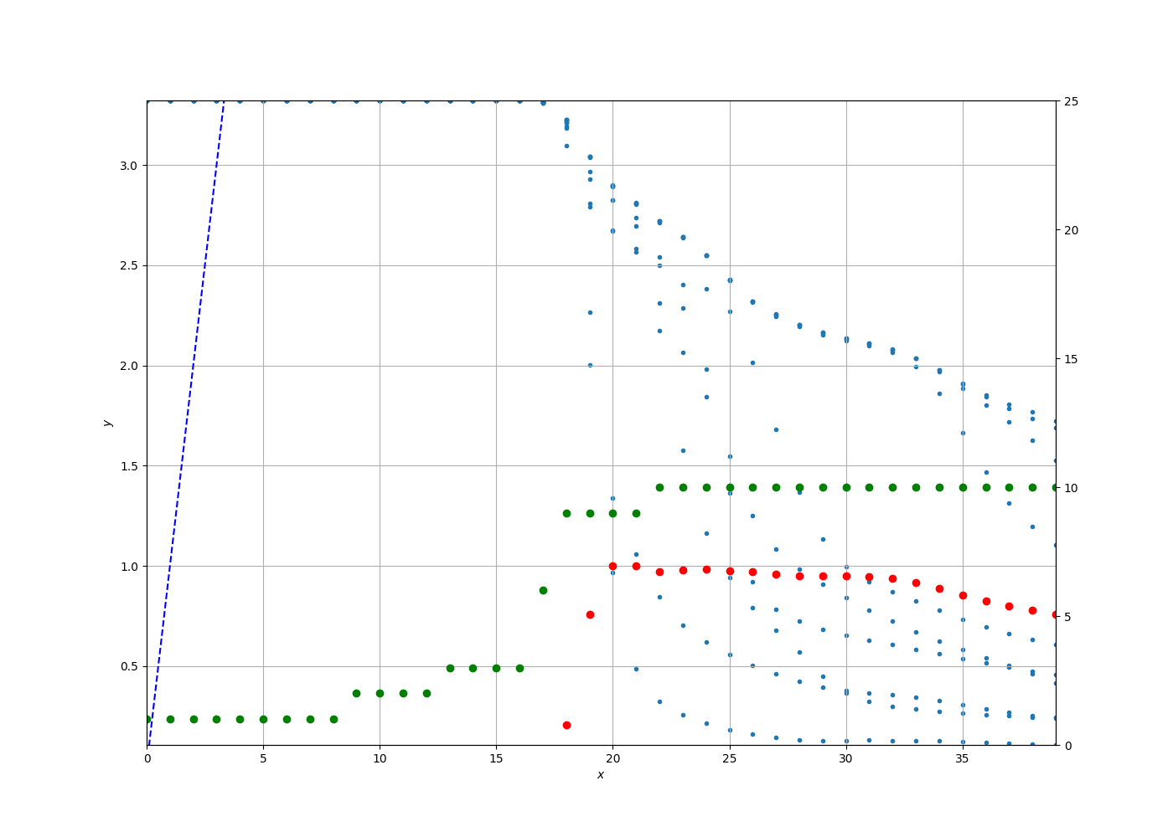

Slide 12
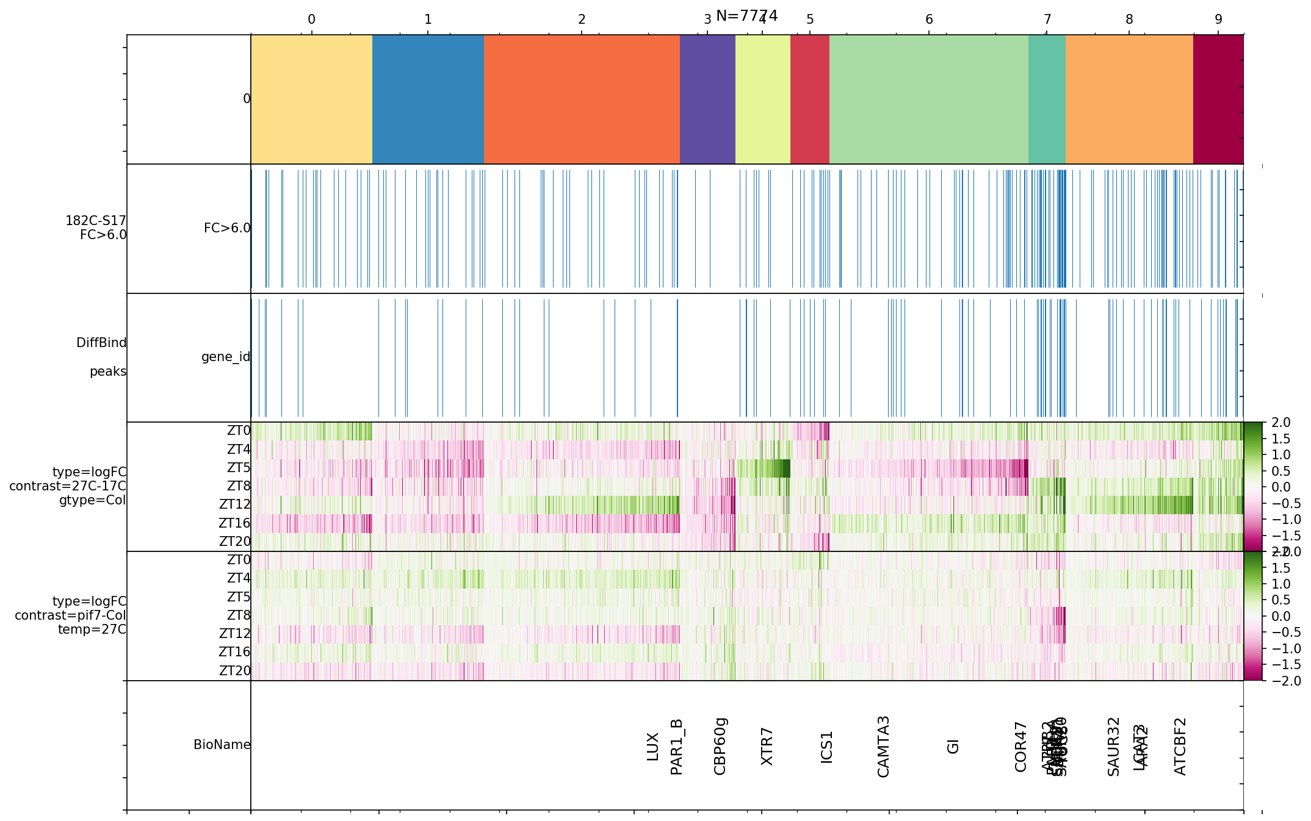
Expectation maximisation specifies a deterministic dynamics on the responsibility matrix (that specifies cluster-assignment)
Possible to feed random-subset of full data.
Information can be extracted from cluster-average entropy. Potentially useful for quality control.
Highly confident cluster should remain highly confident if the clustering is real.

