Slide 1
Local Internet Breakout – Phase 2

Slide 2
Project Overview and Update
Update:
SDWAN Local internet breakout for Office 365 have been deployed to 20 sites
Phase 2 – Overview
Remove the GCC dependency for internet access - Enterprise internet traffic is backhauled to GCC Employee Outbound Internet infrastructure resulting to packet latency, drops and jitter to some applications. This is due to several hops from the underlying path.
Route all external destinations towards the local ISP, the rest will continue to route the SDWAN fabric
Similar deployment with Internet-only sites – Users will have no access to enterprise, URL filtering pushed to umbrella client
Benefits
Improves the user experience by providing Direct Internet Access for Internet bound applications
Optimal performance for latency-sensitive cloud applications.
GCC Internet Circuit downgrade opportunities
Consistent Security Controls - This emulates the existing security controls in GCCs

Slide 3
Deployment Scope and Risks
Local Internet Breakout – Phase 1 – [Currently Deployed]
Forward Microsoft Exchange, SharePoint, OneDrive and Teams to the site’s local internet. All additional applications will be reviewed by Infosec for approval. The application list allowed is centrally managed.
The rest of site’s traffic will remain in the Regional GCC hubs via SDWAN tunnels.
Local Internet Breakout – Phase 2- [New]
Direct all external traffic destinations to local internet
Management and all other internal traffic will remain in Regional GCC hubs via the SDWAN tunnels
Security Controls – GCC Employee Outbound rules will be duplicated to the remote sites.
Risks
Unstable circuits – The user will experience an impact for real-time traffic when circuit performance is unstable. Flapping circuit will be shutdown to avoid further impact.
IP Authentication – Users can connect to Pulse VPN as a workaround while the allow listing is being processed.

Slide 4
Security, Costs and Target Dates
Security
Security Profiles, used for remote virtual firewalls, will be managed by Panorama using a new SDWAN-LIB device group. This will keep all security policy consistent.
Costs
No associated costs
Existing Internet circuits will be used for this model
Tentative list for deployment
Strand – VM100
Farringdon
Manila- PA3020
Iloilo- PA3020
230 Park – Local Fw required
Raleigh – Local Fw required

Slide 5
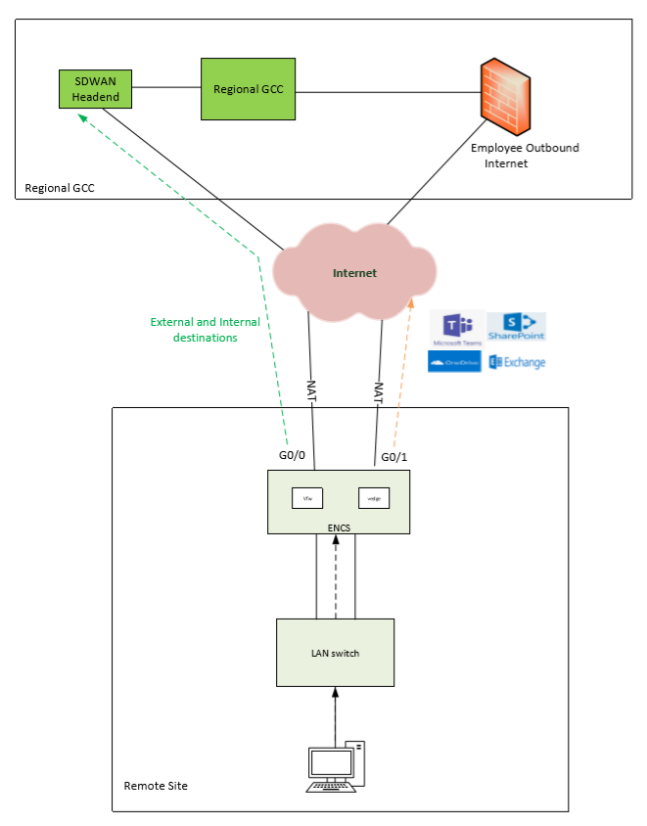
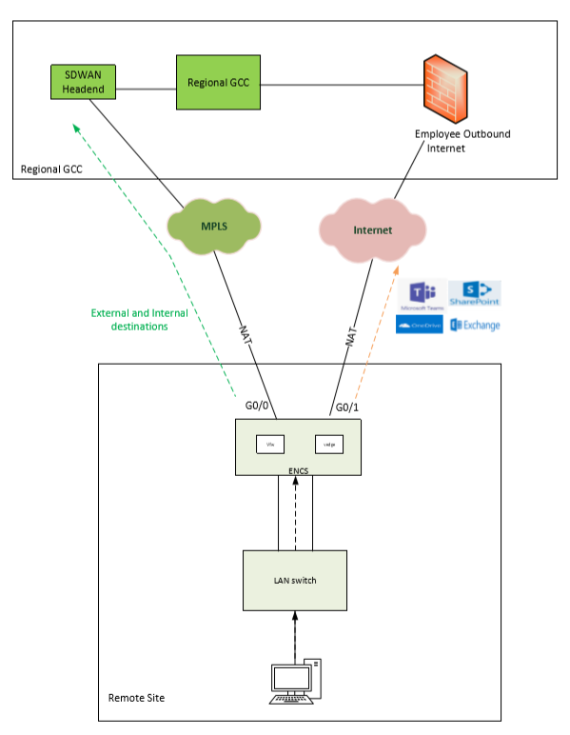
SDWAN- Direct Internet Access (Current Design – Phase 1)

Slide 6
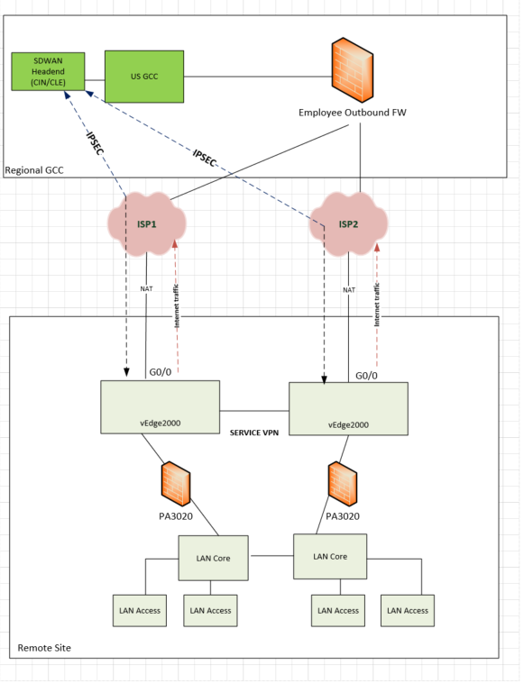
SDWAN- Direct Internet Access – Option 1
Deployment:
Use existing service VPN (VPN40) but route default route to VPN0
Keep the full mesh topology
Employee Outbound Rule – Duplicate the rules from the GCC, rebuild the security zones and will cause an impact
No shared policy to be pushed to FW
Use Pulse VPN as workaround for IP authentication issues

Slide 7
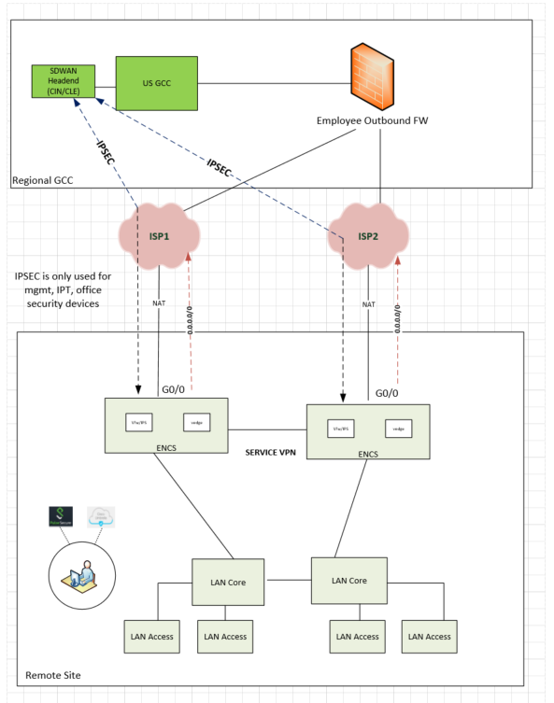
SDWAN- Direct Internet Access – Option 2
Factors to consider:
URL filtering moved to Umbrella client
Local DNS – if DNS will be removed, URL can be disabled on the FW. Otherwise, Umbrella will not work
No user to enterprise traffic – mgmt, office security, IPT
Basic firewall policy similar to UDM sites
Group of users who have direct access which may introduce a problem when they use VPN
Secure extranet on GCCs, no IPs rule needed
Deployment:
New Service VPN for the Site to US vEdge2000 IPSEC tunnel
New Service VPN for the NAT DIA route
Users to use Pulse Secure for the enterprise and DC access
IPSEC tunnel traffic – management, IPT, Office security and others
IPS rule needed, secure extranet on GCC

