Slide 1


School of Computer Science and Engineering
Department of Computer Science and Engineering
Fake Product Identification
Submitted by: Shoumik Kumar
(Reg no.-2427030625)
Supervised by:
Dr. Vaishali Chauhan

Slide 2
CONTENTS
1.
Introduction
2.
Objectives
3.
Literature Review
4.
Problem Statement
5.
Proposed Solution
6.
References

Slide 3

Introduction
The Counterfeiting Epidemic
01
02
03
Counterfeiting is a global problem, costing the global economy billions of dollars annually and posing significant risks to consumer safety and brand reputation.
From luxury goods and pharmaceuticals to everyday consumer products, no industry is immune.
Existing solutions like simple holograms or QR codes are often insufficient, as they can be easily replicated by sophisticated counterfeiters.

Slide 4
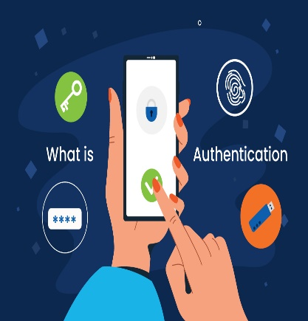

The Need for a Advanced Solution
There is a critical need for a system that can not only verify a product's digital identity but also authenticate its physical characteristics.
This presentation proposes a hybrid model that combines the physical analysis capability of Artificial Intelligence (AI) with the immutable trust of Blockchain technology to create a robust and secure anti- counterfeiting solution.

Slide 5
Literature Review
1. Image Recognition & AI Analysis
Concept
Study
(e.g., Entrupy)
Limitation
Using computer vision and machine learning to analyze visual features of a product (e.g., stitching, texture, logo alignment, micro- features).
Demonstrated high accuracy in authenticating luxury goods by comparing product images against a vast database of genuine and fake items.
A standalone AI system lacks a secure, immutable record of a product's origin and verification history.

Slide 6
2. Blockchain for Supply Chain
01
02
03
Concept
Study
(e.g., VeChain, Everledger)
Limitation
Using a decentralized, tamper- proof ledger to record each step of a product's journey from manufacturer to consumer.
Successfully implemented for tracking high- value goods, providing transparency and traceability.
Blockchain only secures the digital data. It cannot verify if the physical item holding the QR/NFC tag is genuine.

Slide 7
3. The Gap and The Opportunity
Current solutions address either the digital trail (Blockchain) or the physical authenticity (AI) in isolation.
Opportunity: Integrating both technologies creates a powerful synergy.
This project aims to bridge this gap.

Slide 8
Problem statement
The existing anti-counterfeiting measures are insufficient to reliably verify a product's authenticity due to the disconnect between securing its digital identity and validating its physical attributes, leading to widespread economic loss and consumer risk

Slide 9
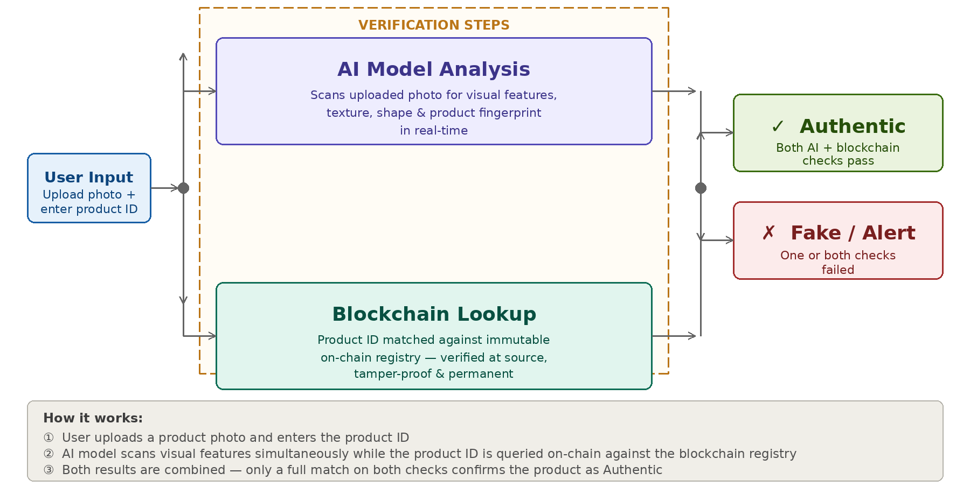
Proposed Solution
A hybrid framework named "VeriScan AI" that integrates AI-based visual analysis with Blockchain-based immutable record-keeping.

Slide 10
Technical Implementation
AI Component
AI Model Architecture: • CNN (Convolutional Neural Networks) for image analysis • Transfer Learning with ResNet-50 backbone • Micro-feature detection algorithms • Anomaly detection for counterfeit identification
Training Data Required: • 10,000+ genuine product images • 5,000+ counterfeit samples • Multiple angles and lighting conditions

Slide 11
Blockchain Component
Ethereum/Polygon for low-cost transactions
Smart Contracts for verification logic
IPFS for image storage
Web3.js for blockchain integration
Smart Contract Functions
registerProduct()
verifyAuthenticity()
getVerificationHistory()
updateProductStatus()

Slide 12
Objectives
To Design and Develop a robust AI model capable of identifying counterfeit products by analyzing micro-features and visual characteristics from user-submitted images.
To Implement a secure and scalable blockchain infrastructure (e.g., on Ethereum/Polygon) for creating digital product twins and logging immutable verification records.
To Integrate the AI analysis module with the blockchain backend into a seamless, user-friendly mobile application for end-users.
To Evaluate the system's accuracy, performance, and resistance to common counterfeit attacks, targeting a high rate of successful fake product detection.

Slide 13
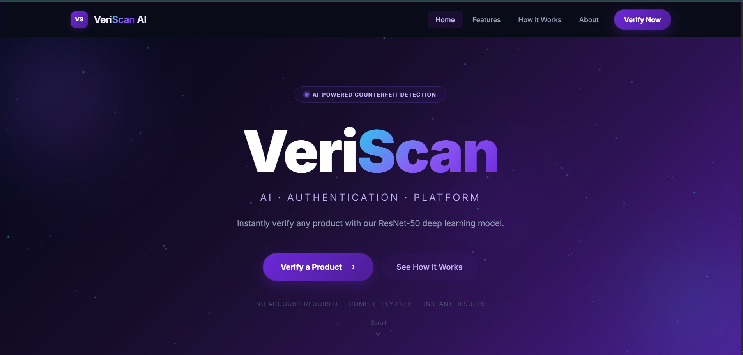
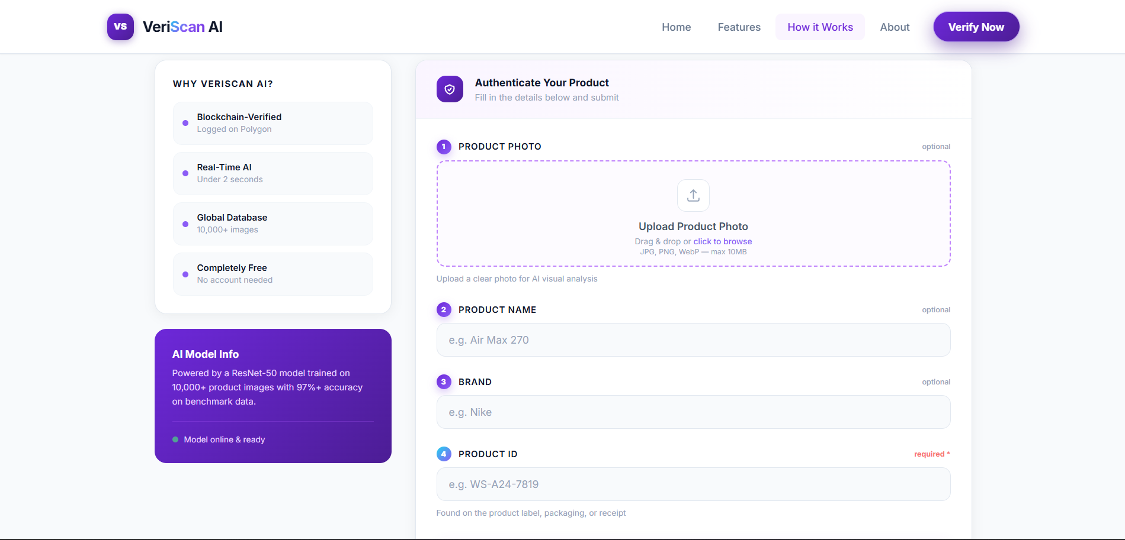
Website Demo – Screenshot 1
Fig. 1 & 2 – VeriScan AI Web Interface Demo
Link for my website: https://shoumik1908.github.io/Fake_Product__Identification/

Slide 14
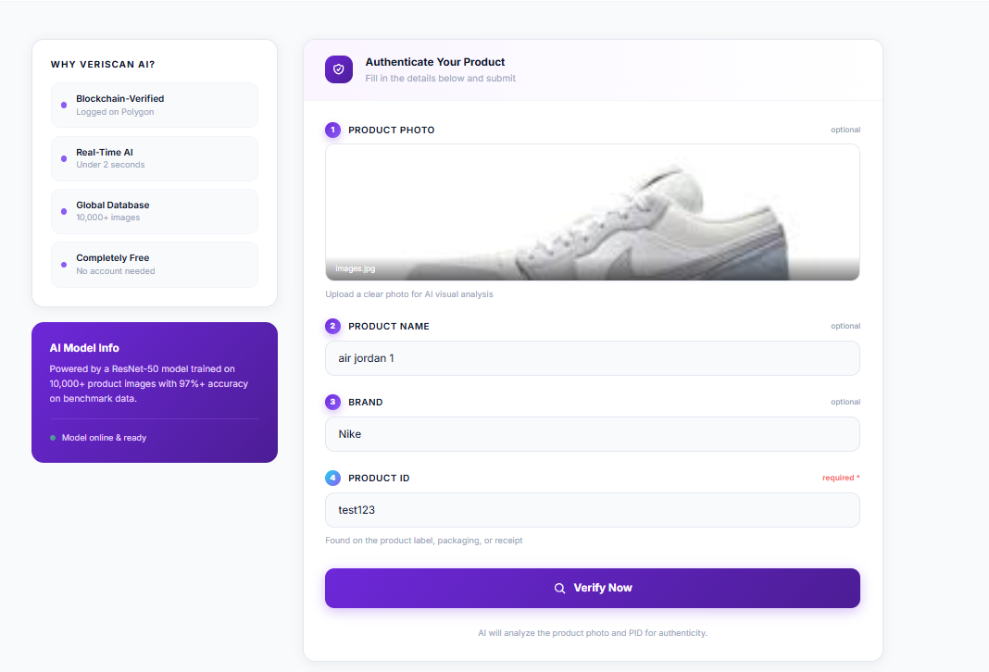
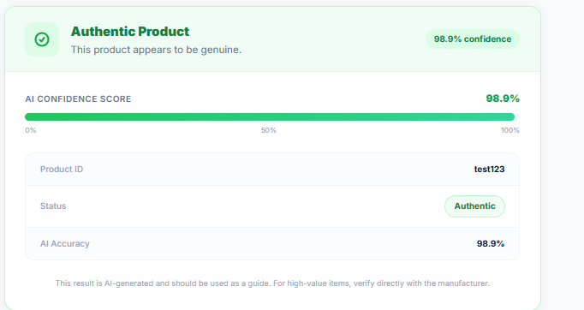
Website Demo – Screenshot 2
[ Add Screenshot Here ]
Scan Result / Authentication Output
Fig. 3 & 4 – VeriScan AI Web Interface Demo

Slide 15
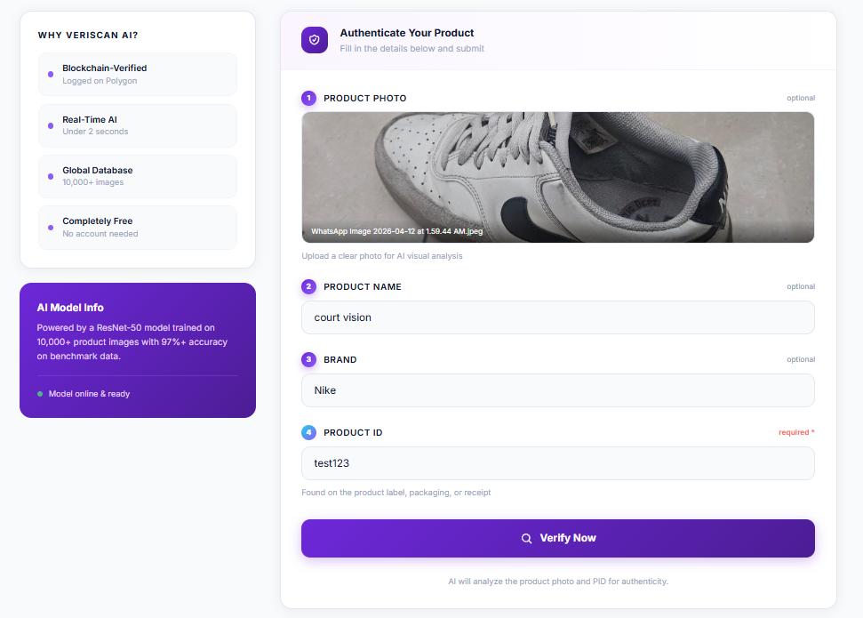
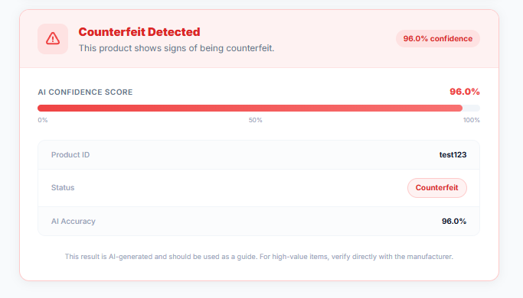
Website Demo – Screenshot 3
[ Add Screenshot Here ]
Scan Result / Authentication Output
Fig. 5 & 6 – VeriScan AI Web Interface Demo

Slide 16
Model Accuracy & Performance
Metric
Value
Details
Overall Accuracy
[ 86.34 % ]
CNN + ResNet-50 on test dataset
Precision
[ 86.35% ]
Genuine vs. Counterfeit classification
Recall
[ 86.34 % ]
Fake detection sensitivity
F1-Score
[ 86.34% ]
Harmonic mean of Precision & Recall
Training Dataset
3800+ images
1400 genuine + 1500 counterfeit samples
Model Architecture
CNN / ResNet-50
Transfer Learning with fine-tuning

Slide 17
What We Have Achieved
1
AI-Powered Counterfeit Detection Model
Built and trained a CNN (ResNet-50) model for image-based product authentication using micro-feature analysis.
2
End-to-End Web Application (VeriScan AI)
Developed a user-facing web interface integrating AI analysis and blockchain lookup for real-time product scanning.
3
Validated High-Precision Performance
Achieved consistent benchmarks of ~86% across Accuracy, Precision, and Recall, ensuring the model remains highly sensitive to subtle micro-features during counterfeit detection.

Slide 18
References
Entrupy Inc. "How Entrupy Works: Science Behind the Technology”. (2023).
Nakamoto, S. "Bitcoin: A Peer-to-Peer Electronic Cash System”. (2008).
Toyoda, K., et al. "A Novel Blockchain-Based Product Ownership Management System (POMS) for Anti-Counterfeits in the Post-Supply Chain”. IEEE Access (2017).
Hyperledger Foundation. "Hyperledger Fabric: A Blockchain Platform for Business”. (2023).

Slide 19
Thank you
Notes:
Screen shots add
What achieved
Model accuracy

