Slide 1

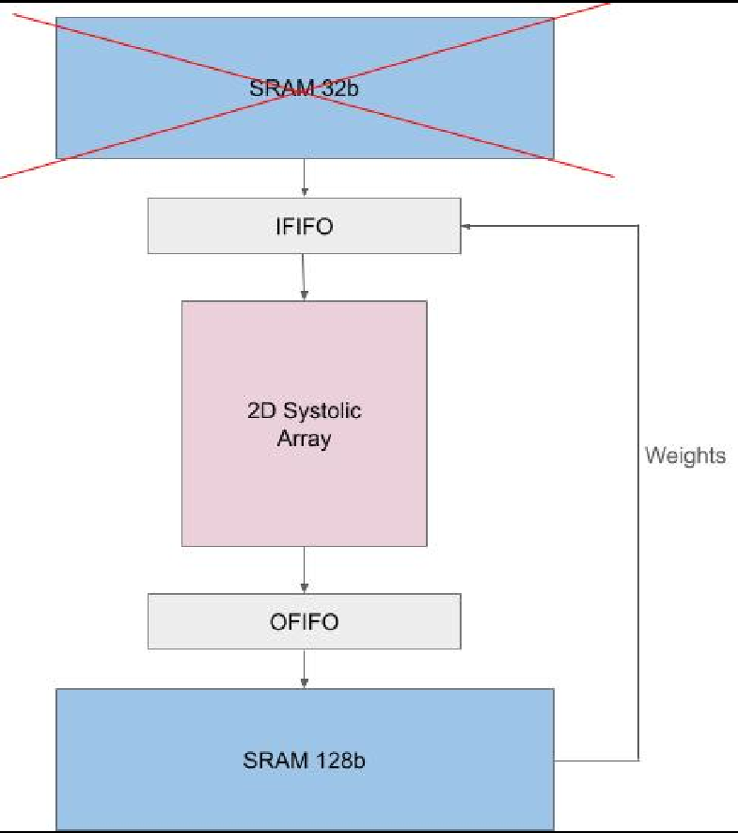
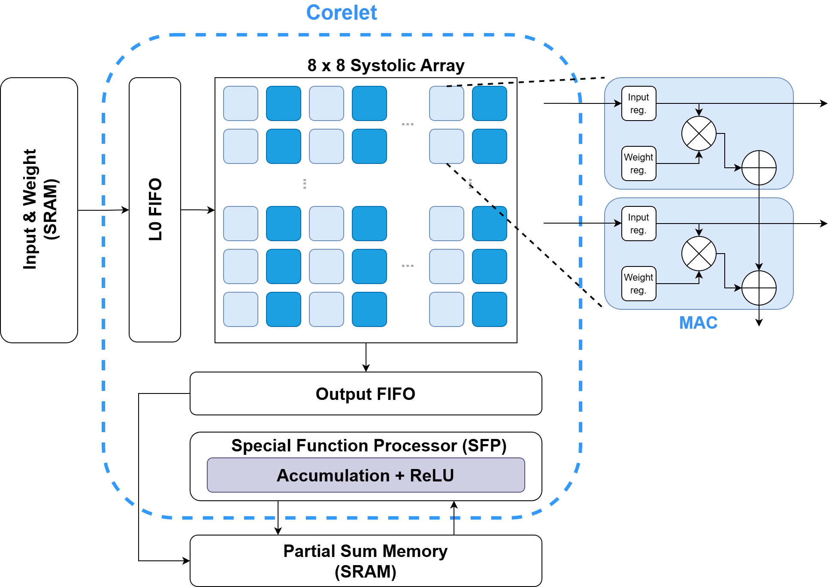
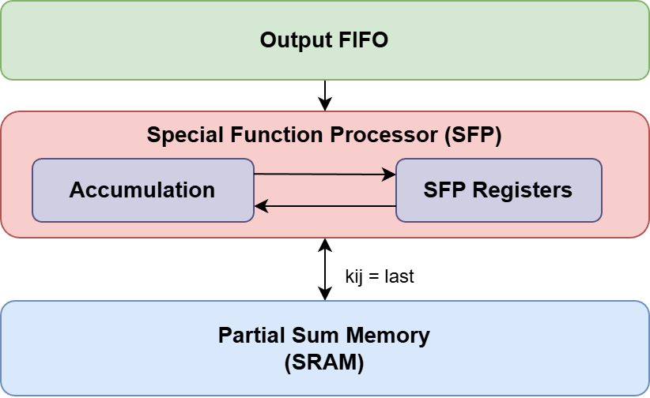
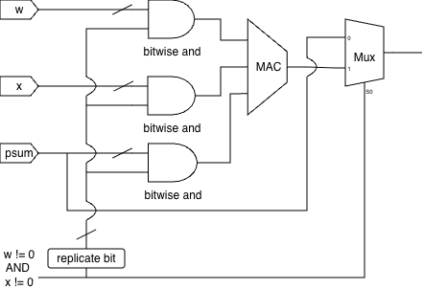
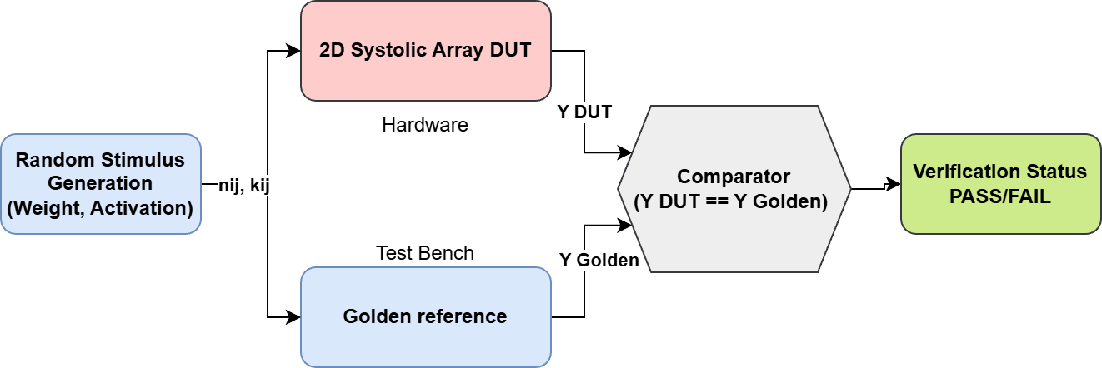
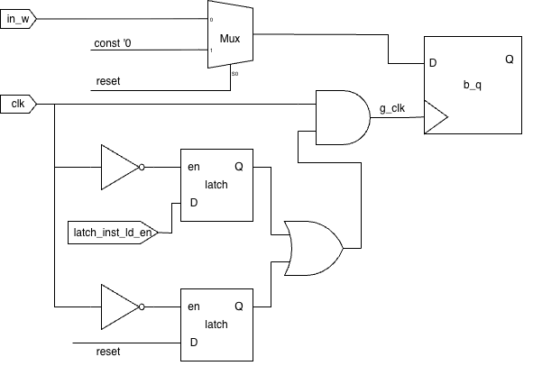
CNN inference on 2-D Systolic Array
Clocked Out
Ahmet Emre Eser, Ashita Singh, Devansh Gupta, Riyansh Chaturvedi, Rohan Nafde, Shoumik Panandikar
Motivation
Base Versions
Alpha 3: Unified Memory
This project develops three specialized 2-D systolic array variants: a weight stationary design for efficient data reuse, a SIMD version supporting 2-bit and 4-bit operations, and a hybrid architecture with configurable weight and output stationary modes. Performance optimizations and comprehensive testing ensure robust acceleration across diverse neural network workloads.
Vanilla (Weight Stationary):The baseline architecture implements the fundamental Weight Stationary (WS) dataflow, primarily optimizing for weight reuse efficiency.
SIMD Enhanced (2/4-bit Precision): Features a Single Instruction, Multiple Data (SIMD) data path to support 2-bit and 4-bit input precision, increasing throughput for quantized neural network operations.
Unified Stationary (WS & OS): Implements a flexible structure supporting dynamic switching between Weight Stationary (WS) and Output Stationary (OS) dataflows, aiming for applicability across various computation patterns.
Concept: In Output Stationary mode, the Partial Sum Memory (pmem) is bandwidth-heavy during accumulation but often idle during the initial weight loading phase.
Optimization: We reuse the existing high-bandwidth pmem (128-bit) to store weights instead of adding a separate, dedicated Kernel Memory (kmem).
2D Systolic Array
Alpha 1: Simultaneous Accumulation
We've implemented in-place accumulation through the SFP pipeline. Each SFP lane holds a dedicated accumulator register that stores the running sum of partial psums (kij) from the MAC array via OFIFO, accumulating them internally
Benefit: This removes the need for an additional 32-bit SRAM bank entirely. Since SRAM blocks dominate the silicon area of a core, eliminating one significantly reduces the total hardware footprint and static power leakage.
Only the final 8×8 block psum is written to SRAM, reducing memory traffic and eliminating intermediate writes. This achieves in-place accumulation within the hardware pipeline.
Alpha 4: Circuit Level Power Optimizations
VGGNet With Quantization Aware Training
Data Gating: When either the weight or activation is zero, the output simplifies to psum, making the MAC computation unnecessary. The MAC unit is bypassed using a MUX that forwards the psum to the output, while all inputs to the MAC are forced to zero. This prevents unnecessary switching activity within the MAC unit, saving dynamic power
 | VGGNet 16 (4 bit) | VGGNet 16 (2 bit)
Accuracy (CIFAR 10) | 89.560% | 85.360%
Alpha 2: Functional Verification
Mapping on FPGA (Cyclone IV GX)
 | VGGNet 16
Total OPs | 128
Frequency | 130.34 MHz
TOPs | 0.01668
Dynamic Power | 31.24 mW
TOPs/W | 0.534
Total Logic Elements | 22,556
Total Registers | 12,146
Data gating circuit
Concept: To ensure the integrity of our systolic array, we employ a rigorous hardware-software verification methodology.
Implementation: We utilize random stimulus testing where the array is fed random numerical inputs (weights and feature maps) spanning the full supported bit precision. A Golden Reference Model concurrently calculates the expected output. The hardware result is then compared against the Golden Result to confirm functional correctness across all operational modes.
Clock gating: Weight and load enable registers hold their values stable for long periods. When a register's load enable is inactive, clock gating prevents the flip-flops from toggling, avoiding the charging and discharging of internal capacitances, hence saving dynamic power.
Clock gating circuit

