Slide 1
Introduction to AWS
AWS Introduction

Slide 2
Cloud computing
Access services on demand
Pay as you go
Provision infrastructure resourses on the go
Notes:
Cloud computing is an on-demand delivery of IT resources over the internet, usually with pay-as-you-go pricing.
Instead of buying, owning, and maintaining physical data centers and servers, you can access technology services, such as computing power, storage, and databases, on an as-needed bases from a cloud provider such as Amazon Web Services (AWS).

Slide 3
Key Benefits
Pay as you go
No upfront commitment
Increase speed and automation
Availability
Notes:
Cloud computing is an on-demand delivery of IT resources over the internet, usually with pay-as-you-go pricing.
Instead of buying, owning, and maintaining physical data centers and servers, you can access technology services, such as computing power, storage, and databases, on an as-needed bases from a cloud provider such as Amazon Web Services (AWS).

Slide 4
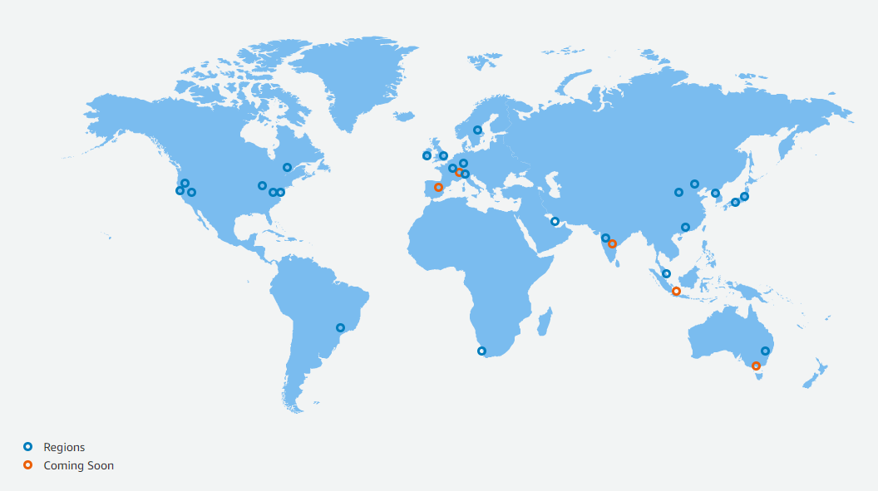
Regions
Notes:
Regions are physical geographic locations around the world where AWS hosts data centers. An AWS Region consists of two or more Availability Zones in the geographical area. AWS Regions are named after the location where they reside.
For example, in the United States, we have a Region in Northern Virginia called the Northern Virginia Region and a Region in Oregon called the Oregon Region.
At AWS, we currently have Regions in North America, South America, Europe, China, Asia Pacific, South Africa, and the Middle East, and we are continuously expanding to meet the needs of our customers.
When you use AWS, you choose the location for your resources by selecting a Region.

Slide 5
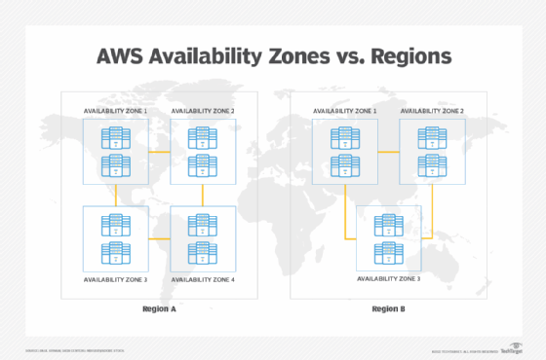
Availability Zones
Notes:
An Availability Zone (AZ) consists of one or more data centers with redundant power, networking, and connectivity. AZs give customers the ability to operate highly available, fault-tolerant, and scalable applications and databases.
Even though AZs are close enough to have low latency (latency is the time between when content is requested and received), they are not built directly next to one another.

Slide 6
Service management
Command Line interface (CLI)
AWS Management console
CloudFormation
SDK
Notes:
Cloud computing is an on-demand delivery of IT resources over the internet, usually with pay-as-you-go pricing.
Instead of buying, owning, and maintaining physical data centers and servers, you can access technology services, such as computing power, storage, and databases, on an as-needed bases from a cloud provider such as Amazon Web Services (AWS).

Slide 7
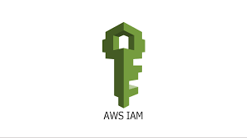

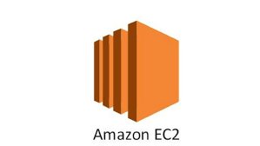
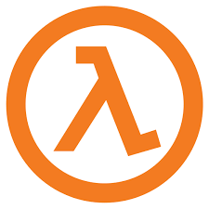
IAM
IAM
Users
Services
Notes:
AWS Identity and Access Management (IAM) is a web service that helps you manage secure access to your AWS accounts and resources.
With IAM, you can create and manage AWS users, applications, and connected services. By using permissions, you can control how users, applications, and services access your AWS resources.

Slide 8
IAM features
Global services
Integrated with AWS services
Integrated with Federations
Free to use
Notes:
Cloud computing is an on-demand delivery of IT resources over the internet, usually with pay-as-you-go pricing.
Instead of buying, owning, and maintaining physical data centers and servers, you can access technology services, such as computing power, storage, and databases, on an as-needed bases from a cloud provider such as Amazon Web Services (AWS).

Slide 9
Compute Services
Virtual machines
Containers
Serverless (Lambda)
Notes:
Cloud computing is an on-demand delivery of IT resources over the internet, usually with pay-as-you-go pricing.
Instead of buying, owning, and maintaining physical data centers and servers, you can access technology services, such as computing power, storage, and databases, on an as-needed bases from a cloud provider such as Amazon Web Services (AWS).

Slide 10
Elastic compute Cloud
Pay as you go
Launch in minutes
Large variety of AMI
Provision to create custom AMI
Notes:
Cloud computing is an on-demand delivery of IT resources over the internet, usually with pay-as-you-go pricing.
Instead of buying, owning, and maintaining physical data centers and servers, you can access technology services, such as computing power, storage, and databases, on an as-needed bases from a cloud provider such as Amazon Web Services (AWS).

Slide 11
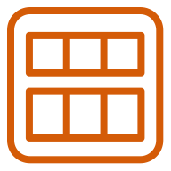

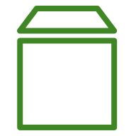
Amazon Machine Image (AMI)
AMI
EC2 instance
Launch instance
Operating system
Storage mappings
Permissions
Root volume
Notes:
When you launch an EC2 instance, you first specify an Amazon Machine Image (AMI). An AMI includes the operating system, storage mapping, architecture type, launch permissions, and any additional preinstalled software applications. Then the AMI is copied to the root device volume. You can use a single AMI to launch multiple EC2 instances with the same configurations.
AWS supports Linux, macOS, Windows, and other operating systems.
For AMIs, you can:
Create your own
Use available AWS AMIs
Purchase from AWS Marketplace
Reference
To learn more about AMI, refer to the AMI online user guide: https://docs.aws.amazon.com/AWSEC2/latest/UserGuide/AMIs.html.

Slide 12
EC2 life cycle
AMI
1
Launch
Pending
Start
3
Reboot
2
4
Rebooting
Running
Stop
Stopping
Stopped
Stop-Hibernate
Terminate
Shutting-down
5
Terminate
Terminated
Notes:
An EC2 instance transitions between different states from the moment you create it all the way through to when you terminate it.
When you first launch an instance from an AMI or start it from a stopped state, it goes into the pending state. You will not be billed at this state.
Once AWS has copied the AMI into the root volume and allocated necessary network components, the instance enters the running state. The instance is ready for use and you will be billed.
You can reboot the instance at any time.
When you stop the instance, this puts the instance into the stopped state, and it cannot be used. You can start the instance again at any time. You will not be billed in the stopped state. This is similar to when you shut down your laptop. When you put the instance into stop-hibernate, the instance enters stopped state, but saves the last information or content into memory, so that the start process is faster. Once running, you can resume from where you stopped.
From the running or stopped state, if you are done with using your instance, you can proceed to terminate the instance. In the terminated state, the instance is permanently deleted and cannot be started. All data in the instance is deleted, unless you have saved the data at an external storage.

Slide 13
Storage types
Block storage
File Storage
Object storage
Notes:
Cloud computing is an on-demand delivery of IT resources over the internet, usually with pay-as-you-go pricing.
Instead of buying, owning, and maintaining physical data centers and servers, you can access technology services, such as computing power, storage, and databases, on an as-needed bases from a cloud provider such as Amazon Web Services (AWS).

Slide 14


EBS Volume
Amazon EC2 instance
Amazon EBS
Notes:
With block storage, data is stored on a device in fixed-sized blocks (for example, 512 bytes). Applications and file systems regulate how blocks are accessed, combined, and modified.
The two types of block storage in AWS are Amazon EC2 instance store and Amazon Elastic Block Store (Amazon EBS).
An Amazon EC2 instance store is a temporary block-level storage for your Amazon EC2 instance. This storage consists of a preconfigured and pre-attached block of disk storage on the same physical server that hosts the Amazon EC2 instance. It is temporary because the storage data is lost when you stop or terminate your Amazon EC2 instance.
If your data must be retained and protected from deletion when an Amazon EC2 instance is stopped or terminated, you can use Amazon Elastic Block Store (Amazon EBS). Amazon EBS is a detachable storage associated with an Availability Zone, similar to an external hard drive you use for your laptop. If you stop or terminate your Amazon EC2 instance, your data is still available in the Amazon EBS volume. You can detach it from the instance you are terminating and re-attach it to another instance.
To back up or copy your data in your Amazon EBS volume to another AZ, or use the data for another Amazon EC2 instance, you can create a snapshot of the volume by using the Amazon EBS snapshot service. Snapshots represent full backups; however, the actual storage consumed by each snapshot is incremental to previous snapshots through the use of appropriate block mappings.

Slide 15
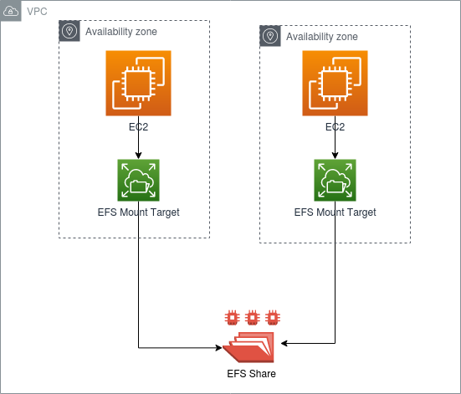
EFS Volume
Notes:
With block storage, data is stored on a device in fixed-sized blocks (for example, 512 bytes). Applications and file systems regulate how blocks are accessed, combined, and modified.
The two types of block storage in AWS are Amazon EC2 instance store and Amazon Elastic Block Store (Amazon EBS).
An Amazon EC2 instance store is a temporary block-level storage for your Amazon EC2 instance. This storage consists of a preconfigured and pre-attached block of disk storage on the same physical server that hosts the Amazon EC2 instance. It is temporary because the storage data is lost when you stop or terminate your Amazon EC2 instance.
If your data must be retained and protected from deletion when an Amazon EC2 instance is stopped or terminated, you can use Amazon Elastic Block Store (Amazon EBS). Amazon EBS is a detachable storage associated with an Availability Zone, similar to an external hard drive you use for your laptop. If you stop or terminate your Amazon EC2 instance, your data is still available in the Amazon EBS volume. You can detach it from the instance you are terminating and re-attach it to another instance.
To back up or copy your data in your Amazon EBS volume to another AZ, or use the data for another Amazon EC2 instance, you can create a snapshot of the volume by using the Amazon EBS snapshot service. Snapshots represent full backups; however, the actual storage consumed by each snapshot is incremental to previous snapshots through the use of appropriate block mappings.

Slide 16
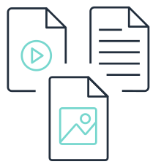
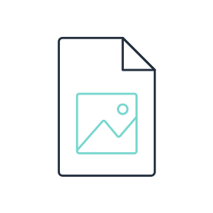

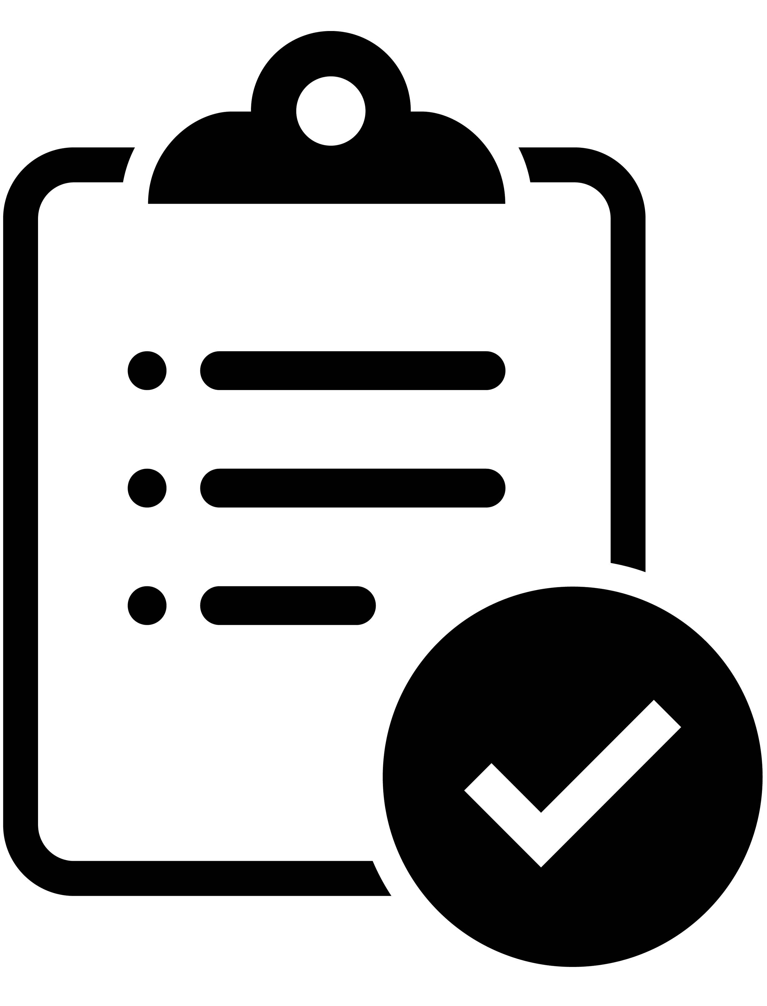
Object storage
Data
Metadata
Key
Object storage
Object
Notes:
In object storage, files are stored as objects. Each object consists of data, metadata, and an object key. The metadata has information about the data (object size, object purpose, and more), and the object key is the unique identifier of the object. When you update files in object storage, the entire file object is updated, instead of a piece of a file, as in block storage.

Slide 17
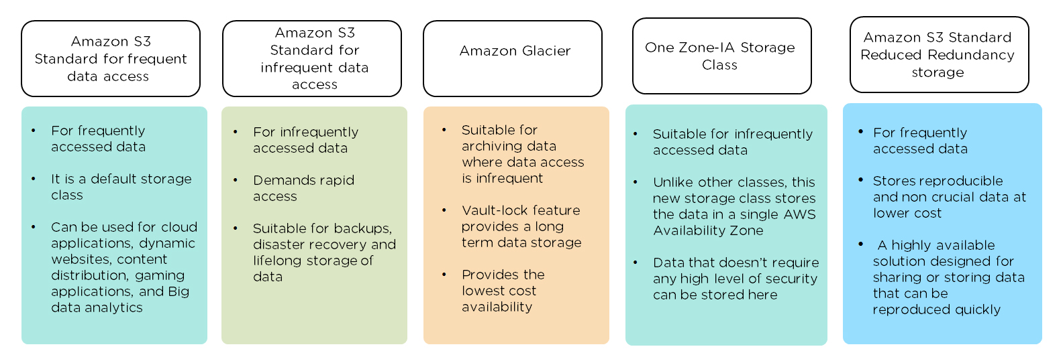
AWS Storage classes

Slide 18
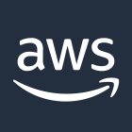




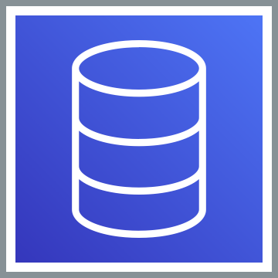
Amazon VPC and subnets
AWS Cloud
Region
Availability Zone 1
Availability Zone 2
VPC (10.0.0.0/16)
Public subnet (10.0.0.0/28)
Public subnet (10.0.16/28)
EC2 Instance
EC2 Instance
Private subnet
Private subnet
Database
Database
Notes:
Amazon Virtual Private Cloud (Amazon VPC) helps you define and provision a virtual network in the AWS Cloud for your AWS resources, similar to a traditional network in a data center.
When you create an Amazon VPC, you must provide the following information:
Region
Name for your Amazon VPC
IP address range for your Amazon VPC
When you create an Amazon VPC, it spans multiple Availability Zones in the Region you selected.
After you create a VPC, the next step is to create a subnet. A subnet is a smaller network inside an Amazon VPC, where you place your AWS resources. Routing can be configured so that subnets are internet-facing, or public, or non-internet-facing, or private. A variety of routing configurations can be used to determine resource reachability outside the VPC. The configurations are applied at the subnet level. In this way, subnets provide a way to bound resources that require a specific external routing configuration.
For high availability, create your public and private subnets in two different Availability Zone.
The purpose of a subnet is to locate resources to specific Availability Zone. Subnets provide bounding of resources for routes providing external access to the VPC or where there is a need to separate resources for security control.

Slide 19
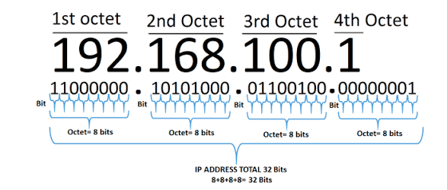
CIDR

Slide 20
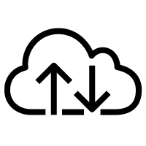






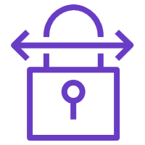

VPC Architecture
Internet
Client
Availability Zone 1
Availability Zone 2
VPC (10.0.0.0/16)
Internet
gateway
Public subnet (10.0.0.0/24)
Public subnet (10.0.1.0/24)
Corporate
data center
NAT
gateway
Internet
EC2 instance
EC2 instance
Private subnet
Private subnet
Customer gateway
Virtual private gateway
VPN connection
Router
Database
Database
Notes:
You connect to your Amazon VPC through the internet by way of an internet gateway. In some ways, this is similar to using a modem or broadband to connect to the internet from your home, but the internet gateway is designed to be highly available and scale seamlessly.
You can connect AWS resources in your private subnet to the internet through a network address translation (NAT) gateway and prevent the internet from connecting to the resources. A NAT gateway should be created in each Availability Zone, so if an AZ becomes unreachable, the resources in the remaining Availability Zones can still reach the internet. However, each NAT gateway is designed to be highly available within the context of its own Availability Zone.
How would you establish an encrypted virtual connection between your on-premises data center and your Amazon VPC? With a virtual private gateway. To establish this connection, you must do the following:
Create the virtual private gateway and attach it to your Amazon VPC.
Create a customer gateway and connect it to your on-premises data center.
Establish a VPN connection between your virtual private gateway and customer gateway.
Resource
To learn more about Amazon VPC features, visit https://docs.aws.amazon.com/vpc/latest/userguide/what-is-amazon-vpc.html.

Slide 21
Route tables
Custom route table
Destination | Target
10.0.0.0/16 | local
0.0.0.0/0 | Internet gateway ID
Availability Zone
VPC (10.0.0.0/16)
Internet gateway
Public subnet
EC2 instance
Private subnet
Main route table
Destination | Target
10.0.0.0/16 | local
0.0.0.0/0 | NAT gateway ID
Database
= NAT gateway
Notes:
When you connect to your Amazon VPC, route tables control where the network traffic is directed.
Each subnet in your Amazon VPC is associated with a route table. You can associate multiple subnets with one route table, but you can’t associate multiple route tables with one subnet.
Each route in the route table has a destination and a target. The destination specifies the CIDR range for which traffic is intended, and the target specifies the path it should use to be routed to the destination. The source is usually the subnet.
For example, to grant your subnet access the internet through an internet gateway, with an ID of igw-12345, the destination will be 0.0.0.0/0 and the target will be igw-12345. A local route is always present and cannot be deleted. The 0.0.0.0/0 route applies to all traffic not captured by a specific route (the local route, in this case).
To connect resources in a private subnet to the internet through a NAT gateway, you must:
Create a NAT gateway with an Elastic IP address in the public subnet.
Update the route table associated with your private subnet to point internet-bound traffic to the NAT gateway.
When you create your Amazon VPC, AWS creates and associates a main route table with your subnets. By default, the main and custom route tables allows traffic between all subnets in the VPC.
To customize your network traffic, add routes in the custom route table and associate the table with your subnets.

Slide 22

Network access control lists
Internet
Client
Availability Zone
Inbound
Rule # | Type | Protocol | Port range | Source | Allow/ Deny
100 | All IPv4 traffic | All | All | 0.0.0.0/0 | ALLOW
* | All IPv4 traffic | All | All | 0.0.0.0/0 | DENY
Outbound
Rule # | Type | Protocol | Port range | Destination | Allow/ Deny
100 | All IPv4 traffic | All | All | 0.0.0.0/0 | ALLOW
* | All IPv4 traffic | All | All | 0.0.0.0/0 | DENY
VPC
Internet
gateway
Public subnet
Network ACL
EC2 instance
Notes:
To securely control your subnets’ inbound and outbound network traffic, you use a virtual firewall called a network access control list (network ACL). A network ACL has separate inbound and outbound rules, and each rule can either allow or deny traffic. Network ACLs are stateless, which means that even though network traffic was allowed to enter the subnet with a rule, it still needs another rule for the outbound network traffic.
Your Amazon VPC comes with a default network ACL, which allows all inbound and outbound IPv4 and IPv6 (if applicable) traffic. If no custom network ACL is created for your subnets, they will use the default network ACL.
To customize network access to your subnets, create a custom network ACL. By default, the custom network ACL will deny all inbound and outbound network traffic until you add rules. You can associate multiple subnets to a network ACL. But a subnet can only be associated with one network ACL. If you associate a custom network ACL with a subnet that has an existing network ACL, the previous one with be replaced.
Resource
To learn more about network ACLs, visit https://docs.aws.amazon.com/vpc/latest/userguide/vpc-network-acls.html.

