Slide 1
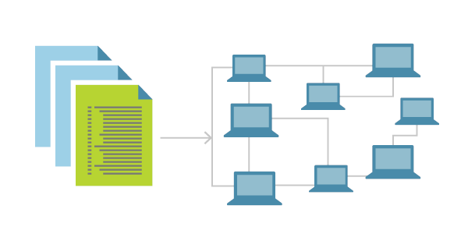
Introduction to Docker CI/CD

Slide 2
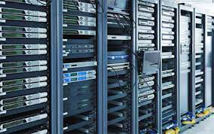

Slide 3
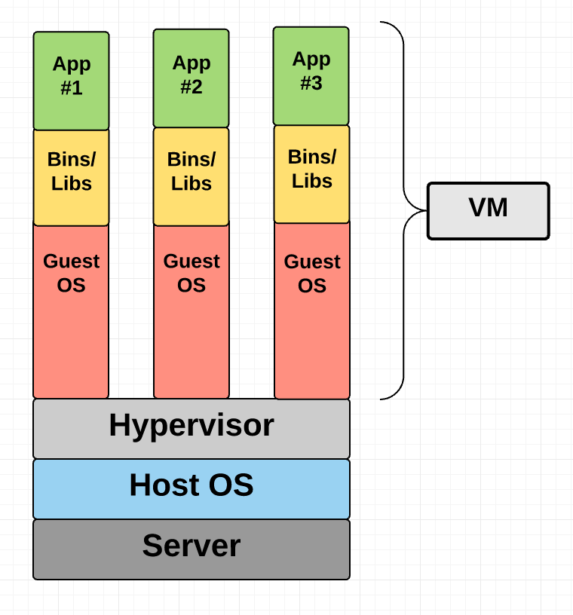

Slide 4
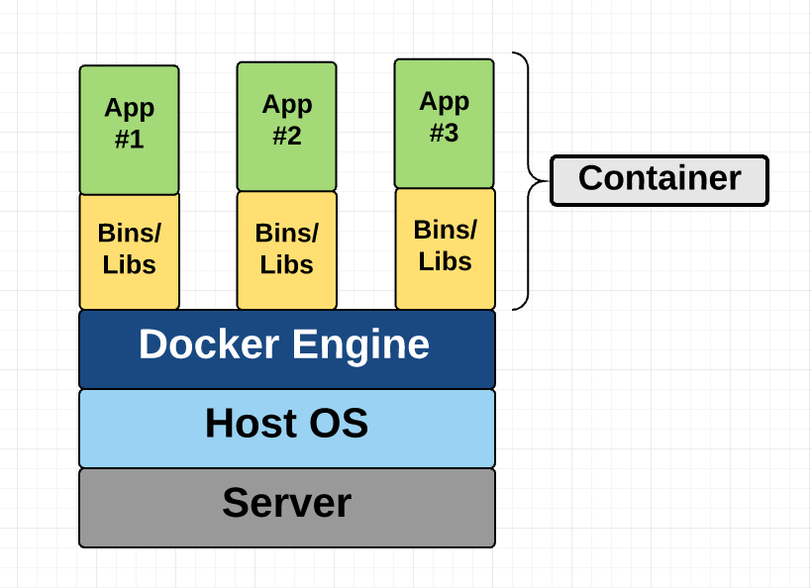

Slide 5
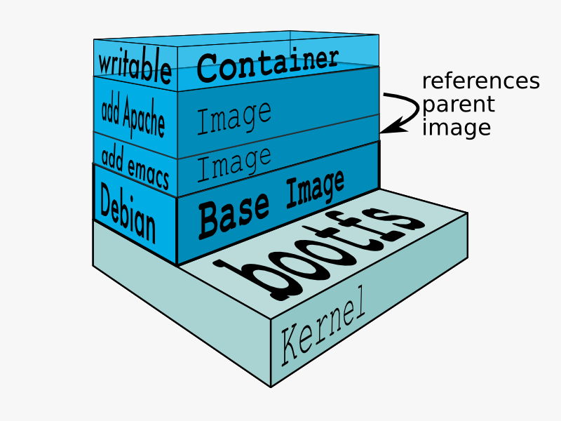

Slide 6
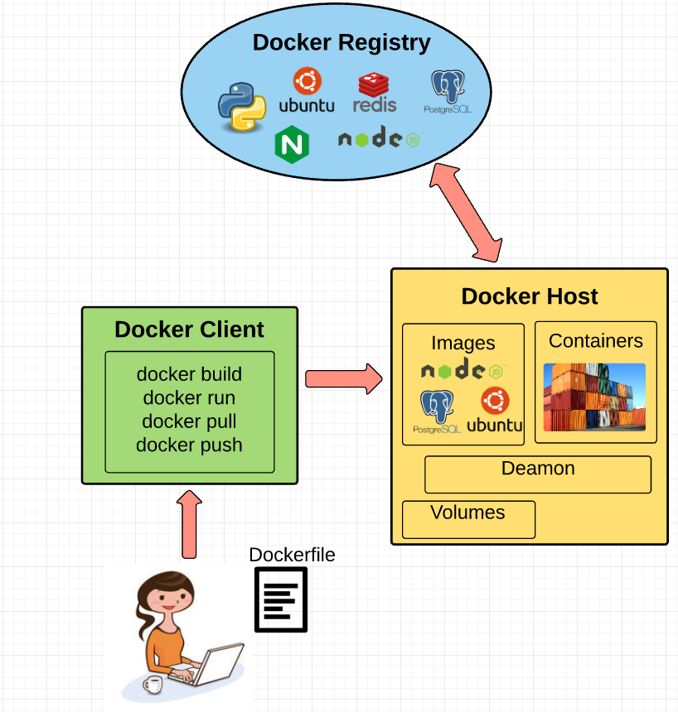

Slide 7
Continuous Integration
Orchestrating builds
Open source
Ecosystem
Jenkins

Slide 8
Commit changes to VC
Feedback
CI server
Jenkins
Build
Test
Deploy

Slide 9
