Slide 1

Data streaming with Kafka Streams

Slide 2

Kafka ?

Slide 3
Streaming processing
Tracking user activity
Log Aggregation
De Coupling systems
Use Cases

Slide 4
Apache Kafka is an open-source distributed event streaming platform used by thousands of companies for high-performance data pipelines, streaming analytics, data integration, and mission-critical applications.
Kafka ?

Slide 5
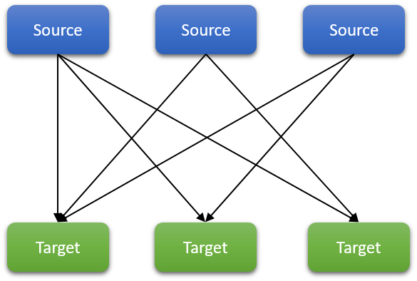

Slide 6
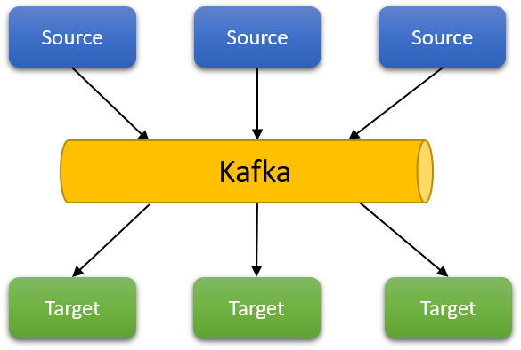

Slide 7
Scale to 100s of nodes
Handle millions of messages per second
Real time data processing
Event tracking
Event Sourcing
Kafka

Slide 8
Logical name to send messages
Topics will be split into multiple partitions
Partition enables topics to be distributed across the cluster
Partition enable horizontal scalability
Unit of parallelism
Topics can span across nodes with partition
Topics

Slide 9
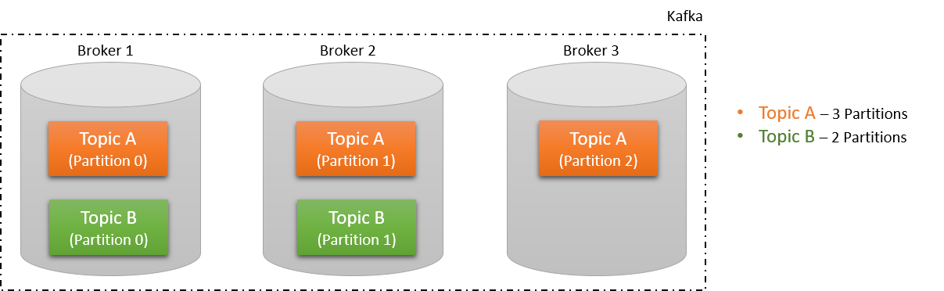

Slide 10
Message in partition are assigned offset
Offsets are unique to partition
Messages are ordered only in a partition
Partition key dictates the partition without which the messages will be assigned to a random partition
Partitions

Slide 11
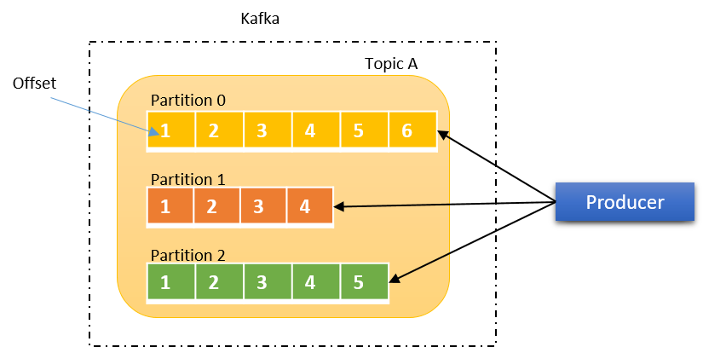

Slide 12
Manages the list of brokers
Elects a leader broker in case of broker failure
Leader zookeeper handles all the writes
Follower zookeeper handles only the reads.
Zookeeper

Slide 13
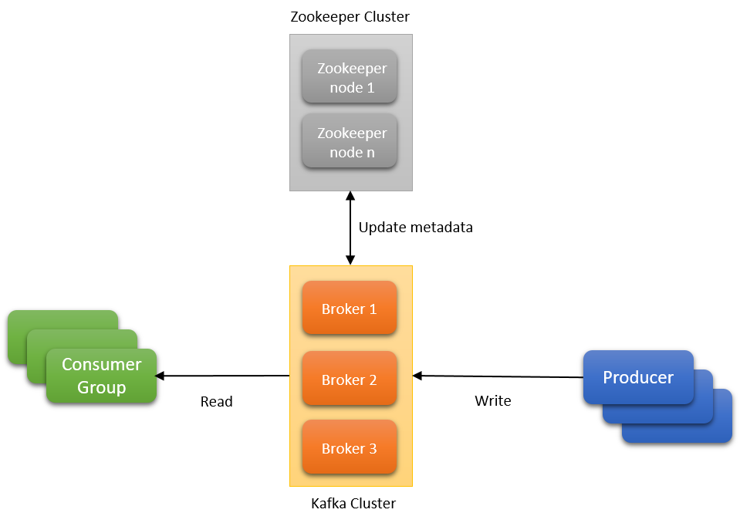

Slide 14
Single node managed by the Zookeeper
Set of brokers form a cluster
Topics created are distributed across brokers based on partition and replications
In case of broker node failure, the zookeeper rebalances the cluster
If a leader partition is lost, the follower partition is elected as a new leader
Broker

Slide 15
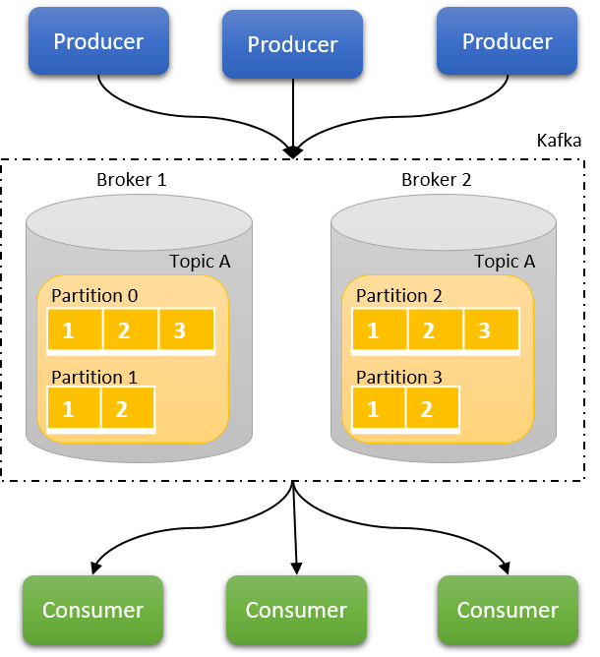

Slide 16
Making a copy of the partition available in another broker
Makes Kafka fault tolerant to broker and partition failure
Leader partition is elected in case of partition available on multiple brokers
The remaining partitions are called followers
Both producers and consumers are served by the same broker
In case of broker failure, the partition from another broker is elected as leader and starts serving the producers and consumers
Replication

Slide 17
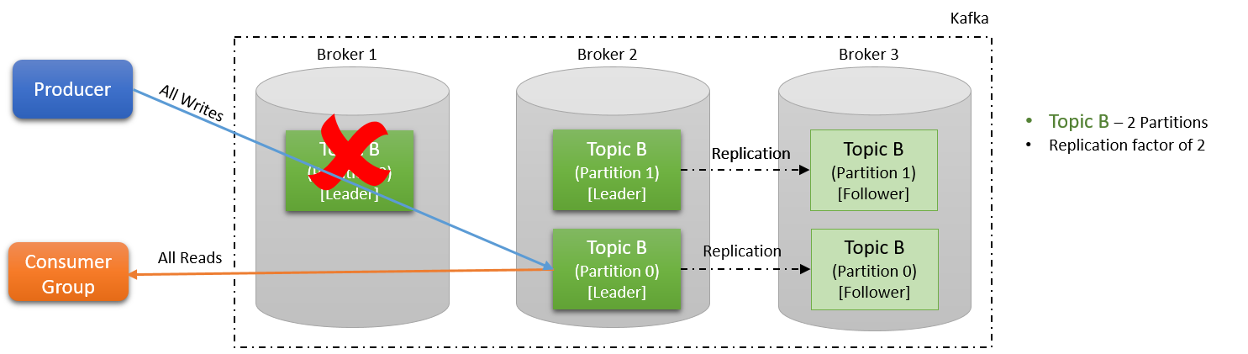

Slide 18
Producers

Slide 19
Writes the messages to appropriate broker
Perform message serialization, partitions, compression.
Load balances messages across brokers based on the partitions.
In case of broker failure, the partition from another broker is elected as leader and starts serving the producers and consumers
Producer

Slide 20
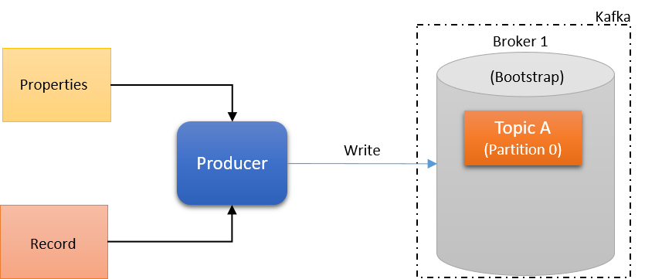

Slide 21
Bootstrap servers (brokers)
Acknowledgements
Batch.size
Key.serializer
Value.serializer
Producer Properties

Slide 22
The message written to the Kafka is called as a producer record
Name of the topic and value is mandatory
Other fields like partition, timestamp and key are optional
Producer Record

Slide 23
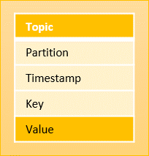

Slide 24
Bootstrap servers – list of brokers are called bootstrap servers. At least 2 bootstrap servers are recommended.
Producer first establishes the connection with the one of the bootstrap server
The bootstrap server returns all the brokers and the metadata like topics, partitions, replication factor etc.
The Producer then identifies the leader broker for the leader partition and post the message to the leader broker.
Key Points

Slide 25
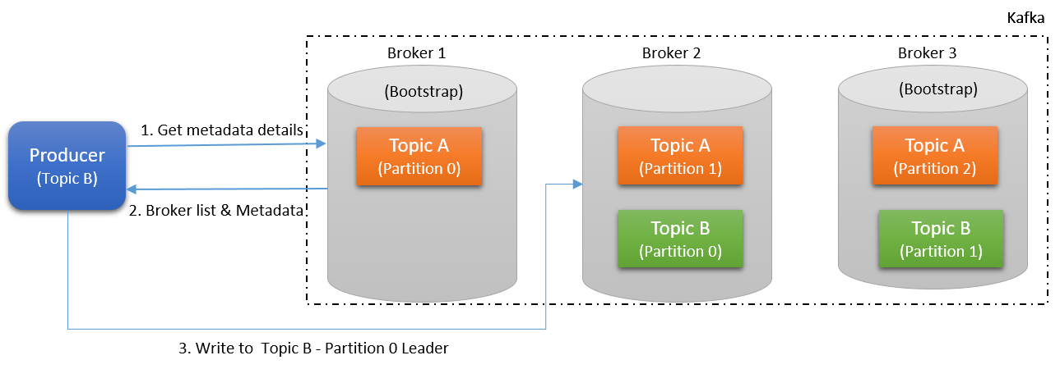

Slide 26
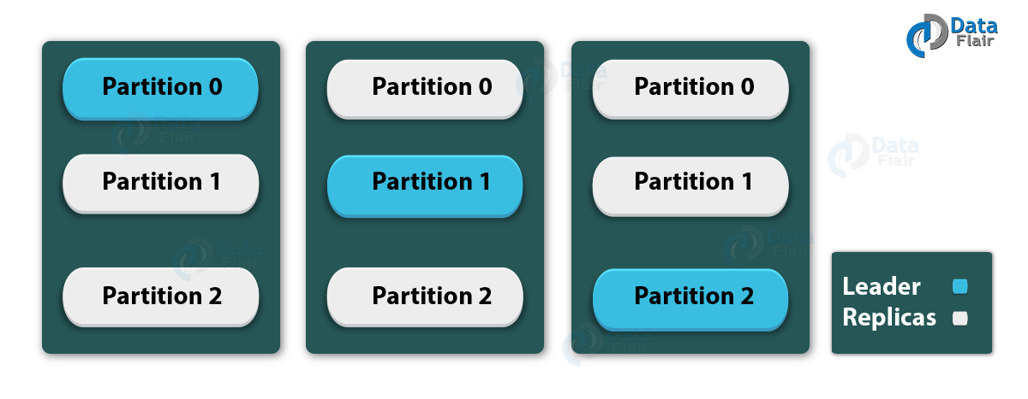

Slide 27
Workflow

Slide 28
Serializer
Producer first serialize the record based on the serializers passed.
Both key and value are serialized
Partition
Producer decides which partition of the topic the message to be written to.
Partition is decided after hashing the partition key
In case of no partition key, round-robin algorithm is used
Workflow

Slide 29
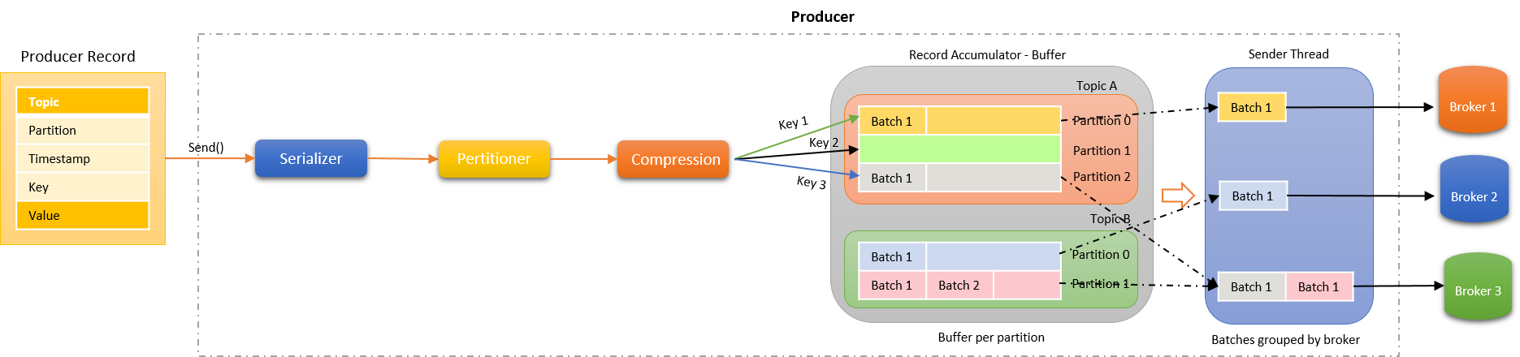

Slide 30
Partition
Order is maintained per partition in the order received
Partition key plays the role to decided which partition the message is written to
Custom partition can be used to control the partition to be written to.
Compression
Records are compressed before they are written to the record accumulator.
Enables faster replication and faster transfer
Helps better throughput , low latency and better disk utilization.
Workflow

Slide 31
Record Accumulator
Records are accumulated in buffer per partition of the topic.
Records are grouped into batches based on the producer batch.size property.
Each partition in a broker gets a separate buffer/accumulator.
Sender Thread
Batches of the partition in the record accumulator are grouped by broker to which they are sent.
The records are dispatched to the broker.
Workflow

Slide 32
Producer delivery Semantics

Slide 33
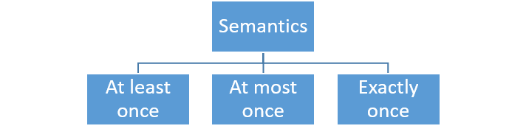

Slide 34
Records are acceptable to be read more than once.
Unacceptable to loose a message
Can result in message duplication.
Retries are allowed by the producer till the producer gets the acknowledgement from the broker.
Ensures that all messages are delivered.
Most preferred semantics of all.
Results in moderate throughput and moderate latency.
At least once

Slide 35
Records are delivered at the most once or maximum one time.
Acceptable to loose a message
No retries and follow send and forget protocol.
Unacceptable to have duplicate messages
Application adopting at most once can easily achieve high throughput and low latency
Ex: metrics, transaction, log events
At most once

Slide 36
Records should be read only once.
Unacceptable to loose a message
Most difficult delivery semantics of all.
Results in lower throughput and high latency.
Exactly once

Slide 37
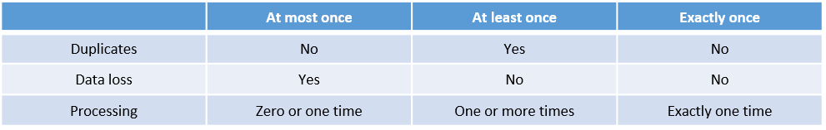

Slide 38
Ack = 0
At most once delivery semantics
Producer do not wait for acknowledgement from the broker after sending message
Messages will not be retried.
Send and forget approach.
Chances of data loss is high
Can result in data loss in case the message has not reached the broker and the broker dies.
Producer delivery semantics

Slide 39
Ack = 1
At least once delivery semantics
Producer wait for response from the broker after sending message
Messages will be retried in case the producer does not receive the acknowledgement from the broker.
Producer will retry based on the configuration value.
Default value of retry is 0.
Moderate chances of data loss
Data loss can happen after sending the ack but before replication to other broker fails and in this case producer will not retry sending the record.
Producer delivery semantics

Slide 40
Ack = All
Exactly once delivery semantics
Producer wait for response from the broker after sending message
Messages will be retried in case the producer does not receive the acknowledgement from the broker.
Producer will retry based on the configuration value.
Broker will send the ack only after ISR is met.
Less chances of data loss
Data loss can happen after sending the ack but all the brokers with ISR failed.
Producer delivery semantics

Slide 41
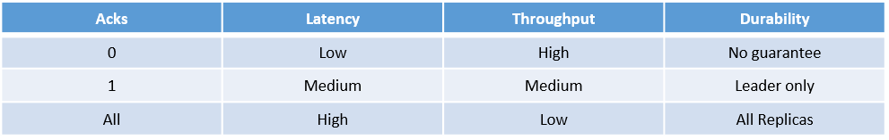

Slide 42
Consumer delivery Semantics

Slide 43
Consumer
Kafka Consumer can subscribe to one or more topics
Can also subscribe to a list of topics matching a regular expression
Optimal consumption of data
Takes a Kafka connection and consumer properties to read records from the appropriate broker.
Consumer delivery semantics

Slide 44
Multi app Consumption
Multiple applications can consume records from the same topic
Each application that consumes the data from the broker, gets its own copy and read at its own speed.
Offset consumed from one application can be different from the another application.
Kafka keeps track of offsets consumed by each application in an internal topic called `_consumer_offset` topic.
Consumer delivery semantics

Slide 45
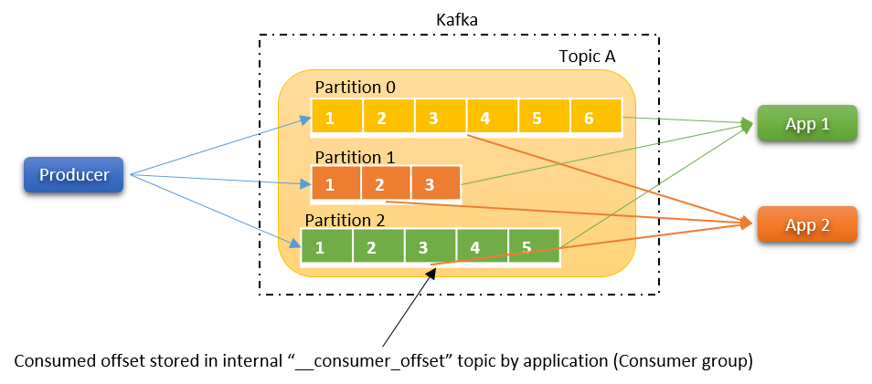

Slide 46
Each application consuming the records from Kafka is referred to as Consumer Group.
Application = Consumer Group
Each consumer group can have one or more consumers
Consumer from a consumer group will consume all the partitions of a topic.
To increase the rate of processing and in parallel, additional consumers can be added to the consumer group.
Kafka takes care of keeping track of the offsets consumed per consumer in a consumer group and rebalancing when adding/removing consumers.
Consumer Group

Slide 47
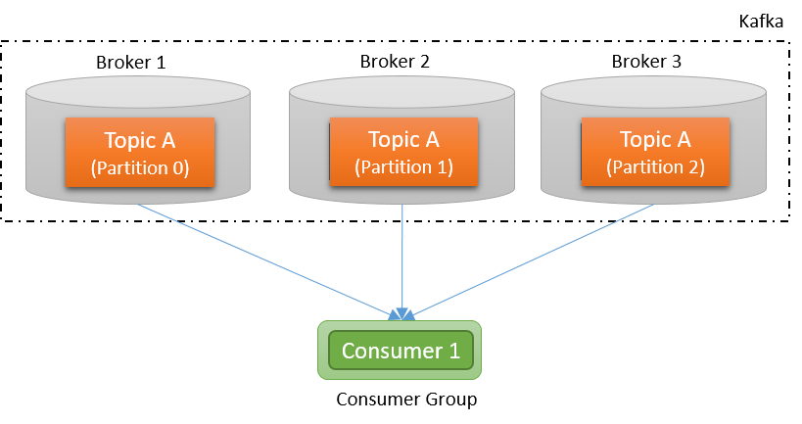

Slide 48
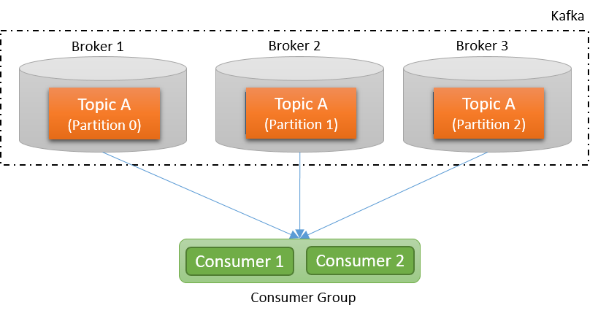

Slide 49
In case of multiple consumers in a consumer group, each consumer is assigned with one or more partitions.
Each consumer in the group will process the records in parallel from each of the leader partition of the brokers.
A consumer can read from multiple partitions.
No single partition can be assigned to two consumers in the same consumer group.
When there are more numbers of consumers in a consumer group is more than the number of partitions in a topic, the consumers will be idle.
Consumer Group

Slide 50
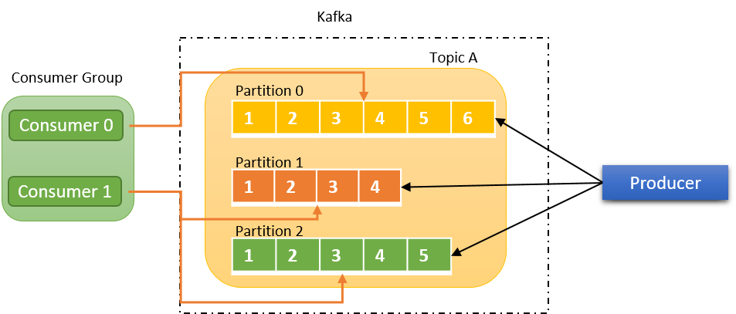

Slide 51


Slide 52
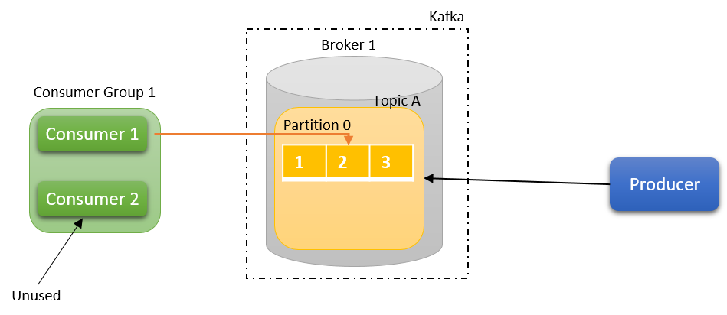

Slide 53
