Slide 1
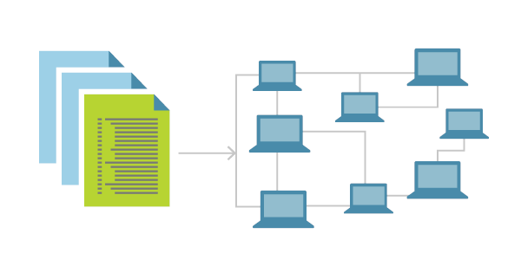
Deployment with K8s

Slide 2
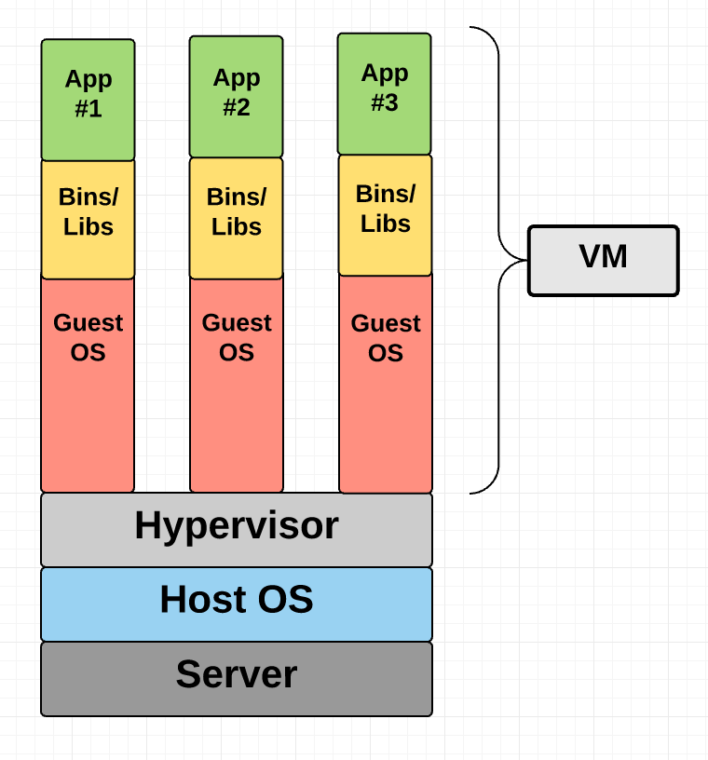

Slide 3
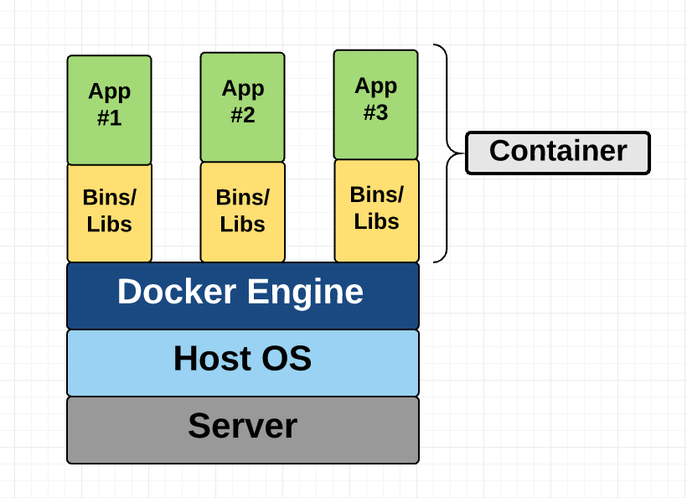

Slide 4
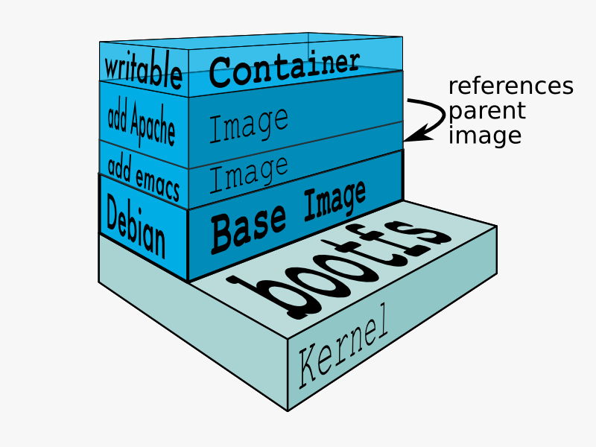

Slide 5
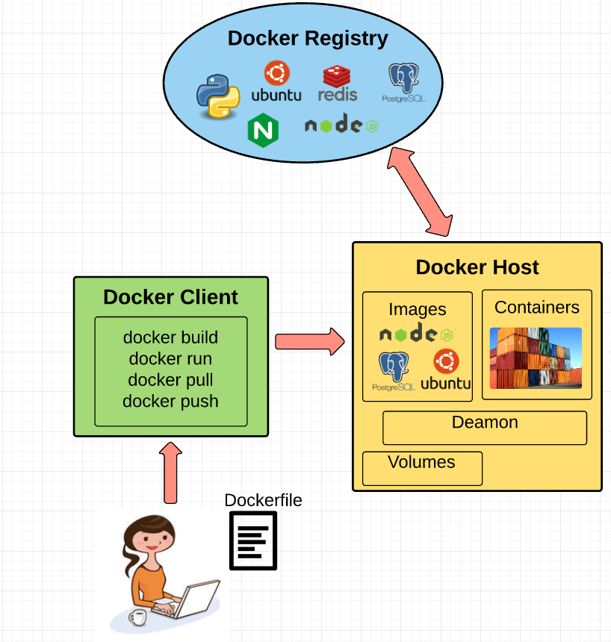

Slide 6
Continuous Integration
Orchestrating builds
Continuous deployment
CI / CD

Slide 7
Commit changes to VC
Feedback
CI server
CI / CD
Build
Test
Deploy

Slide 8
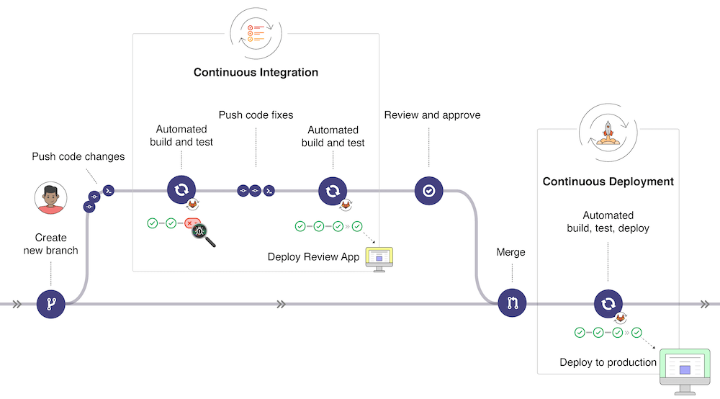

Slide 9
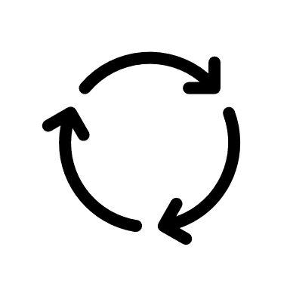
Replica-Sets
Blue-Green Deployment
Canary-Deployment
Deployment

Slide 10
Recreate
Delete all the old pods and start with the new pods
Causes application downtime
Can introduce breaking schema changes
Rolling update
Start the pods and delete the old pods once the new pods are up and serving traffic
No downtime
Cannot introduce breaking schema changes
Deployment

Slide 11
Higher order resource for Deployment
Manages the Replica-Sets
Creates the Replica-Sets in the background
Co-ordinates between older and newer versions of Replica-Sets
No change is needed at the Service and Ingress level
K8s Deployment

Slide 12
Rolling Update
Default strategy
Removes the pod one by one while adding the pods
Application is available through out the deployment steps
Use this, when applications supports both versions of the application to run parallelly.
Deployment Strategies

Slide 13
Recreate
Delete all the pods and replaces with new pods
Use this, when different versions of the applications cannot be run parallelly.
Application downtime during deployment
Deployment Strategies

Slide 14
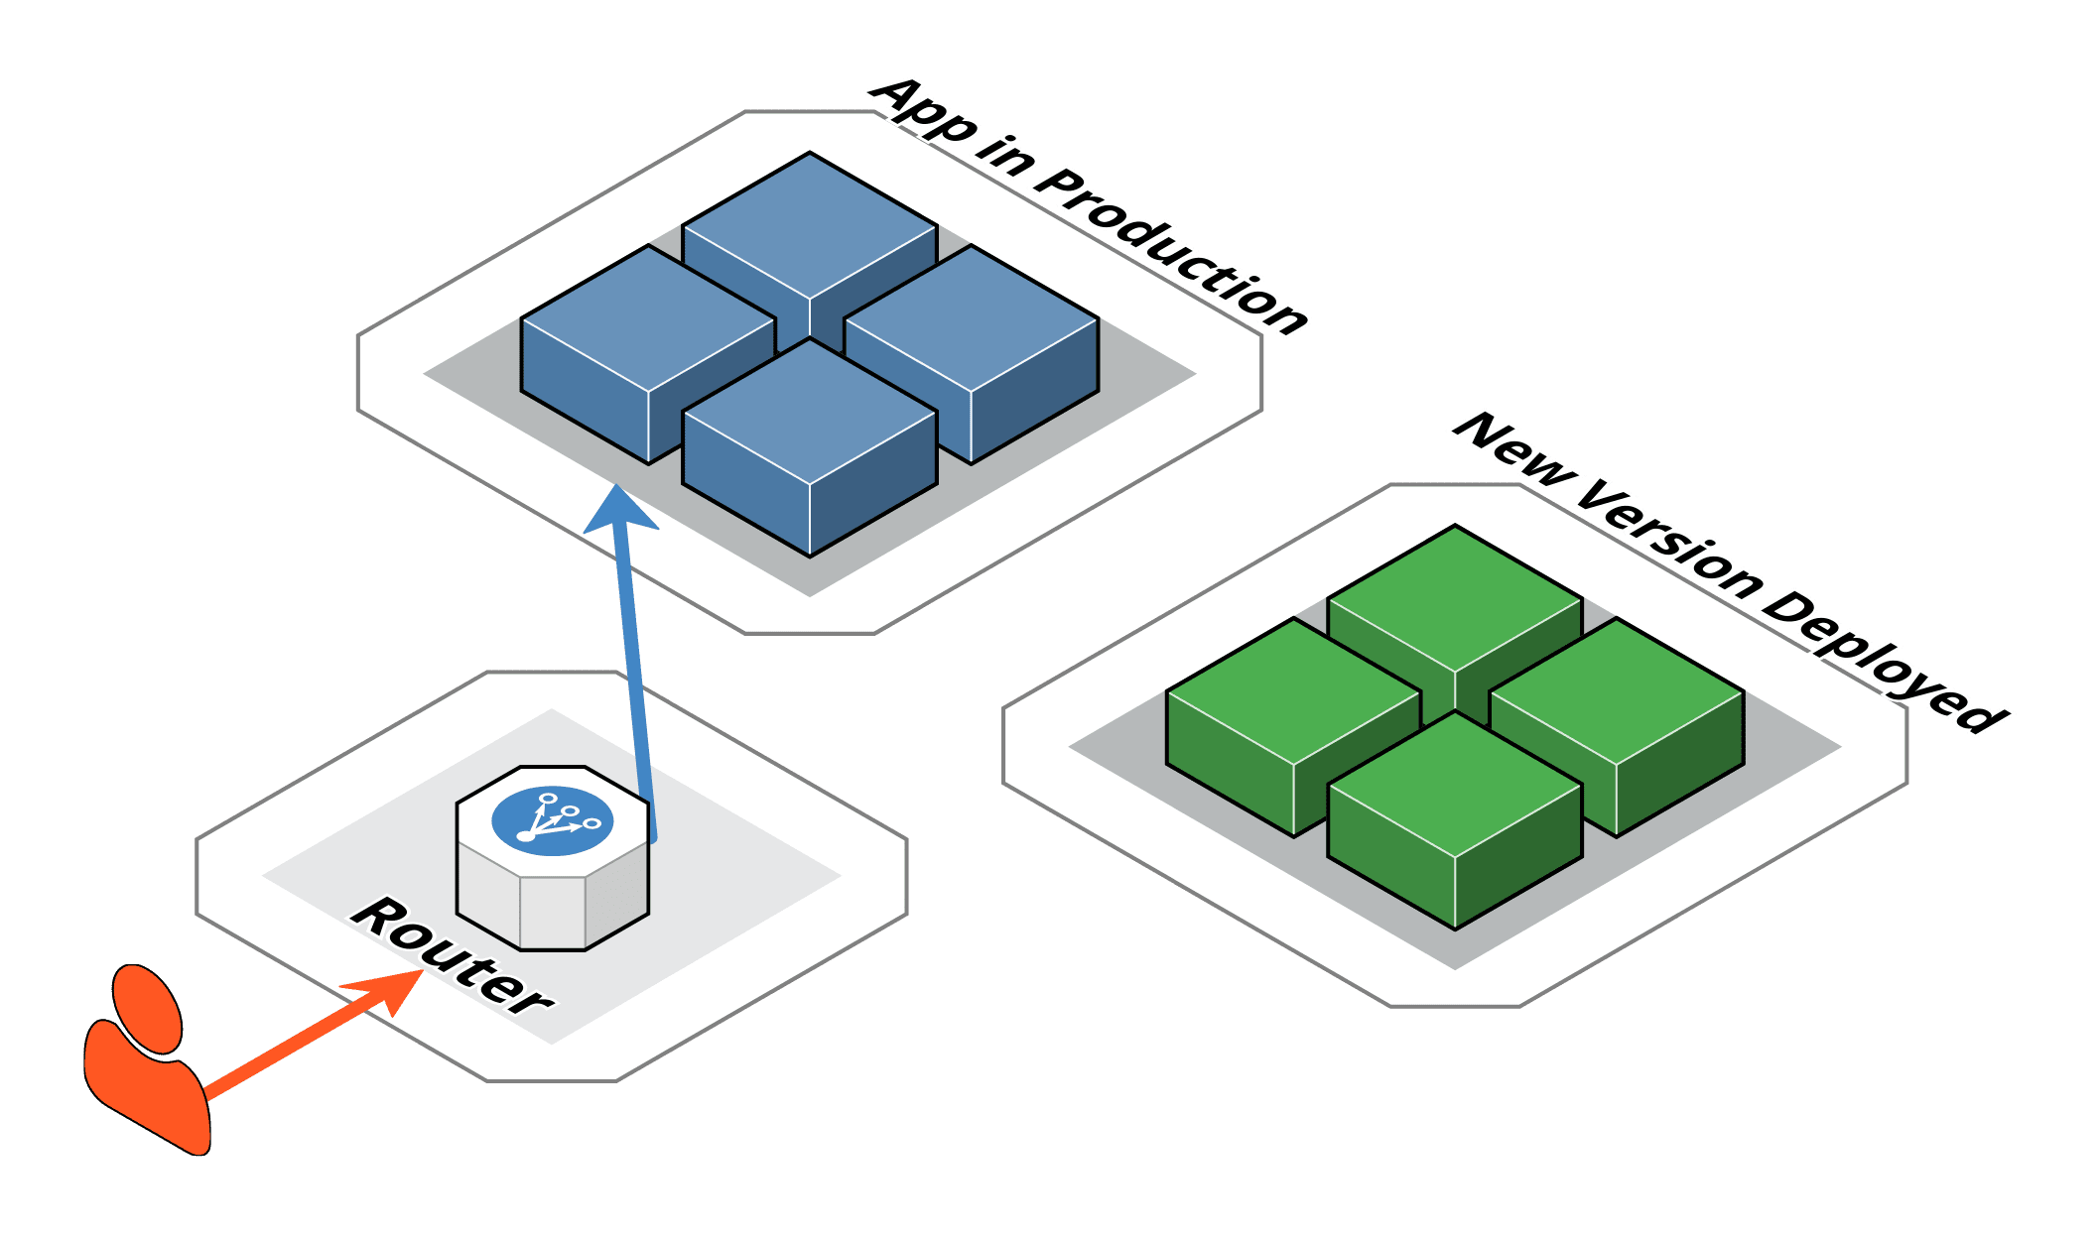
Blue-Green

Slide 15
Deployment
Triggering the rolling update
Pausing the deployment
Resuming the deployment
Status of the deployment
K8s Deployment Commands

