Slide 1
BUILDING MICROSERVICES

Slide 2
Agility
Code refactoring
Big ball of mud
Slower release cycles
Brittle
Vertical scaling
Configuration drift
Motivation
for
Microservices

Slide 3
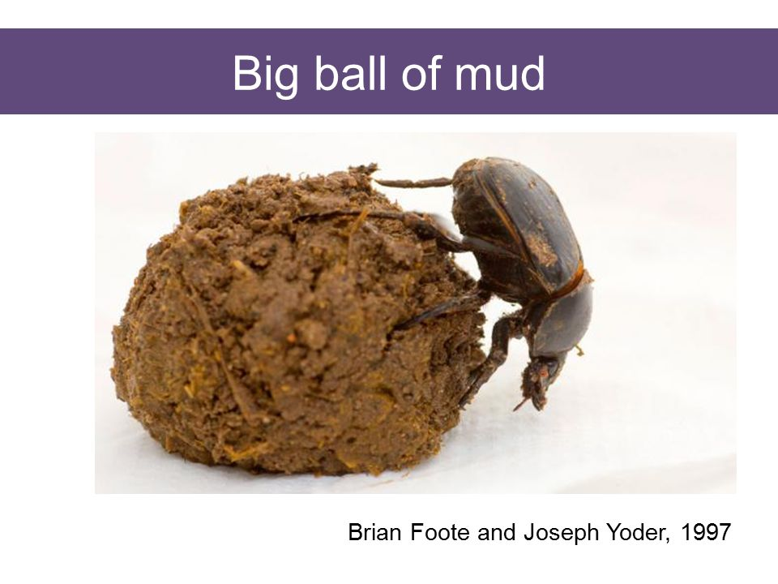

Slide 4
Architecture style
Structure an application into collection of services
Loosely coupled
Independently deployable
Organized into smaller teams
Microservices

Slide 5
Decomposition of Monolith
Configuration management
Discovering Services
Resiliency patterns
Transactions
Security
Availability
Monitoring and Tracing
Challenges

Slide 6
Business capability
Domain driven design
Decomposition

Slide 7
Centralized configuration
Eliminates configuration drift
Options
Spring cloud config server
Kubernetes ConfigMaps
ParameterStore and Secrets Manager
Configuration management

Slide 8
Enables load balancing
Allows horizontal scaling of microservices
Monitor health of each microservices and keep the pool of healthy microservices
Options
Spring Cloud Eureka Server
Kubernetes Ingress Services
AWS Load Balancers- ALB, NLB
ALB - OCI - Layer - 7
HTTP, HTTPS, Cookies, Session affinity
NLB - OCI - Layer - 4
Discovering Services

Slide 9
Do not provide consistency
Prefer AP over C in the CAP theorem
Eventual consistency using Sagas
Database split across multiple microservices
Transactions

Slide 10
Prevents failing of downstream API’s
Allows for Bulk Head
Provides time for failing service to recover
Can optionally send a fallback implementation
Options
Resiliency4j server
Istio Service Mesh
AppMesh/KongMesh
Resiliency Patterns

Slide 11
Token based security
Oauth 2
Security

Slide 12
API Gateway
Common entry point
Assigned to the domain name
Rate limit
Enforcing policies
Aggregator
Options
Spring Cloud API Gateway
Kubernetes Ingress
Istio Service Mesh
Availability

Slide 13
Tracing HTTP requests
Aggregating the logs to centralized server
Set up monitoring and alerting mechanisms
Options
Sleuth and Zipkin
ELK
Istio Service Mesh
Monitoring and Traceability

Slide 14
Deploying microservices
Blue-green deployment
Canary deployment
Rolling deployment
Options
Kubernetes Deployment
Istio
Deployment

