Slide 1

Event driven Microservices with Kafka

Slide 2
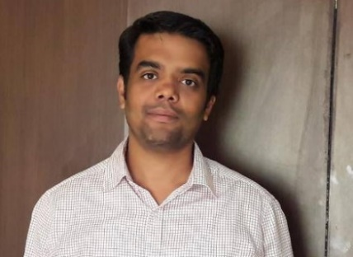

Pradeep Kumar
Software/Consultant and Trainer for more than 18 years
Designed and implemented complex, distributed, scalable Microservices based SaaS applications
Conduct workshops and training programs building production grade web applications covering all major challenging concerns

Slide 3

Kafka ?

Slide 4
Streaming processing
Tracking user activity
Log Aggregation
De Coupling systems
Use Cases

Slide 5
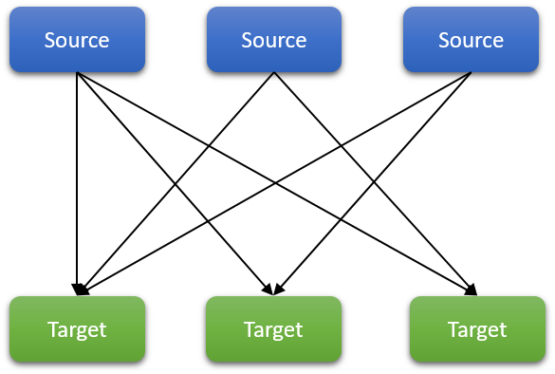

Slide 6
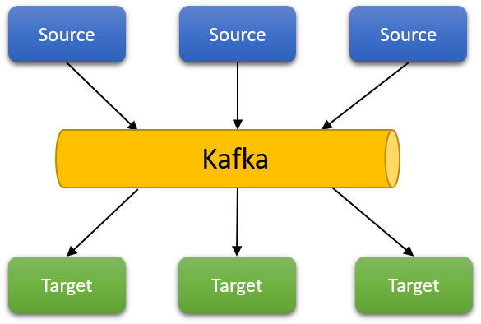

Slide 7
Scale to 100s of nodes
Handle millions of messages per second
Real time data processing
Event tracking
Event Sourcing
Kafka

Slide 8
Logical name to send messages
Topics will be split into multiple partitions
Partition enables topics to be distributed across the cluster
Partition enable horizontal scalability
Unit of parallelism
Topics can span across nodes with partition
Topics

Slide 9
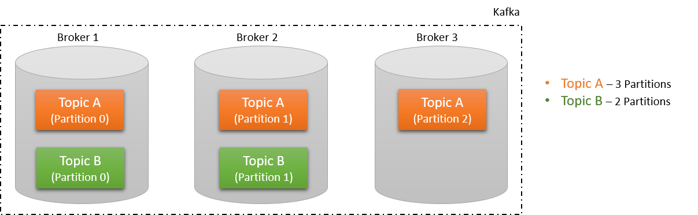

Slide 10
Message in partition are assigned offset
Offsets are unique to partition
Messages are ordered only in a partition
Partition key dictates the partition without which the messages will be assigned to a random partition
Partitions

Slide 11
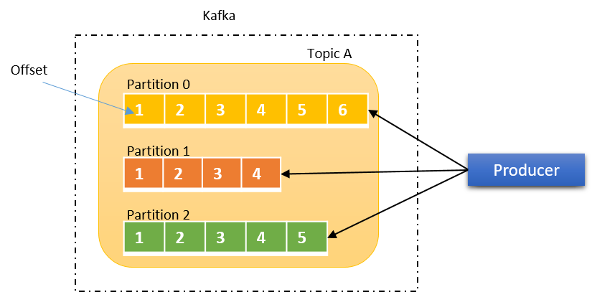

Slide 12
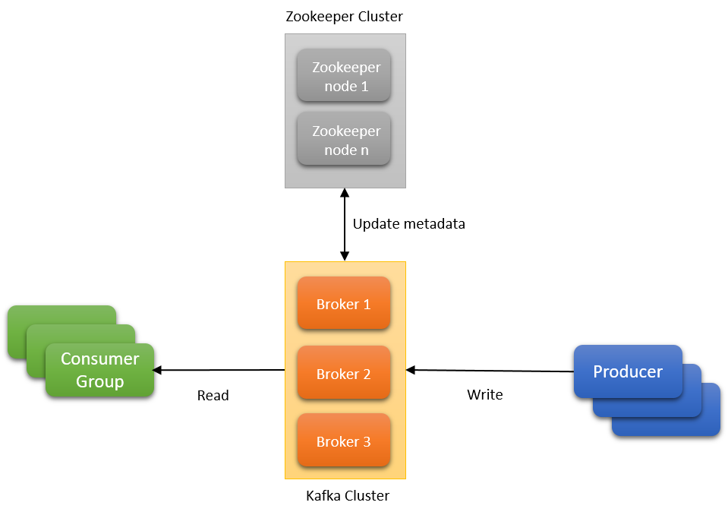

Slide 13
Single node managed by the Zookeeper
Set of brokers form a cluster
Topics created are distributed across brokers based on partition and replications
In case of broker node failure, the zookeeper rebalances the cluster
If a leader partition is lost, the follower partition is elected as a new leader
Broker

Slide 14
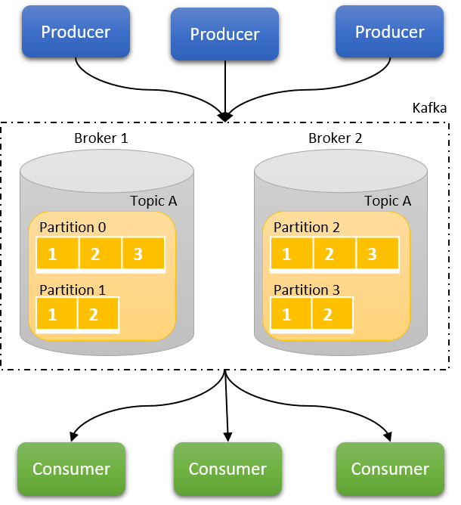

Slide 15
Making a copy of the partition available in another broker
Makes Kafka fault tolerant to broker and partition failure
Leader partition is elected in case of partition available on multiple brokers
The remaining partitions are called followers
Both producers and consumers are served by the same broker
In case of broker failure, the partition from another broker is elected as leader and starts serving the producers and consumers
Replication

Slide 16
Represents the state of a resource
Immutable
Records an activity of business interest
Expressed as past-tense
Can be replayed
Event

Slide 17
Events are first class citizens
Data can be derived from the events
Asynchronous
Scalable
Distributed
Event Driven Systems

Slide 18
High level DSL
Handles streams processing tasks out of box
Allows for fluent interface style of programming
Processor API is the low-level API allowing more control
Emphasis on functional style programming
Kafka Streams

Slide 19
src-topic
processor-1
processor-2
Topology
processor-3
out-topic

Slide 20
source
mask
Topology
map
filter
rewards
purchase
sink

Slide 21
Mask the credit card number from the source stream
Extract the item purchased and the zip code to determine the purchase pattern
Identify the customer and amount spent
Streams Topology

Slide 22
Create a StreamsConfig
Build a Serde
Construct the processing topology
Assemble the modules
Start the Streams
Streams

Slide 23
Stateful data processing
Provides business insights
Joining streams to enrich the data
Can be confined with timestamps
Events with state provides context which is of business value
State and Store

Slide 24
event
event
state-store
transformValue
TransformValues
downstream
downstream

Slide 25
Data locality
From performance consideration
Faster lookups
Reduced latency
Data is local to each Stream task
No data sharing across different threads
Fault tolerant
Changelog topic backups up the state store
State and Store

Slide 26
Event Sourcing
Events are source of truth
Eventual consistency
Transactions using Saga
Choreography
Orchestrated
Microservices

Slide 27
Thank You

