Slide 1
Optimization Unstable Code
Shoumit Karnik – UID - 116717496
Akshay Manoj –UID – 116921169

Slide 2
Code Optimization
Program transformation technique, which tries to improve the code by making it consume less resources
High-level general programming constructs are replaced by very efficient low-level programming codes.
Reduces readability and adds code that is used to increase the performance.
Should be correct, it must not, in any way, change the meaning of the program(But does it?)

Slide 3
How it works
Transformation that is expected to:
improve the running time of a program
or decrease its space requirements
Parser
ICG
Optimizer
MCG

Slide 4
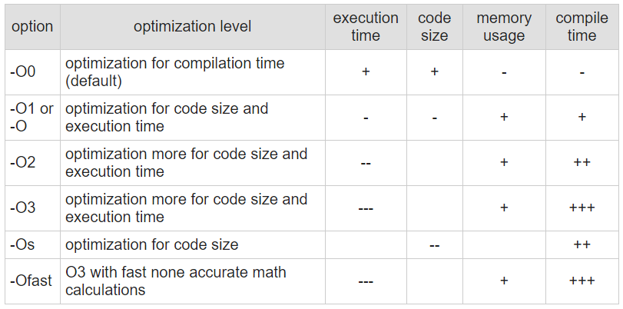
GCC Optimization with an Example
gcc -O option flag
Sets the compiler's optimization level.

Slide 5
#include <stdio.h>
int largest_element(int arr[], int num)
{
int i, max_element;
max_element = arr[0];
for (i = 1; i < num; i++)
if (arr[i] > max_element)
max_element = arr[i];
return max_element;
}
int main()
{
int arr[] = {1, 24, 145, 20, 8, -101, 300};
int n = sizeof(arr)/sizeof(arr[0]);
printf("Largest element of array is %d", largest_element(arr, n));
return 0;
}

Slide 6
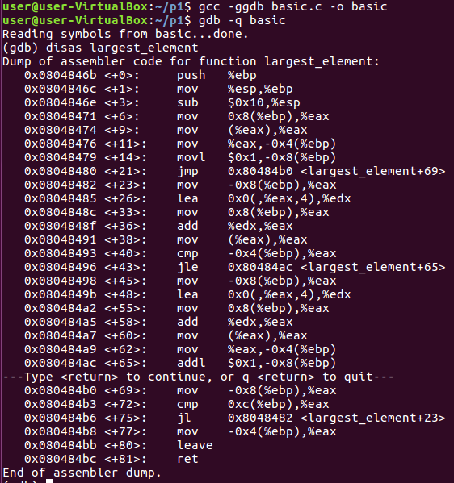
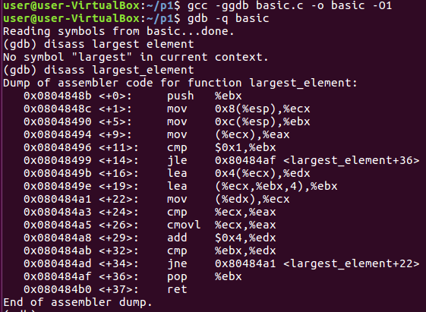
Comparing disassemblies

Slide 7
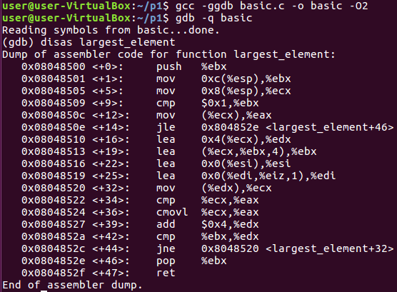

Almost identical ?
Because the compiler cannot optimize this particular code any further.
But it is possible for other codes

Slide 8
Unstable Code
Certain code pieces with undefined behavior
Present in many systems
This code is unpredictably removed by the compiler

Slide 9
The debate: Optimization vs Security
Latest systems are moving towards optimizing code
Security sometimes compromised for speed and efficiency
Vulnerabilities arise due to removal of security checks in code
These optimized codes are then vulnerable for even very basic attacks

Slide 10
Undefined Code Behavior
Behavior, upon use of a nonportable or erroneous program construct or of erroneous data
Ranges from
- ignoring the situation completely with unpredictable results, to
- behaving during translation or program execution in a documented manner characteristic of the environment to
- terminating a translation or execution

Slide 11
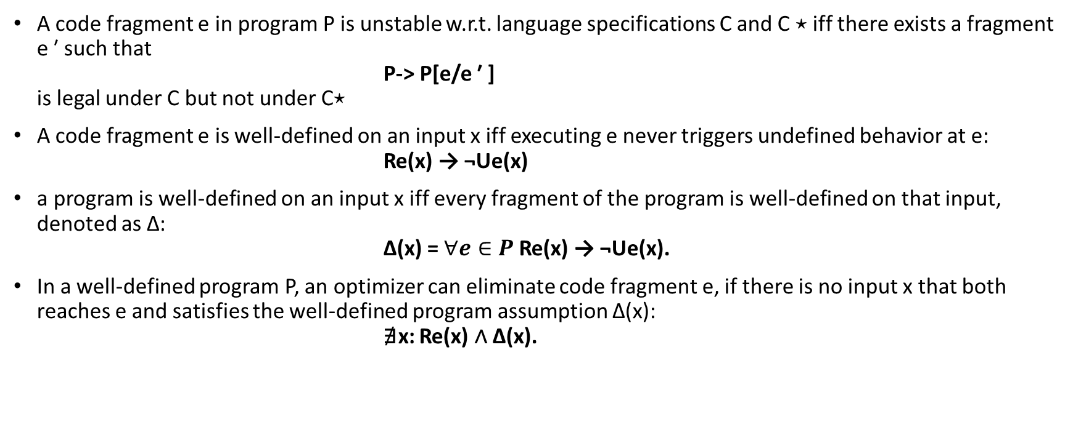
Mathematical Construct
A code fragment e in program P is unstable w.r.t. language specifications C and C ⋆ iff there exists a fragment e ′ such that P-> P[e/e ′ ] is legal under C but not under C⋆
A code fragment e is well-defined on an input x iff executing e never triggers undefined behavior at e: Re(x) → ¬Ue(x)
a program is well-defined on an input x iff every fragment of the program is well-defined on that input, denoted as ∆: ∆(x) = $∀e∈P$Re(x) → ¬Ue(x).
In a well-defined program P, an optimizer can eliminate code fragment e, if there is no input x that both reaches e and satisfies the well-defined program assumption ∆(x): ∄x: Re(x) ∧ ∆(x).

Slide 12
Sample Codes for Analysis

Slide 13
Null pointer dereference
#include<stdio.h>
#include<errno.h>
struct s1{
int propno;
char div;
};
struct foo {
int id;
int phone;
char *name;
struct s1 k1;
} a;
struct foo* getfoo(){
int i,j;
char l[100];
scanf("%d",&i);
if(i>10)
{
a.id=1;
a.phone=1000;
a.name=“Some_Text_Here";
return &a;
}
else
return NULL;
}
int main(){
struct foo *s = getfoo();
printf("OK ");
struct s1 b = s->k1;
if(!s){
printf("Null Object");
}
printf("Id = %d",s->id);
}

Slide 14
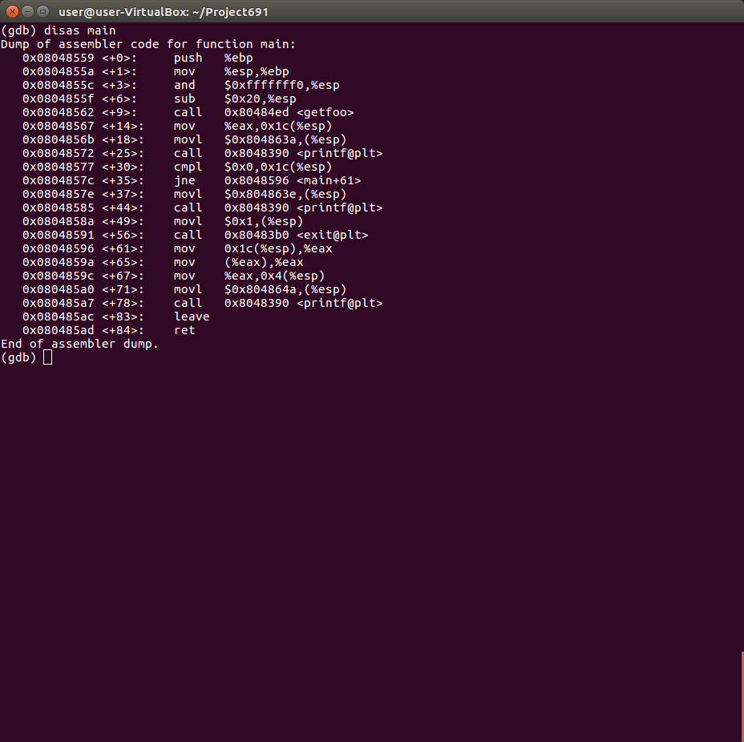
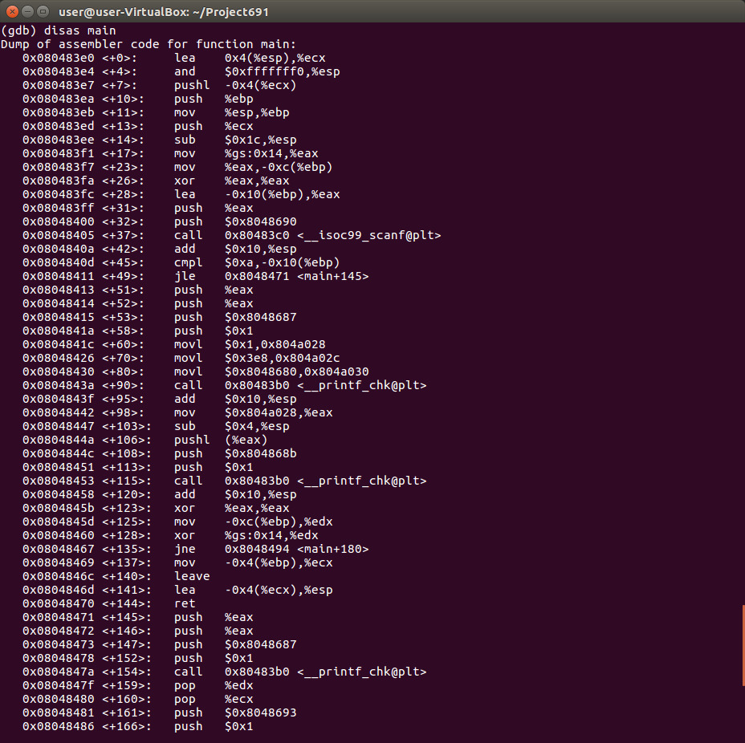

Slide 15
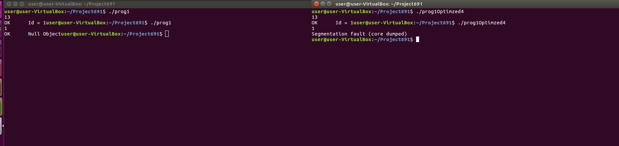
Run Comparisons

Slide 16
Signed Integer overflow
#include<stdio.h>
#include<stdlib.h>
int main(){
int i;
printf("Enter the value for a:");
scanf("%d",&i);
int y= abs(i);
if(y+100 <0)
{
printf("signed integer overflow detected");
exit(2);
}
printf("%d\n",i);
}

Slide 17
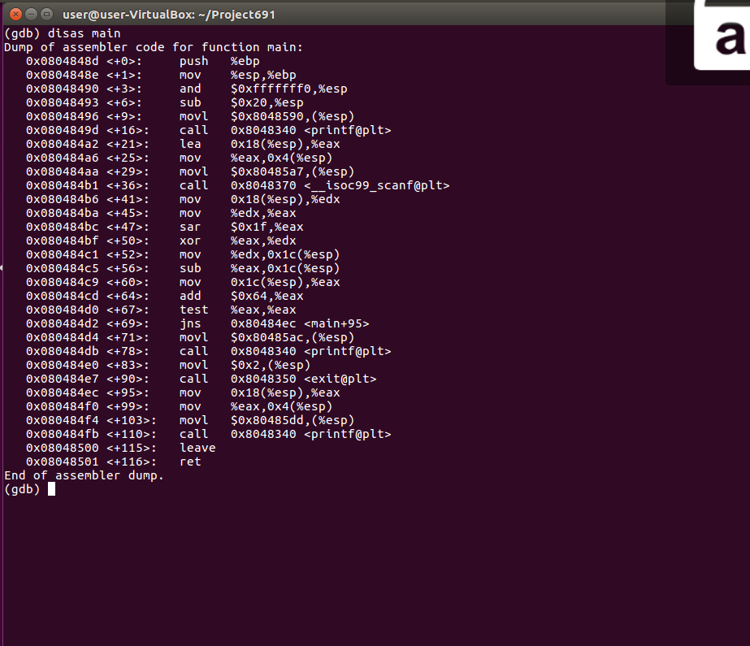
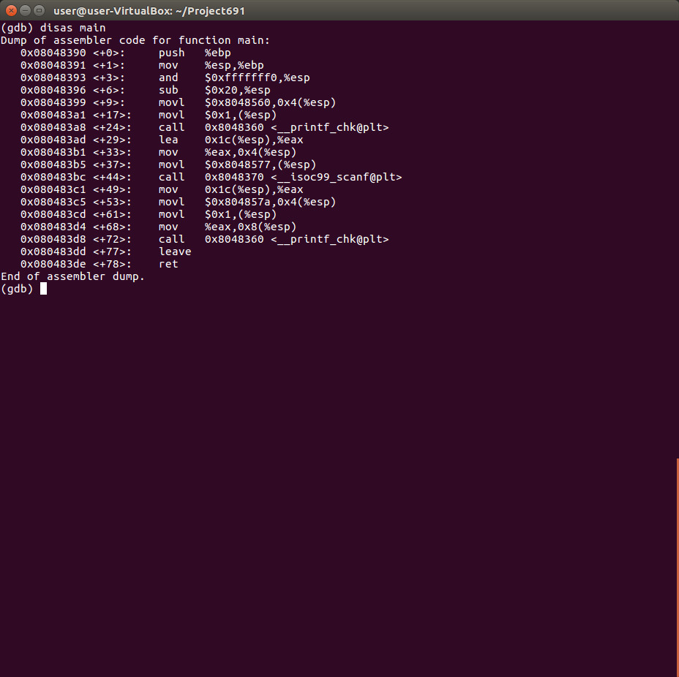

Slide 18
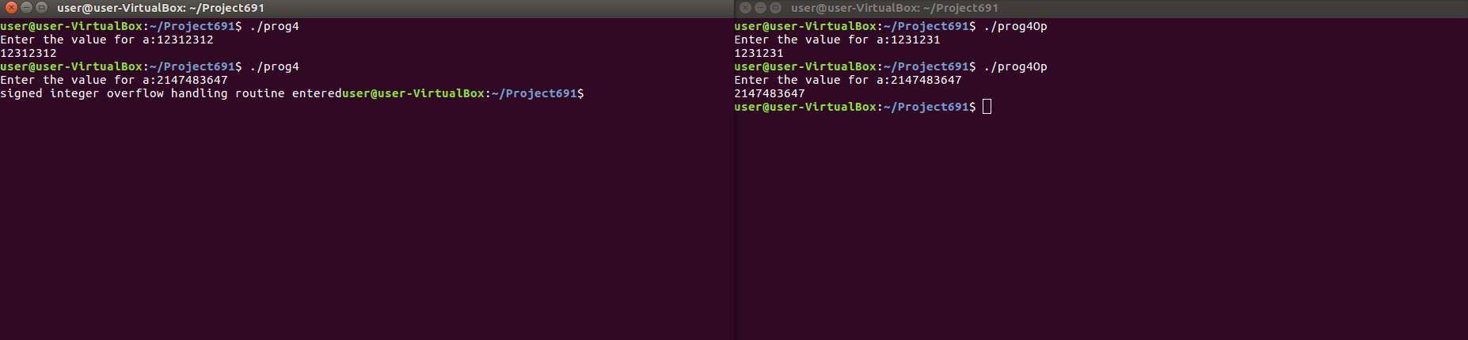
Run Comparisons

Slide 19
Absolute value overflow
#include<stdio.h>#include<stdlib.h>
int main()
{ int i;
printf("Enter the value for a:");
scanf("%d",&i);
if(abs(i)<0) {
printf("int min caught"); }
printf("%d\n",i);
}

Slide 20
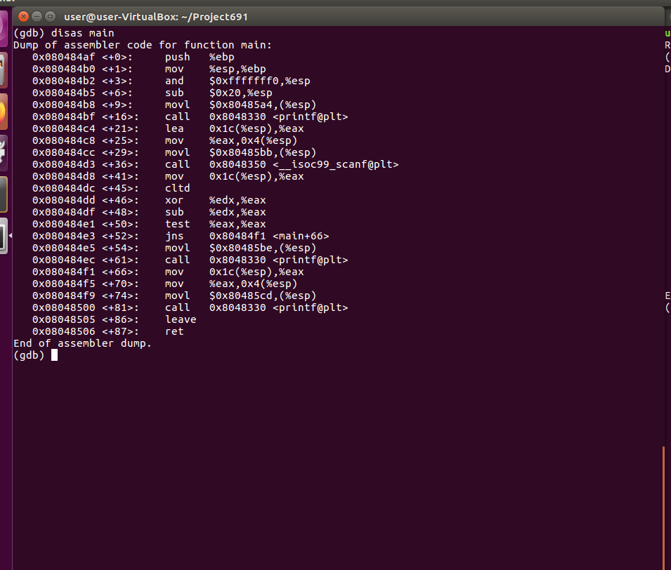
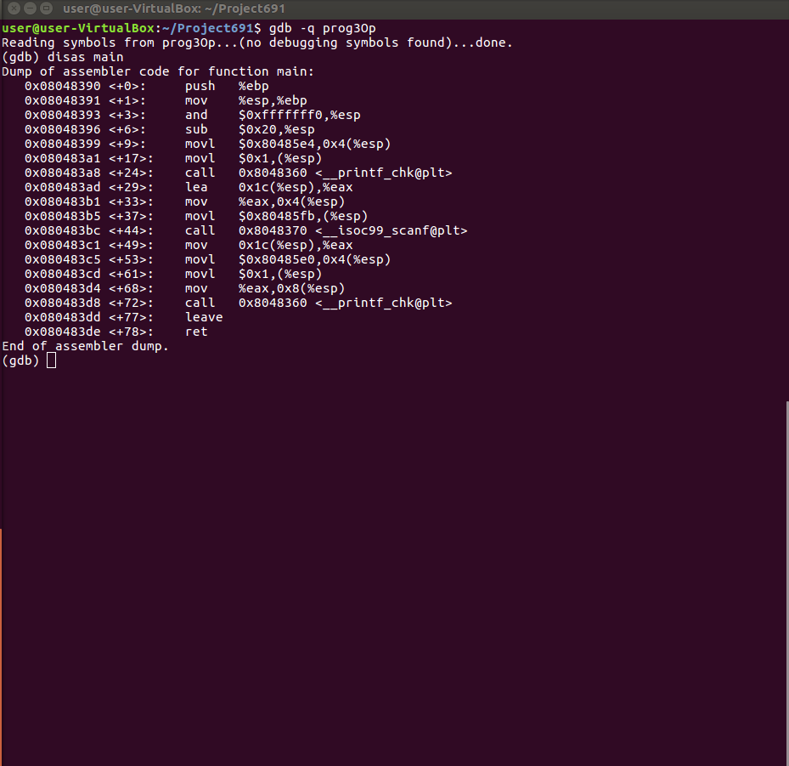

Slide 21
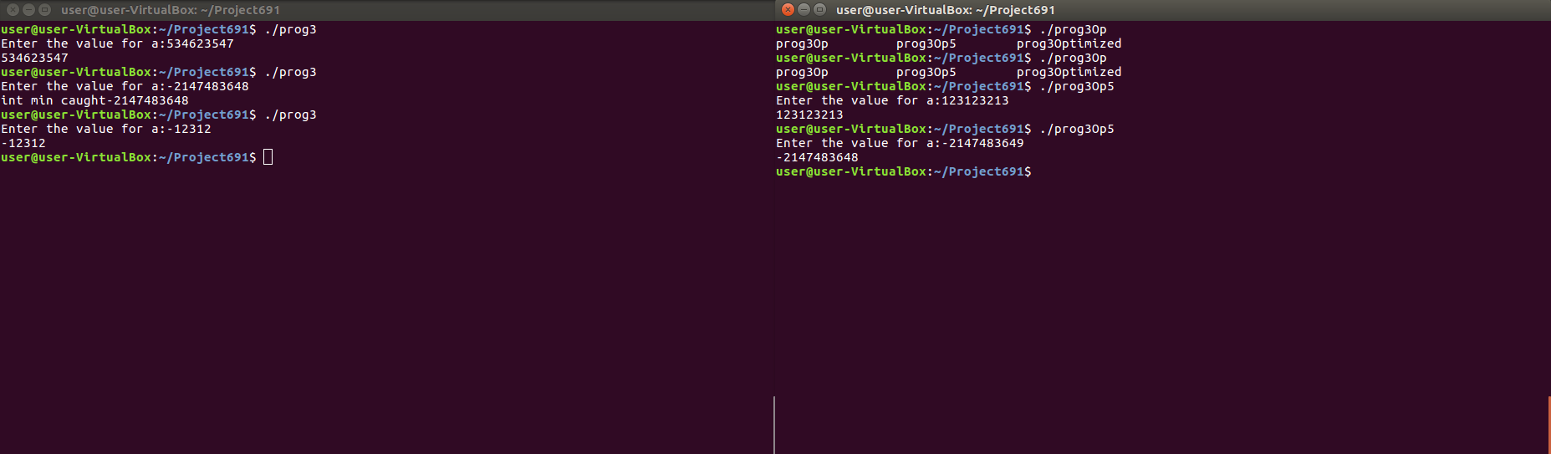
Run Comparison

Slide 22
Mitigation Strategies

Slide 23
Choose security over optimization?
Considerations that arise in deciding whether or not to apply optimization:
• safety
• profitability
Does the transformation change the results of executing the code?
yes - don’t do it!
no - it is safe

Slide 24
GCC -flags
-ftrapv
-fno-delete-null-pointer-checks
-fno-strict-overflow

Slide 25
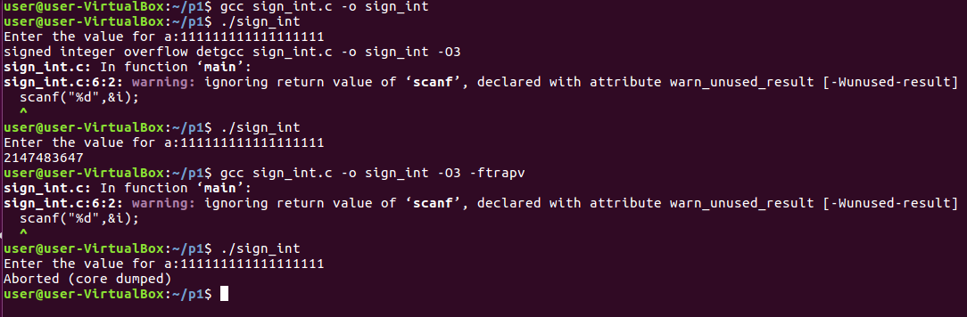
-ftrapv Example: Signed Integer Overflow

Slide 26
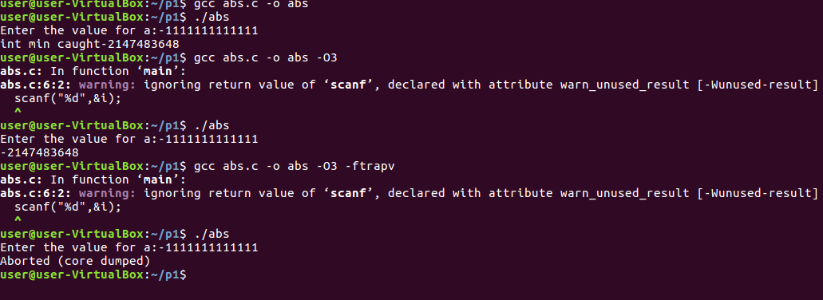
-ftrapv Example: Absolute value Overflow

Slide 27
Code complication
Adding complicated code which the optimizer does not deem as “unnecessary” and hence will not be eliminated
Should be used in critical places where the checks are really important and give rise to vulnerabilities

Slide 28
Example: Null Pointer Dereference
#include<stdio.h>
#include<errno.h>
struct s1{
int propno;
char div;
};
struct foo {
int id;
int phone;
char *name;
struct s1 k1;
} a;
struct foo* getfoo(int i){
char l[100];
if(i>10)
{
a.id=1;
a.phone=1000;
a.name='"Some_Text_Here";
return &a;
}
else
return NULL;
}
int main(){
int i ;
scanf("%d",&i);
printf("OK");
if(getfoo(i)){
struct foo *s = getfoo(i);
printf("Id = %d",s->id);
}
else{
printf("Null Object");
}
}

Slide 29
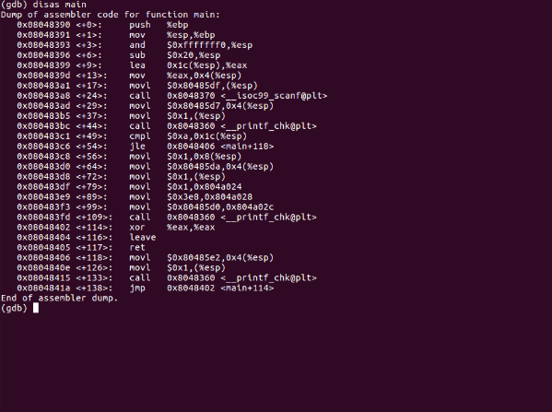
Disassembly:

Slide 30
Compiler Design Improvements
Compilers have improved – vulnerabilities still remain
Need for compiler designers to rethink optimization strategies
Compilers in a race to provide fast, small chunks of code
Security checks sacrificed many times

Slide 31
Tools to Identify Unstable Code
Certain tools to check for vulnerable code
STACK
Saturn
Kint

Slide 32
Improving Coding Standards
Need to declare certain constructs/objects as undefined
C coding standards are already taking this into consideration and issuing more warnings.
More and more codes are being classified as unstable

Slide 33
Citations
[1] Towards Optimization-Safe Systems: Analyzing the Impact of Undefined Behavior Xi Wang, Nickolai Zeldovich, M. Frans Kaashoek, and Armando Solar-Lezama.
[2] Undefined Behavior: What Happened to My Code? Xi Wang, Haogang Chen, Alvin Cheung, Zhihao Jia, Nickolai Zeldovich, and M. Frans Kaashoek. Proceedings of the 3rd ACM SIGOPS Asia-Pacific Workshop on Systems (APSys 2012), Seoul, South Korea, July 2012.

