Slide 1






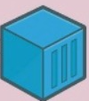

Google Cloud Platform
Cloud Shell
Cloud Build
Container Registry
Cloud Run
HTTP
Cloud Pub/Sub
Response

