Slide 1
Telecom Churn Case Study SUBMISSION
Soumik Majumder
Roll Number: DDA1610098

Slide 2
Telecom Churn Prediction Modelling
Based on the available data of Customer Churning 4 different methodology has been applied to predict the customer Churning. This 4 different Methods are:
K-NN Model
Naïve Bayes Model
Logistic Regression
SVM Model
Based on the Output comparison of the 4 modelling technique it has been observed that logistic regression model is performing the best to predict which customer is going to churn.
In the Next Slide We will put our Observation about the various factor and their impact on customer Churning

Slide 3
Recommendation to Avoid Churning
Observation | Recommendation
Churning Tendency is higher for Month to Month Customer than who are in Contract for a year | Telecom Company should attract customer to come for one or two year contract to avoid sudden churning
Churning Rate is higher among the customer who are spending more | Telecom company should bring some freebie offers for high-spending customer
Churning is higher for the Customer without TechSupport Service | Telecom company can include TechSupport in the package to reduce churning
There is no gender bias in the total spending or Churning | No Specific plan for targeting any specific gender will not help in reducing Churn or total spend
Senior Citizen are spending more on an average | Some plan should be launched focusing senior citizen
There is not much effect on Churning for the Streaming services | Company should not focus much on giving streaming services to the customer as freebies who are potential candidate for churning
Customer with Paperless Billing are prone to churn | PaperBilling might cause more customer interaction

Slide 4
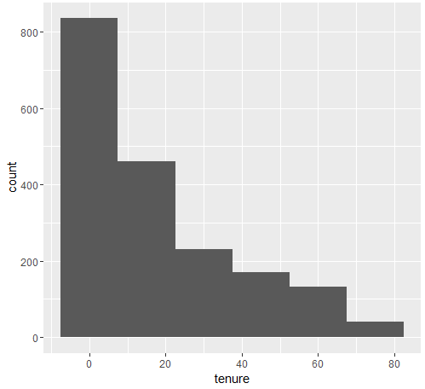
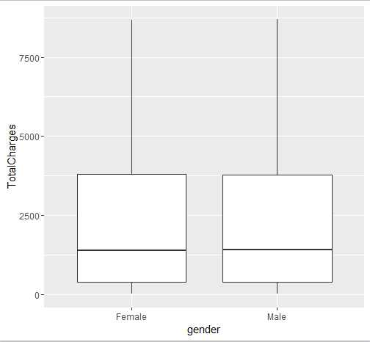
Effect of Churn on Various Dependent Variable
Churn Count is much higher for the low tenure customer.
No significant difference between male and female in Total Spending.

Slide 5
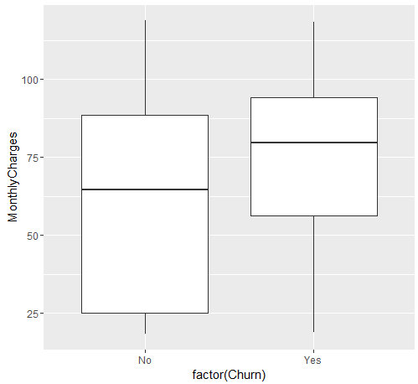
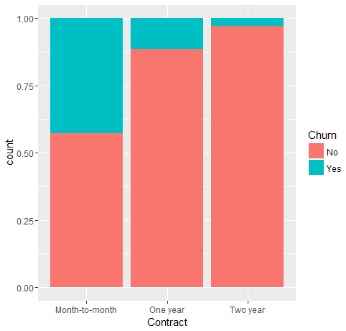
Effect of Churn on Various Dependent Variable
Churn rate is higher among those who are spending more on monthly basis
Churning tendency is higher for month to month Contract Customer rather than those who are in one year or two year contract.

Slide 6

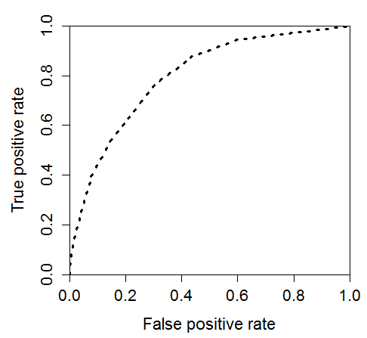
K-NN Model
The Modelling has been done considering the Churning = 1 or “Yes” as Positive Class.
So The target is to reduce the Prediction of Customer will not Churn where in reality they will actually Churn (False Negative) , i.e Specificity Should be High for the delivered model.
Optimal K has been chosen as K= 9 using train function with a trial run from K =1:50
ROC Curve
Various Statistics for the Optimum Model

Slide 7
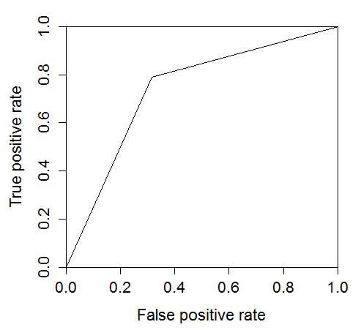
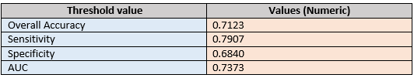
Naïve Bayes Model
The Modelling has been done considering the Churning = 1 or “Yes” as Positive Class.
For this modelling all numerical field has been converted to Categorical one using binning technique by CUT function
ROC Curve
Various Statistics for the Optimum Model

Slide 8
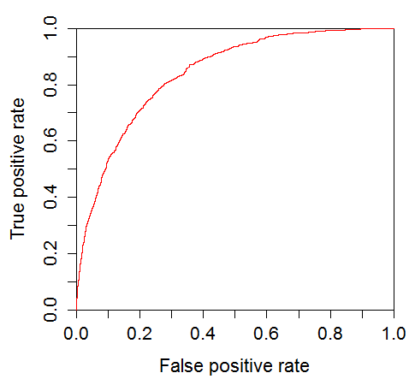
Logistic Regression Model
ROC Curve
This modelling has been done in multiple stages:
In Step 1 : glm function has been applied with binomial family parameter to fit all the available variable in the model
In Step 2: All the non relevant variable has been removed from Stepwise forward-backward method
Step 3: Multi collinearity among the dependent variable has been checked with VIF function to reduce those variables
Final Stage: All the insignificant variable has been removed based on their P value so that finalised model is having only highly significant variable

Slide 9


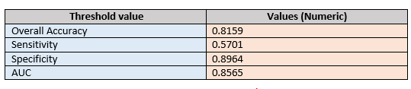
Logistic Regression Model
Final Modelling Statistics:
Model Evaluation:
C And K Statistics: Model Statistics:
AIC Value has been reduced during various iterations.
Big difference between NULL and Residual Deviances shows variables included in the model is having +ve effect in improving modeling performance

Slide 10
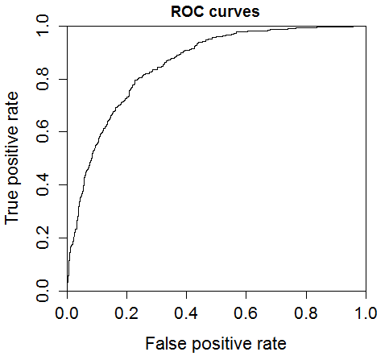
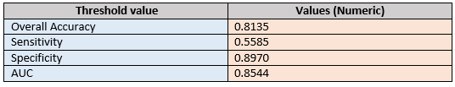
SVM Model
This Model has been formulated considering the hyperplane as linear and Multiple model has been generated with different Cost parameter value ranging from 0.001 to 100.
Using tune function optimum cost parameter value has been reached as 0.1
Various Statistics for the Optimum Model

