Slide 1
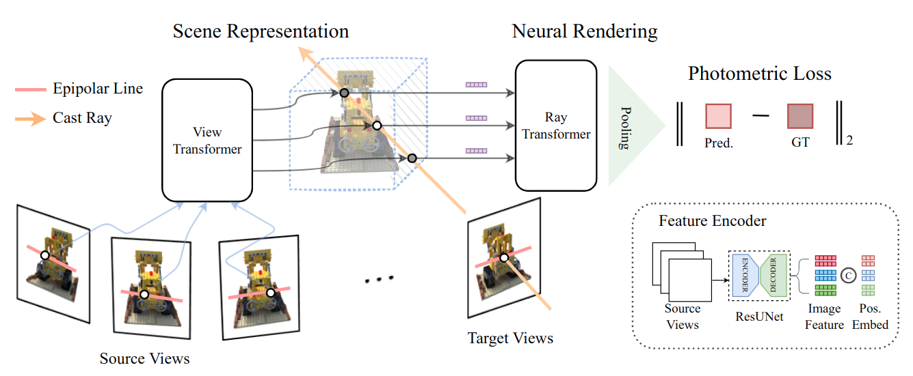
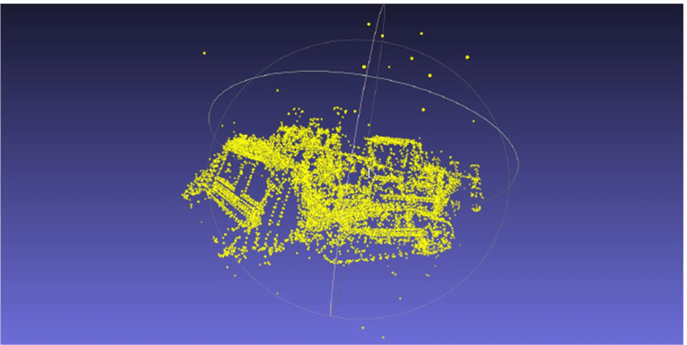
Depth Supervised NeRF
Depth from Attention
vs
Depth from Point Cloud
Shounak Naik, Prof. Ziming Zhang

Slide 2
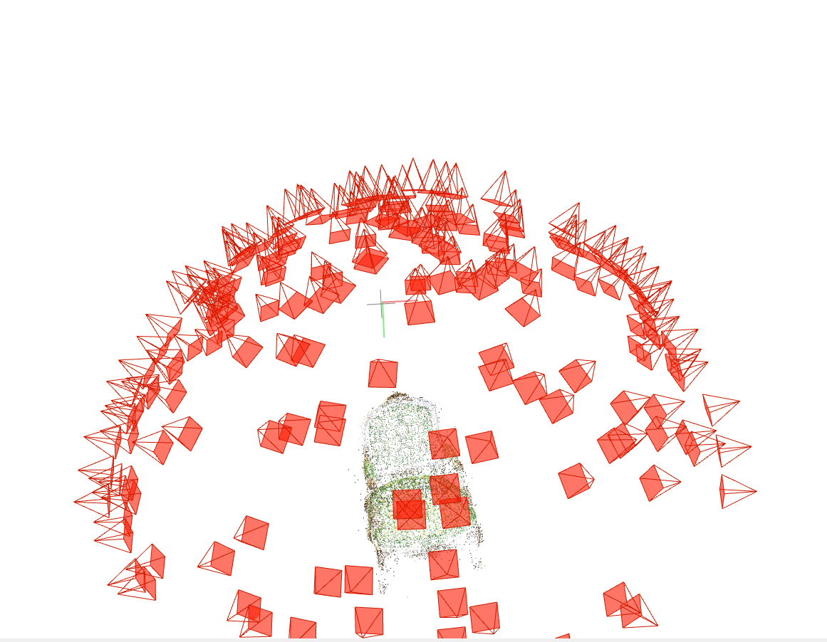
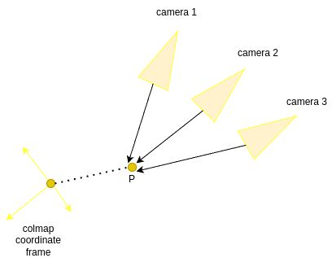
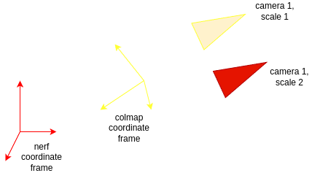
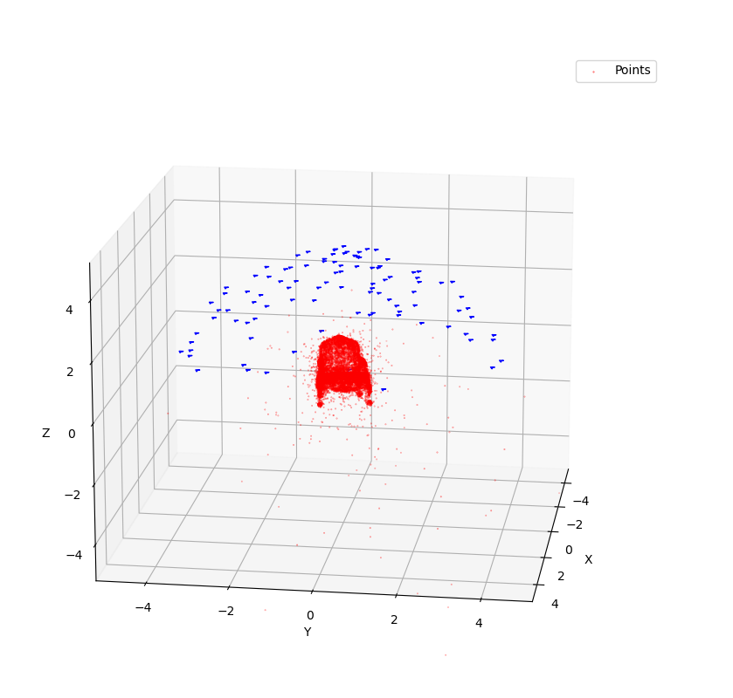
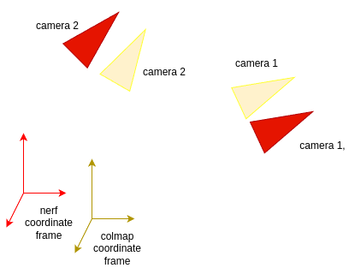
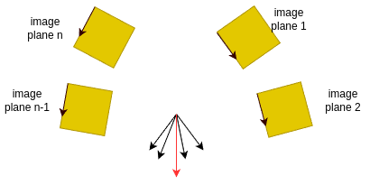
COLMAP and NeRF Frames
COLMAP Point Cloud
NeRF compliant COLMAP Point Cloud
Transformation
is noisy

Slide 3
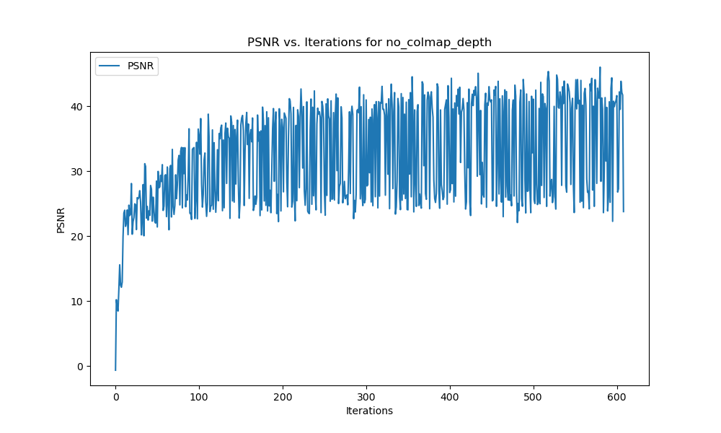
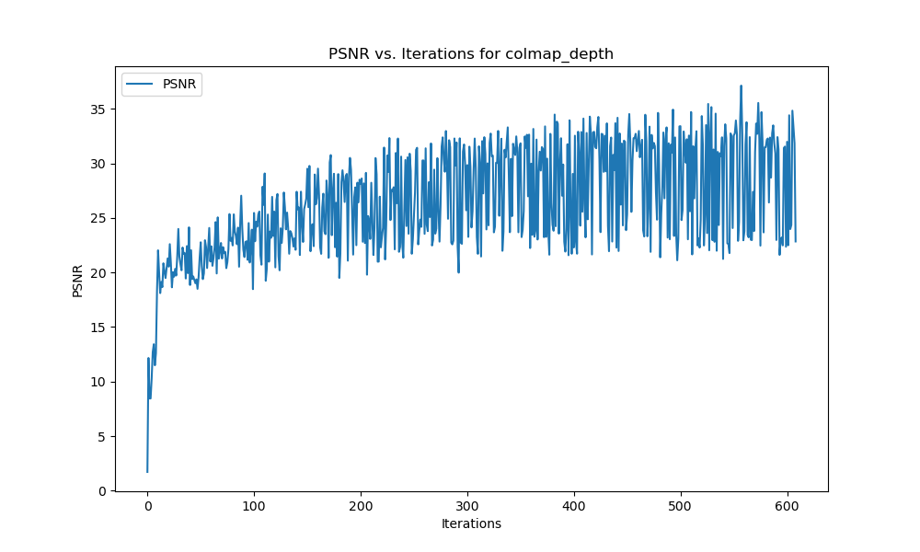
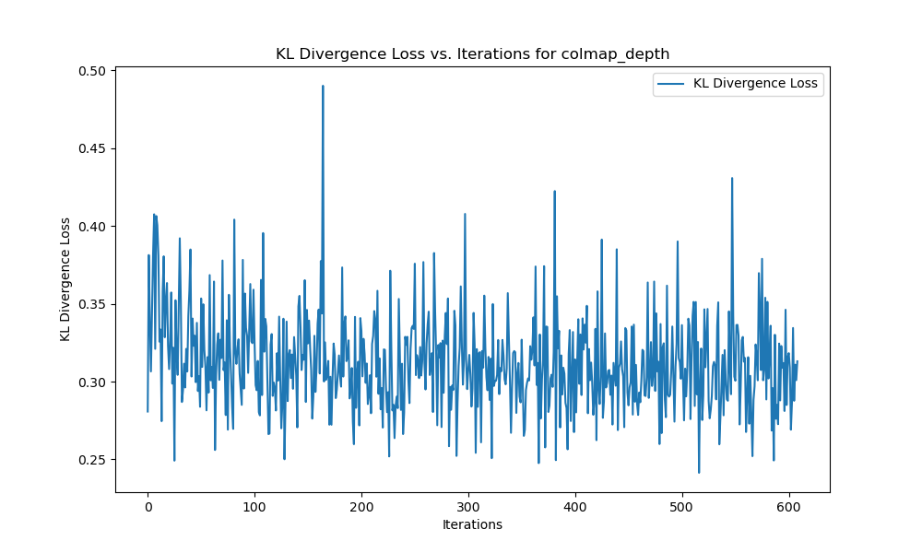
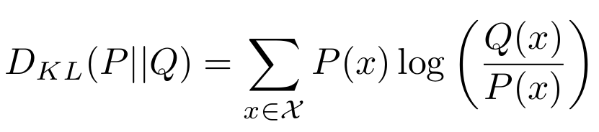
KL Divergence
PSNR Without Depth Loss
PSNR With KL Divergence Depth Loss
P - COLMAP, Q- Attention
P changing with batching and
converting to probability function.
Moving target problem.
KL Divergence Depth Loss

Slide 4
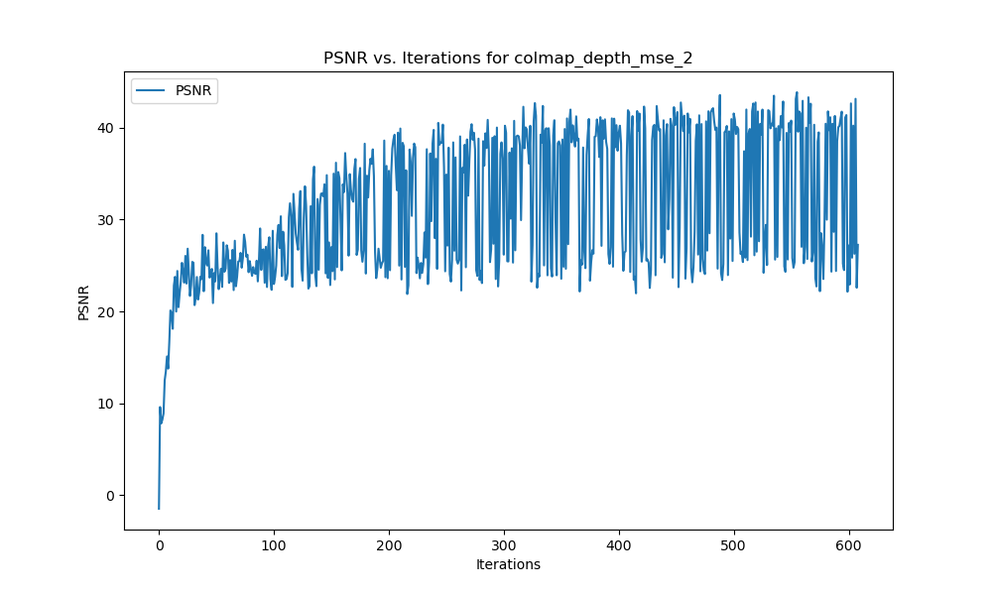
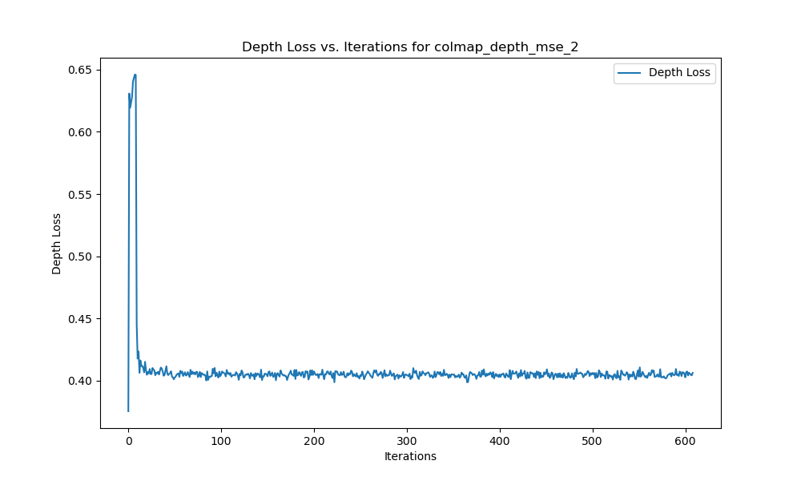
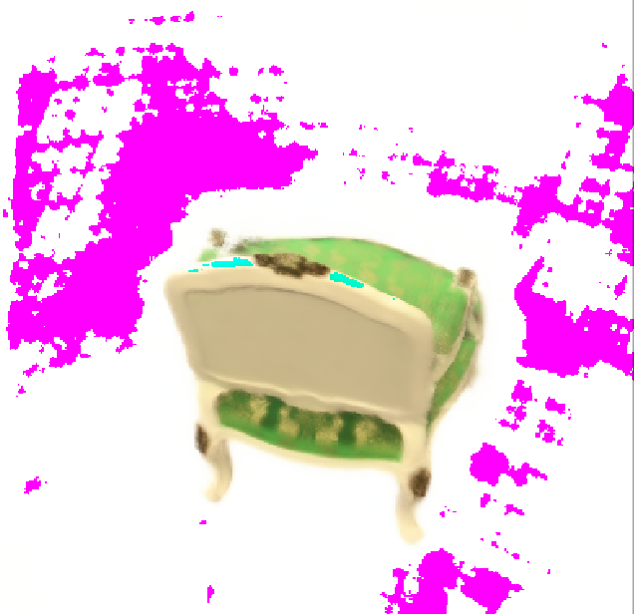
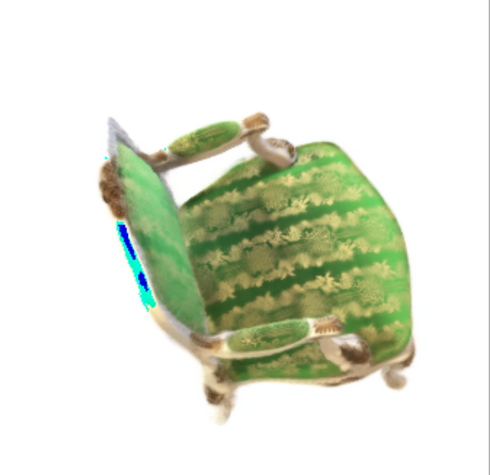
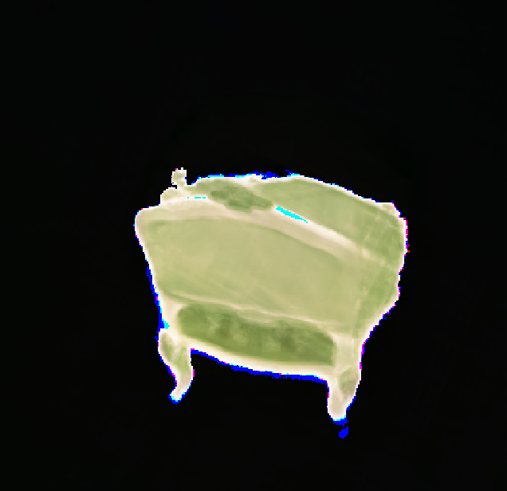
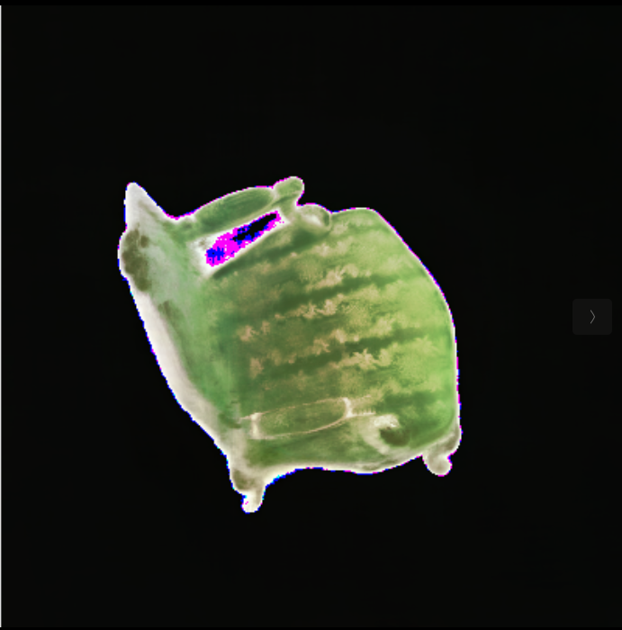
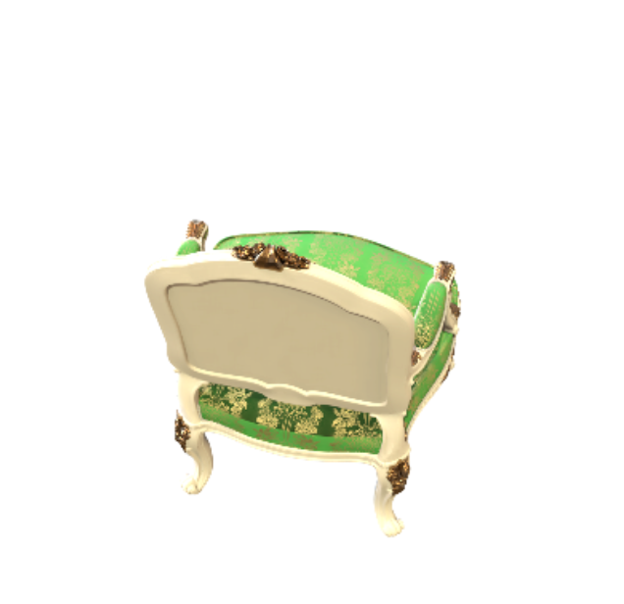

Mean Squared Error
Results from 100 poses,
similar results from 25 poses
PSNR Without Depth Loss
PSNR With MSE Depth Loss
MSE Depth Loss
150 epochs
600 epochs
150 epochs
600 epochs
No Depth Loss
MSE Depth Loss
Ground Truth

