Slide 1
Your Future App
Shouq Alqarni | T5: Data Science Bootcamp

Slide 2
Goal: This project aims to help new developers to decide what App types and characters people prefer.

Slide 3
Project Plan
EDA
Model
This section will answer the develop questions
This section will help the developer to predict the Rate and Installs

Slide 4
Data
The dataset contains over 2 million instances with 24 features for each.
Features include numerical and categorical types, such as rating, type, developer, etc.
The data was collected in the month of June 2021, with the help of Python script (Scrapy)

Slide 5
01
EDA
Explaratory Data Analysis

Slide 6
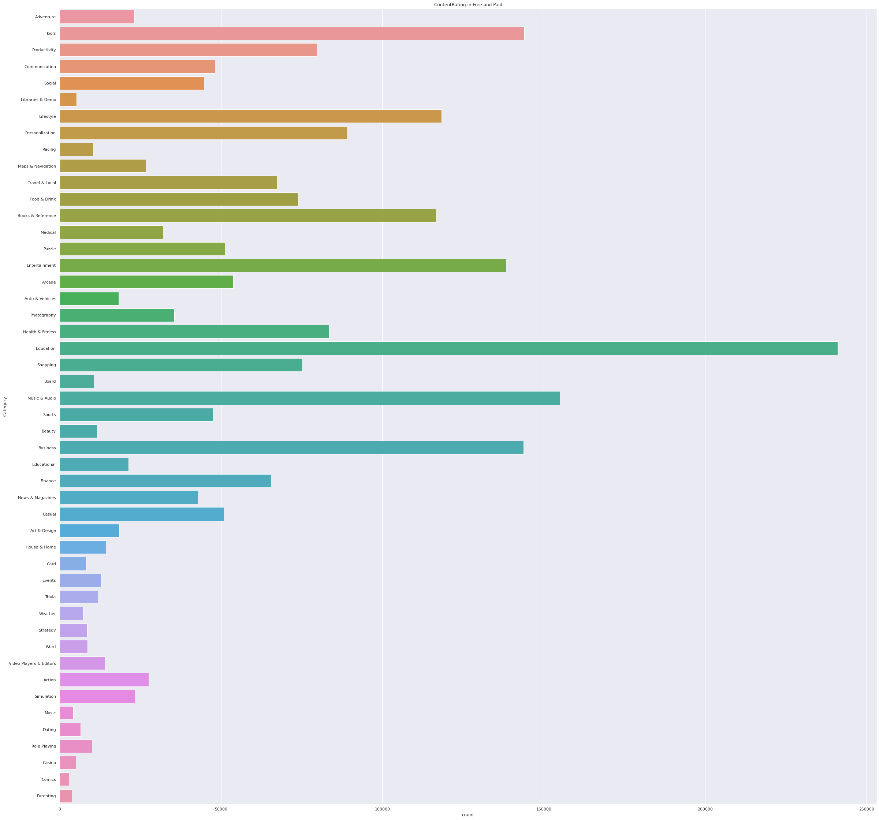
Which category has more Apps?
The most common category is "Education" followed by "Music & Audio" and "Comics" is the least common category.
- countplot

Slide 7
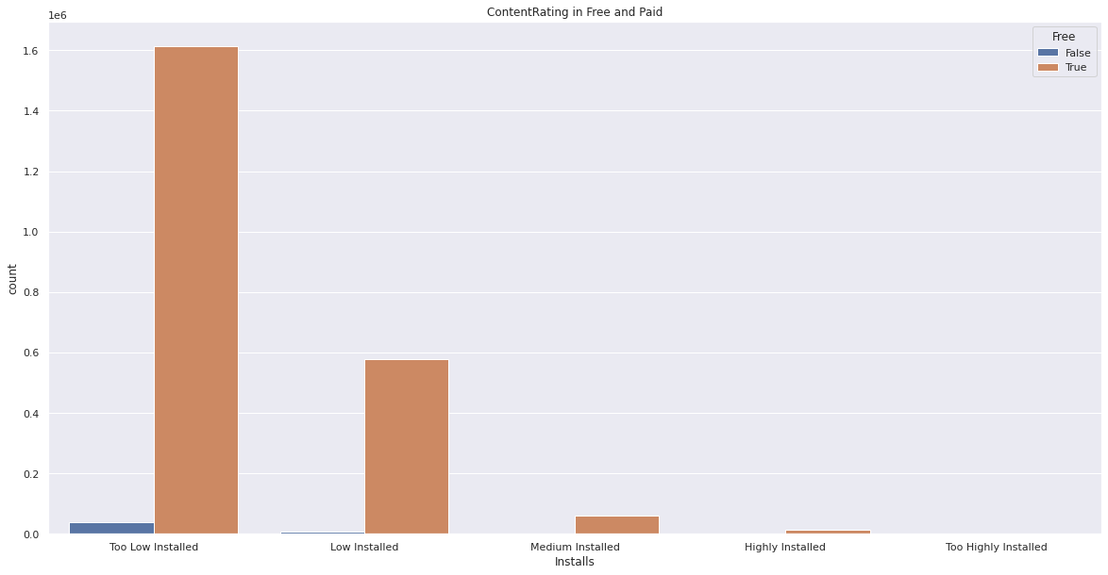
The maximum installs Apps belongs to which Installs label?
The maximum Installed Apps belongs to “Too Low Installed” whether they Free or Paid
- countplot

Slide 8
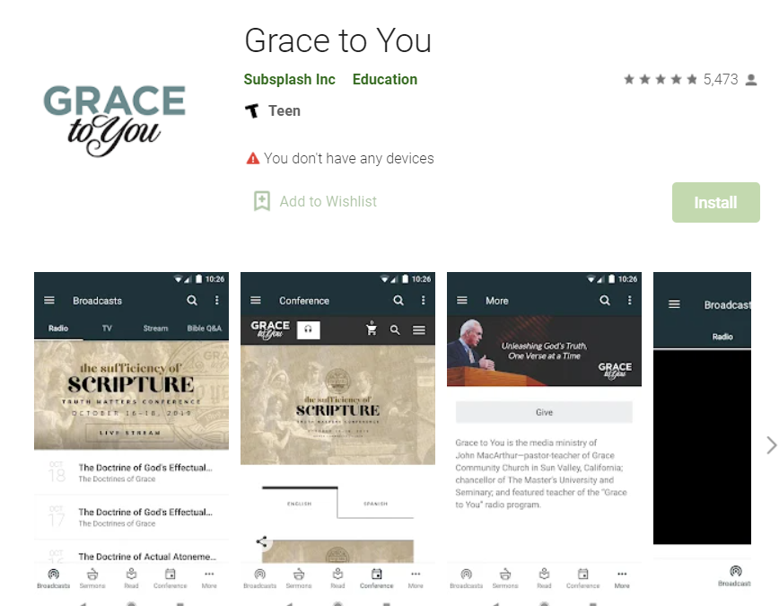
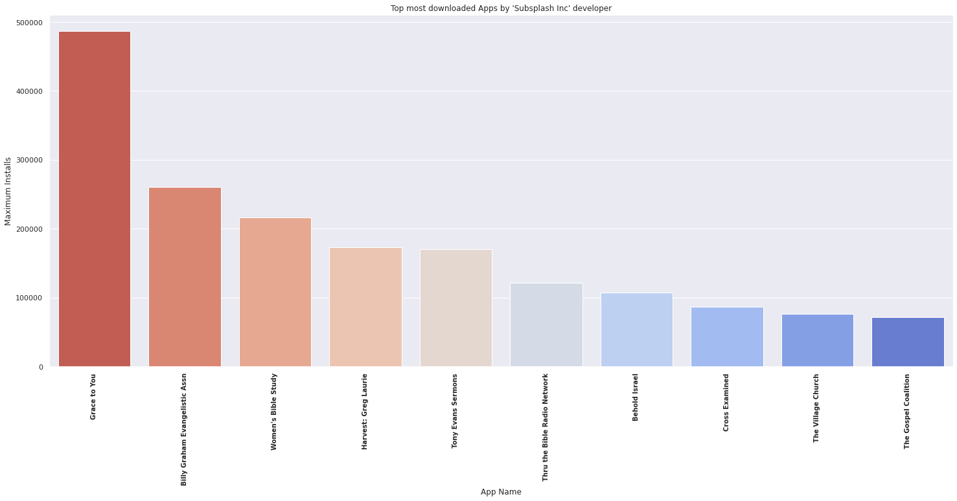
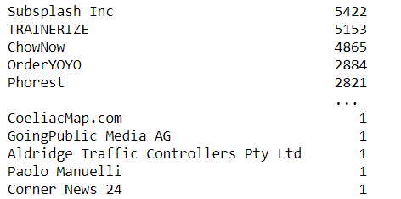
Who is the developer who has the maximum number of Apps?
‘ Subsplash Inc ‘ is the developer with the highest number of Apps.
- value_counts()
loc()
barplot

Slide 9
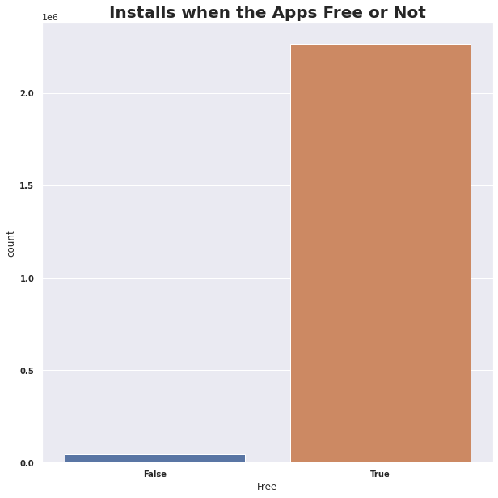
Will the price affect number of installations?
The number of installs when the app free is clearly higher than paid Apps.
- groupby()
- countplot

Slide 10
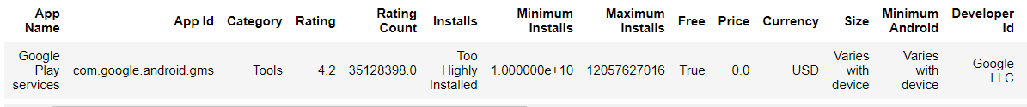

What is the most downloaded App?
"Google Play services" is the most downloaded app. And that because it is used to update Google apps and apps from Google Play.
- loc()

Slide 11
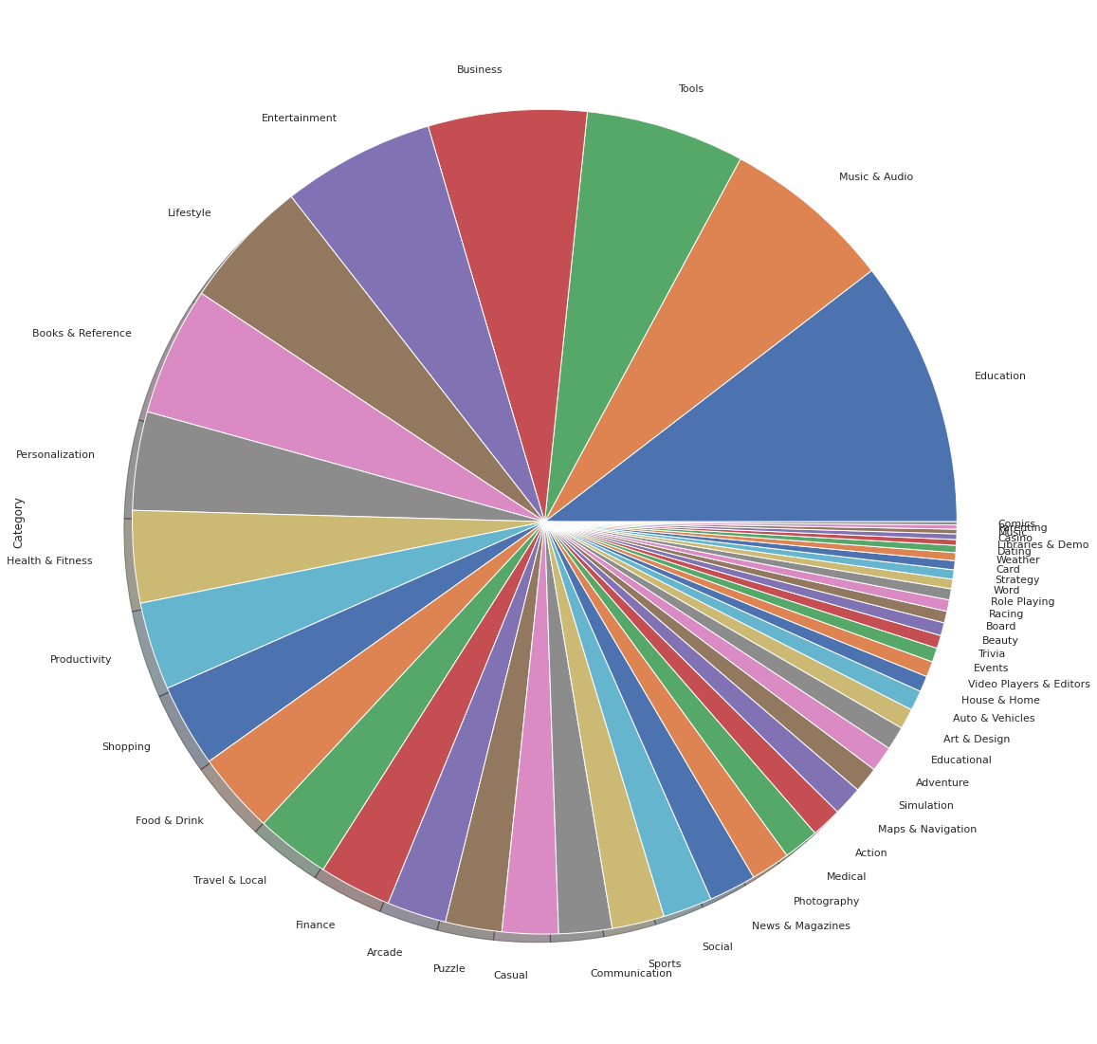
What is the most famous category of the App?
The most famous category is "Tools". While the second famous category is "Communication"
loc()
plot()
Value_counts()

Slide 12
02
Models
Regression and Classification models

Slide 13
Dataset
Df_dropna
Drop rows with missing values without handling the missings
Df_replaceMissing
Handle the missing values by imputing mean and median or extracting some missings from another column

Slide 14
Summary of Classification Models
Df_replaceMissing
Df_dropna
 | Logistic Regression |  | Logistic Regression (scaling) |  | Decesion Tree |  | Random Forest
Accuracy | 0.94% | 0.99% | 0.47% | 0.46% | 99.9% | 100% | 100% | 100%
Precision | 0.94% | 0.99% | 0.47% | 0.46% | 99.9% | 100% | 100% | 100%
Recall | 0.94% | 0.99% | 0.47% | 0.46% | 99.9% | 100% | 100% | 100%
F1 Score | 0.94% | 0.99% | 0.47% | 0.46% | 99.9% | 100% | 100% | 100%
By applying the cross validation, I got 1% in the logistic and 100% un the decision and random forest

Slide 15
Summary of Regression Models
Df_replaceMissing
Df_dropna
 | Linear Regression |  | Linear Regression (scaling) |  | Decesion Tree |  | Random Forest
Accuracy | 100% | 0.99% | 100% | 100% | 100% | 100% | 100% | -
RMSE | 1.84 | 1.85 | 1057041.5 | 507969.0 | 0.50 | 0.47 | - | -

Slide 16
Conclusion
1
3
5
2
4
The maximum Installed Apps belongs to “Too Low Installed”
Using regressions worse than trees
The most installed App is “"Google Play services“ from “Tool” category
‘Subsplash Inc ‘ is the developer with the highest number of Apps.
There is no big diffrence between the two datasets

Slide 17
Challenges
Individual Work
Big Data
Visualization

Slide 18
What to do next?
Using ensample model
Using regression to predict missings
Using Deep Learning algorithms
Using visualization in the models section
Using Oversampling in the dataset

Slide 19
Thanks for listining

Slide 20
Question ?
Suggestions ?

