Slide 1
Full Stack Web Application Employee Search
By : Shouri Reddy Tumma
Mail ID : shouri_reddy@ymail.com

Slide 2


AGENDA
The Task
Objectives
Layers of Full Stack
Frontend Implementation
Backend Implementation
Database
User Interface Implementation
Tools & Technologies

Slide 3
The Task
The task is to implement search functionality in a Full Stack Web Application against a phone directory (database).
Implementing a search API in a Backend app that searches the database. And building a Frontend where user gets entire information of employee by entering a search string such as name or number.
Deploying the application using Heroku cloud platform

Slide 4
Objectives
Managing employee records such as First Name, Last Name, Address, Date joined, Salary with work, office and mobile phone numbers.
User can retrieve information of specific employee by searching through name or number.
Creating a webpage to get records of each employee in a tabular format and using MySQL to store details in the database.
Build, run and operate application in the cloud through Heroku.

Slide 5
Layers of Full Stack
Client-Side Code
Browser
Server-Side Code
Web Server
Database
OS

Slide 6
Frontend Web Development
Defined components on the page with HTML.
Make them look pleasing with CSS.
Enable interactivity with JavaScript.
Enhance productivity with use of frameworks.
jQuery to simplify interactions between JS code and HTML.
Using AJAX to get data from API and creating dynamic webpages.

Slide 7
Backend Web Development
Creating the page components and content dynamically on the web server.
Generating pages by programming in Java and Spring Boot.
Importing the HTML+CSS+JavaScript to web browser.
Java Spring Boot to develop web application with Spring Framework.
Aim to achieve fast response to end users.

Slide 8
Database
Responsibility is to store large amount of data.
Retrieve the data efficiently.
Enforcing data consistency rules on the data.
MySQL Relational database to store each employee records such as name, mobile, address etc.

Slide 9
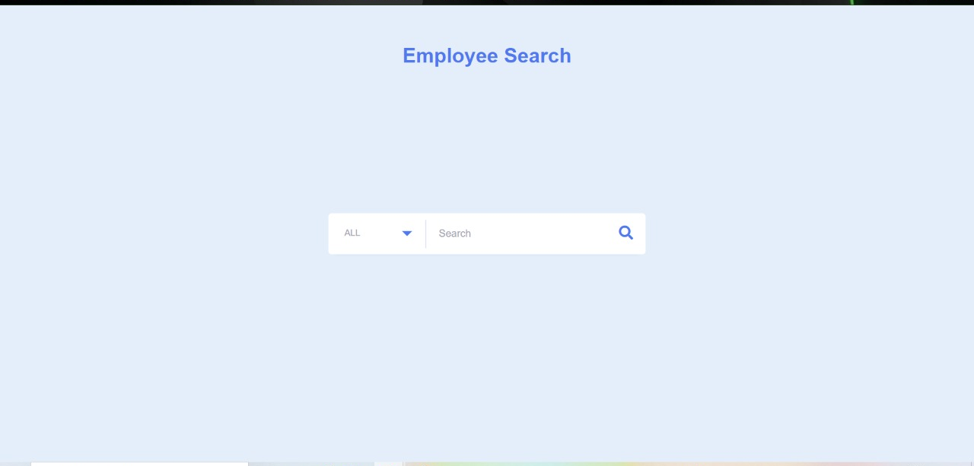
user Interface
For full implementation, please refer video attached in this Github link

Slide 10
Tools and Technologies
Tools used
Spring tool suite
MySQL Workbench
Technologies used
Frontend: HTML, CSS, JavaScript, jQuery, AJAX
Backend: Java Spring Boot
Cloud Platform
Heroku

Slide 11
THANK YOU

