Slide 1

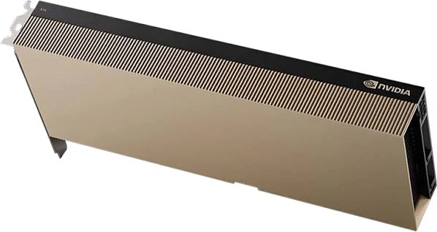
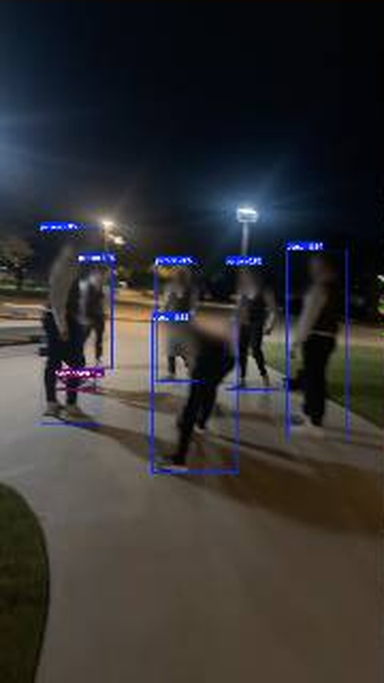
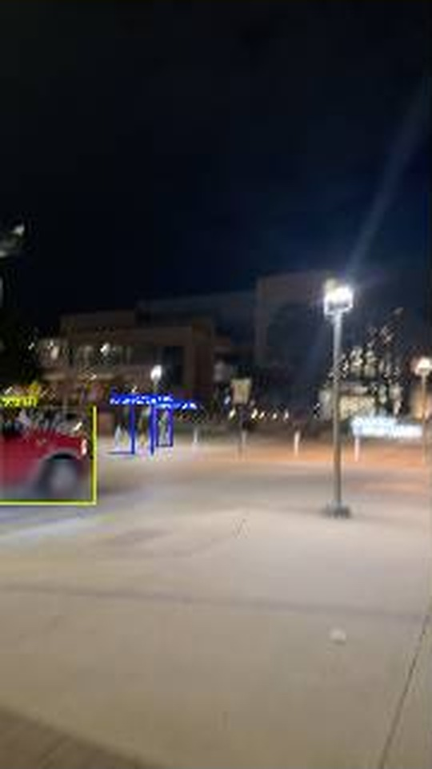
GPU Processing
NVIDIA A16
17,607 photos in 18 min
~16 photos per second
Privacy Blur and Object Detection — YOLOv8x + YOLOv8-Face

Slide 2
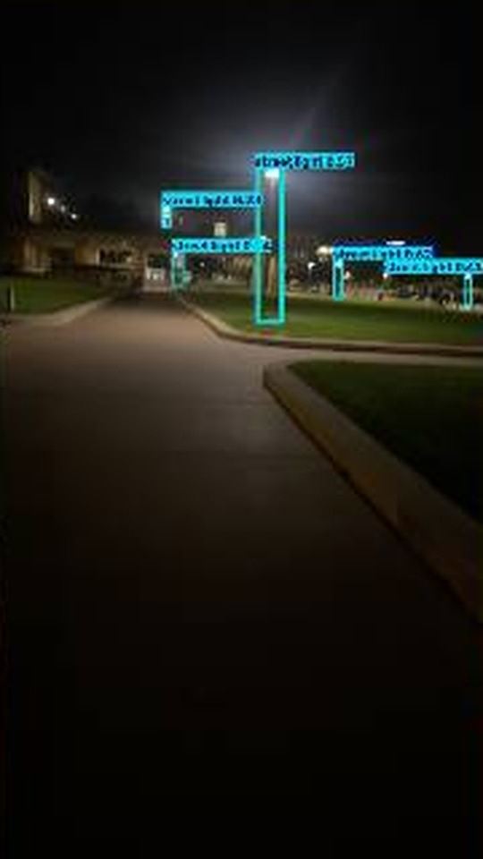
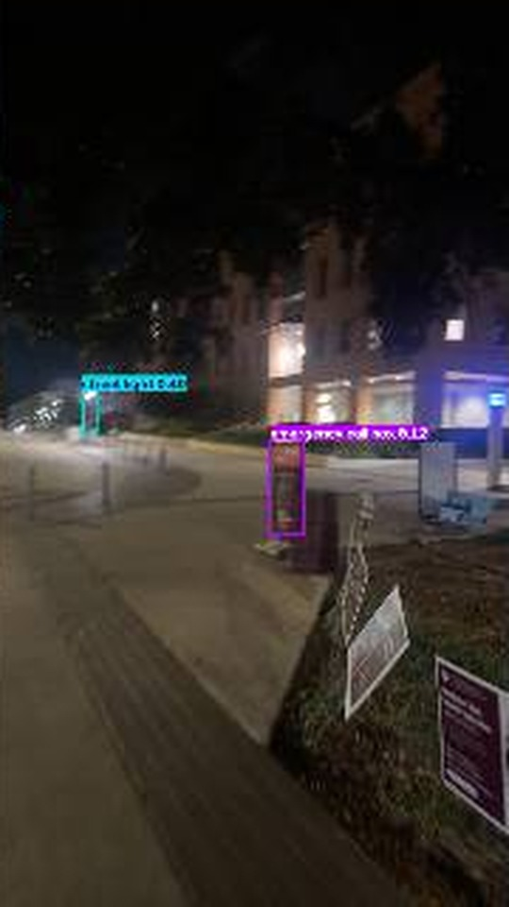
GPU Processing
NVIDIA A16
17,607 photos in 18 min
26,430 objects found
Lights, Trees and Emergency Phones — YOLO-World (yolov8x-worldv2)

Slide 3
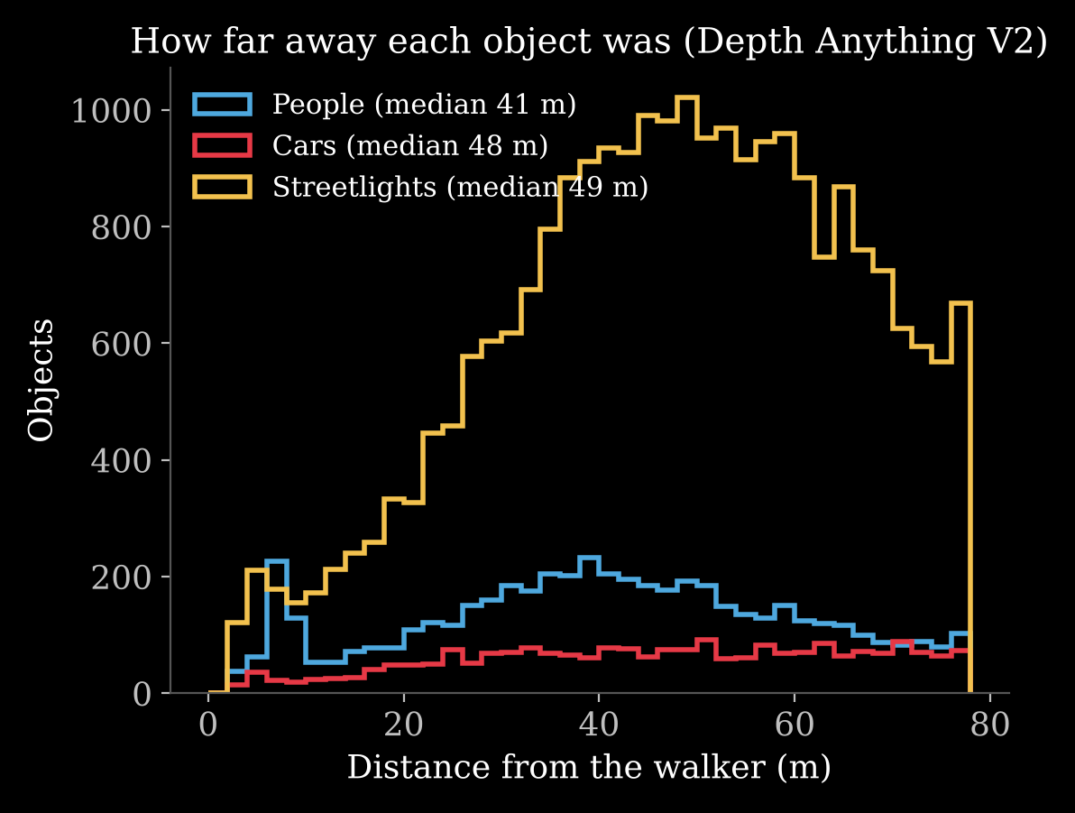
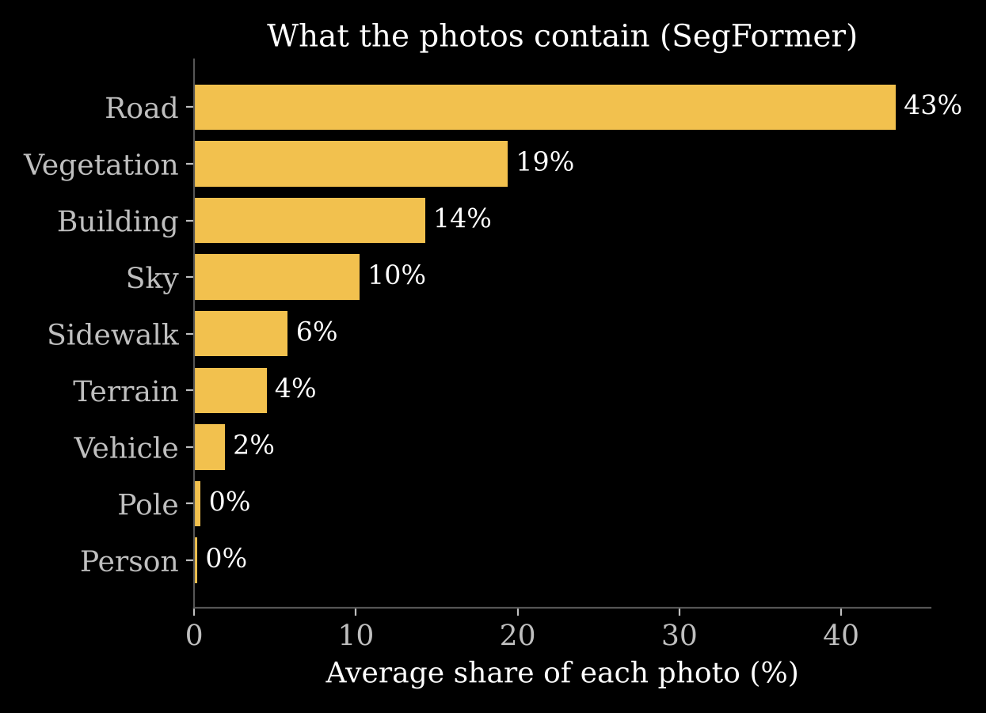
GPU Processing
NVIDIA A16
17,607 photos in 59 min
~5 photos per second, 2 models
Depth and Scene — Depth Anything V2 + SegFormer

Slide 4
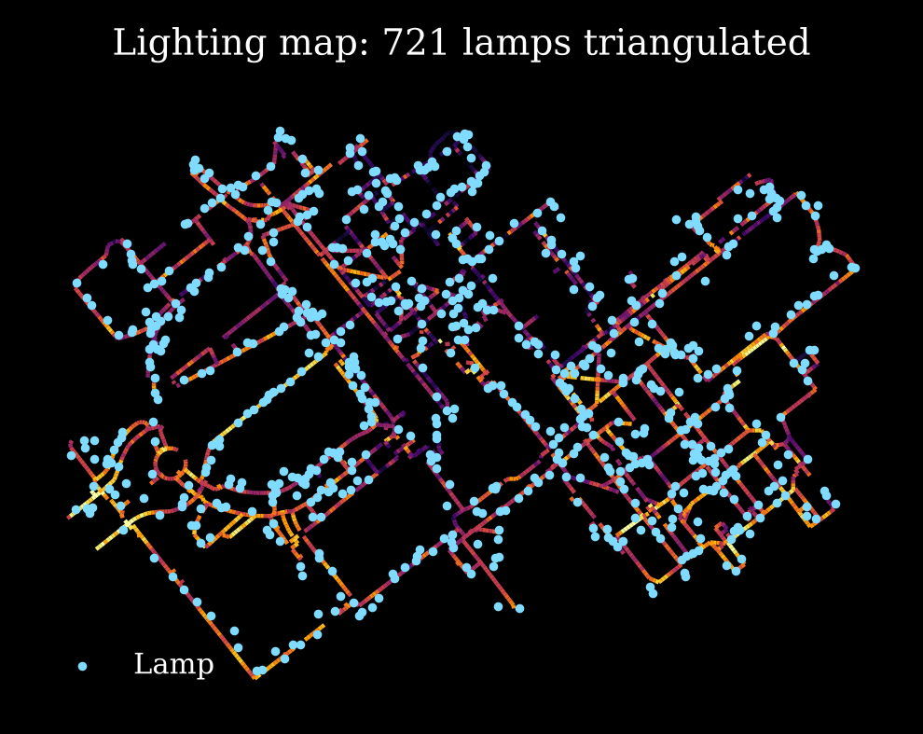
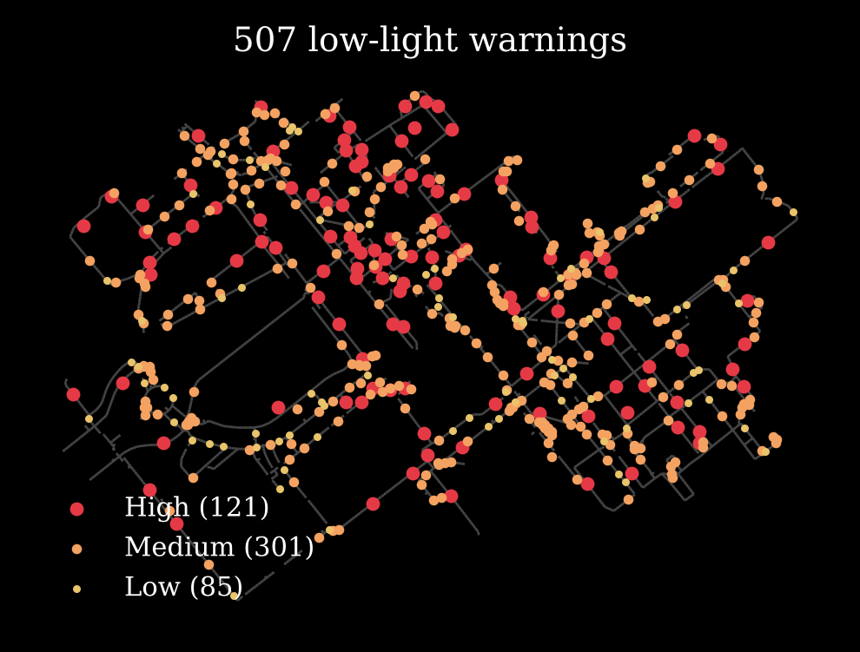
GPU Processing
NVIDIA A16
284k readings in 2 min
3,622 path stretches mapped
Lamp Mapping — Triangulation + OpenStreetMap

Slide 5
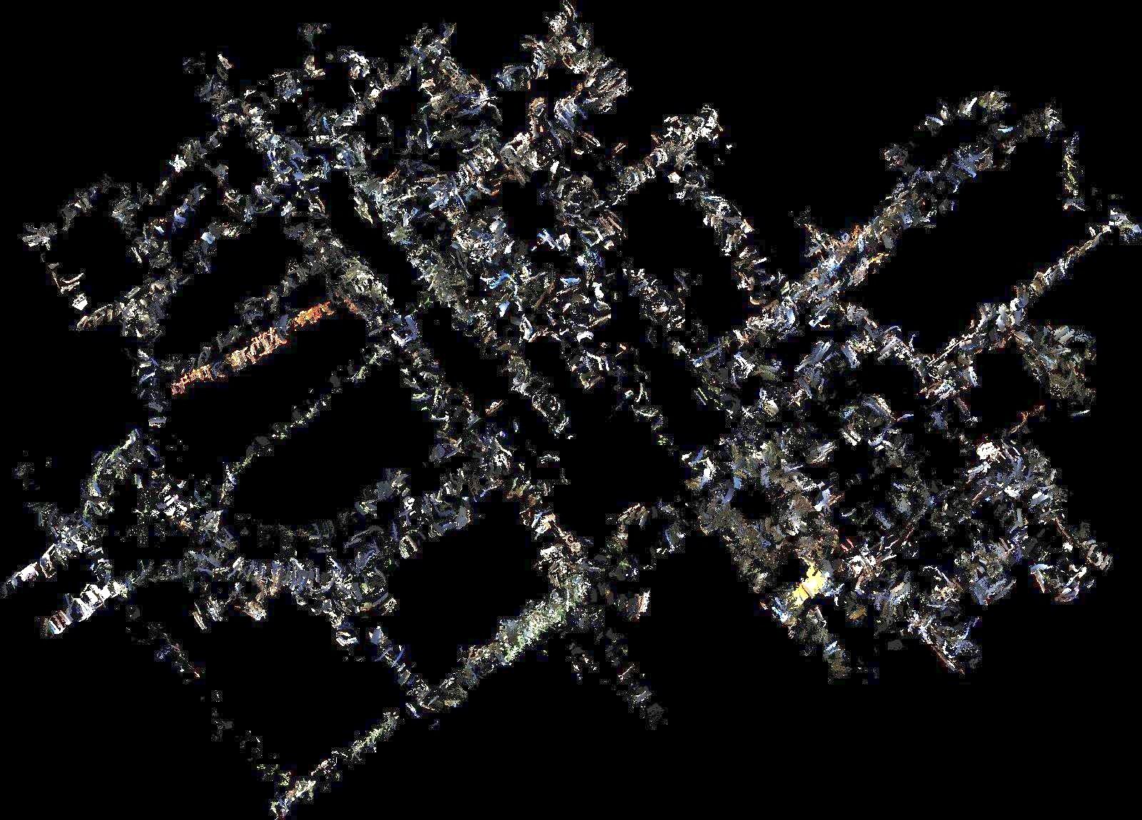
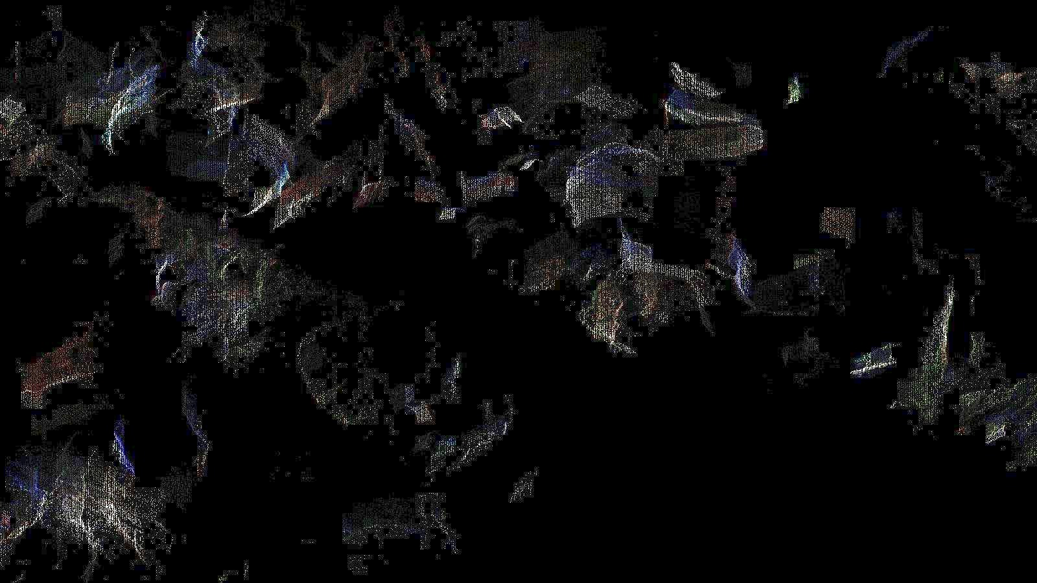
GPU Processing
NVIDIA A16
44M points in 10 min
5,874 frames fused to 2.5M
3D Point Cloud — Depth Fusion (Depth Anything V2)

