Slide 1

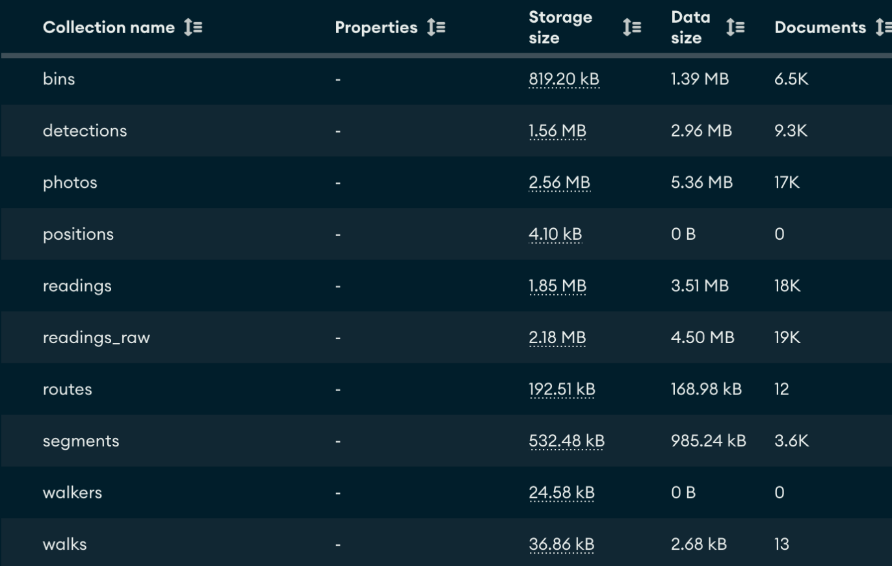
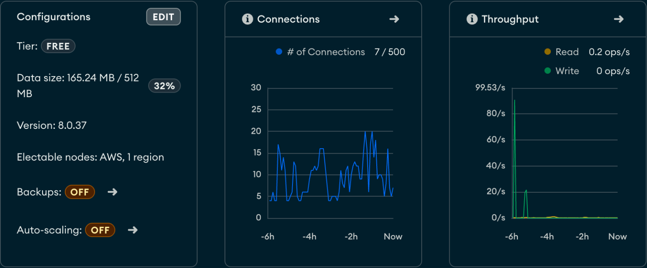
Data Storage
73,407
documents · 18.88 MB
Atlas Cluster — Cluster0 on AWS, database lux_survey

Slide 2
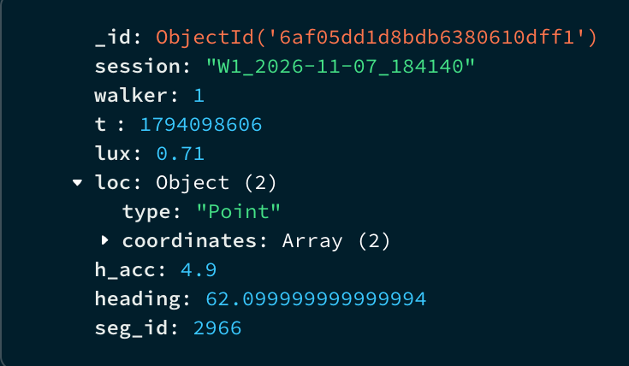
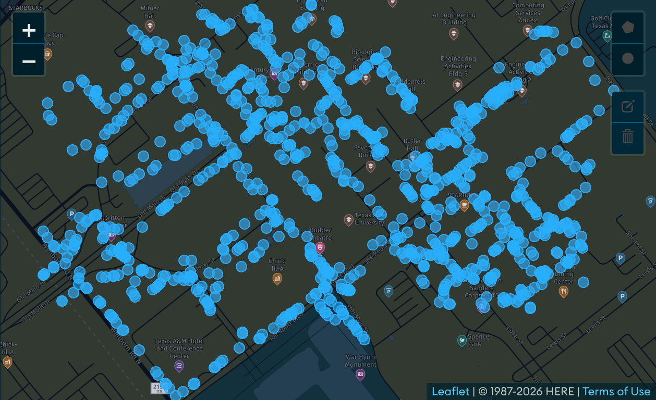
Data Storage
17,715
light readings · 3.51 MB
readings — the clean 1-per-second light readings

Slide 3
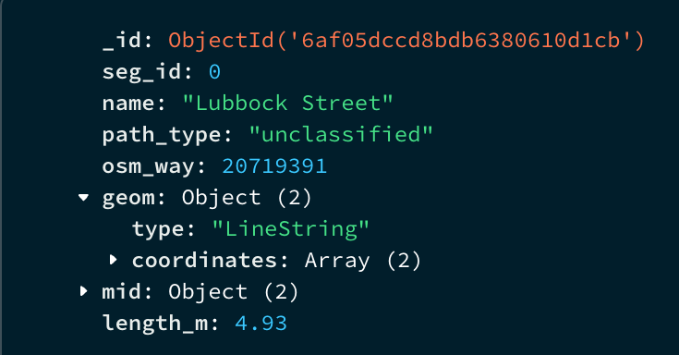

Data Storage
3,622
path stretches · 985 kB
segments — the 5 m path stretches the map lights up

Slide 4
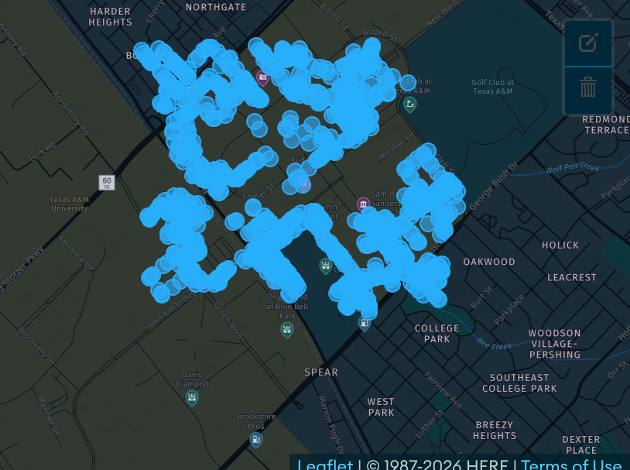
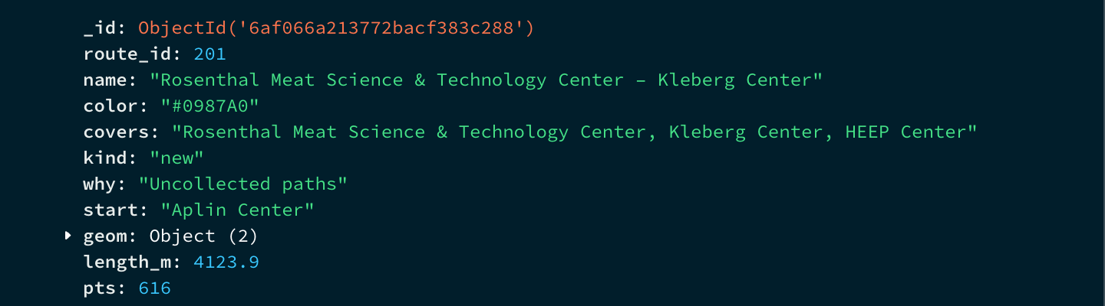
Data Storage
6,457
route bins · 1.39 MB
routes and bins — 10 m bins still waiting for data

Slide 5
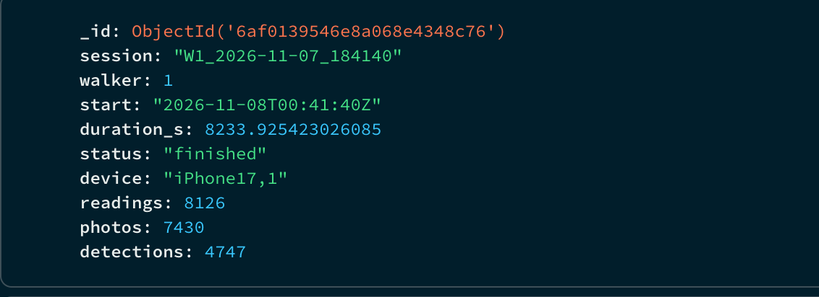
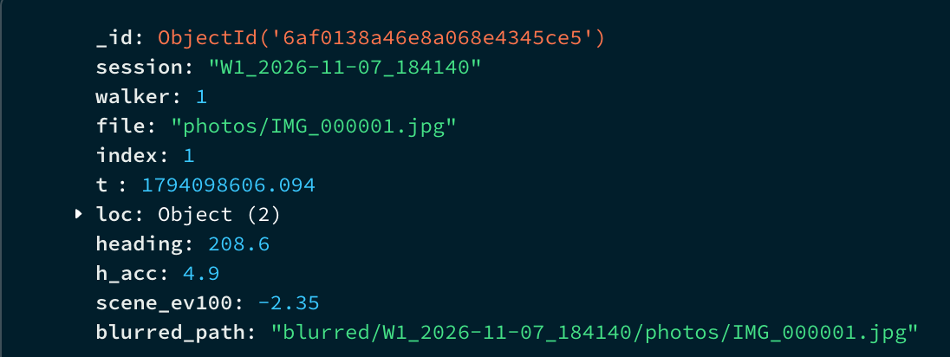
Data Storage
17,289
photos · 5.36 MB
walks and photos — 13 walks, every blurred photo

Slide 6
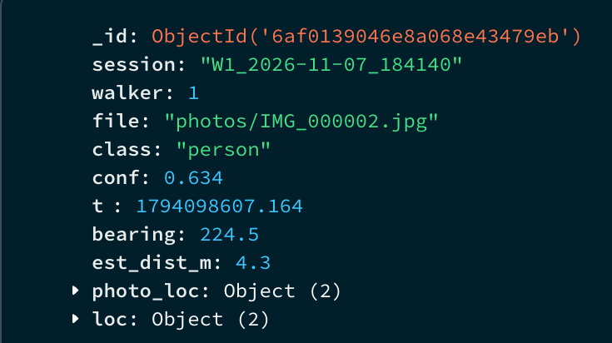
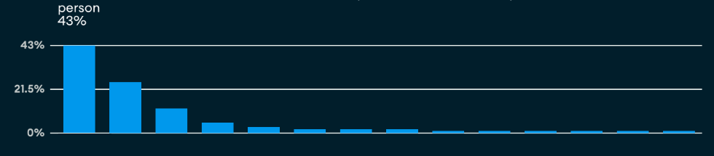
Data Storage
9,334
detections · 2.96 MB
detections — every person, car and object the GPU found

Slide 7
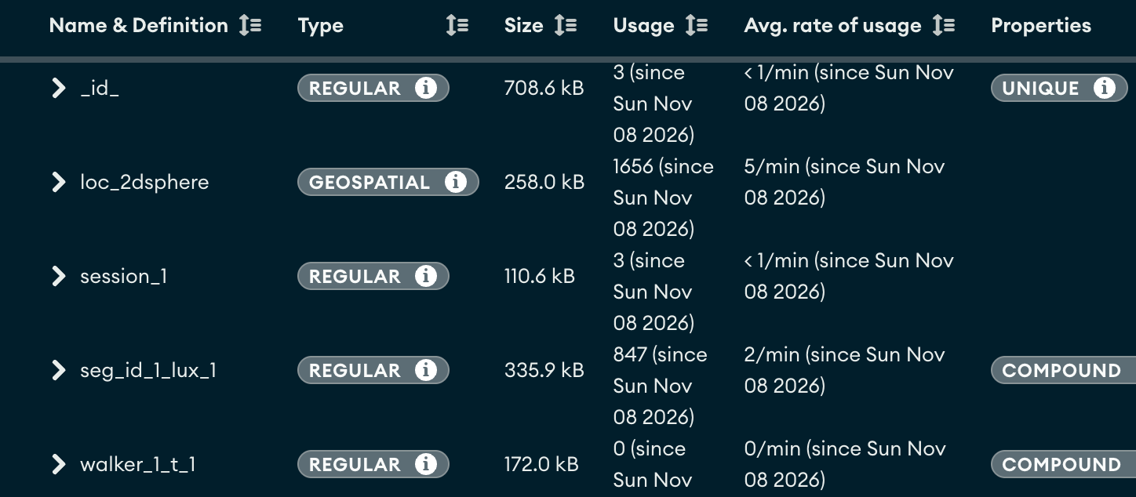
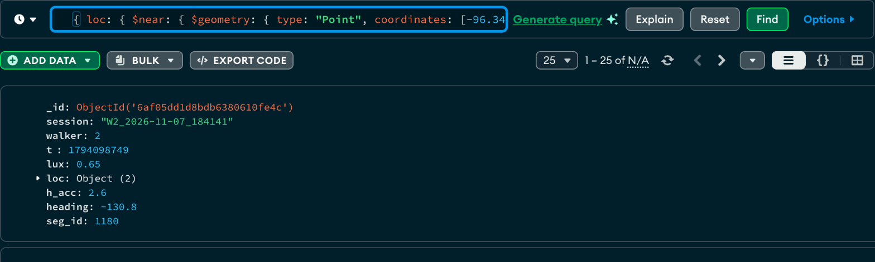
Data Storage
31
indexes · 1,656 geo lookups
Location Queries — 2dsphere index + $near

