Slide 1
INTELLIGENT INDUSTRIAL MAINTENANCE MANAGEMENT
MaintenaX
A scenario-based MVP for coordinated, explainable maintenance decisions.
TEAM NAME
TEAM ID
PROBLEM STATEMENT
404:NOT FOUND
DQ3-023
DQBH
Team Members
Name | Registration No.
Sonhita Ghose | 26BEC1406
Kinjal Sarkar | 26BCE1313
Aishani Basu | 26BCE1366
Shourya Kumar Gupta | 26BCE1304
Live Demo
Notes:
MaintenaX is our response to DQBH’s activity-management challenge: make industrial maintenance coordinated, visible, and accountable. The cover establishes the team, the problem statement, and the live demo destination.

Slide 2


THE OPERATING REALITY
Maintenance is a coordination problem before it is a repair
“Maintenance is not just about fixing machines — it is about coordinating activities.”
The work succeeds only when context, people, timing, resources, and decisions stay aligned.
MANY MOVING PARTS
Assets, work orders, technicians, skills, schedules, priorities, parts, dependencies, execution status, and history must line up.
LOW EARLY VISIBILITY
Fragmented tools make clashes, work progress, and decisions hard to see early.
IMPLICATION
Without one operational view, the cost of a late change is harder to predict, explain, and recover from.
404: NOT FOUND • DQ3-023 • DQBH
02
Notes:
The repair is only one moment in the lifecycle. The harder problem is keeping people, resources, timing, and decisions aligned before work begins. This is the operating reality MaintenaX is designed to make visible.

Slide 3
THE GAP
DQBH’s challenge is to replace fragmentation with one accountable workflow
TODAY · FRAGMENTED
INTELLIGENT ACTIVITY MANAGEMENT
Context is distributed
Make the next decision explainable
Fragmented data: activities, assets, resources, and schedules lack one operational view.
Conflicts and traceability: overlapping assignments and resource contention disrupt work, while teams still need to know what changed, when, and why.
Who should do the task—and why was this technician recommended?
What happens if a technician drops out, and which recovery path protects the SLA?
Can a spare part transfer between sites, and what ripple does that create?
Maintenance Data → Intelligence → Scenario Analysis → Human Decision
Opportunity: make maintenance structured, conflict-aware, explainable, and auditable.
The system supports the decision; it does not replace the accountable planner.
03
404: NOT FOUND • DQ3-023 • DQBH
Notes:
MaintenaX changes the unit of work from an isolated record to an accountable flow. The planner can see the operating context, test an alternative when a technician drops out or a part must move between sites, and leave an explanation behind. The opportunity is decision support, not autonomous control.

Slide 4
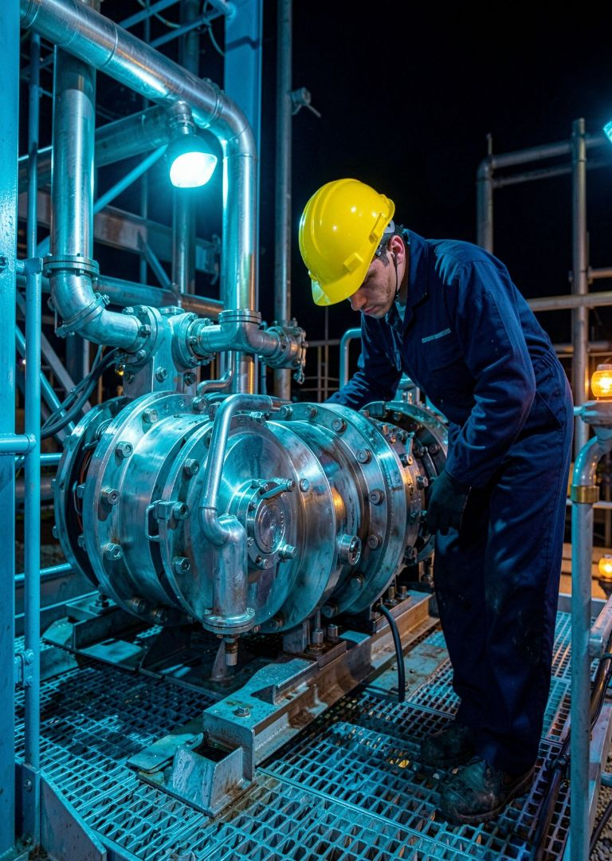
THE LIFECYCLE
MaintenaX connects six steps across the maintenance lifecycle
Each step preserves the context needed by the next one, from the first request to the final audit trail.
01 · CAPTURE
02 · COORDINATE
Request and operating context enter one workflow.
People, timing, resources, and constraints stay visible.
INTELLIGENCE & COPILOT · EXPLAINS
OPERATIONAL CORE · COMPUTES
Intelligence & Copilot
03 · LEARN
Operational Core
Scenario estimates and explanations that support controlled decisions.
Status and history remain available for the next decision.
Requests, workflow, scheduling, resources, and audit.
RandomForest repair-time estimate
Technician compatibility score and ripple ranking
Dropout simulation and spare-part transfer feasibility
SLA forecast and Ollama explanation
404: NOT FOUND • DQ3-023 • DQBH
Capture the request and operating context.
Coordinate work, people, timing, and resources.
Preserve status and history in an audit-ready record.
04
The Intelligence Engine computes. The Copilot explains.
Notes:
The lifecycle is deliberately connected. The Operational Core captures requests, coordinates work, and preserves the audit trail; Intelligence & Copilot adds scenario estimates and explanations without replacing human control. The six lifecycle steps are supported by these two distinct layers.

Slide 5
THE USER JOURNEY
One user journey turns a maintenance request into accountable execution
Recommendations inform the plan; they never change real assignments automatically.
01
02
03
04
SERVICE REQUEST
VALIDATE
ML RECOMMENDATION
COMPARE ALTERNATIVES
Capture the need and context.
Check constraints, history, and resources.
Estimate repair time and fit.
Review options and trade-offs.
05
06
07
08
SIMULATE SCENARIOS
HUMAN APPROVAL
EXECUTE
AUDIT
Planner chooses and confirms.
Technician carries out the approved plan.
Record status, evidence, and rationale.
Test dropout, ripple, and SLA risk.
CONTROL POINT
HANDOFF
Human approval remains in the loop. MaintenaX suggests; the planner decides.
Planner → MaintenaX → Technician → Audit / Management.
05
404: NOT FOUND • DQ3-023 • DQBH
Notes:
The journey is deliberately human-controlled: MaintenaX validates the request, recommends options, compares alternatives, and simulates scenarios before a planner approves the path. The approved plan is executed and audited; no recommendation changes a real assignment automatically.

Slide 6
INTELLIGENCE & COPILOT
Intelligence & Copilot — From Data to Decisions
Separate the calculation, the explanation, the scenario comparison, and the approval.
01
02
03
04
RECOMMEND
EXPLAIN
SIMULATE
APPROVE
Compute options
Make context clear
Compare scenarios
Keep humans in control
RandomForest repair-time prediction, compatibility scoring, ripple strategy, and SLA forecasting.
Ollama Qwen 2.5 3B turns the recommendation into a natural-language explanation.
Test recovery paths and inspect repair time, compatibility, ripple impact, and SLA risk.
A manager reviews the scenario before any operational change is made.
OPERATING MODEL
PROTOTYPE BOUNDARY
The operational engine calculates. Ollama explains, not decides. Recommendations remain proposed options, not automatic assignments.
These are scenario estimates and explanations for a prototype — not measured production accuracy, savings, or fully autonomous decisions.
DATA → INTELLIGENCE → SCENARIO ANALYSIS → HUMAN DECISION
06
Notes:
MaintenaX separates calculation from explanation and approval. The intelligence engine computes repair-time, compatibility, ripple, and SLA signals; Ollama explains the result in natural language, while a human decides whether to act. The stages are intentionally explicit so evaluators can see the control boundary.

Slide 7
THE TECHNICAL FOUNDATION
ARCHITECTURE FLOW
Connected architecture for a scenario-based MVP
React + Vite → FastAPI REST API → SQLite-backed Intelligence Engine → Ollama / Qwen 2.5 3B
The operator experience calls the API; the Intelligence Engine computes prototype scenarios; Ollama / Qwen 2.5 3B explains the results.
INTELLIGENCE ENGINE MODULES
Validation
History
Compatibility scoring
RandomForest repair-time estimation
Ripple strategy ranking
Recovery simulation
Spare-part transfer checks
SLA forecasting
The prototype separates the operator interface, API boundary, scenario intelligence, and natural-language explanation.
CONNECTED, NOT PRODUCTION-READY
No real GPS, IoT, or blockchain claims.
The Intelligence Engine computes. The Copilot explains.
07
Notes:
The architecture keeps the prototype's boundaries legible: React + Vite presents the operator experience, FastAPI exposes the SQLite-backed API, the Intelligence Engine computes scenario estimates, and Ollama / Qwen 2.5 3B turns those results into natural-language explanations. This is a connected MVP path, not a claim of production-ready end-to-end integration.

Slide 8
THE OPERATOR EXPERIENCE
Visibility and trust for operators
Two demo scenarios make the decision boundary concrete: compare, explain, approve.
DEMO SCENARIO · RECOVERY
DEMO SCENARIO · RESOURCE
SR501 → T02
PUMP-12 shortage
Simulate T02 dropout → find replacements → compare compatibility, repair time, and ripple impact.
Recommend recovery → human approval.
Candidate-site transfer check → feasible / infeasible.
SCENARIO CHECK
ASSIGNMENT STAYS UNCHANGED
The prototype checks transfer feasibility before approval.
The actual assignment is not automatically changed.
TRUST SIGNALS
TRACEABILITY
SCOPE
Validation and controlled workflows.
Changes remain explainable and auditable.
Scenario estimates, not autonomous decisions.
08
404: NOT FOUND • DQ3-023 • DQBH
Notes:
For SR501, the prototype can simulate a T02 dropout, compare replacement options, and recommend recovery for human approval. A PUMP-12 shortage triggers a candidate-site transfer feasibility check. Neither scenario changes a real assignment automatically.

Slide 9
CAPABILITIES & LIMITS
Prototype capabilities with a staged path to production
Demonstrate the workflow honestly now; harden the platform only after the scenario path is validated.
CAPABILITIES — Run the maintenance request lifecycle locally with React, FastAPI, and SQLite; validate workflows, compare scenarios, support human decisions, and retain an audit trail.
STAGED ROLLOUT — Start with a bounded workflow or site, validate API behavior and mock-data scenarios, then consider production infrastructure such as PostgreSQL, cloud hosting, security hardening, monitoring, backups, and scalable APIs.
EXPLICIT LIMITS — This is not a production-ready integration claim. There is no real GPS, IoT, or blockchain integration, no measured ML accuracy or measured cost/SLA savings, and no fully autonomous decision-making.
INTERPRETATION — Predictions and recommendations are scenario estimates for decision support, not measured production gains. Human assignment and status control remain in the loop.
NOW
NEXT
ALWAYS
Prototype workflow and scenario evidence.
Validate bounded integrations and operational controls.
Keep human approval and caveats visible.
09
404: NOT FOUND • DQ3-023 • DQBH
Notes:
The prototype demonstrates workflow, scenario comparison, and audit-oriented decision support. Predictions and recommendations are scenario estimates, not measured production gains. We make no production-ready integration, GPS/IoT or blockchain, accuracy, savings, or autonomy claims.

Slide 10
REFERENCES
Evidence behind the pitch
THE PROMISE
Intelligent.
Resilient.
Resource-aware.
Explainable.
Human-controlled.
DQBH, “Next-Generation Activity Management Platform,” DataQuest 3.0, Round 1
“Where do we start? Guidance for technology implementation in maintenance management for manufacturing,” 2018
Dinis, “Maintenance capacity planning, spare parts management, and maintenance scheduling: An overview,” Elsevier, 2025
“A competence-based planning methodology for optimizing human resource allocation in industrial maintenance,” 2023–2024
MaintenaX GitHub repository
React documentation; FastAPI documentation; SQLAlchemy documentation
Prototype scope: scenario estimates only; no autonomous assignment changes.
Live Demo
MaintenaX gives maintenance managers better decisions, better scenarios, and better explanations.
404: NOT FOUND • DQ3-023 • DQBH
10
Notes:
Close by returning to the product promise: MaintenaX makes maintenance activity easier to coordinate, easier to understand, and easier to audit. The references distinguish the challenge, the technical foundation, and the repository-reported scope.

