Slide 1
REVIEW-2

Slide 2
Parallel Implementation of K-Means Clustering algorithm

Slide 3




TEAM MEMBERS
Shourya Gupta
Sam Methuselah
Mihir Antwal
Ridhika Sahni
19BCE1704
19BCE1698
19BCE1641
19BCE1697

Slide 4
ABSTRACT
This is a constantly growing field and has an influx of algorithms being invented for faster and more reliable results. But the K-Means Clustering algorithm has been used as it is and as a part of many of the new algorithms. K-Means a popularly used clustering algorithm known for its simplicity and correctness.
The goal of this project is to achieve execution time improvements of K-Means algorithm for by parallelizing the distance computations and have 100% CPU Utilization.
Notes:
This is a constantly growing field and has an influx of algorithms being invented for faster and more reliable results. But the K-Means Clustering algorithm has been used as it is and as a part of many of the new algorithms. K-Means a popularly used clustering algorithm known for its simplicity and correctness.
The goal of this project is to achieve execution time improvements of K-Means algorithm for by parallelizing the distance computations and have 100% CPU Utilization.

Slide 5
PROBLEM STATEMENT
The goal of this project is to achieve execution time improvements of K-Means algorithm for by parallelizing the distance computations and have 100% CPU Utilization. We have implemented a 3 naïve K-Means algorithm where the distance between each data point and each centroid is computed sequentially. Then, using the multiprocessing module in python, we have divided the tasks between all the processors available in the system to parallelize the distance computation and utilizing the full computing power of the CPU.
Notes:
Execution time improvements are not achieved until the computations are significantly high. We can see that the improvements for a larger dataset are clearly visible in the graphs that are provided in the below segmen

Slide 6
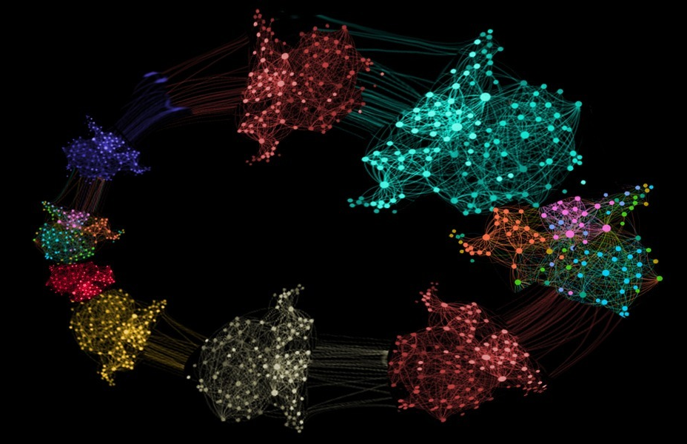
Clustering Algorithms
Clustering is a technique for finding groups of data points having similarity in their features, called clusters.
There are two types of Clustering techniques:
- Unsupervised learning
- Supervised learning

Slide 7
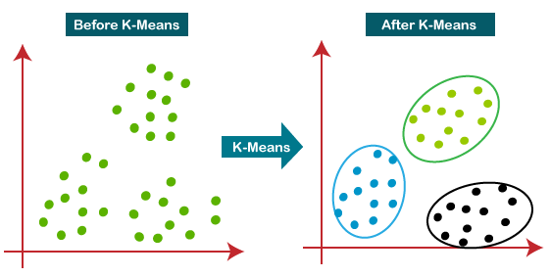
K-Means Algorithm
It is a type of unsupervised learning, which is used when we have unlabeled data. This algorithm finds groups in the data, with the number of groups represented as a variable K.
Clustering takes place on the basis of a feature similarity (in our case being the Euclidean distance).
Notes:
It is a type of unsupervised learning, which is used when we have unlabeled data. This algorithm finds groups in the data, with the number of groups represented as a variable K.
The algorithm works iteratively to assign each data point to one of K groups based on the features that are provided.
Clustering takes place on the basis of a feature similarity (in our case being the Euclidean distance).

Slide 8
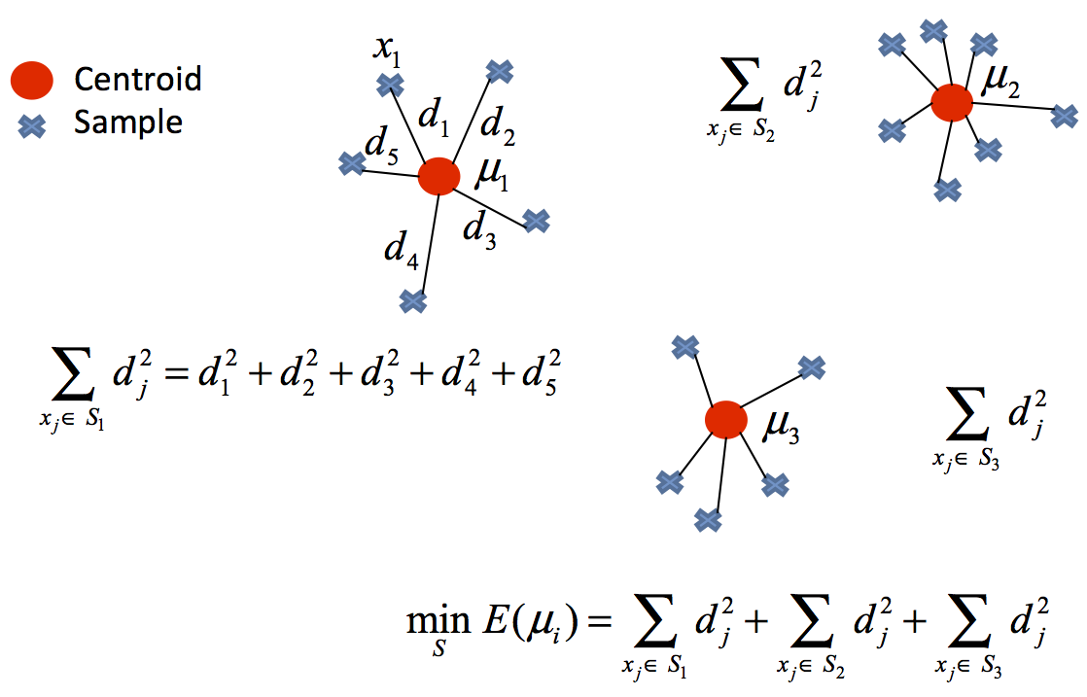
This algorithm results in the below two things:
The centroids of the K clusters, which can be used to label new data.
Labels of the training data
Notes:
This algorithm results in the below two things:
The centroids of the K clusters, which can be used to label new data.
Labels of the training data
Unsupervised Learning Algorithm
Popular for simplicity and correctness
Computation Intensive Due to Distance Calculations
Increase in any of the 3 parameters contributing to Time complexity will increase time taken to run the program

Slide 9
Advantages
Disadvantages
K-Means has very intuitive approach and hence easy to implement
If the clusters are big, then K-Means is, in most cases, faster for small K values.
K-Means produces tighter clusters than Hierarchical clustering.
Easy to interpret the clustering results.
Clusters obtained tend to have similar density
Difficult to predict K value. Hence, different approaches such as squared errors of prediction(SSE) for regression are needed.
It often produces uniform clusters with relatively uniform size even if the input data has different cluster size.
Sensitive to outliers.

Slide 10
Time Complexity:
O(NKT)
(N = Number of Data Points, K = Number of Clusters to form, T = Number of Iterations to final clusters)
Space Complexity:
O(((m+k)*n)+n)
(m = Number of data points, k = Number of Clusters, n = Number of features)

Slide 11
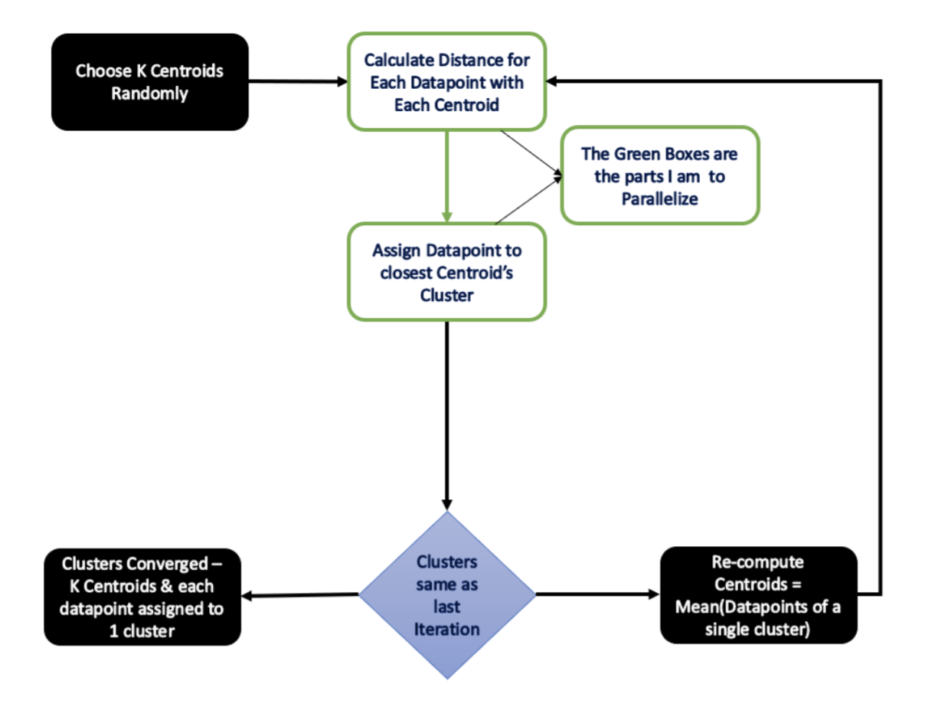
Flow Chart for Sequential Implementation of K-Means

Slide 12
Sequential K-Means Implementation
Steps:
Pick K centroids randomly
Compute Distance between each data point with k centroids
Assign Cluster based on the minimum distance from the centroid
If Clusters are not the same as previous iteration:
Recompute Centroids with new cluster Assignments
Repeat from Step 2
If no, End Process

Slide 13
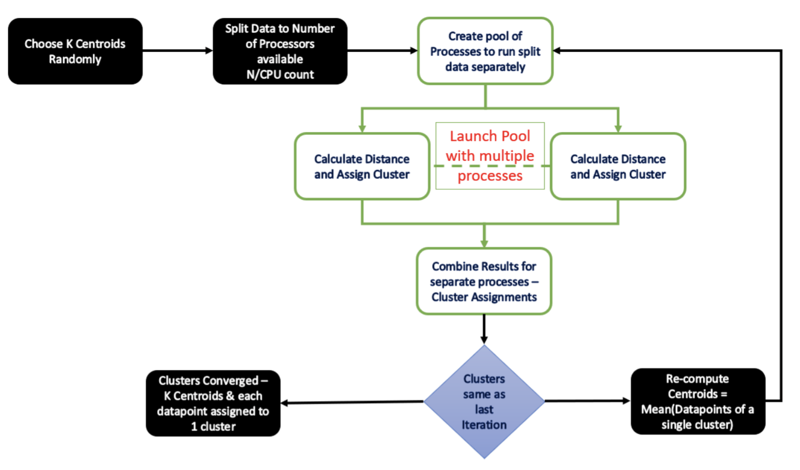
Flow Chart for Parallel Implementation of K-Means
Notes:
Before getting in this flow diagram – there is one that thing that I need to define → Kernel: So, kernel is used to calculate the distance between a given datapoint and k centroids and to pick the least distance out of all the k distances. The speedups depend on the number of blocks and the threads per block that are launched to calculate the distances.
Here, given than we have N datapoints, and have to run P blocks of the kernel. Then for each block, we will have N/P threads. So, it means we are aiming at making the runtime of our program reduced by P times.
Pool() will launch given number of processes with find_cluster function on multiple processors. Using the Multiprocessing module, inbuilt with python
Load is shared by all CPU Processors
Faster than sequential for large inputs

Slide 14
Clustering and Centroids

Slide 15
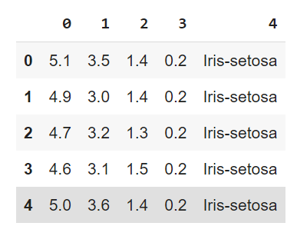
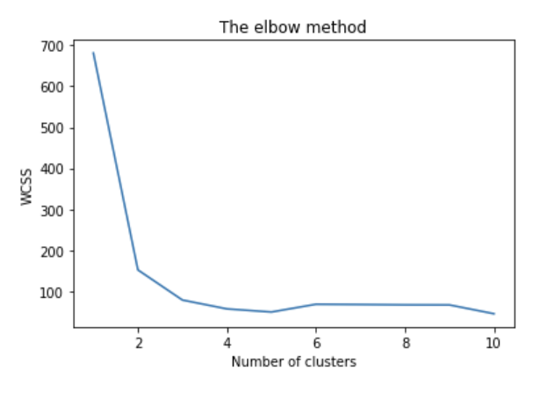
Notes:
So we took the iris dataset and tried to learn how to form clusters and find centroids using k-means.
We applied the kmeans on the dataset for 1 to 11 cluster and then plotted the results onto a line graph, allowing us to observe 'The elbow’
After that we applied the kmeans to the dataset and Created the kmeans classifier

Slide 16
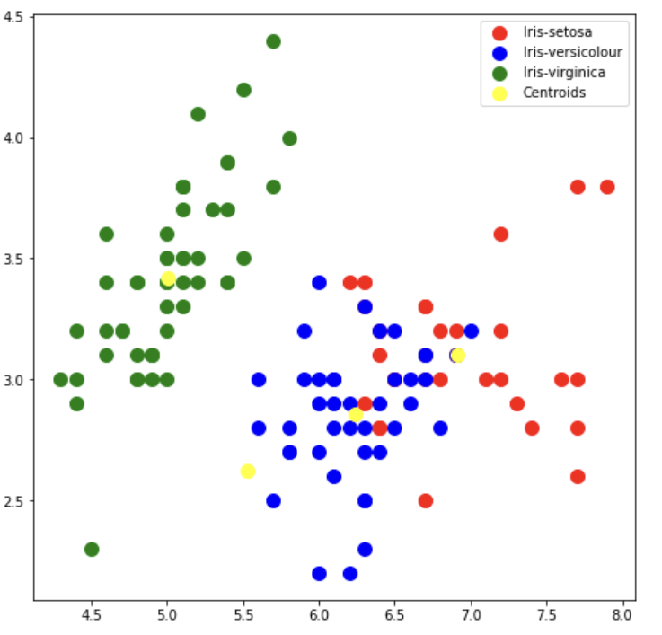
Notes:
Here we created the plot to Visualise the clusters
And also plotted the centroids of the clusters

Slide 17
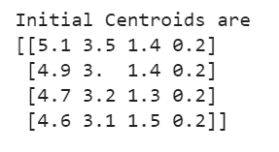
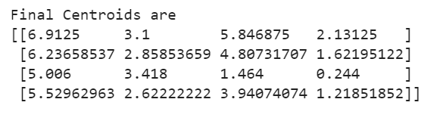
Notes:
The centroids initialized were the ones during the cluster creation
The final centroids are the ones from k-means

Slide 18
Parallel Processing

Slide 19
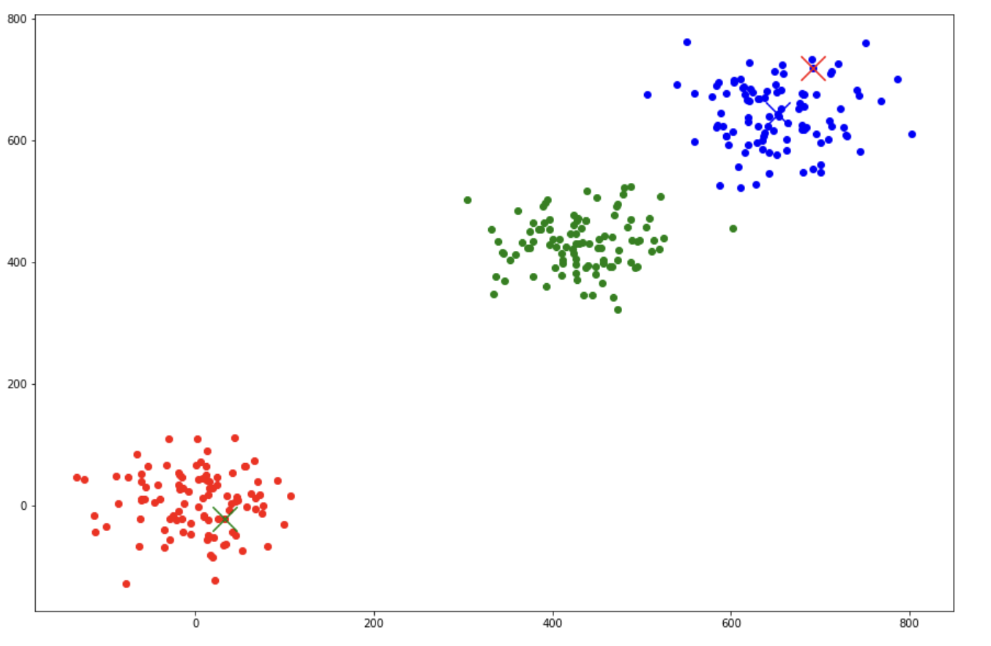
Notes:
We took the number of samples as 100 and the number of clusters as 3
Then we choose the centroids completely random inside the clusters

Slide 20
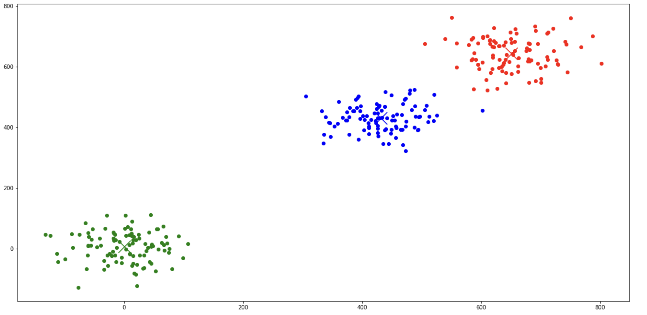
Notes:
Then we put the algorithm to find the distance. And also the map reduce is used for the k-means
The process works in parallel and we get the centroids
Now this two programs helped us gained knowledge on how the k-means works and how we can parallelize it

Slide 21
System and Testing
AMD Ryzen 9 5900HS 3.30 GHz
16 GB RAM
64-Bit Windows Operating System
Wholesale Customer Data:
(440 Data points × 8 Attributes)
Wine Quality Data:
(4898 Data points x 12 Attribute)
Notes:
Coming to the final program we worked on. The program will work on the datasets and the time of processing is calculated from the time the Clustering process starts and till it ends for both sequential and parallel k-means
We have given the number of clusters from 3 to 9 to test out how the parallel k-means is working in comparison to the sequential k-means

Slide 22
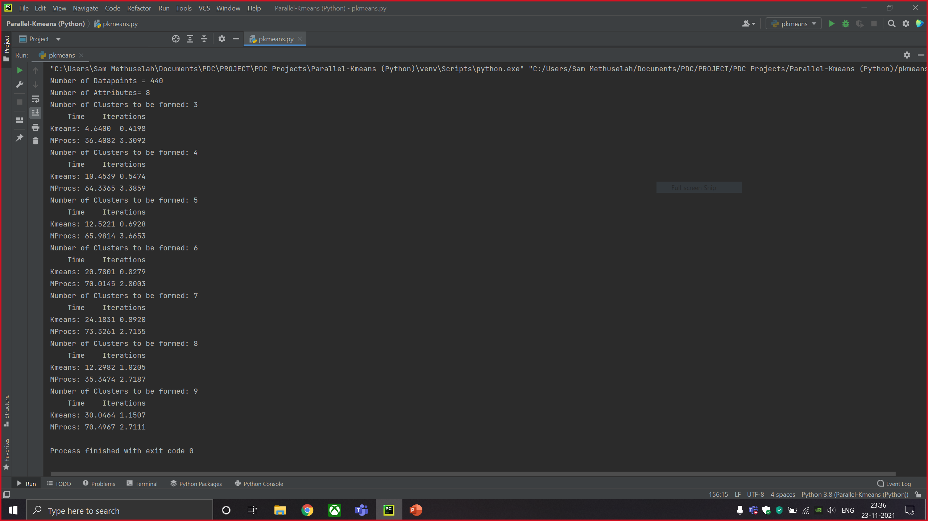
Notes:
This is output of the code for the dataset – Wholesale Customer having 440 data points and 8 attributes

Slide 23
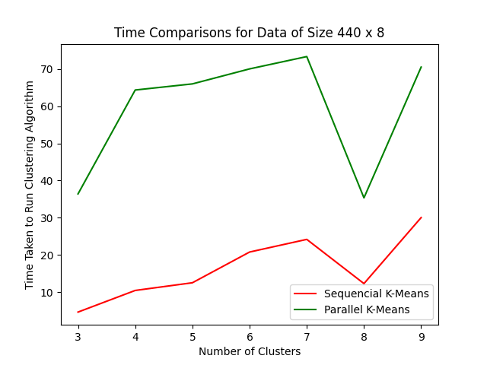
Notes:
The program also plots the two graphs-
One is the time comparison between the Sequential and Parallel K-Means
Here Green shows the Parallel whereas Red shows the Sequential…
We get not so successful results as the Parallel surely is taking a lot of time

Slide 24
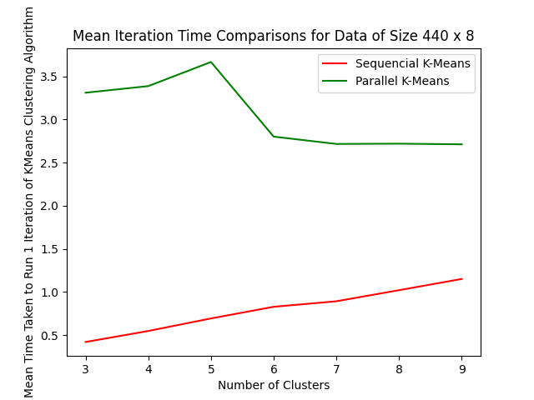
Notes:
This , the 2nd graph shows the comparison in the mean iteration time

Slide 25
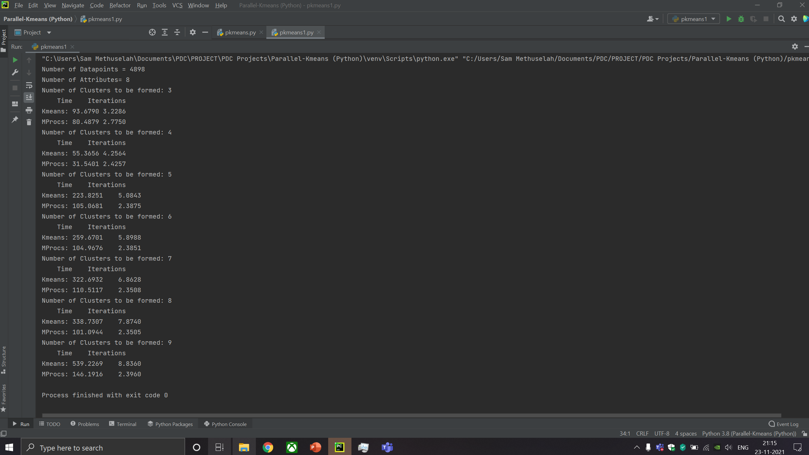
Notes:
This is output of the code for the dataset – Winequality having 4898 data points and 12 attributes
We have taken only 8 attributes to make the comparison more easier
This is where things get interesting

Slide 26
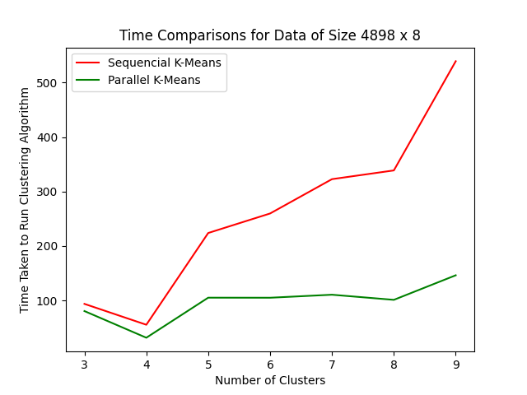
Notes:
As we can see the Parallel K-means is taking almost consistent time as the number of clusters increase but the Series K-Means take more time with more clusters

Slide 27
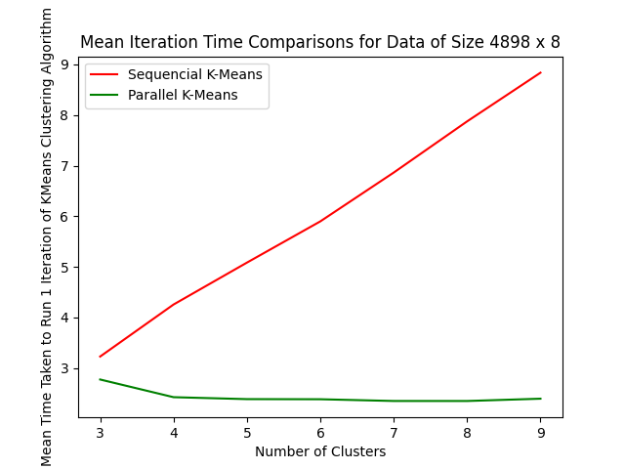
Notes:
And her the consistency of the Parallel-Kmeans is really impressive and so is the linear growth in the iteration time of Sequential

