Slide 1
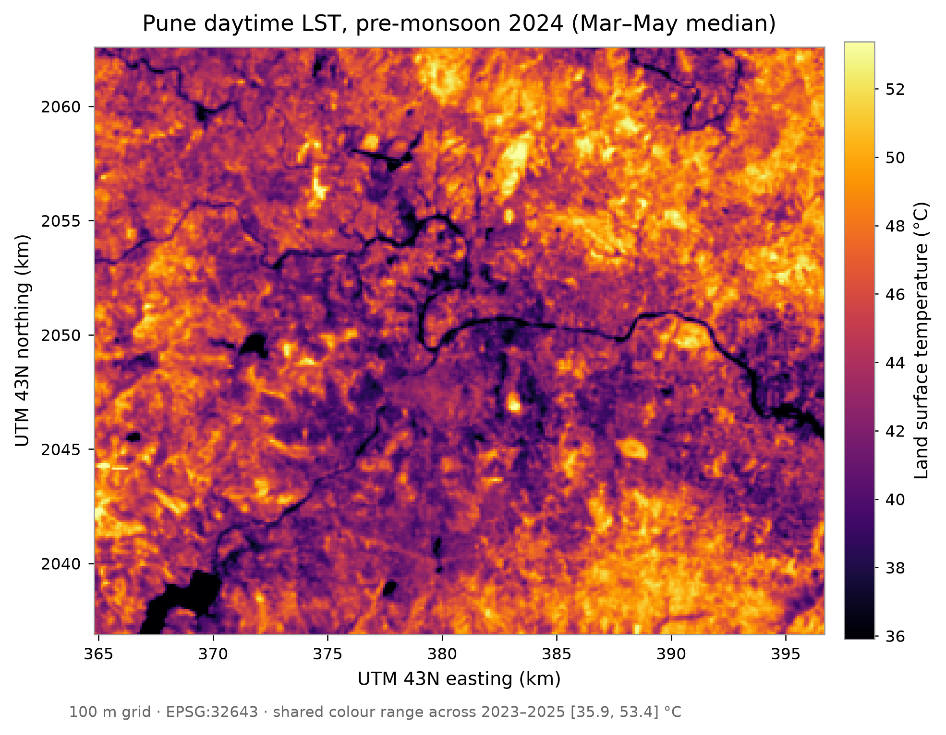
MirageAI
Concrete vs. Canopy: Explainable Machine Learning for Urban Heat Island Drivers in Pune
Shourya Tiwari · Shashwat Kumar
Rishik Sinha · Shubhankar Bhan
Applications and Use Cases of Machine Learning (TE7483)
Symbiosis Institute of Technology, Pune
MirageAI · Concrete vs. Canopy
1 / 16
Notes:
Good morning, everyone. We're Shourya Tiwari, Shashwat Kumar, Rishik Sinha and Shubhankar Bhan, and this is our case study for Applications and Use Cases of Machine Learning at Symbiosis Institute of Technology, Pune. The project is called MirageAI, and the subtitle is Concrete versus Canopy: explainable machine learning for urban heat island drivers in Pune. Let's start with the picture on the right. It's a satellite map of daytime Land Surface Temperature, or LST, over Pune and Pimpri-Chinchwad, for March to May 2024, on a grid of one-hundred-metre cells. Bright yellow is hot, dark purple is cool. Those dark lines are the rivers, and the dark patches in the corner are reservoirs. Now, most of us picture a city as a hot island sitting in cooler countryside. That's the textbook urban heat island, and it's why we called the project MirageAI. When we actually looked at the data, that hot core turned out to be a mirage: in the daytime, Pune's dense core is cooler than its dry surroundings. So the real question isn't "is the city hot?" It's "which surfaces are hot, why, and what would actually cool them?" Our goal has three parts. First, predict how much hotter or cooler each hundred-metre cell is than the city as a whole, using only open satellite data. Second, explain those predictions with Explainable AI, so a planner can see what pushes a place up or down. Third, use the model for Counterfactual Analysis: if we add trees to the hottest urban cells, how much cooler are similar places? Two principles run through the whole talk. One: we test the model honestly, on places and a year it has never seen, because ordinary random testing flatters spatial models. Two: every result is an association learnt by comparing places, not proof of cause and effect. You'll hear both again. Here's the plan for the next forty minutes or so: the problem and our research questions, then the data and how we prepared it, the models, Spatial Block Cross Validation, the results, SHAP, the greening scenarios, and finally applications, limitations and future work. So let's start with why urban heat is a problem worth solving in the first place.

Slide 2
PROBLEM STATEMENT
Why do urban heat islands matter for Pune?
1
Rapid urbanisation
2
Urban Heat Island
PUNE'S TWIST
built-up land spreading outward
hard surfaces store and re-emit heat
3.4–4.0 °C
cooler: city core vs outer ring, daytime, 2023–25
3
Loss of vegetation
4
Rising surface heat
canopy replaced by roofs and paving
pre-monsoon city median above 44 °C
Assume a hot core and you green the wrong places.
5
Explainable prediction
6
Actionable planning
planners will not act on a black box
where to green, and by how much
MirageAI · Concrete vs. Canopy
2 / 16
Notes:
Let's begin with the basic idea. An urban heat island is a part of a city that's hotter than its surroundings. It happens when we swap soil, grass and trees for roofs, roads and paving. Those surfaces soak up sunlight, store the heat, and have almost no water to evaporate. Vegetation works differently: it cools itself a bit like we do when we sweat. Through evapotranspiration, it spends solar energy turning water into vapour instead of heating the surface. And trees shade the ground on top of that. There are actually two heat islands. The air-temperature one is what people feel. The surface one is the skin temperature of ground and roofs, which satellites measure with thermal-infrared sensors. We work with the surface version: Land Surface Temperature, or LST. Why Pune? Pune and Pimpri-Chinchwad are among the fastest-growing urban areas in India, and built-up land keeps spreading out into what used to be farmland, grassland and scrub. In the pre-monsoon months, the city-wide median surface temperature in our data is above forty-four degrees. Heat affects health, pushes up electricity demand, and hits outdoor workers hardest. Cities are now writing heat action plans, and the practical question in every one of them is: where would greening cool the most? Here's the twist, in the dark panel. In daytime Pune, land cells within five kilometres of the centre are 3.4 to 4.0 °C cooler than the outer ring beyond twelve kilometres, in all three of our years. So a planner who assumes a hot core may plant trees in the wrong places. Why isn't earlier work enough? Many studies correlate temperature with a single index like NDVI, or fit a linear model that can't see thresholds or interactions. And most machine-learning studies test on randomly chosen pixels. Neighbouring pixels are nearly identical, so the model is graded on near-copies of its training data, and accuracy looks better than it really is. That's where Explainable AI comes in. A planner won't act on a black box. They need to know why a place is hot, which factors matter, roughly by how much, and that the explanation is stable. So our problem is: predict surface heat accurately where the model has never looked, explain it, and turn it into honest, actionable guidance. With the problem clear, let's pin down exactly what we set out to answer.

Slide 3
RESEARCH OBJECTIVES
What did we set out to answer?
Objectives
RQ1
Can satellite features accurately predict the LST Anomaly across Pune?
▪ Predict the LST Anomaly from satellite features
▪ Identify the strongest drivers of urban heat
▪ Build a spatially reliable ML framework
▪ Explain predictions with Explainable AI (SHAP)
▪ Simulate greening to support planning
RQ2
Which environmental factors contribute most to urban heat?
RQ3
How does Spatial Block Cross Validation compare with a random split?
RQ4
Can Explainable AI (SHAP) reliably interpret the model's predictions?
RQ5
Can Counterfactual Analysis estimate cooling from more vegetation?
MirageAI · Concrete vs. Canopy
3 / 16
Notes:
This slide is our contract with you: five objectives on the left, five research questions on the right. Each question gets a measured answer by the end of the talk. Let's go through the objectives quickly. One, prediction: estimate each cell's LST Anomaly, meaning how much hotter or cooler it is than that year's city-wide median, from satellite features alone. Two, find the drivers: which surfaces go with heat and which go with cooling. Three, scientific reliability. Spatial data break the usual machine-learning assumption that samples are independent, so we need a validation design that respects geography. Four, explanation: every prediction should break down into feature contributions, using SHAP. Five, decision support: use the model to simulate greening, and give planners a range rather than one over-confident number. Now the research questions. RQ1: can satellite variables accurately predict the LST Anomaly across Pune? And by accurately we mean in unseen places and an unseen year, not on the neighbours of training data. RQ2: which environmental factors contribute most? Vegetation, dryness, moisture, land cover or terrain. This is the "concrete versus canopy" question in our title. RQ3: how does Spatial Block Cross Validation compare with a conventional random split? This matters because if random testing overstates accuracy, every study that relies on it is affected, and it could even change which model we pick. RQ4: can Explainable AI, specifically SHAP, interpret the model reliably? An explanation is only useful if it's stable, so we check it across two models and two SHAP methods, and we're upfront about where it isn't stable. RQ5: can Counterfactual Analysis estimate the cooling that goes with more urban vegetation? Here we have to be careful. The model learns from comparing places, so a simulation tells us how much cooler similar places with more trees are, not a guaranteed effect of planting. Each question maps onto part of the pipeline: RQ1 and RQ3 onto evaluation, RQ2 and RQ4 onto Explainable AI, and RQ5 onto the Counterfactual Analysis. To answer any of these we need data first, so let's look at the four sources we used.

Slide 4
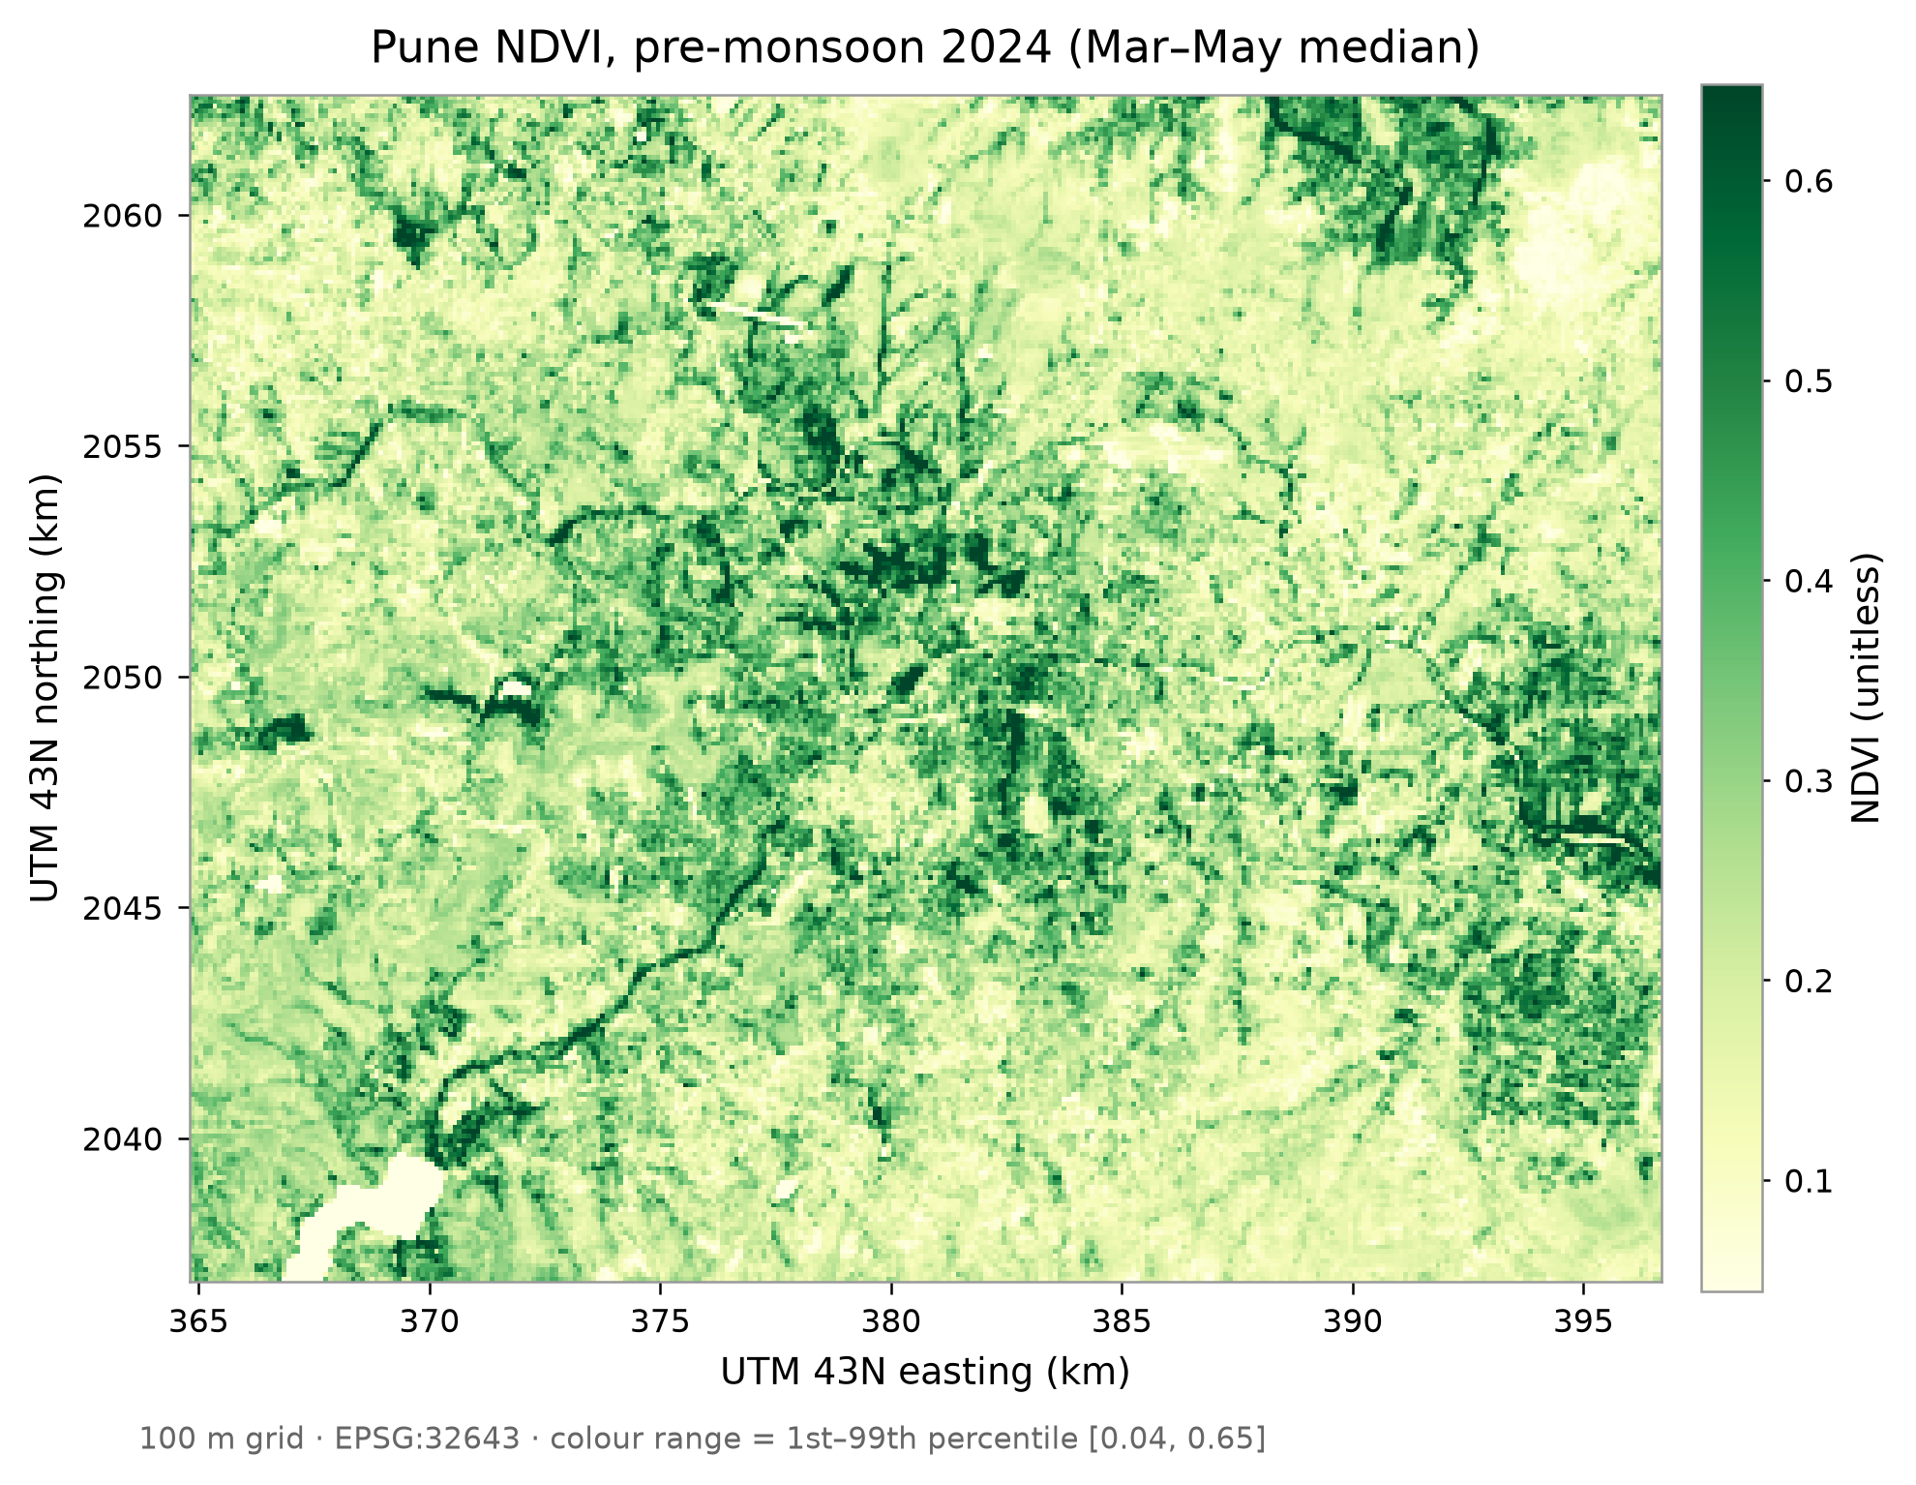
DATASETS
Which data, and why four sources?
Landsat 8/9 100 m thermal
target: Land Surface Temperature (LST)
Sentinel-2 10–20 m
NDVI, NDBI, MNDWI indices
ESA WorldCover 2021 10 m
7 land-cover fractions, distance to water
SRTM DEM 30 m
elevation, slope
243,252 land cell-years, 2023–25
KEY TAKEAWAY Four open sources give heat, vegetation, land cover and terrain on one 100 m grid.
MirageAI · Concrete vs. Canopy
4 / 16
Notes:
We use four open datasets, all through Google Earth Engine, which lets us process years of imagery in the cloud without downloading a single raw scene. The study area is a box over Pune and Pimpri-Chinchwad, and the period is the pre-monsoon season, March to May, of 2023, 2024 and 2025. Why pre-monsoon? Skies are clear and surface heat peaks, so the signal is strong and we lose very few images to cloud. First, Landsat 8 and 9, Collection 2 Level 2. Their thermal sensor measures emitted infrared radiation, and the surface temperature product comes from that. This is our target, Land Surface Temperature. The thermal sensor's native resolution is about one hundred metres, and that's why our whole grid is one hundred metres. Second, Sentinel-2 surface reflectance, at ten to twenty metres. Its red, near-infrared, green and short-wave infrared bands give us three spectral indices: NDVI for greenness, NDBI, which turned out to measure dryness, and MNDWI for moisture. The map on the left is NDVI for 2024. Green is vegetated; you can pick out the river corridors and the green hills. Third, ESA WorldCover 2021, a global land-cover map at ten metres. Every ten-metre pixel has a class: tree, grass, crop, built-up, water and so on. We turn those into fractions: what share of each hundred-metre cell is trees, what share is built-up. We also compute distance to water from it. Fourth, the SRTM elevation model at thirty metres, which gives us elevation and slope. Pune is hilly, and dry, steep slopes behave very differently from the river plain. So why four sources? Because no single sensor sees every driver. Landsat sees heat, but not why. Sentinel-2 sees the current state of vegetation and moisture. WorldCover sees what the surface is made of, and SRTM sees the shape of the land. Together that's 13 features per cell, for 81,084 land cells a year, or 243,252 cell-years in total. And one rule: the target comes only from Landsat, and no feature is derived from it, so there's no target leakage. Of course, raw satellite images aren't model-ready, so next let's see how we built the dataset.

Slide 5
DATA PREPROCESSING
How was the dataset built?
1
Projection
2
Resampling
3
100 m grid
UTM 43N (EPSG:32643), metres
seasonal median, area-weighted mean
Landsat thermal scale · 81,084 land cells
4
Water mask
5
Missing values
6
LST Anomaly
≥ 50% water removed · 2,697 rows
cloud masks · nodata −9999 · none dropped
cell LST − that year's median
KEY TAKEAWAY One clean table: 243,252 land cell-years, and no cell lost to missing data.
MirageAI · Concrete vs. Canopy
5 / 16
Notes:
Raw satellite images can't go straight into a model. They come from different sensors, at different resolutions, with clouds and gaps. Let me walk you through our six steps, in order. Step one, projection. Satellite products arrive in latitude and longitude, and a degree isn't a fixed distance. So we reproject everything to UTM zone 43 North, code EPSG 32643, where the units are metres. That makes areas, slopes, distances and our four-kilometre blocks exact. Step two, resampling. Our sources come at ten, twenty and thirty metres. First we take a seasonal median of each pixel over March to May, which washes out passing clouds and odd days. Then we aggregate to one hundred metres with an area-weighted mean, so each cell is the average of the finer pixels inside it. For land cover, we turn each class into a zero-or-one mask first and then average, so what comes out is the fraction of the cell in that class. Step three, the hundred-metre grid itself, matched to the Landsat thermal sensor. Modelling at thirty metres would pretend to a detail the target simply doesn't have. Each cell also gets a stable identifier from its coordinates, so the same cell in 2023, 2024 and 2025 always lands in the same block. Step four, the water mask. Cells that are at least half water, reservoirs and wide river reaches, are removed: 899 cells a year, 2,697 of 245,949 rows, and none of them urban. Water temperature is driven by thermal inertia, not land-surface drivers, and it's not something a planner can change anyway. Step five, missing values. Landsat and Sentinel-2 ship with quality flags, so we mask cloud, cirrus and cloud shadow, and skip scenes over thirty percent cloud. Masked pixels get an explicit no-data value of minus 9999, so a gap can never pass for a real zero. We need at least 3 clear observations per cell, and thanks to the clear pre-monsoon season, no cell failed that check. Step six, the target. Absolute temperature shifts from year to year with weather and overpass timing, and nothing in our features knows the year. So we model the LST Anomaly: each cell's LST minus that year's city-wide median. Positive means hotter than typical; negative means cooler. The model learns the spatial pattern, not the year. Now that we've prepared the dataset, let's see how we engineered the features.

Slide 6
FEATURE ENGINEERING
Which features describe each cell?
S
Spectral
L
Land-cover fractions
T
Terrain
NDVI greenness · B8, B4
NDBI dryness · B11, B8
MNDWI moisture · B3, B11
Trees · Grass · Crops
Water · Bare land
Shrubs · Built-up
share of cell, sum = 1
Elevation SRTM, metres
Slope degrees
Distance to water metres
Captures: vegetation and water state, every year
Captures: what the surface is made of
Captures: shape of the land, nearness of water
KEY TAKEAWAY 13 features, never coordinates: the model learns why a place is hot, not where.
MirageAI · Concrete vs. Canopy
6 / 16
Notes:
Feature engineering means turning raw measurements into inputs that mean something for the problem. Give a model raw reflectance in twelve bands and it has to discover vegetation on its own. Give it NDVI and it starts from a number that physically means greenness. Good features make a model more accurate, easier to explain, and more robust in new places. We built 13 of them, in three families. First, the spectral indices from Sentinel-2. Each one is a normalised difference of two bands, so it sits between minus one and plus one. NDVI compares near-infrared and red: healthy leaves reflect strongly in near-infrared and absorb red, so high NDVI means dense, green vegetation. NDBI compares short-wave infrared and near-infrared. It was designed to pick out built-up land, but as you'll see on the next slide, in Pune it acts as a dryness index. MNDWI compares green and short-wave infrared and responds to water and moisture, so we call it the moisture index. Second, the land-cover fractions from WorldCover: the share of each cell that's trees, grass, crops, water, bare land, shrubs and built-up. Fractions beat a single class label, because a cell that's sixty percent built and forty percent trees is a very different place from one that's entirely built. The seven fractions add up to one, which creates perfect collinearity for linear regression. So for the linear model only, we drop built-up as the reference category. The tree models keep all seven; otherwise SHAP could never attribute anything to concrete. Third, terrain: elevation and slope from SRTM, plus distance to the nearest water body in metres, which picks up the cooling influence of rivers and reservoirs. And just as important is what we left out. Coordinates, latitude, longitude, easting and northing, are never features. If they were, the model could simply memorise that a certain spot is hot without learning why, and its explanation would boil down to "it's hot because of where it is", which is useless to a planner. The code actually asserts this rule, along with keeping out the year and the observation count. Before training anything, we explored these features, and that's where we found our first surprise.

Slide 7
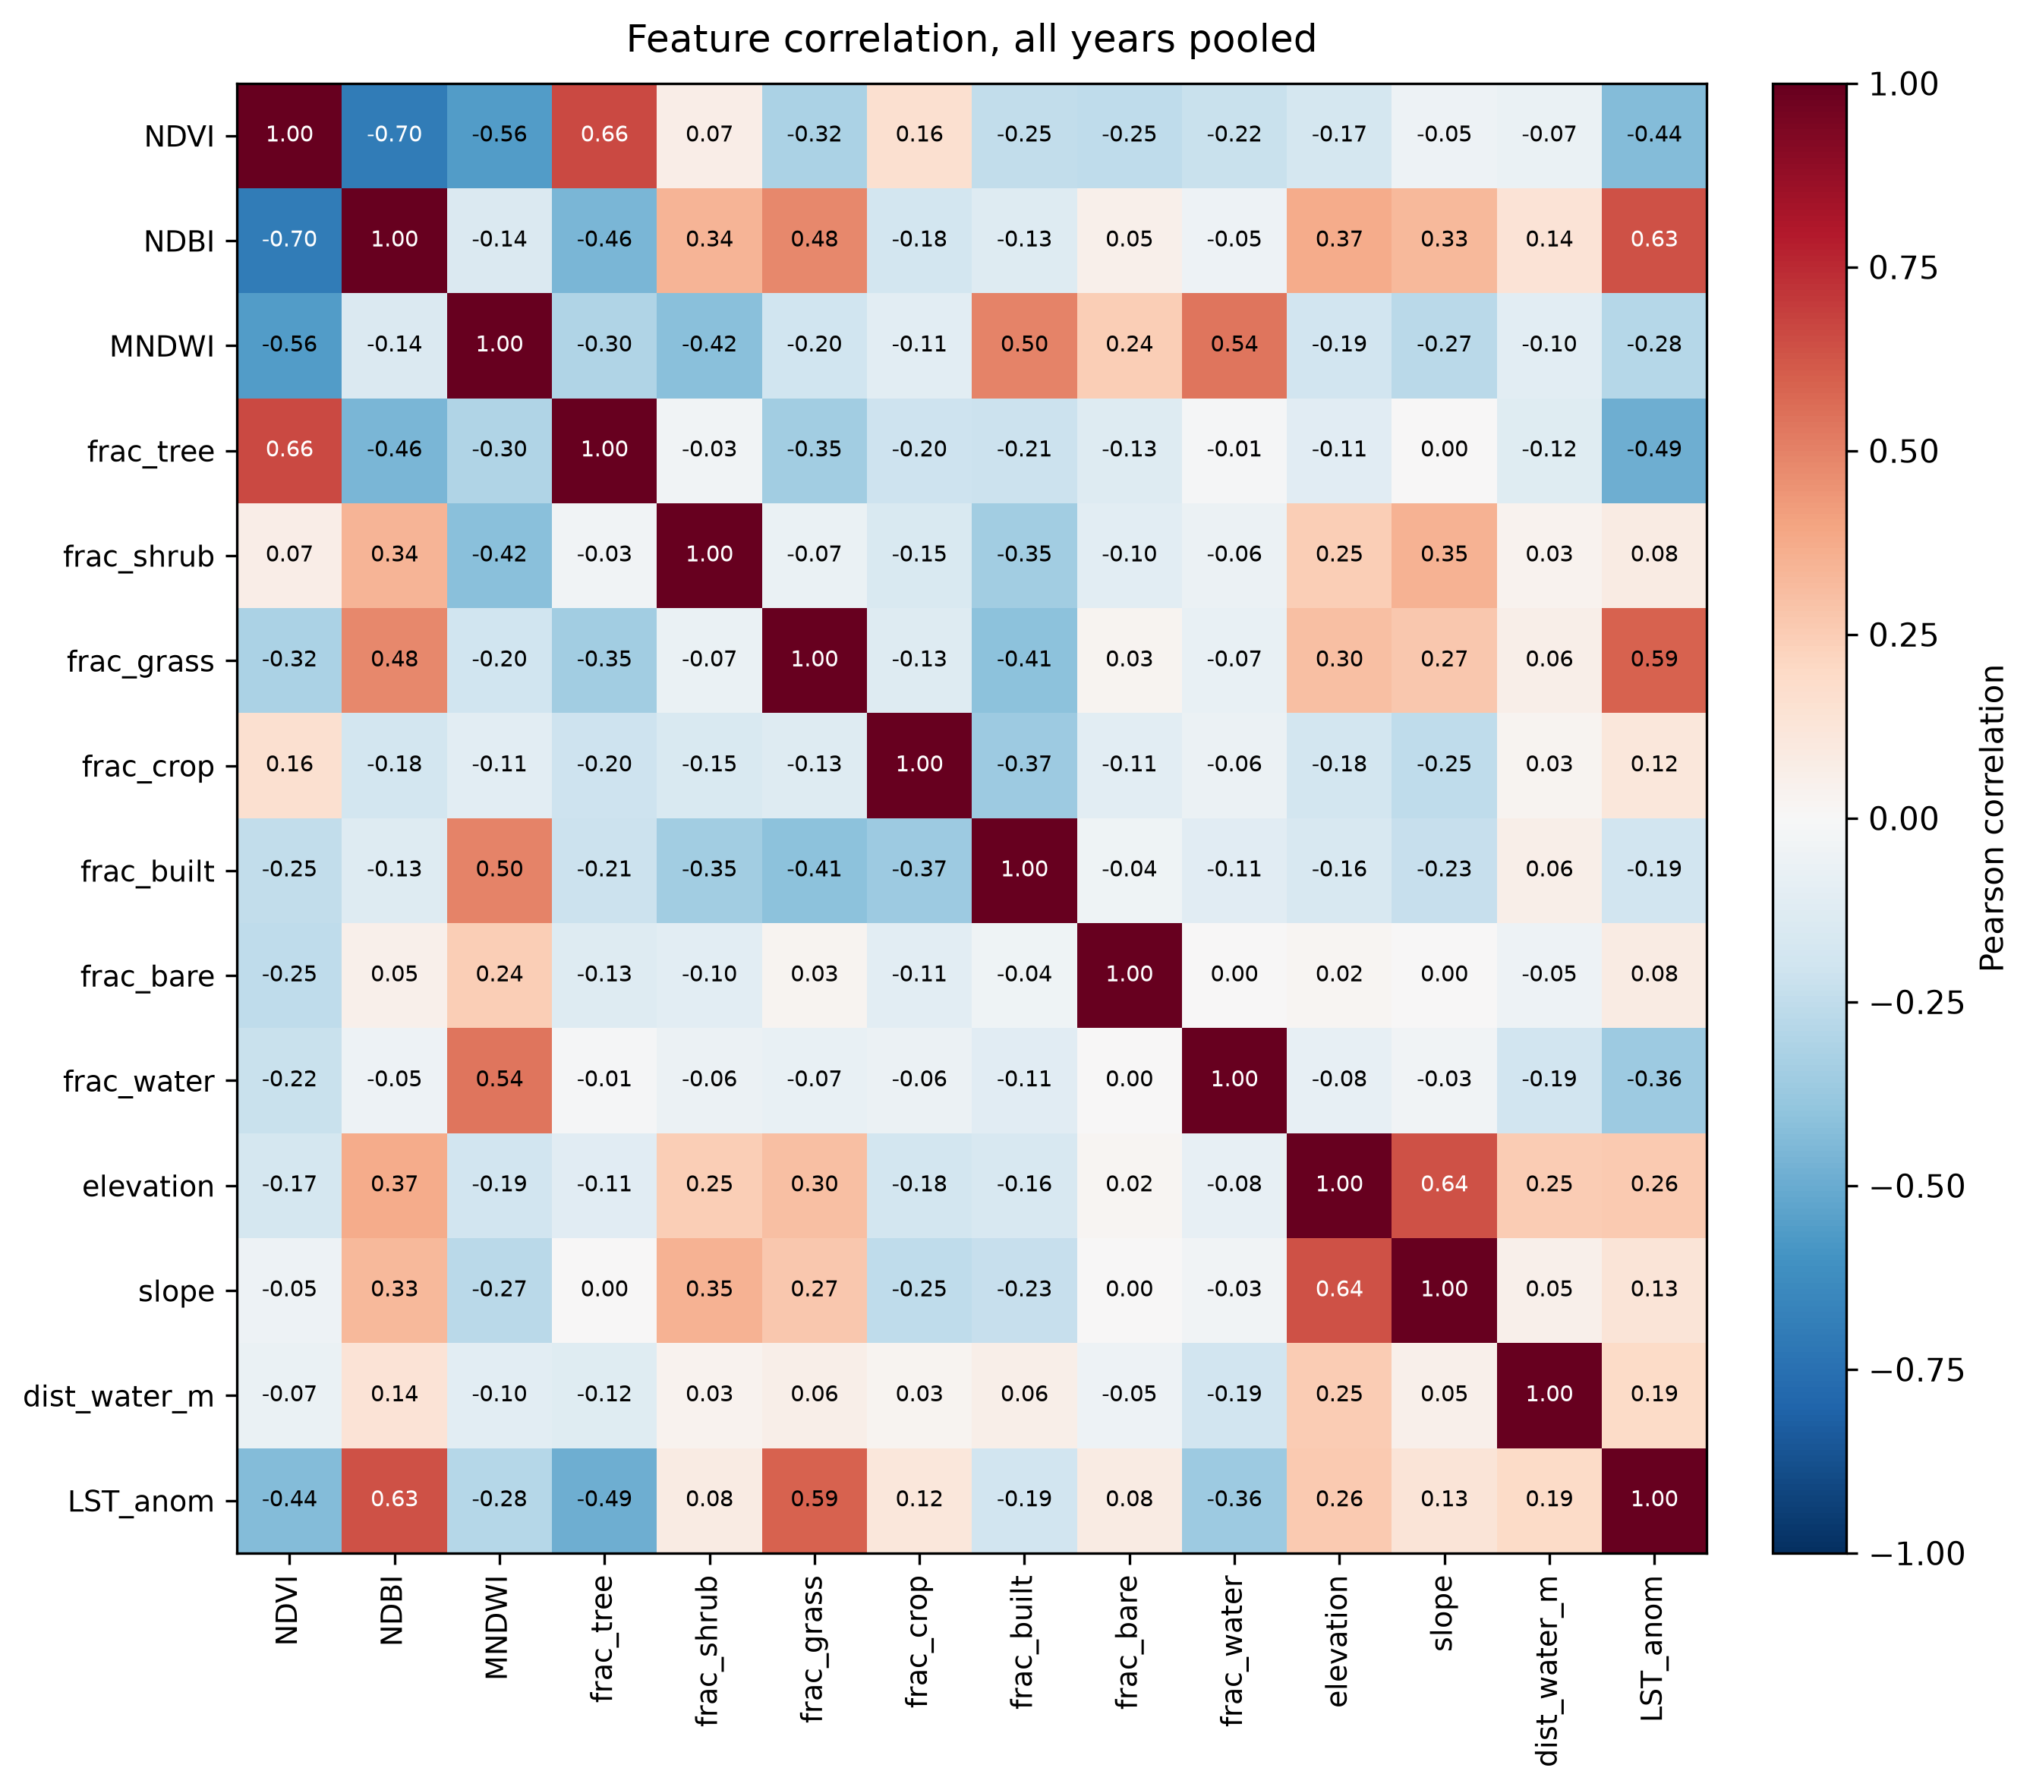
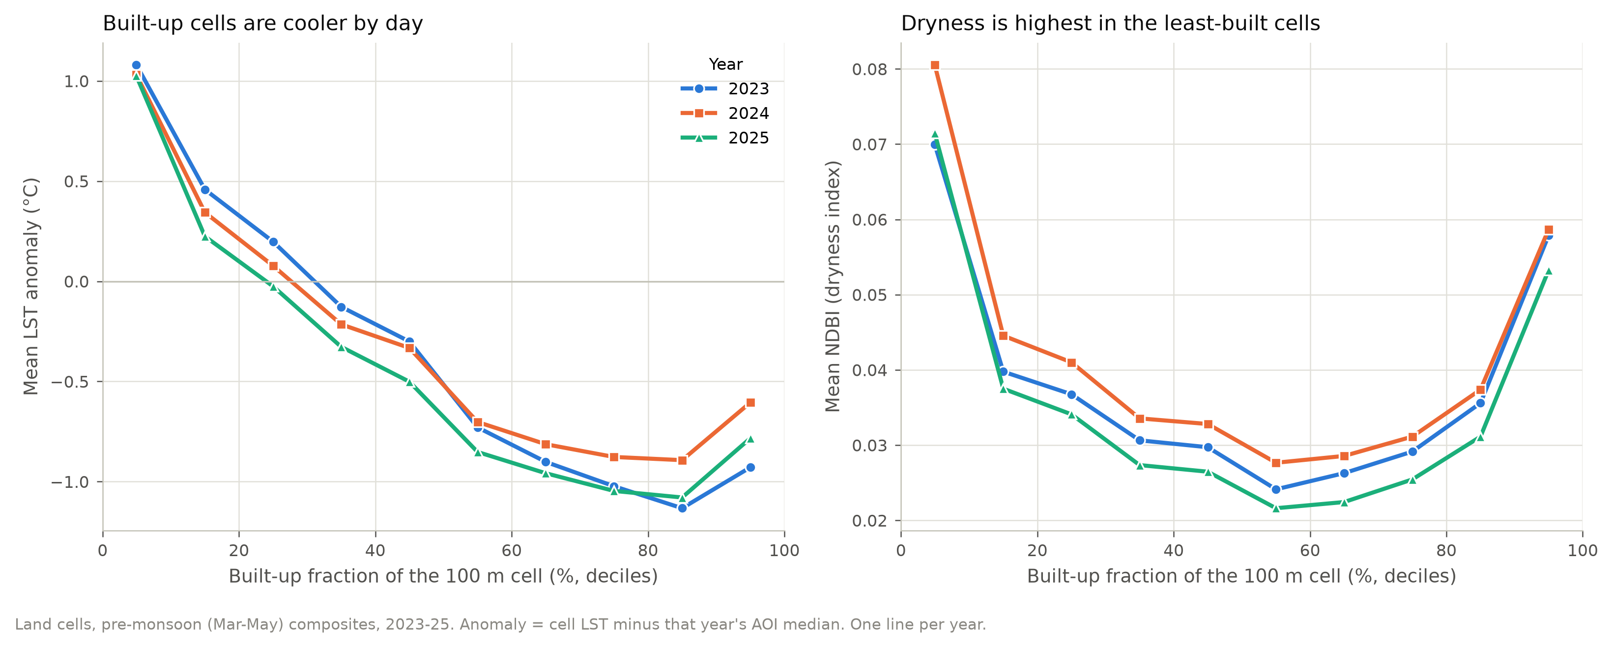
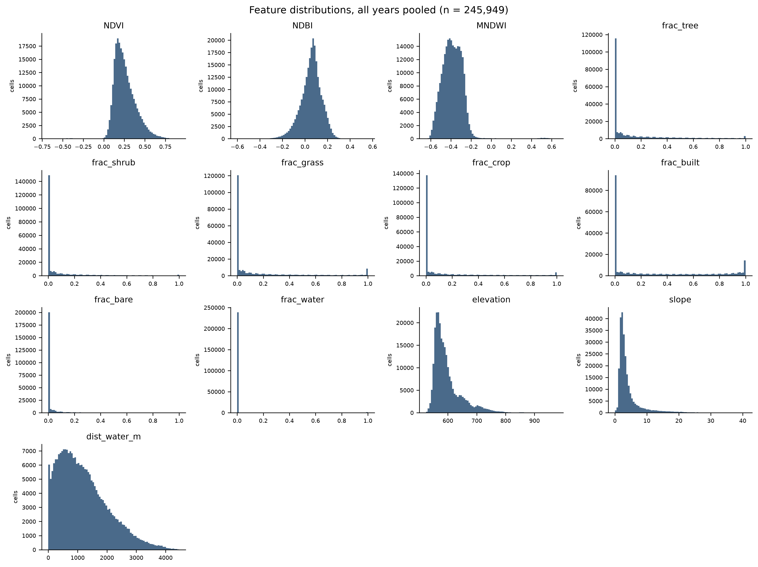
EXPLORATORY DATA ANALYSIS
What did the data reveal before modelling?
Multicollinearity (VIF)
NDVI 29.8 · MNDWI 18.8 · NDBI 18.4
median 2.2 across all features
r with LST Anomaly: NDBI +0.63 · trees −0.49
KEY TAKEAWAY Vegetation goes with cooler surfaces; NDBI measures dryness, not concrete.
MirageAI · Concrete vs. Canopy
7 / 16
Notes:
Before we trained anything, we spent time just looking at the data. Exploratory analysis tells you which relationships exist, which of your assumptions are wrong, and which features might cause trouble later. On the left is the correlation matrix: every feature and the target, pooled over all three years. Red is positive, blue is negative. Look at the bottom row, the LST Anomaly. The strongest positive correlations are NDBI at +0.63 and grass fraction at +0.59, so dry grassland is the hottest surface in Pune. The strongest negative ones are tree fraction at −0.49 and NDVI at −0.44: vegetation goes with cooler surfaces. And here's the surprise: built-up fraction is negative too, −0.19. More concrete goes with slightly cooler daytime surfaces. The small histograms, bottom middle, show the shape of every feature. The land-cover fractions are zero-inflated: most cells have none of a given class, so there's a spike at zero and sometimes at one. The indices are roughly bell-shaped. Shapes like these suit tree models, which split on thresholds and don't assume normality. The two line plots, top right, group cells by built-up fraction. On the left, the mean LST Anomaly falls as built-up share rises: the least-built cells run 2.1 °C warmer than cells that are eighty to ninety percent built, in all three years. On the right is the important discovery. NDBI, the so-called built-up index, is highest in the least-built cells. Why? Because it responds to short-wave infrared, which is high for dry grass, fallow fields and bare soil. So in Pune, NDBI behaves much more like a dryness indicator than a built-up indicator, and that's what we call it from here on. Finally, multicollinearity, measured with the variance inflation factor, or VIF. A VIF above ten means a feature is largely predictable from the others. With built-up dropped, the median VIF is 2.2, but the three indices are high: NDVI 29.8, MNDWI 18.8 and NDBI 18.4. They overlap, so in the linear model their individual coefficients are unstable, and when we explain the tree models we rank them together as one spectral group. With a feel for the data, let's look at the models we compared.

Slide 8
MACHINE LEARNING MODELS
Which models did we compare?
Model | Family | How it learns | Why include it
Mean baseline | constant | predicts the training mean | the floor to beat
Linear Regression | linear | weighted sum of features | interpretable status quo
Random Forest | bagging | averages many deep trees | robust, nonlinear
XGBoost | boosting, depth-wise | each tree fixes past errors | strong on tabular data
LightGBM | boosting, leaf-wise | histogram splits, leaf-wise growth | fast, fast exact SHAP
Tuning inside Spatial Block Cross Validation: 25 candidates per model · 4 km folds · 2023–24 only · 60,000 rows
KEY TAKEAWAY A baseline and four learners on identical folds, so the comparison is fair.
MirageAI · Concrete vs. Canopy
8 / 16
Notes:
We compared five models, from the simplest possible up to state-of-the-art gradient boosting, and they were all trained and tested on exactly the same folds, so the comparison is fair. The mean baseline isn't really a model. It predicts the training-set average for every cell. Its job is to set the floor: anything useful has to beat it clearly. Because our target is an anomaly around zero, the baseline's error is basically the spread of the data. Linear regression predicts the target as a weighted sum of the features plus a constant. It's fast and easy to read: each coefficient tells you how much the prediction moves per unit of a feature. But it assumes straight-line, additive effects. It can't learn that tree cover helps a lot at first and then levels off, or that dryness matters more on slopes. We standardise features inside each training fold, so test data never leaks into the scaling. Linear regression stands in for the status quo in many heat island studies. Random Forest builds hundreds of decision trees. Each tree grows on a bootstrap sample of the rows and looks at random subsets of features at each split, so the trees end up different from each other, and the forest averages them. Averaging reduces variance, so the forest is robust, and it picks up nonlinearity and interactions automatically. That idea is called bagging. XGBoost and LightGBM use the other big idea, boosting. Instead of independent trees, they add small trees one at a time, and each new tree is fitted to the errors left by the ones before it, with a small learning rate so the model improves gradually. XGBoost grows each tree level by level, depth-wise. LightGBM grows leaf-wise, always splitting the leaf that cuts the error most, and it bins feature values into histograms, which makes it very fast on our quarter of a million rows. Every hyperparameter was tuned by randomised search, 25 candidate settings per model, scored inside the 4-kilometre spatial folds, on 2023 and 2024 only, with a 60,000-row sample. So the 2025 test year never influenced a single setting. But a fair comparison also needs a fair test, and that brings us to the core of the project: Spatial Block Cross Validation.

Slide 9
SPATIAL BLOCK CROSS VALIDATION
MAIN CONTRIBUTION
Why Spatial Block Cross Validation?
Random split
Spatial block split · 4 km
4 km blocks
residual autocorrelation range 3,950 m
5 × 5 = 25 runs
seeds × folds behind every score
+0.02 vs +0.12–0.15 °C
test cells touch training neighbours → Spatial Leakage
whole blocks held out → honest score
RMSE inflation, random → blocks: linear vs trees
test
train
KEY TAKEAWAY Spatial Block Cross Validation gives a more honest estimate of model performance.
MirageAI · Concrete vs. Canopy
9 / 16
Notes:
This is the methodological heart of the project, so let's build it up step by step. Normal machine-learning evaluation assumes the test data are independent of the training data. Geographic data break that assumption. Tobler's first law of geography says near things are more related than distant things. Two neighbouring hundred-metre cells usually have almost the same land cover, vegetation and temperature. Statisticians call this spatial autocorrelation. Look at the left diagram, a random split. We pick test cells at random, shown in dark blue. Almost every test cell has training cells right next to it, so a flexible model can more or less look up the answer from a neighbour it has already seen. That's Spatial Leakage, and it makes accuracy look better than it'll ever be in a genuinely new place. The right diagram is Spatial Block Cross Validation. We cut the city into square blocks and hold out whole blocks at once. Now test cells are surrounded by other test cells, and the model has to predict from what a place is like, not from what its neighbours were. And that's exactly the question a planner asks: how good is this model in a neighbourhood it hasn't seen? How big should a block be? Big enough that the leftover errors stop being correlated across its edge. We fitted a variogram to the model's residuals, and the correlation range came out at about 3,950 metres, so we use 4-kilometre blocks. Blocks are dealt to 5 folds at random, repeated over 5 seeds, so every score is a mean of 25 runs. We also add a spatio-temporal test: train on 2023 and 2024, test on 2025 in unseen blocks. So what did it show? Going from random to 4-kilometre blocks, linear regression's error rises by only 0.02 °C, but the tree models rise by 0.12 to 0.15 °C. The more flexible the model, the more random splitting flatters it. So random testing doesn't just inflate scores; it can change which model looks best. And to be precise: Spatial Block Cross Validation doesn't make the model better. It measures generalisation to new places honestly, and that's what lets us trust everything that follows. So with honest testing in place, let's see how the models actually performed.

Slide 10
RESULTS
How accurate is it, and why LightGBM?
Model | RMSE random | RMSE 4 km | R² 4 km | RMSE 2025 | R² 2025
Mean baseline | 3.43 | 3.45 | −0.04 | 3.39 | −0.04
Linear Regression | 1.85 | 1.87 | 0.69 | 1.90 | 0.67
Random Forest | 1.64 | 1.76 | 0.73 | 1.75 | 0.72
XGBoost | 1.59 | 1.75 | 0.73 | 1.75 | 0.72
LightGBM | 1.62 | 1.75 | 0.73 | 1.75 | 0.72
1.75 °C
RMSE, 2025, unseen places
R² 0.72
variance explained, 2025
Best model: LightGBM
Tied-best accuracy
Least memorisation of the trees
Fast, exact TreeSHAP
RMSE in °C, mean of 25 runs; lower is better. 2025 = unseen year, unseen 4 km blocks.
KEY TAKEAWAY LightGBM predicts unseen places and an unseen year with 1.75 °C RMSE, R² 0.72.
MirageAI · Concrete vs. Canopy
10 / 16
Notes:
Here are the numbers. Our main metric is RMSE, root mean squared error, in degrees Celsius. Think of it as the typical size of a prediction error, with big errors penalised more. Lower is better. R squared is the share of the variation the model explains: one is perfect, zero is no better than the mean. Let's read the table column by column. Under random cross-validation, XGBoost looks best at 1.59 °C. That's the number a lot of studies would publish. Under 4-kilometre spatial blocks, everything gets worse, and the three tree models end up tied between 1.75 and 1.76 °C, well inside their fold-to-fold spread. So the random-split winner was partly an artefact of Spatial Leakage. The last two columns are the toughest test: 2025, a year no model saw during training or tuning, in blocks it never saw. LightGBM scores 1.75 °C, with R squared 0.72. Random Forest and XGBoost are within a few thousandths of a degree, so honestly, it's a tie, not a knockout. Now compare that with the floor. The mean baseline's error is about 3.39 °C, so the tree models roughly halve it. Linear regression reaches 1.90 °C. That's decent, and it tells us a lot of the signal is fairly simple, but the trees add real value by capturing thresholds, like the tree-cover knot you'll see later. So why LightGBM as the best model? Three reasons. One, it's tied for the best accuracy on the honest tests, and marginally lowest on 2025. Two, it memorises places the least of the three tree models: when it has already seen a place in earlier years, it improves by 0.15 °C, against up to 0.23 for Random Forest. A smaller gap means it leans less on memorising places. Three, it trains fast and has exact, fast TreeSHAP explanations, which really matters when you explain tens of thousands of cells. We don't throw the others away, though. Every explanation is repeated with XGBoost, and every scenario is averaged across all three tree models. Accuracy tells us the model works. Next, let's see what it actually learned, using SHAP.

Slide 11
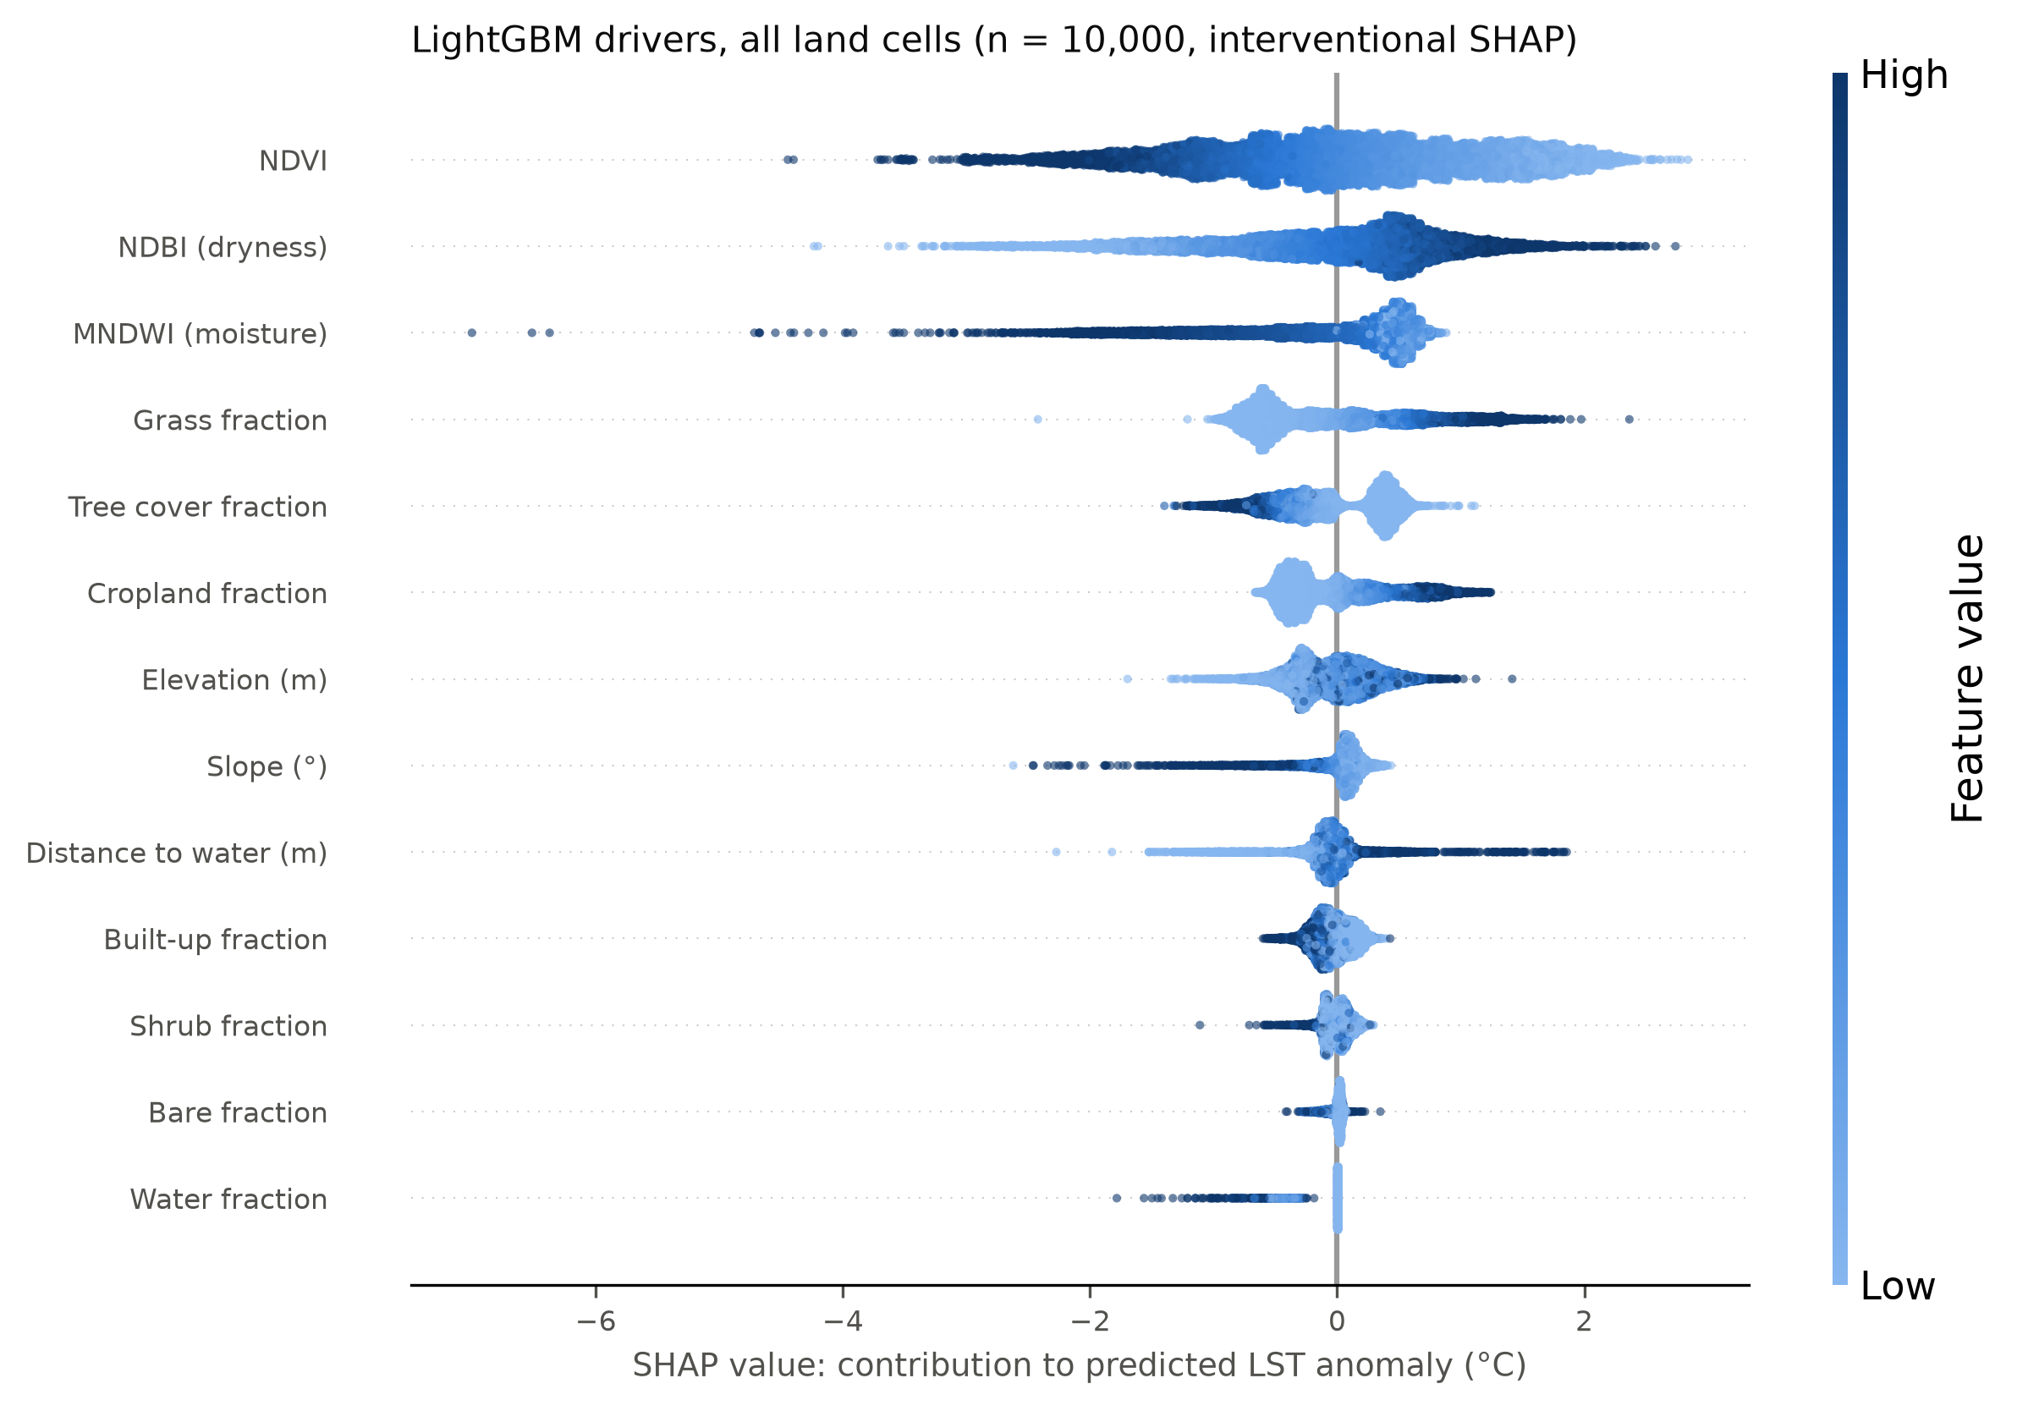
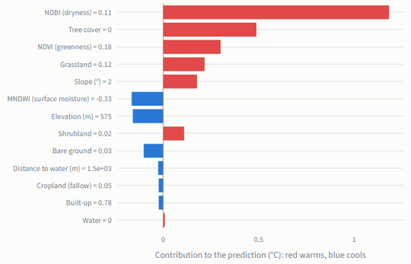
EXPLAINABLE AI
MAIN CONTRIBUTION
What did SHAP reveal?
GLOBAL SHAP · 10,000 cells
LOCAL SHAP · one hot, tree-less fringe cell
1.49 °C
spectral group, mean |SHAP|
ρ 0.99
same ranking in XGBoost
95%
same leading group
KEY TAKEAWAY Vegetation, dryness and moisture lead; built-up is the smallest driver group.
MirageAI · Concrete vs. Canopy
11 / 16
Notes:
A good prediction isn't enough; we want to know why. For that we use SHAP, short for SHapley Additive exPlanations, the core of our Explainable AI. The idea comes from cooperative game theory. Picture a team of four that wins a prize, and you want to split it fairly by each person's contribution. The catch is that what someone adds depends on who else is already on the team. Lloyd Shapley's answer, which later contributed to a Nobel Prize, is to imagine every possible order in which the members could join, measure what each person adds at the moment they join, and average that over all orders. That average is their Shapley value. In SHAP, the features are the team members and the prediction is the prize. For a single cell, SHAP starts from the model's average prediction, the base value, and gives every feature a contribution in degrees Celsius, so that the base value plus all contributions equals the prediction exactly. That additivity is what makes SHAP so easy to read. That's a local explanation, on the right: one hot, tree-less fringe cell. Red bars push it warmer: high dryness, no tree cover, low NDVI. Blue bars pull it cooler. A planner can see exactly why this cell is predicted hot. Now collect SHAP values over ten thousand cells and you get the global view on the left, a beeswarm plot. Each dot is one cell; its position is the feature's contribution, and its colour is the feature's value, dark for high. Dark dots for NDVI sit on the left, so greener means cooler. High dryness sits on the right. Feature importance is the average absolute SHAP value, and NDVI 0.95, NDBI 0.73 and MNDWI 0.61 °C lead. But is it reliable? The three indices are correlated, so the model can pass credit between them. That's why we rank feature groups. The spectral group leads at 1.49 °C, about 2.1 times the dry-cover group, and built-up is the smallest group at 0.12 °C. XGBoost gives the same ranking, rank correlation 0.99, and the same leading group in 95% of cells. Just remember that SHAP explains the model, not the physical world, so these are associations. If we trust what the model learned, we can ask it a what-if question, and that's our Counterfactual Analysis.

Slide 12
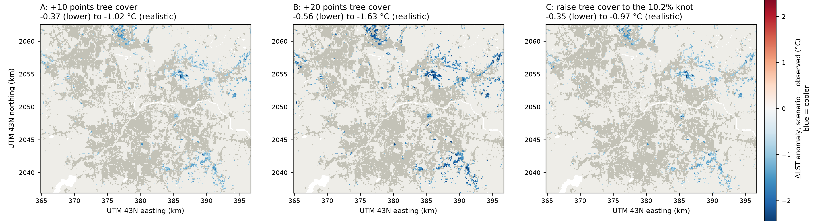
COUNTERFACTUAL ANALYSIS
MAIN CONTRIBUTION
What if tree cover increases?
1
Current
2
Modified
3
Predicted cooling
2,673 hottest urban cells, tree-sparse
+10 points tree cover, from built, bare, grass
0.37–1.02 °C cooler (lower–realistic)
KEY TAKEAWAY About 10% tree cover on the hottest cells goes with 0.4–1.0 °C cooler surfaces.
MirageAI · Concrete vs. Canopy
12 / 16
Notes:
Now we turn the trained models into a policy simulator. Counterfactual Analysis asks: what would the model predict if one thing about a place were different? Here, the thing we change is tree cover. Step one, the current state. We took the urban cells, more than half built-up, that fall in the hottest ten percent of observed temperature, averaged over three years. That's 2,673 cells. They're mostly tree-sparse, newer developments on the city fringe, many of them on the eastern edge, not the old core. Step two, the modification. We raise their tree cover by ten percentage points. Because the fractions still have to add up to one, the new canopy is taken from built-up, bare and grass, in proportion to what each cell has. In the lower bound, we leave the spectral indices untouched. In the realistic bound, we let NDVI, NDBI and MNDWI respond, using small models that learn how the indices change with land cover. The truth probably lies in between, so we always report a range. Step three, the predicted cooling. Averaged over LightGBM, XGBoost and Random Forest, ten more points of tree cover go with 0.37 to 1.02 °C cooler surfaces. Twenty points go with 0.56 to 1.63 °C. And raising every cell just to the 10.2% knot goes with 0.35 to 0.97 °C. The three maps show where that cooling lands for each scenario; blue is cooler. Two subtleties worth knowing. First, diminishing returns: the cooling per point of canopy roughly halves beyond about ten to twelve percent cover, from 0.12 to 0.05 °C per point. So spreading some canopy across many bare places beats piling it into a few. Second, we leave out the very first pixel of canopy. Going from zero to one percent is worth 1.4 °C in the model, but that reflects what kind of place has no trees at all, not what one tree does. And the caveat that matters most for policy. The model learned by comparing places, so these numbers tell us how much cooler similar places with more trees are. They're associations, not measured effects of planting, and they give planners a ranking and a plausible range, not a guarantee. So how could a city actually use all of this? Let's look at applications.

Slide 13
APPLICATIONS
Who can use this, and how?
1
Smart cities
2
Urban planning
3
Green infrastructure
seasonal 100 m heat map from open data
target the dry fringe, not the core
spread canopy to ~10% cover
4
Tree plantation
5
Heat mitigation
6
Climate adaptation
priority list: 2,673 hottest urban cells
know where and why it is hot
reproducible baseline for future seasons
Dashboard: pick a cell, read its SHAP breakdown, try a greening what-if
MirageAI · Concrete vs. Canopy
13 / 16
Notes:
So what can a city actually do with this? Let me run through six applications, each tied to something the project actually produced. Smart cities. The whole pipeline runs on open satellite data and rebuilds every table and figure from one command. A city could rerun it every pre-monsoon season and get a fresh hundred-metre heat map at almost no cost, without installing a single sensor. That's a cheap monitoring layer for a smart-city platform. Urban planning. The first lesson is simply where the problem is. In daytime Pune, the hottest urban surfaces aren't in the dense old core; they're on the dry, tree-sparse fringe, where development is newest and still going on. And that's exactly where planning rules for new layouts, setbacks and open spaces can still change the outcome. Green infrastructure. Our scenarios suggest the biggest gains per unit of canopy come from getting bare places up to about ten percent tree cover. That favours spreading street trees, small parks and green buffers widely across hot areas, rather than building one big park in one spot. Tree plantation. We can rank individual hundred-metre cells, so the 2,673 hottest urban cells become a ready-made, mappable priority list for plantation drives, ward by ward. Heat mitigation. Heat action plans need to know where people are exposed to the hottest surfaces. The map, together with each cell's SHAP explanation, tells officials not just where it's hot, but why: dryness, missing vegetation, or terrain. Different causes call for different fixes, such as greening, irrigation or cool roofs. Climate adaptation. Heatwaves are expected to get more frequent. A reproducible, honest model gives a baseline to compare future seasons against, and the same method can move to other Indian cities by changing only the study-area box. And at the bottom: we built a read-only Streamlit dashboard that shows every result, and lets a user pick a cell, read its explanation and try a greening what-if. Throughout, these outputs support decisions; they don't replace field surveys or local knowledge. Of course, these applications are only as good as the evidence behind them, so let's be clear about the limitations.

Slide 14
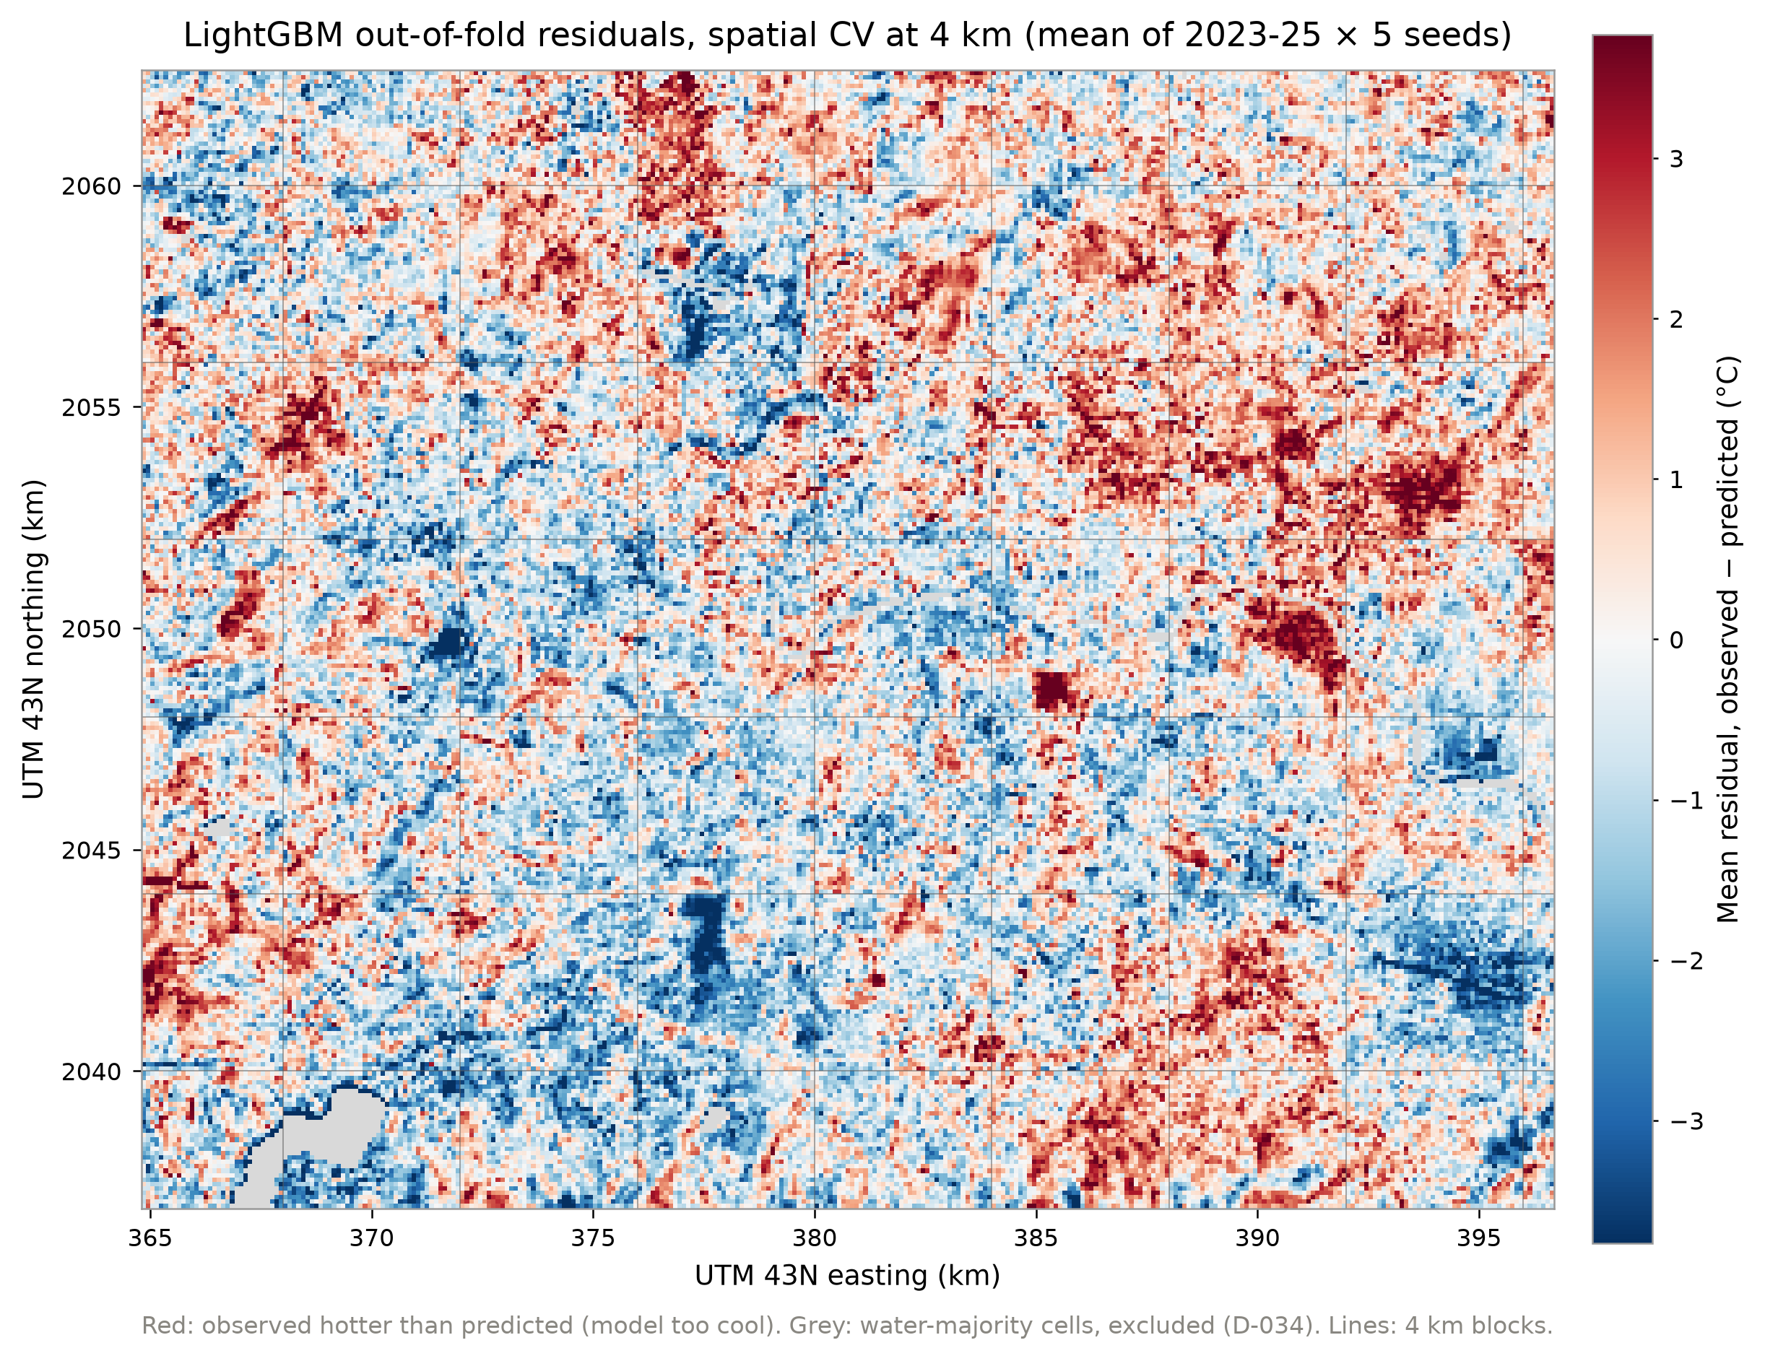
LIMITATIONS
What can these results not tell us?
1
Pune only
one city, one climate
2
Pre-monsoon data
daytime, Mar–May
3
100 m thermal resolution
mixed pixels
4
Correlation ≠ causation
associations only
5
Static land cover
WorldCover 2021
KEY TAKEAWAY These are daytime, pre-monsoon associations for Pune, not causal effects.
MirageAI · Concrete vs. Canopy
14 / 16
Notes:
Every study has limits, and being clear about them is part of doing it properly. Here are five. First, Pune only. We studied one city with one climate: semi-arid and hilly, where the surroundings dry out before the monsoon. That dryness is exactly why the core is cooler by day. In a humid or heavily irrigated region the pattern could look quite different, so we can't assume the drivers transfer without testing. Second, pre-monsoon data only, and daytime only. Landsat passes over in the late morning. At night, built surfaces release the heat they've stored, and the classic heat island may well come back. After the monsoon the surroundings turn green and the contrast changes. So our conclusions hold for daytime, March to May. Third, the hundred-metre thermal resolution. Landsat's thermal sensor sees about a hundred metres, so one cell mixes roofs, roads, trees and courtyards. We can't resolve a single street or building, and heat blurs across cell edges. You can see a symptom of that on the right: the map of model residuals, red where a cell is hotter than predicted and blue where it's cooler. The errors are clustered, with residual Moran's I around 0.6. That tells us there are drivers we can't see, like building height, roof material and irrigation. Fourth, correlation isn't causation. Everything we learned comes from comparing different places at the same time. Places with more trees are cooler, but they might also be wealthier, better irrigated or older. SHAP explains the model, not physics, and the Counterfactual Analysis gives associations. Proving a causal effect would need before-and-after data from real planting. Fifth, static land cover. We used one WorldCover map from 2021 for all three years, so any construction or clearing since then is invisible to the land-cover fractions. The Sentinel-2 indices are updated every year, though, and partly make up for it. None of these limits changes the validation results, which are honest by design. They bound how far the scenarios can be read. Each of these limits suggests a next step, so let's look at where the work goes next.

Slide 15
FUTURE WORK
Where does the work go next?
Near term
Medium term
Long term
1
2
3
4
5
6
More cities
Multiple seasons
Higher resolution
Meteorology
Real-time dashboard
Climate projections
test whether drivers transfer
night, post-monsoon, winter
~70 m thermal, building heights
air temperature, humidity, wind
auto-update every season
canopy needed for future warming
MirageAI · Concrete vs. Canopy
15 / 16
Notes:
The limitations point straight to the next steps, and we've laid them out on a timeline, from what could be done next semester to longer-term research. Near term, more cities. The pipeline only needs a study-area box, so the first step is running it on other Indian cities with different climates, say a humid coastal city and a hotter inland one. If the same drivers come out on top, the conclusions generalise; if not, we learn where they break. Also near term, multiple seasons. Adding night-time thermal data and post-monsoon and winter composites would show whether Pune's daytime cool island flips into a classic heat island at night. That matters for health, because hot nights stop the body from recovering. Medium term, higher-resolution imagery. Thermal data from the ECOSTRESS instrument on the space station, at roughly seventy metres, or downscaling methods, would sharpen the picture. Building footprints and heights would add exactly the urban-form drivers our clustered residuals point to. Also medium term, meteorological variables. Air temperature, humidity and wind from weather stations or reanalysis would let us connect surface temperature to the air temperature people actually feel, and check whether our associations carry over. Long term, a real-time dashboard. Today's Streamlit dashboard is read-only and shows stored results. The next version would pull in each new season automatically, update the map, and let planners run the realistic-bound scenario live. And finally, climate projections. Pairing our model with downscaled climate scenarios would let us ask how much canopy the hottest wards would need to offset projected warming by mid-century. That turns the tool from describing today into planning for tomorrow. On the method side, we'd also add nested Spatial Block Cross Validation to remove the small optimism left by tuning, and use before-and-after land-cover change to move from association toward cause. Let me close by pulling the whole story together.

Slide 16
CONCLUSION
What did we learn?
Problem
Method
Results
Explainability
Impact
where is Pune hot, and why?
13 features · 4 km Spatial Block Cross Validation
LightGBM: 1.75 °C RMSE · R² 0.72
vegetation and dryness lead; built-up smallest
~10% canopy: 0.4–1.0 °C cooler
Thank you
Shourya Tiwari · Shashwat Kumar
Rishik Sinha · Shubhankar Bhan
Symbiosis Institute of Technology, Pune
Questions?
MirageAI · Concrete vs. Canopy
16 / 16
Notes:
Let me pull everything together, following the arrows on the slide. The problem. Pune is urbanising fast, and heat action plans need to know where greening will cool the most. The textbook idea of a hot core doesn't hold in daytime Pune: the core is cooler than the dry fringe. And the usual evaluation habit, random pixel splits, overstates how well models really work. The method. We combined four open satellite datasets into 13 physically meaningful features on a hundred-metre grid, modelled the LST Anomaly with five models, and evaluated them with 4-kilometre Spatial Block Cross Validation and an untouched 2025 test, never using coordinates as features. The results. Random cross-validation flattered the flexible models by up to 0.15 °C. Under honest testing, the tree models tie, and LightGBM, our final model, predicts the anomaly in unseen places and an unseen year with an RMSE of 1.75 °C and an R squared of 0.72. The Explainable AI. SHAP shows that vegetation, dryness and moisture lead, and that built-up fraction, the concrete in our title, is the smallest driver group. The raw link between built-up cover and cooler surfaces, −0.22 °C per ten points, shrinks by 87% once vegetation and dryness are modelled. So the cool core is mainly a vegetation and dryness contrast, and those rankings hold across models. The real-world impact. Pune's hottest urban surfaces are tree-sparse fringe developments. In these data, raising them to about ten percent tree cover is associated with roughly 0.4 to 1.0 °C cooler daytime surfaces, with gains per point roughly halving beyond that. That gives planners a concrete, mappable target, with honest bounds and clearly stated caveats. If you remember one sentence, make it this: in daytime Pune, the surface heat is in the dry fringe, not the dense core, and canopy matters far more than concrete. Thank you for listening. Every number you've seen traces back to an output table in our repository, and we'd be happy to take your questions.

