Slide 1
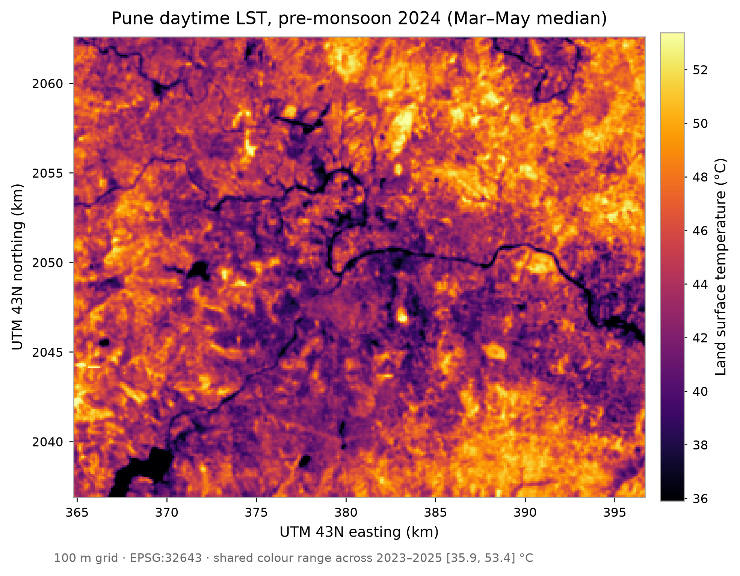
MirageAI
Concrete vs. Canopy: Explainable Machine Learning for Urban Heat Island Drivers in Pune
Shourya Tiwari · Shashwat Kumar
Rishik Sinha · Shubhankar Bhan
Applications and Use Cases of Machine Learning (TE7483)
Symbiosis Institute of Technology, Pune
MirageAI · Concrete vs. Canopy
1 / 19
Notes:
[Shourya] Good morning. I am Shourya, and with Shashwat, Rishik and Shubhankar I will present MirageAI: Concrete vs. Canopy, explainable machine learning for urban heat island drivers in Pune. In one sentence: we expected Pune to show a daytime urban heat island, and in the satellite data it turns out to be a mirage. The city core is cooler than its dry surroundings. Over the next twelve minutes we show how we measured that honestly, what the models associate with surface heat, and what that means for greening the hottest parts of the city. Every claim is an association from comparing places, not a causal effect.

Slide 2
MOTIVATION
Where would greening cool Pune most?
3.4–4.0 °C
▪ Heat plans ask where greening cools most.
▪ Satellite LST: free, city-wide, repeatable.
▪ Assume a hot core, target the wrong places.
▪ Random-pixel validation flatters models.
cooler: city core vs outer ring, land cells, daytime, 2023–25
MirageAI · Concrete vs. Canopy
2 / 19
Notes:
[Shourya] Indian cities are writing heat action plans, and the practical question is where greening would cool most. Satellite land surface temperature is the usual evidence: free, city-wide and repeatable. Two things make it easy to misuse. First, textbook cities are warmer than their surroundings, but daytime Pune is the opposite: land cells within five kilometres of the centre are 3.4 to 4.0 °C cooler than the outer ring beyond twelve, in every one of the three years. Assume a hot core and you green the wrong places. Second, most published temperature models are scored on randomly held-out pixels, which flatters them.

Slide 3
PROBLEM STATEMENT
Predict and explain surface heat where the model has never looked
Predict each 100 m cell's daytime LST anomaly in unseen places and years, and explain it.
Honest accuracy
Trustworthy explanation
Bounded scenarios
Unseen areas and an unseen year.
Stable across models and methods.
Ranges, not forecasts.
Hard rule: coordinates are never model inputs.
MirageAI · Concrete vs. Canopy
3 / 19
Notes:
[Shourya] Formally, this is supervised regression on spatially autocorrelated data. The inputs are satellite land cover, spectral indices and terrain for every hundred-metre cell; the output is that cell's daytime temperature anomaly. Three requirements make it hard. Accuracy must be honest, so whole areas and a whole year are held out. Explanations must survive a change of model or SHAP method. And greening scenarios must be ranges with stated assumptions. One hard rule runs through everything: coordinates are never inputs, otherwise the model memorises where a cell is instead of learning why it is hot.

Slide 4
OBJECTIVES
Objectives: five research questions
RQ1
Drivers: Which land-cover and terrain factors go with daytime LST?
RQ2
Nonlinearity: Do tree models find thresholds and interactions that linear models miss?
RQ3
Validation: How much does random CV overstate accuracy?
RQ4
Greening: How much cooling goes with more tree cover in the hottest cells?
RQ5
Cool island: Is the built core cooler by day, and is that the buildings?
MirageAI · Concrete vs. Canopy
4 / 19
Notes:
[Shourya] Five research questions structure the work. The first asks which land-cover and terrain factors are associated with daytime surface temperature. The second asks whether nonlinear models find thresholds and interactions that a linear model misses. The third measures how much random cross-validation overstates accuracy. The fourth asks how much cooling is associated with more tree cover in the hottest urban cells. The fifth asks whether Pune has a daytime cool island, and whether the negative built-up association survives once vegetation and dryness are modelled. Each gets a number by the end. Shashwat will now take you through the data and method.

Slide 5
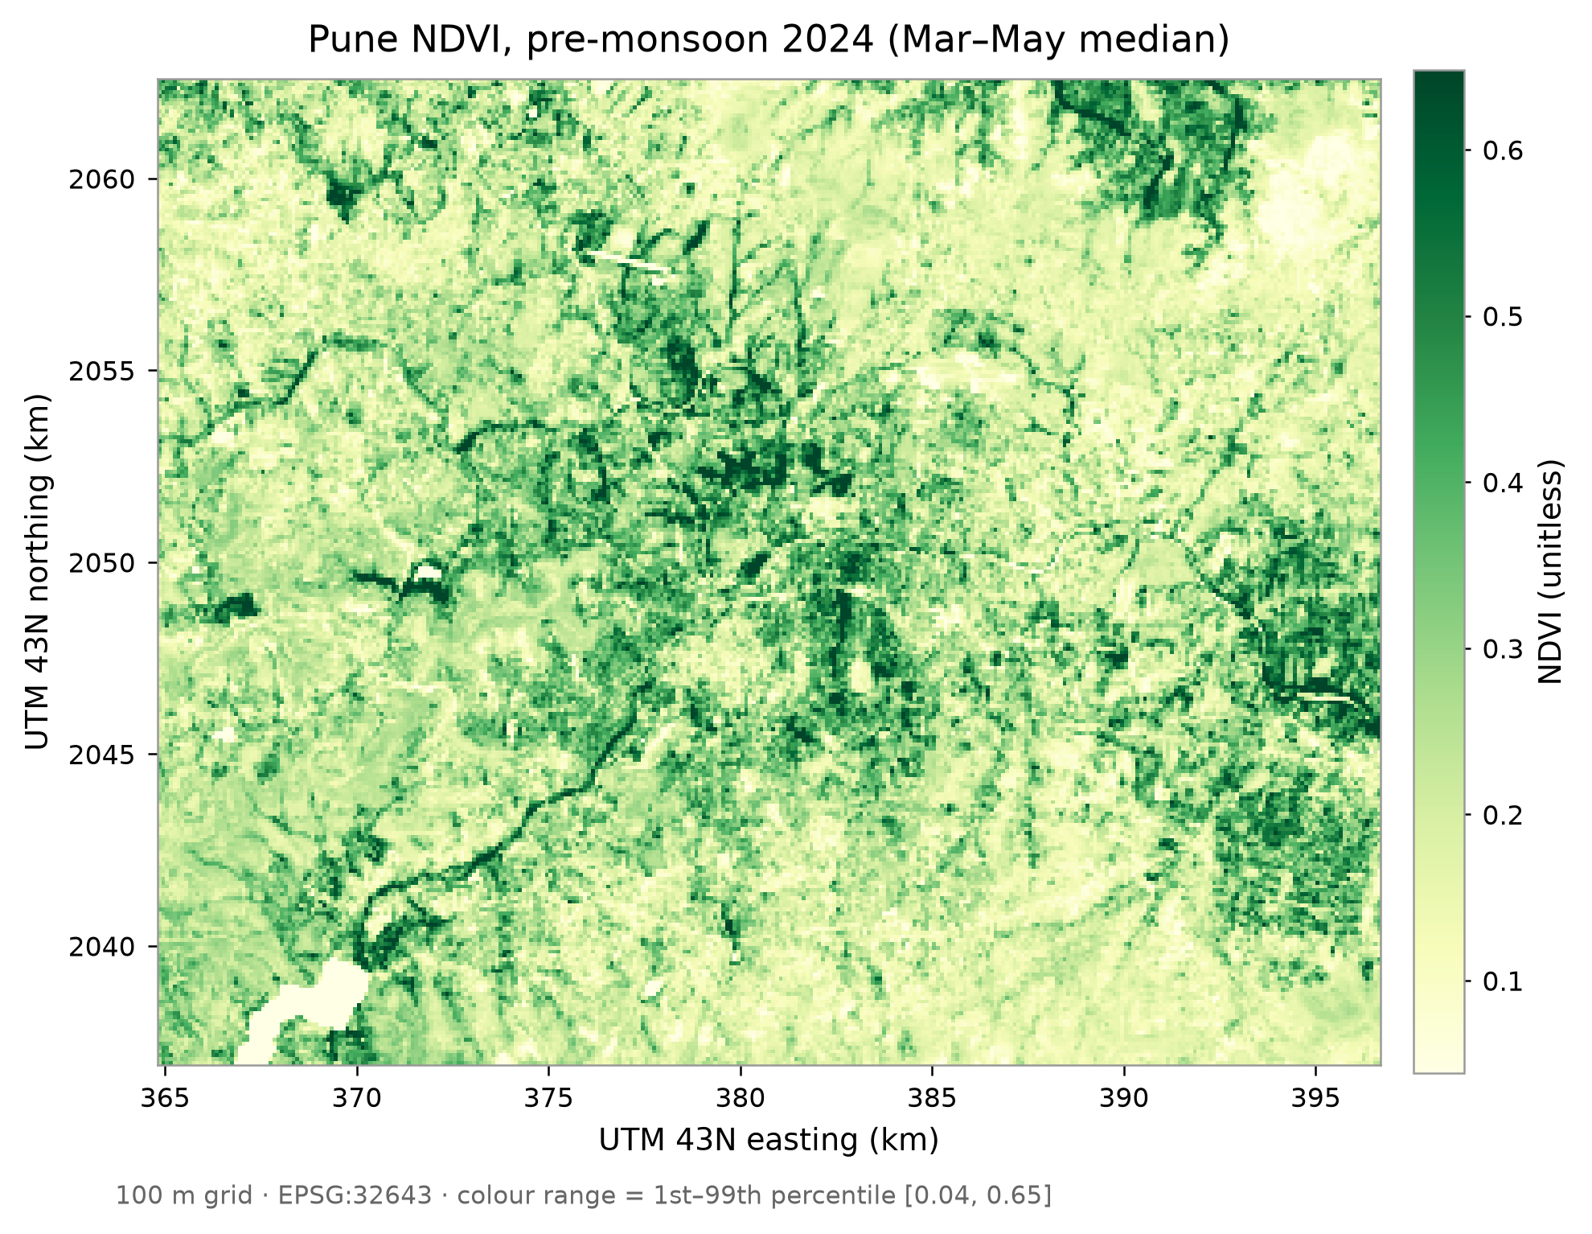
DATASET
Four open datasets on one 100 m grid
Landsat 8/9 surface temperature (target)
Sentinel-2 NDVI, dryness, moisture
WorldCover 2021 7 land-cover fractions
SRTM elevation, slope
100 m grid · 3 seasons · 243,252 land cell-years
MirageAI · Concrete vs. Canopy
5 / 19
Notes:
[Shourya] The study area is a box over Pune and Pimpri-Chinchwad on a hundred-metre grid, the native resolution of the Landsat thermal band. We use three pre-monsoon seasons, March to May of 2023, 2024 and 2025, when skies are clear and surface heat peaks. All four sources come through Google Earth Engine. Landsat 8 and 9 give the target, land surface temperature. Sentinel-2 gives NDVI, a dryness index and a moisture index. ESA WorldCover gives seven land-cover fractions per cell, and SRTM gives elevation and slope. We dropped 2,697 water-majority rows, leaving 81,084 land cells a year, 243,252 cell-years and 13 features.

Slide 6
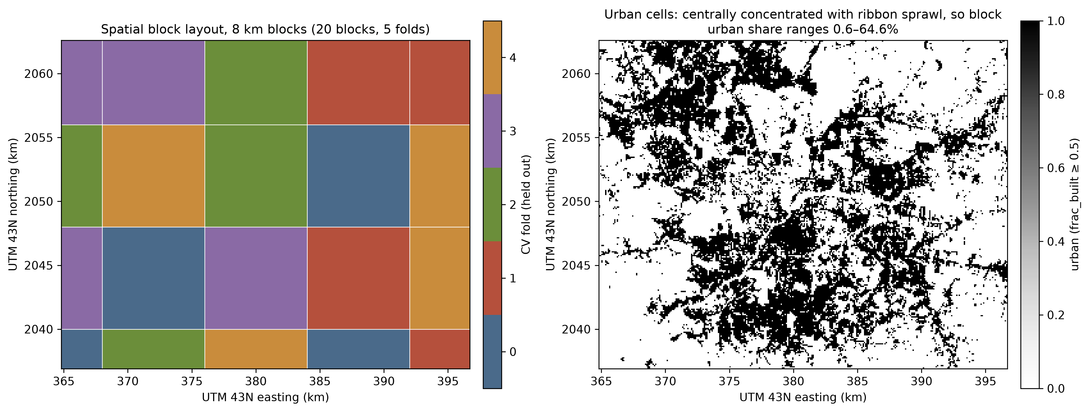
METHODOLOGY
Validation designed before any model is tuned
Target
anomaly from each year's median
Block size
residual range 3,950 m → 4 km
Layouts
5 random seeds × 5 folds
Final test
2025, unseen blocks, untouched
MirageAI · Concrete vs. Canopy
6 / 19
Notes:
[Shashwat] Thank you, Shourya. The target is each cell's temperature anomaly from that year's city median, because the absolute level shifts between years with weather and scene timing. The key design choice is validation. Neighbouring cells are nearly identical, so we hold out whole square blocks. The block size comes from the autocorrelation the model cannot explain: the residual variogram flattens at about 3,950 metres, so we use four-kilometre blocks. The map on the right shows one layout: blocks are dealt to 5 folds at random, repeated over 5 seeds, so every score is a mean over 25 runs. The 2025 season is held back as an untouched test.

Slide 7
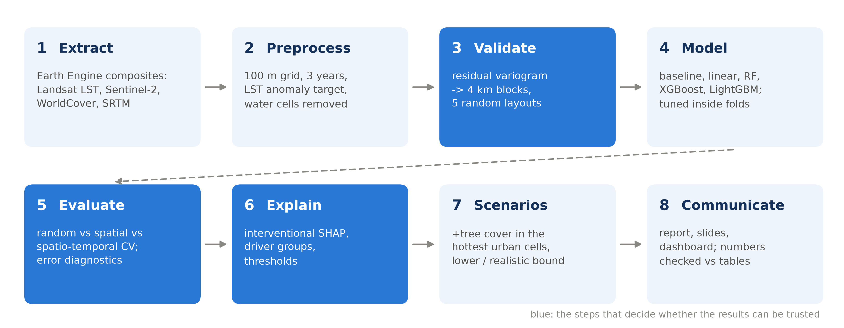
ML PIPELINE
Eight stages, one command
One command rebuilds every table and figure; a script re-checks every quoted number.
MirageAI · Concrete vs. Canopy
7 / 19
Notes:
[Shashwat] This is the whole pipeline. We extract and composite the data in Earth Engine, then build the hundred-metre table with the anomaly target and remove water cells. Stage three is the validation design you just saw. We then train a baseline and four learners, tuned inside the spatial folds, and evaluate them under random, spatial and spatio-temporal cross-validation. Stage six explains the models with SHAP; stage seven runs the greening scenarios; stage eight is this deck, the report and the dashboard. The blue stages are the ones that decide whether the results can be trusted. One command rebuilds everything, and a script re-checks every number we quote against the output tables.

Slide 8
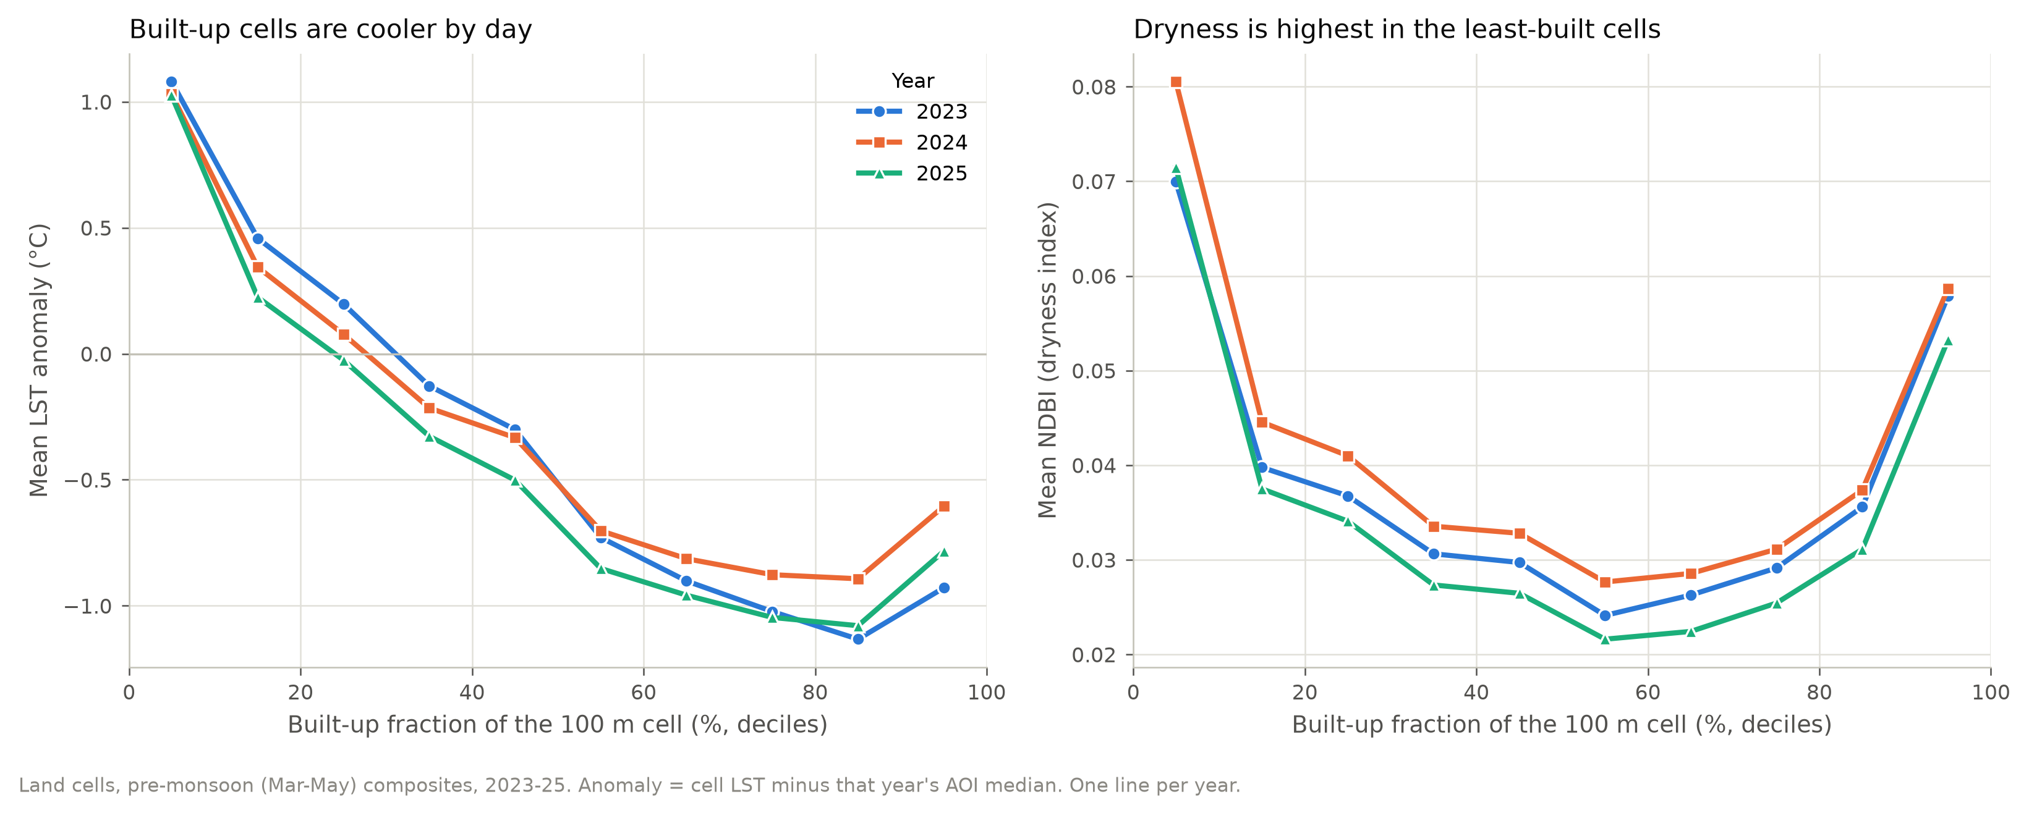
EXPLORATORY DATA ANALYSIS
The mirage: the built core is cooler by day
2.1 °C
NDBI peaks in the least-built cells: here it measures dryness.
least-built vs most-built cells
MirageAI · Concrete vs. Canopy
8 / 19
Notes:
[Shashwat] The first thing the data showed us. On the left is the 2024 temperature map: rivers and reservoirs are coolest, the dry hills and fringe are hottest, and the built-up core sits in between. On the right, cell by cell, the least-built tenth of cells runs 2.1 °C warmer than cells that are eighty to ninety percent built, in all three years. The second panel explains why NDBI misleads here. It was designed as a built-up index, but it peaks in the least-built cells, because it tracks dry grass, fallow fields and bare soil. So we call it a dryness index throughout, and MNDWI a moisture index.

Slide 9
MODELS
A baseline and four learners on identical folds
Baseline
Linear
Random Forest
XGBoost
LightGBM
training mean: the floor
standardised in-fold; the status quo
bagged deep trees
boosted trees, depth-wise
boosted trees, leaf-wise
Tuning, inside spatial CV
Randomised search · 25 candidates per model · 4 km spatial folds · 2023 and 2024 only · 60,000-row sample
MirageAI · Concrete vs. Canopy
9 / 19
Notes:
[Shashwat] We compare five models on exactly the same folds. The mean baseline is the floor. Linear regression, standardised inside each fold, stands for the linear status quo in heat island studies. Random Forest averages many deep trees; XGBoost and LightGBM are gradient boosting, which adds small trees one at a time to fix the previous errors. Hyperparameters come from a randomised search of 25 candidates per model, scored inside the four-kilometre spatial folds, on 2023 and 2024 only and a 60,000-row sample. So the 2025 test never influenced a single setting. All three tree models settle on large, slowly learning ensembles.

Slide 10
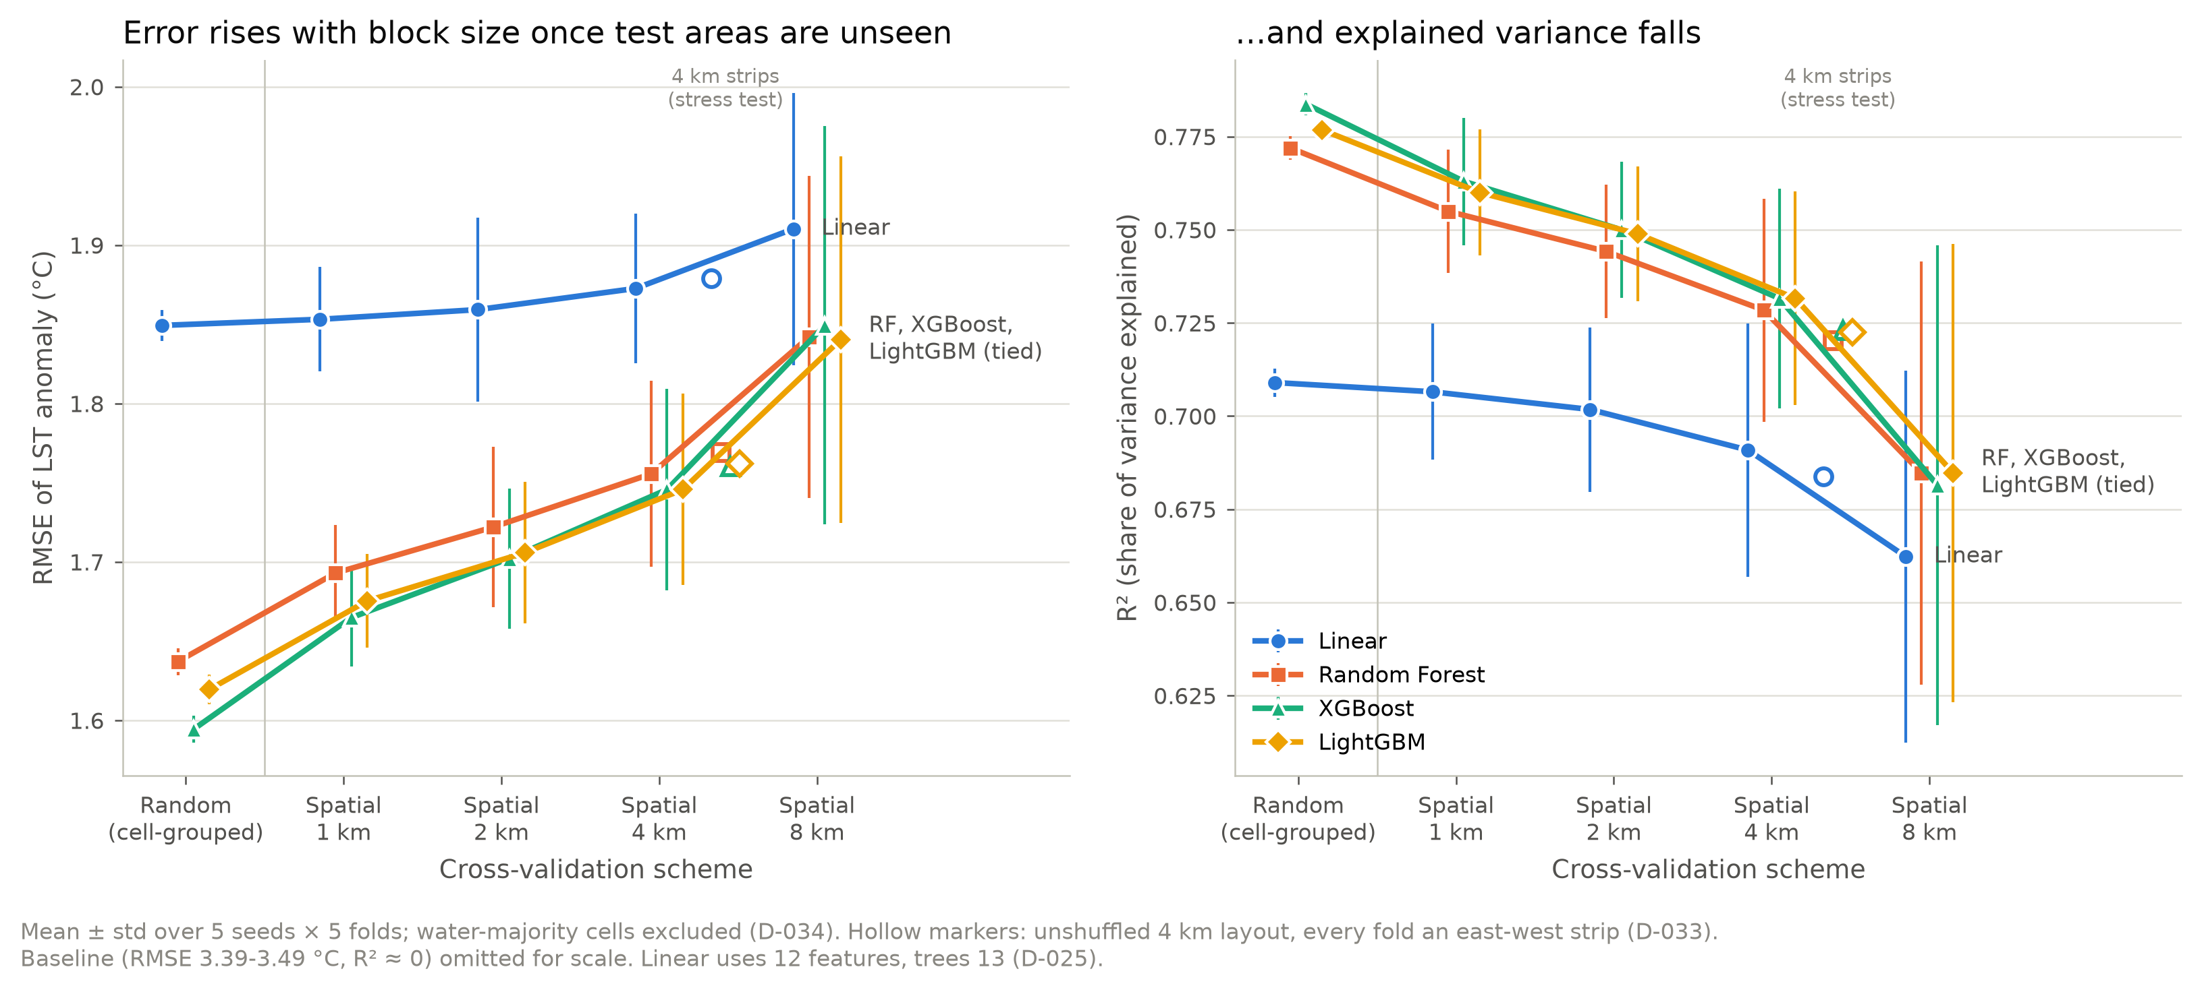
EVALUATION
Random cross-validation flatters flexible models
Random → 4 km blocks: linear +0.02 °C, trees +0.12–0.15 °C. Flexible models are flattered most.
MirageAI · Concrete vs. Canopy
10 / 19
Notes:
[Shashwat] We score every model by RMSE in degrees, with R squared and residual Moran's I as diagnostics, under random, block and spatio-temporal tests. Here error rises steadily as the held-out blocks grow from one to eight kilometres. The key finding is that the inflation depends on the model. Going from random to four-kilometre blocks, linear regression loses only 0.02 °C, while the tree models lose 0.12 to 0.15 °C. The most flexible model, XGBoost, loses the most, 0.15 °C. So random validation does not just inflate scores, it changes which model looks best. Rishik will now show the results.

Slide 11
RESULTS · ACCURACY
The three tree models tie once places are unseen
RMSE, °C | Random CV | 4 km blocks | 2025 unseen | 2025 seen place
Linear | 1.85 | 1.87 | 1.90 | 1.88
Random Forest | 1.64 | 1.76 | 1.75 | 1.52
XGBoost | 1.59 | 1.75 | 1.75 | 1.56
LightGBM | 1.62 | 1.75 | 1.75 | 1.60
1.75–1.76 °C
trees tied, 4 km blocks
R² 0.72
2025, unseen places
0.15–0.23 °C
memorisation gap, trees (linear 0.02)
MirageAI · Concrete vs. Canopy
11 / 19
Notes:
[Rishik] Thank you, Shashwat. The table gives RMSE in degrees for each model under each test. Under random validation XGBoost looks best. Once whole blocks are held out, the three tree models are tied, between 1.75 and 1.76 °C, well inside the fold spread. The cleanest test is 2025: places and a year the models never saw. LightGBM scores 1.75 °C, R squared 0.72. The last column scores the same rows with a model that had seen those places in 2023 and 2024. The difference is the memorisation gap: 0.15 to 0.23 °C for the trees but only 0.02 for linear regression. We use LightGBM as the reference: lowest on 2025 and cheapest to explain.

Slide 12
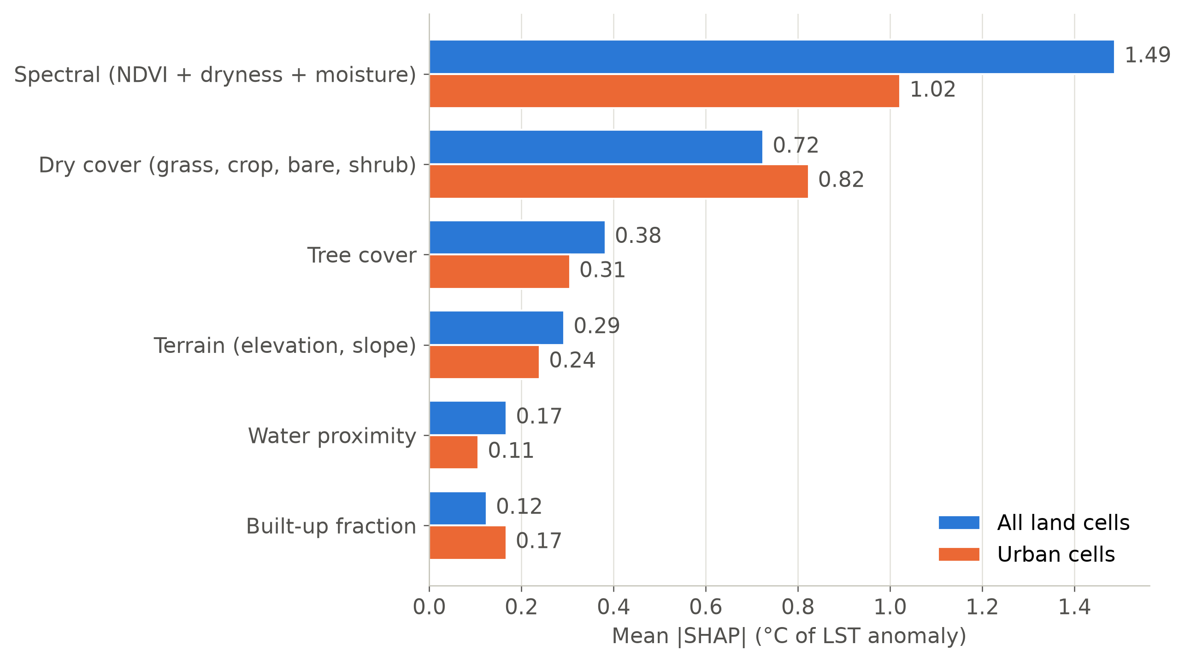
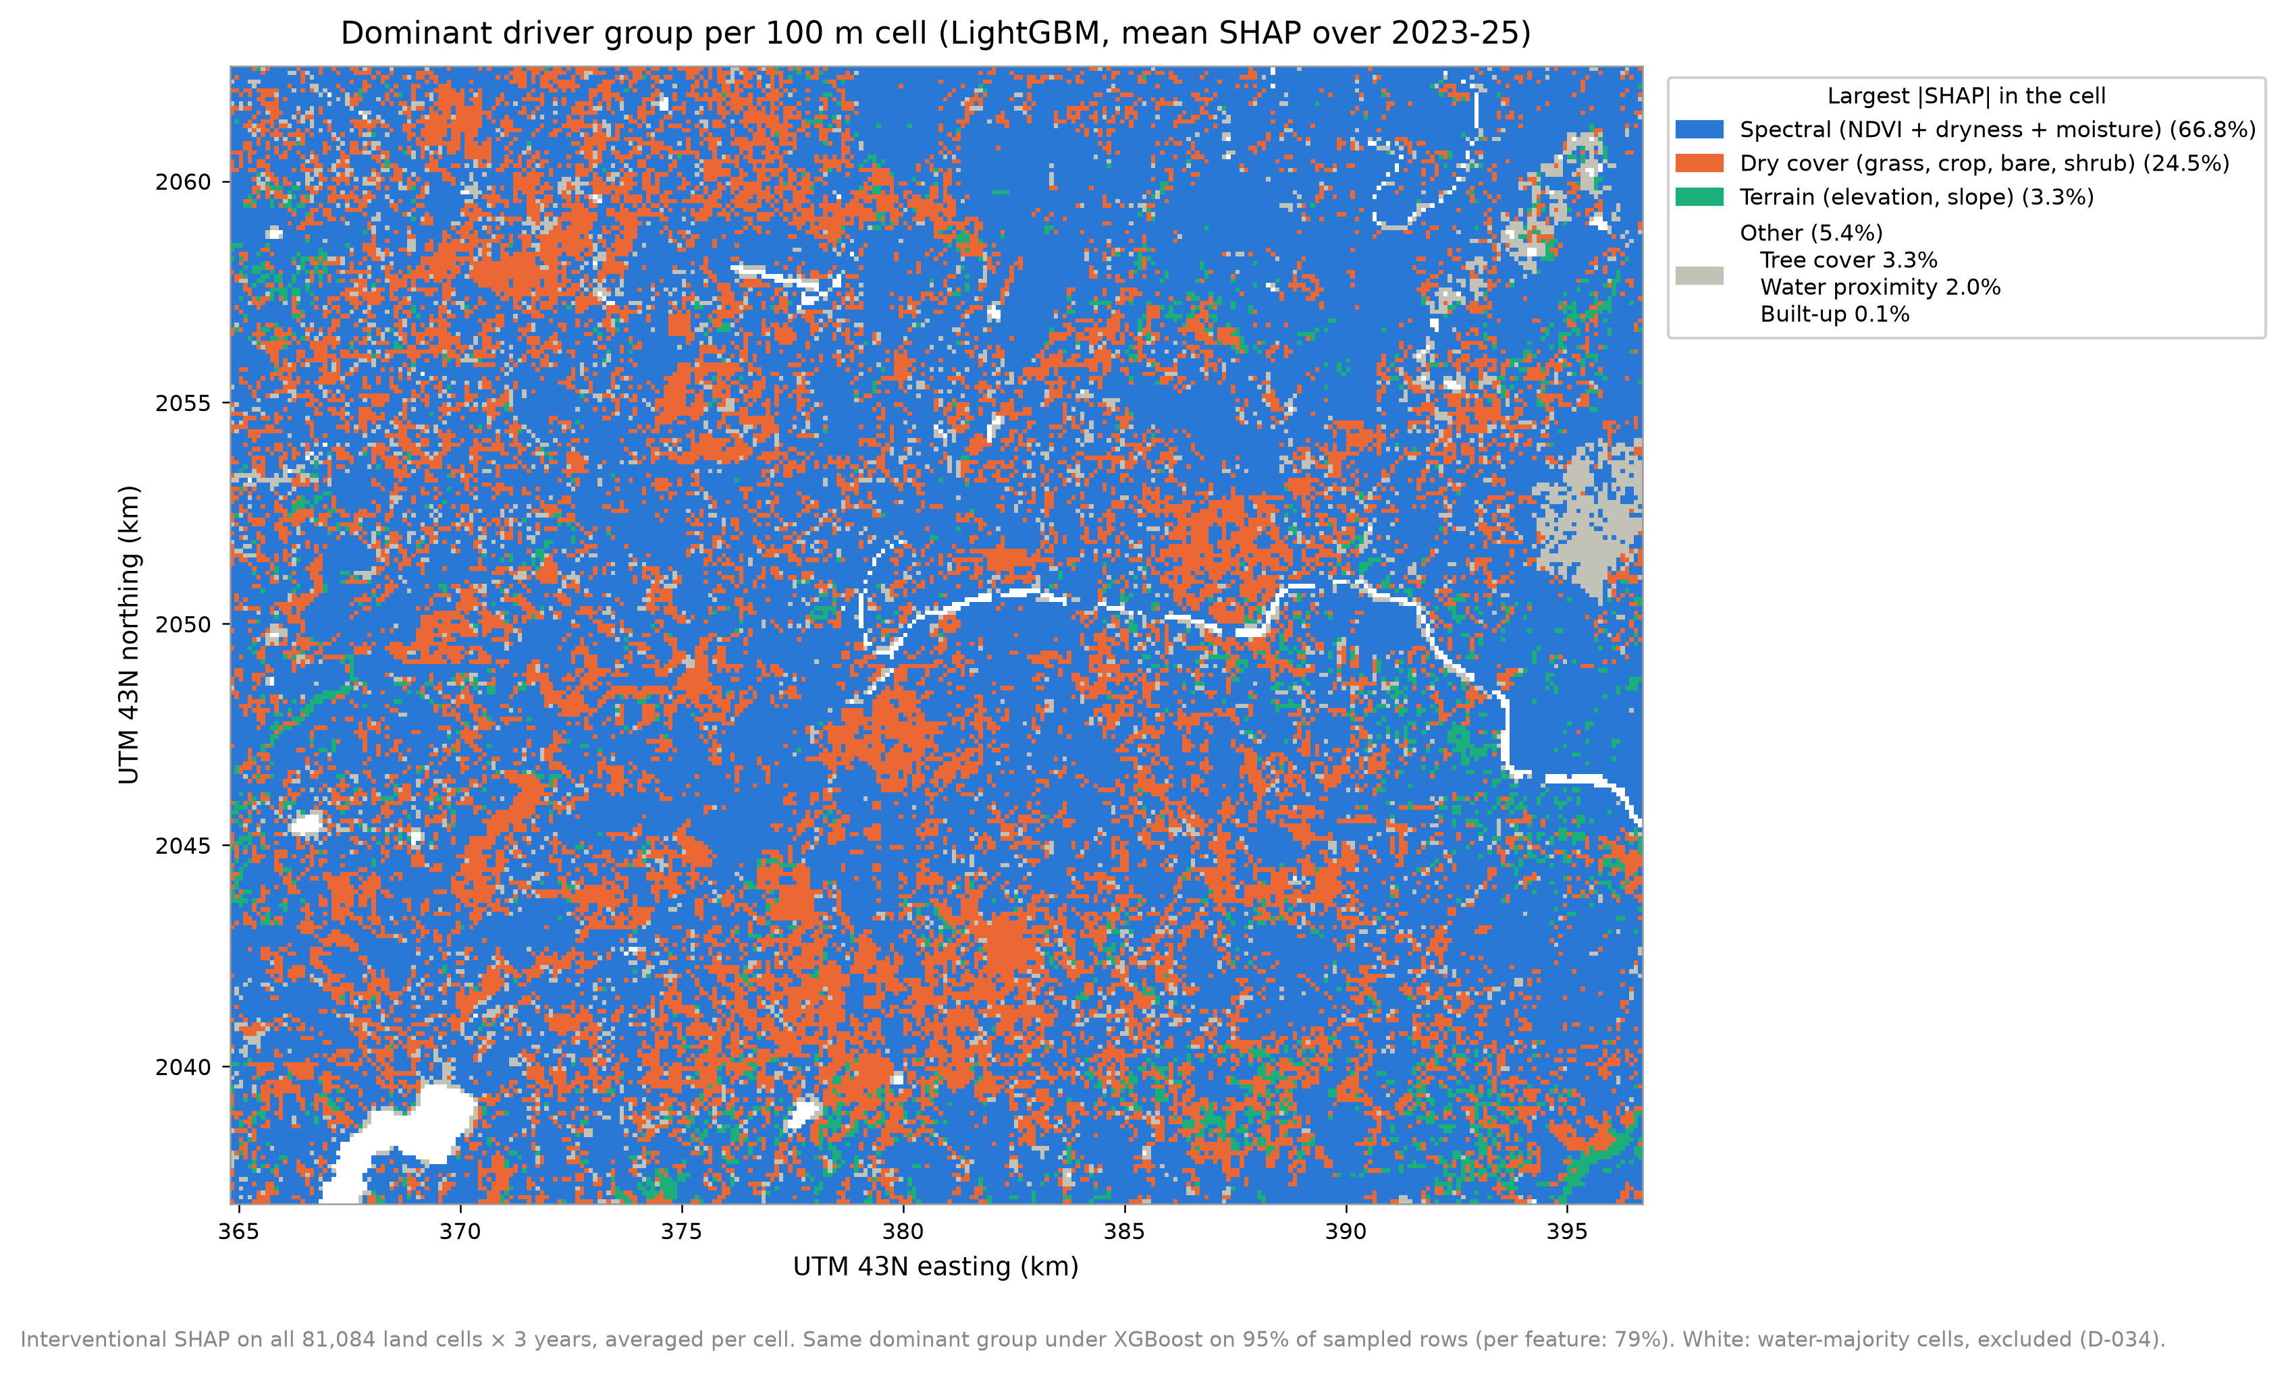
RESULTS · DRIVERS
Vegetation, dryness and moisture lead
1.49 °C
2.1×
95%
spectral block, mean |SHAP|
the dry-cover group
same leading group, XGBoost
MirageAI · Concrete vs. Canopy
12 / 19
Notes:
[Rishik] SHAP splits each prediction into contributions from each feature, in degrees. NDVI, dryness and moisture are strongly correlated, so the models trade credit between them, and we rank groups instead. The spectral block dominates: 1.49 °C on average per cell, about 2.1 times dry cover at 0.72 °C. In urban cells, dry cover rises to 0.82 °C. Built-up fraction, the concrete in our title, is the smallest group. XGBoost gives the same ranking, rank correlation 0.99. The map shows the leading group per cell: spectral in 66.8% of cells and dry cover in 24.5%, rising to 42.7% of urban cells. The leading group is the same under XGBoost for 95% of cells. These are associations, not causes.

Slide 13
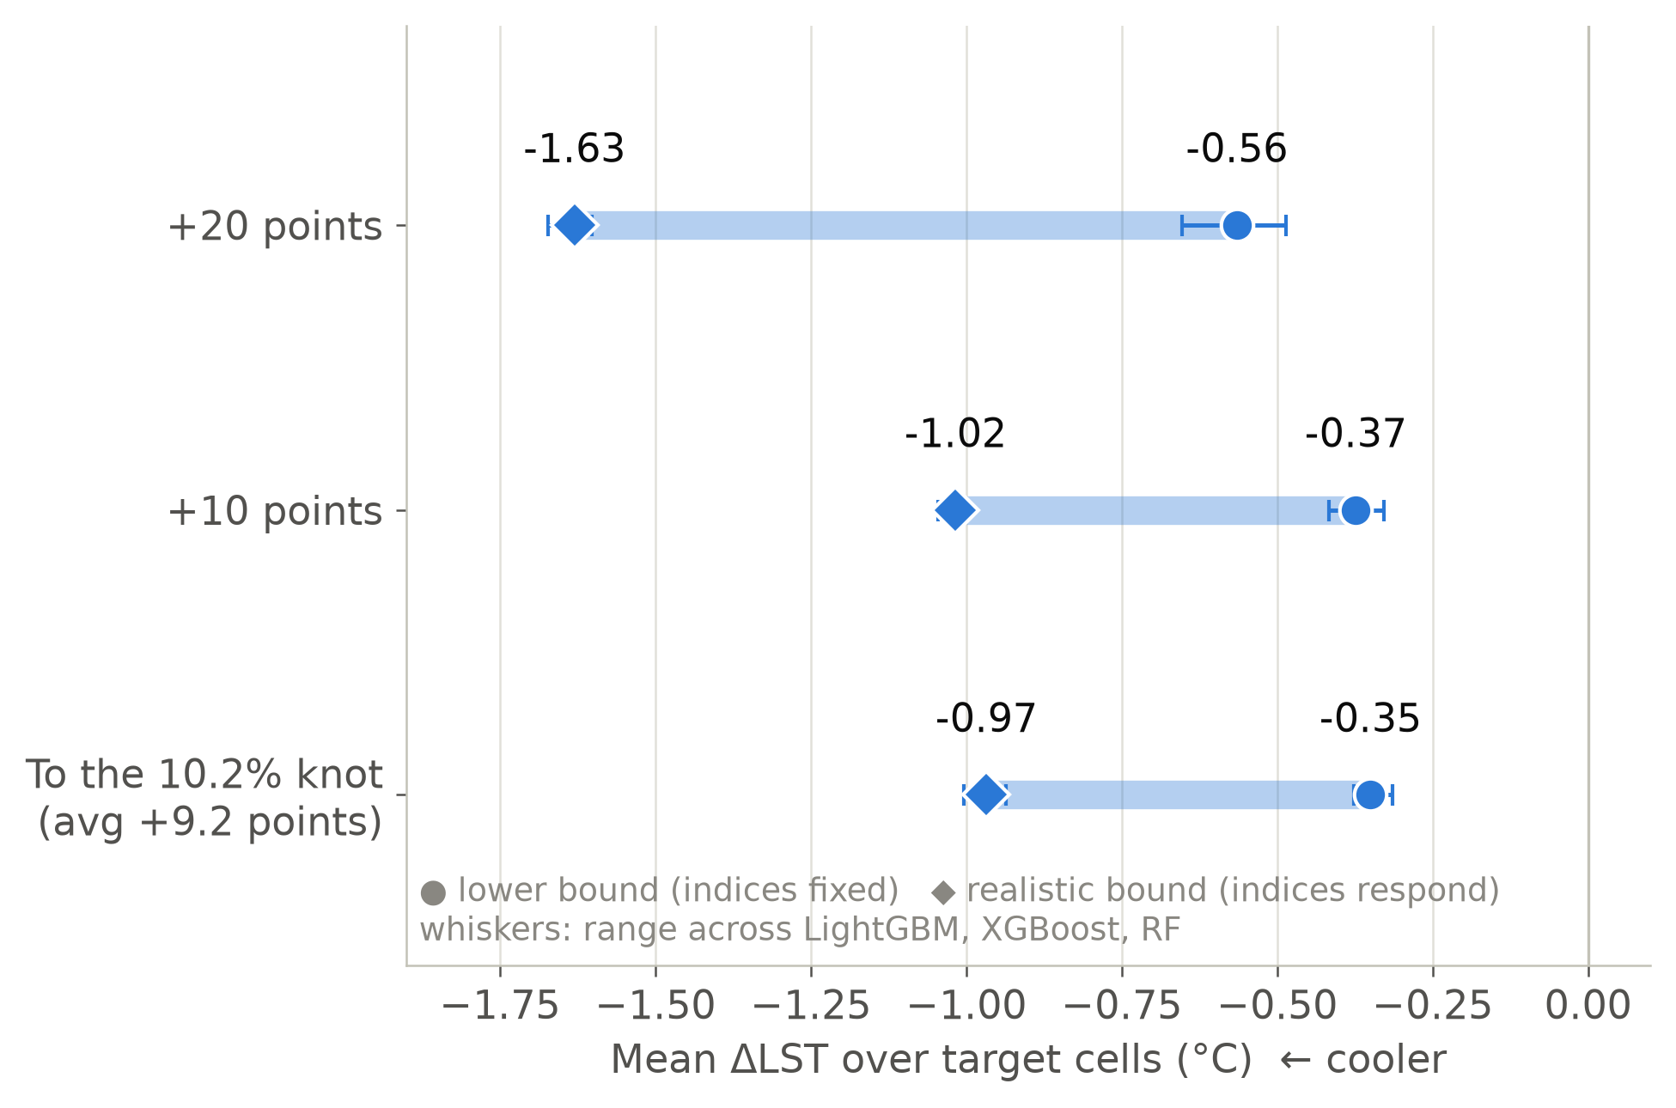
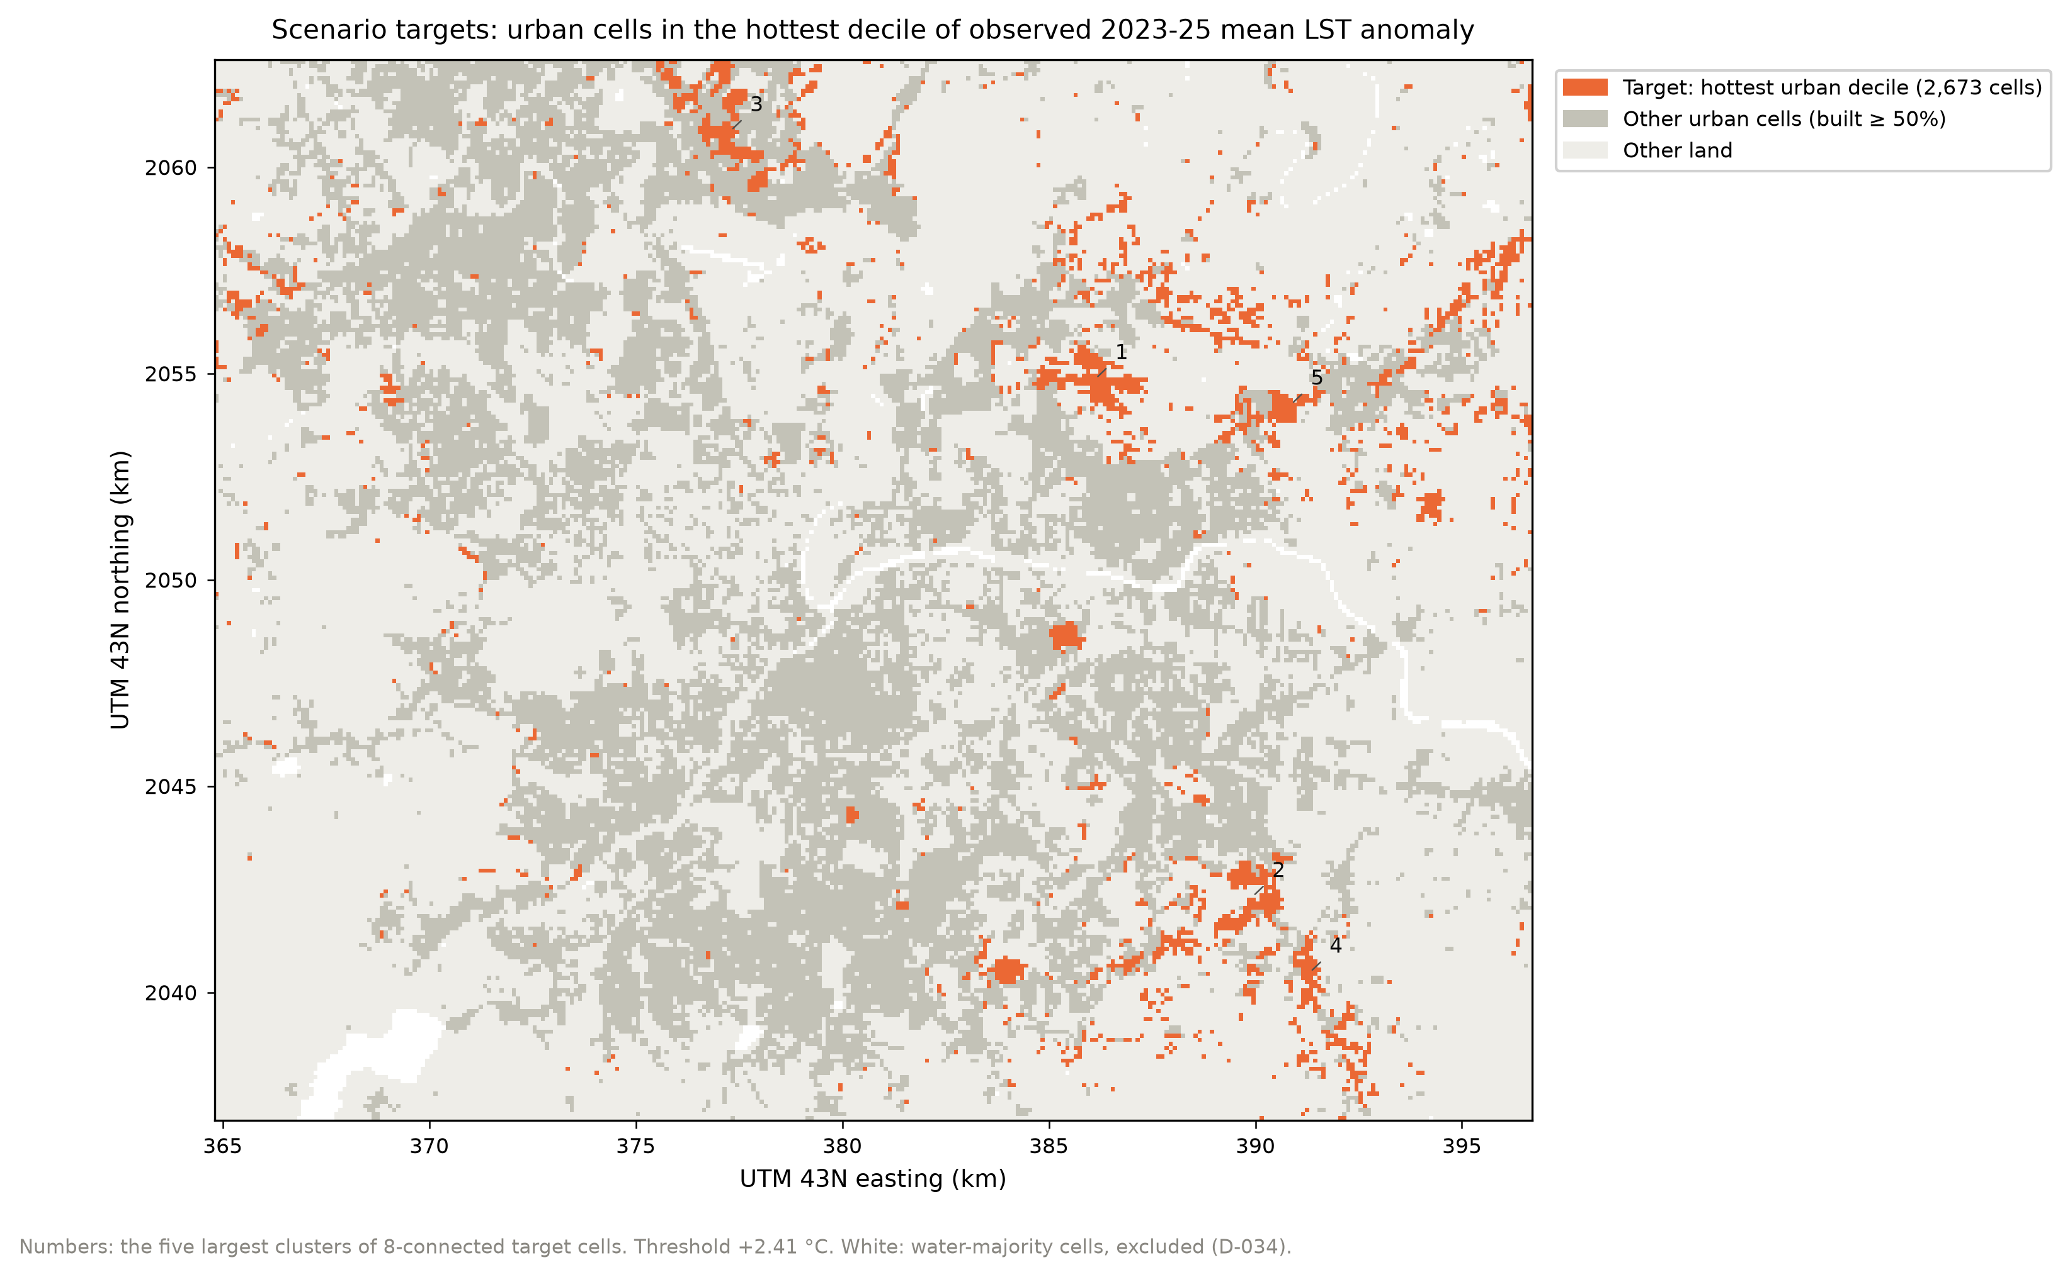
RESULTS · GREENING SCENARIOS
Greening the hottest urban cells
~10% canopy: 0.4–1.0 °C cooler. Gains per point halve past ~10–12%. First-pixel step excluded.
MirageAI · Concrete vs. Canopy
13 / 19
Notes:
[Rishik] We targeted the 2,673 urban cells in the hottest tenth of observed three-year temperature: mostly tree-sparse fringe development on the eastern edge, shown on the left. We raised their tree cover, taking the new canopy from built, bare and grass in proportion. The lower bound holds the spectral indices fixed; the realistic bound lets them respond. Adding ten points of tree cover is associated with 0.37 to 1.02 °C cooler surfaces, and twenty points with 0.56 to 1.63. Gains per point roughly halve past the knot, from 0.12 to 0.05 °C. We exclude the first pixel of canopy: on its own it is worth 1.4 °C, which reflects what tree-less places are, not what one tree does.

Slide 14
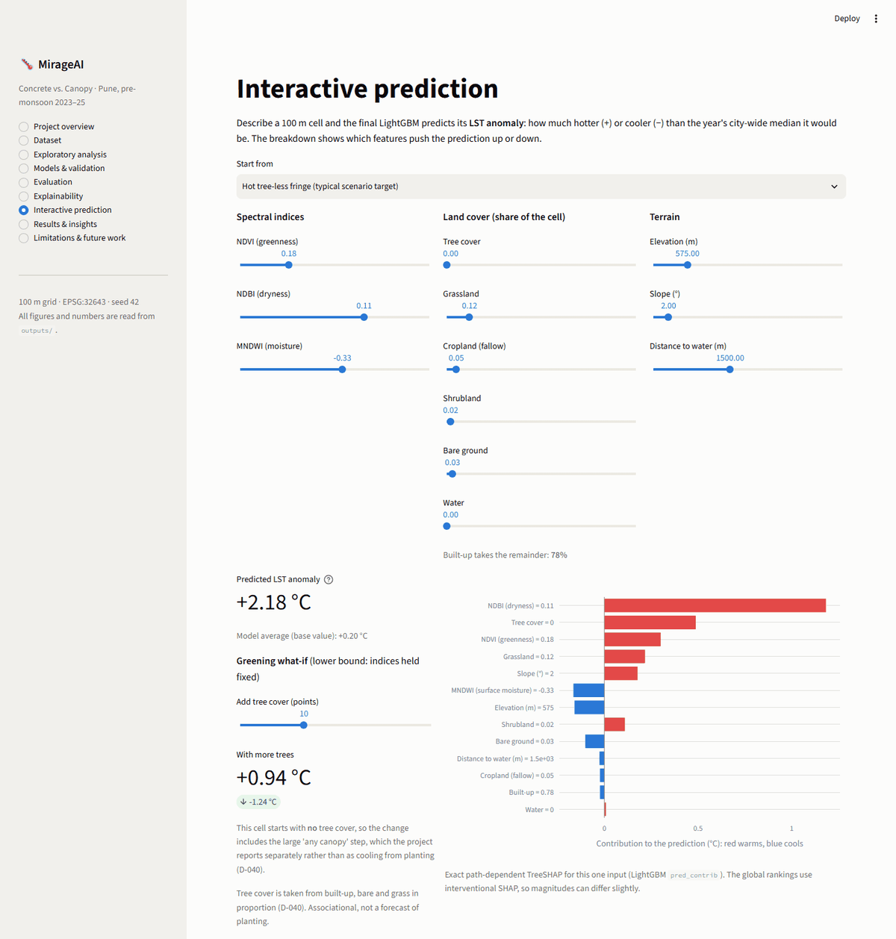
DASHBOARD DEMO
Every result, explorable in a browser
Run it
streamlit run app.py
Demo path
▪ Pick a hot, tree-less fringe cell.
▪ Read its per-feature breakdown.
▪ Add tree cover: lower-bound what-if.
▪ Read-only: numbers come from the pipeline.
MirageAI · Concrete vs. Canopy
14 / 19
Notes:
[Rishik] Everything we have shown is also in an interactive Streamlit dashboard. It has nine pages, from the dataset and exploratory maps to evaluation, explainability and the scenario results. It is read-only: it loads the tables and figures the pipeline wrote, so it cannot disagree with the report. The one live page is interactive prediction, shown here. We pick a hot, tree-less fringe cell; the final LightGBM predicts its anomaly and breaks it into per-feature contributions, red for warming and blue for cooling. Then we add tree cover and see the lower-bound change. If the live demo is slow, this screenshot is the same page. Shubhankar will close with what we learned.

Slide 15
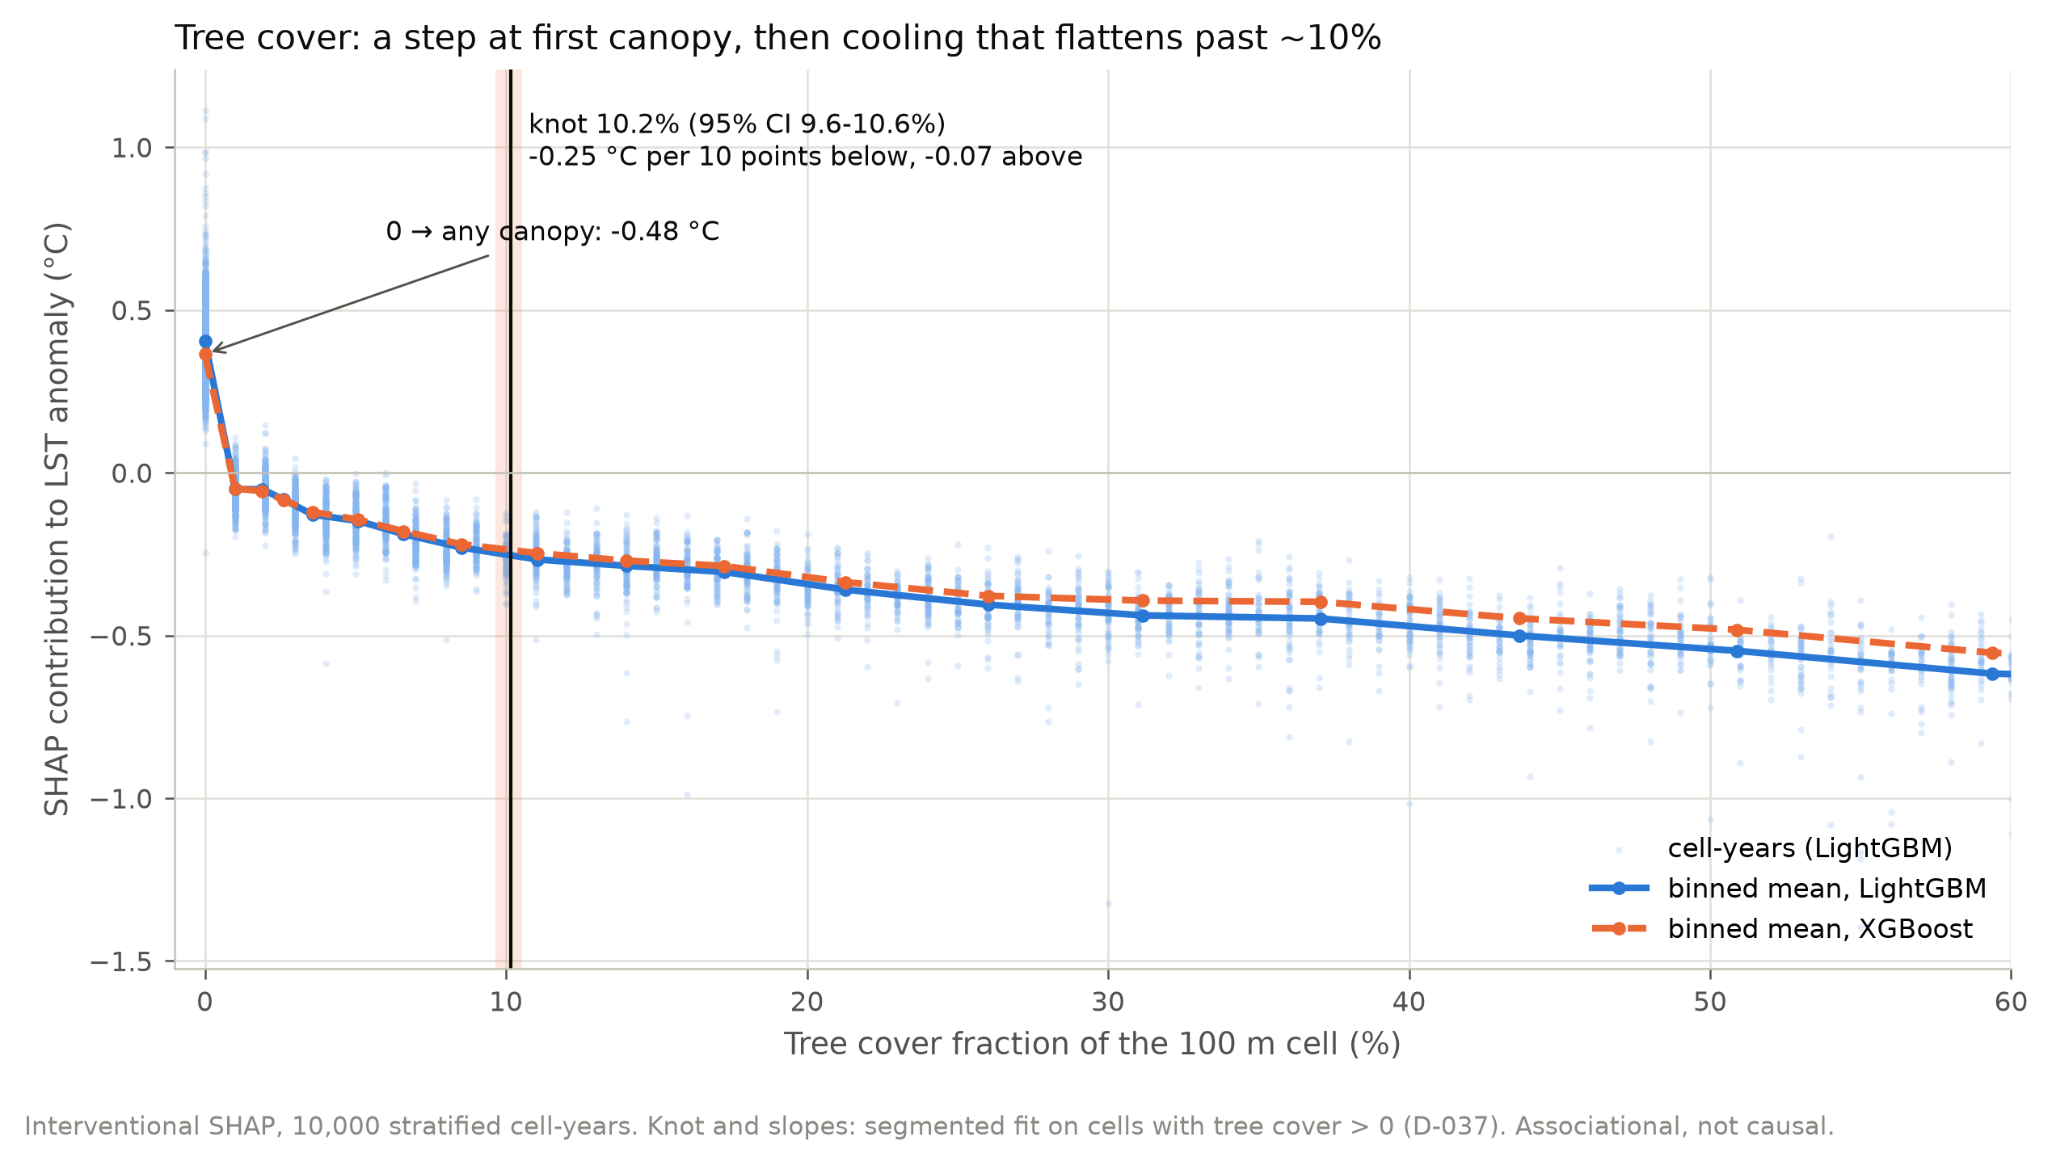
KEY INSIGHTS
Concrete vs canopy: what the evidence says
−87%
built-up association once vegetation and dryness are modelled
10.2%
tree-cover knot: gains per point flatten beyond
Spatial CV
the honest score; random CV flatters flexible models
MirageAI · Concrete vs. Canopy
15 / 19
Notes:
[Shubhankar] Thank you, Rishik. Three insights. First, concrete. On raw data more built-up cover goes with cooler surfaces, -0.22 °C per ten points. With vegetation and dryness in the model, that association shrinks to -0.029 °C, 87% smaller, and it does not flip. So the cool core is mostly a vegetation and dryness contrast, not an effect of buildings. Second, canopy. The tree-cover response bends: about -0.25 °C per ten points up to a knot at 10.2%, then only -0.07 beyond, and both models agree on that shape. Third, method. Random validation flatters flexible models, so spatial validation is the honest score.

Slide 16
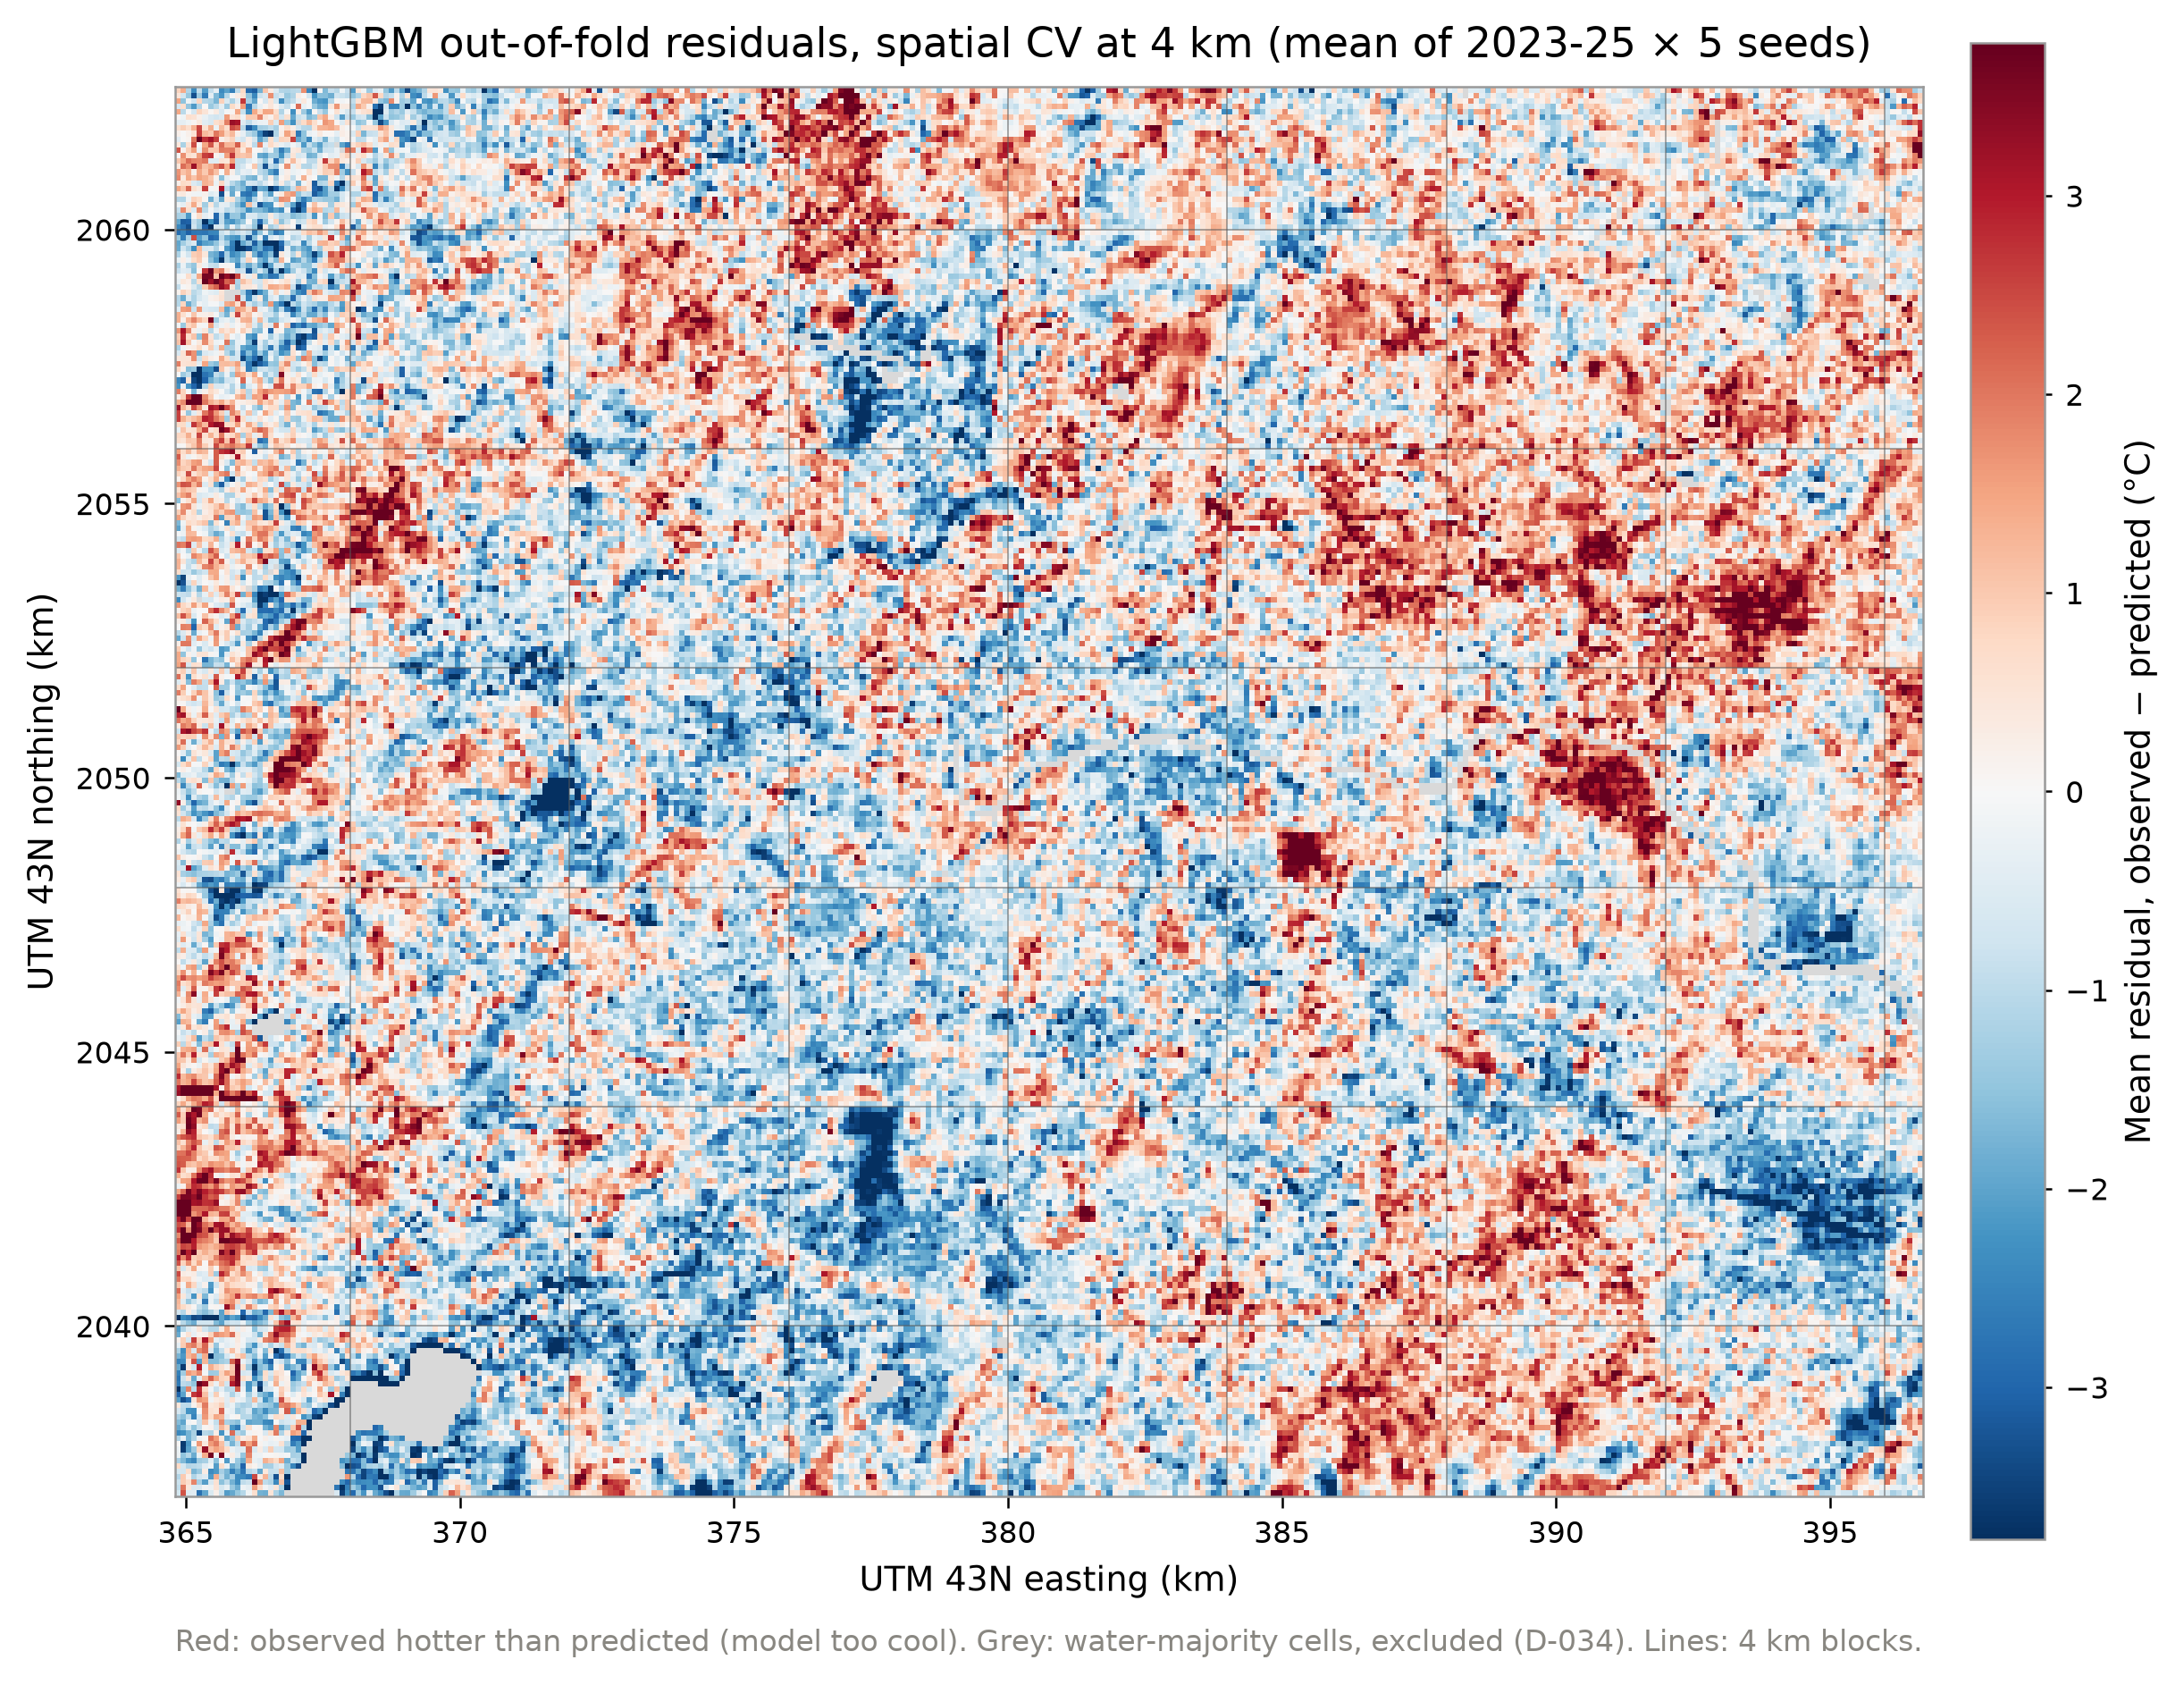
LIMITATIONS
What these results cannot tell us
▪ Daytime surface LST, not air temperature
▪ Associations, not causal effects
▪ Residual Moran's I ≈ 0.6: missing drivers
▪ Static 2021 land cover
▪ One city, one season
MirageAI · Concrete vs. Canopy
16 / 19
Notes:
[Shubhankar] Four limits. One: land surface temperature is the skin temperature the satellite sees in daytime, not air temperature or comfort. Two: everything is an association from comparing places; we have no before-and-after planting evidence. Three: the residuals are still clustered, with Moran's I around 0.6, which points to drivers we cannot see, such as building height, roofing material and irrigation. The map shows those clusters, red where a cell is hotter than predicted. Four: land cover is a single 2021 map for all three years. None of these changes the validation results; they bound how far the scenarios can be read.

Slide 17
FUTURE SCOPE
Where the work goes next
Urban form
Air temperature
Before and after
building height, roofs, irrigation
ground and mobile sensors
multi-year land-cover change
Night and seasons
Nested spatial CV
Live scenarios
where the island may flip
remove tuning optimism
realistic bound in the dashboard
MirageAI · Concrete vs. Canopy
17 / 19
Notes:
[Shubhankar] With more time we would do six things. Add the urban-form layers the residuals point to: building height, roof material and irrigated green space. Pair surface temperature with ground or mobile air-temperature data, to see whether the associations carry over to the air people breathe. Use land-cover change over several years for before-and-after comparisons. Extend to night-time and post-monsoon composites, where the heat island may not be inverted. Run nested spatial cross-validation to remove the small tuning optimism. And ship the index models so the dashboard can show the realistic bound live.

Slide 18
CONCLUSION
Conclusion
1.75 °C
R² 0.72
0.4–1.0 °C
RMSE, unseen places and year
on the 2025 test
cooler at ~10% canopy
Pune's hottest urban surfaces are tree-sparse fringe developments, mostly on the eastern edge. In these data, raising them to ~10% tree cover is associated with ~0.4–1.0 °C cooler daytime surfaces, with gains per point roughly halving beyond ~10–12% cover. These are cross-sectional associations, not measured effects of planting.
MirageAI · Concrete vs. Canopy
18 / 19
Notes:
[Shubhankar] To conclude, three numbers and one sentence. Spatially validated models map the anomaly to 1.75 °C RMSE, R squared 0.72, in places and a year they never saw. And the sentence we would give a planner, read as written: Pune's hottest urban surfaces are tree-sparse fringe developments, mostly on the eastern edge. In these data, raising them to about ten percent tree cover is associated with roughly 0.4 to 1.0 °C cooler daytime surfaces, with gains per point roughly halving beyond ten to twelve percent cover. These are cross-sectional associations, not measured effects of planting. In daytime Pune, the surface heat is in the dry fringe, not the dense core.

Slide 19
Thank you
Questions?
Shourya Tiwari · Shashwat Kumar
Rishik Sinha · Shubhankar Bhan
Symbiosis Institute of Technology, Pune
Applications and Use Cases of Machine Learning (TE7483)
Report · slides · dashboard · code: MirageAI repository
MirageAI · Concrete vs. Canopy
19 / 19
Notes:
[Shubhankar] Thank you for listening. We are happy to take questions, and every number you have seen can be traced to an output table and a logged decision.

