Slide 1

Notes:
Presenter: Shourya Bafna. Introduce the team and the goal of Phase 2.

Slide 2
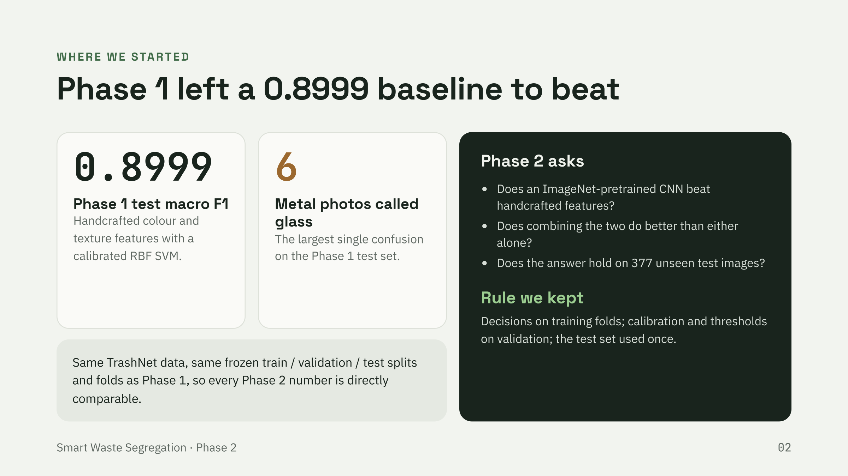
Notes:
Presenter: Shourya Bafna. Recap Phase 1 and state the three Phase 2 questions.

Slide 3
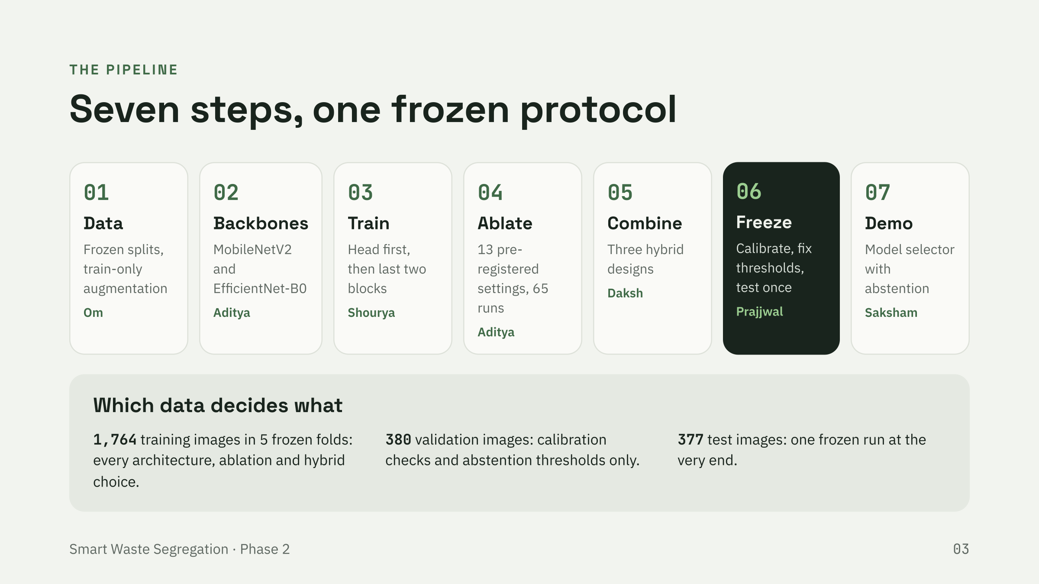
Notes:
Presenter: Shourya Bafna. Walk through who built each stage and which data each decision used.

Slide 4
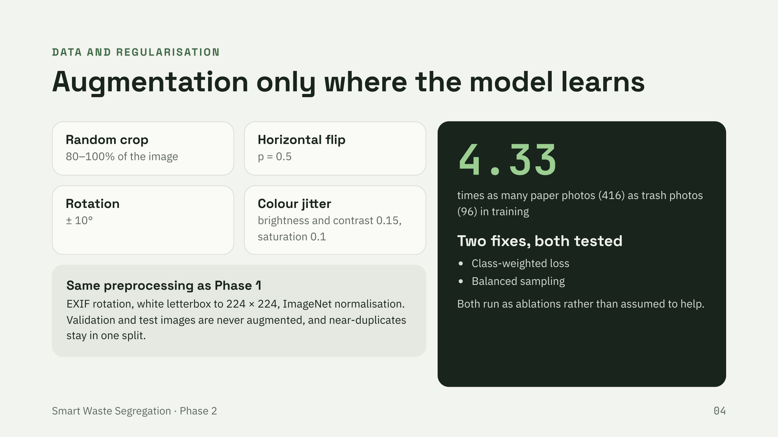
Notes:
Presenter: Om Yadav. Explain the train-only augmentation and the imbalance options.

Slide 5
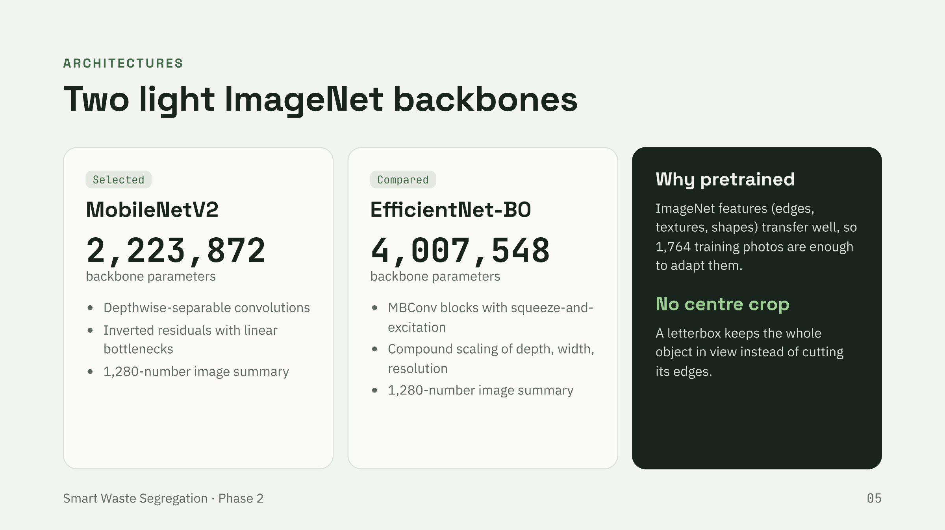
Notes:
Presenter: Aditya Bhardwaj. Compare the two backbones and explain transfer learning.

Slide 6
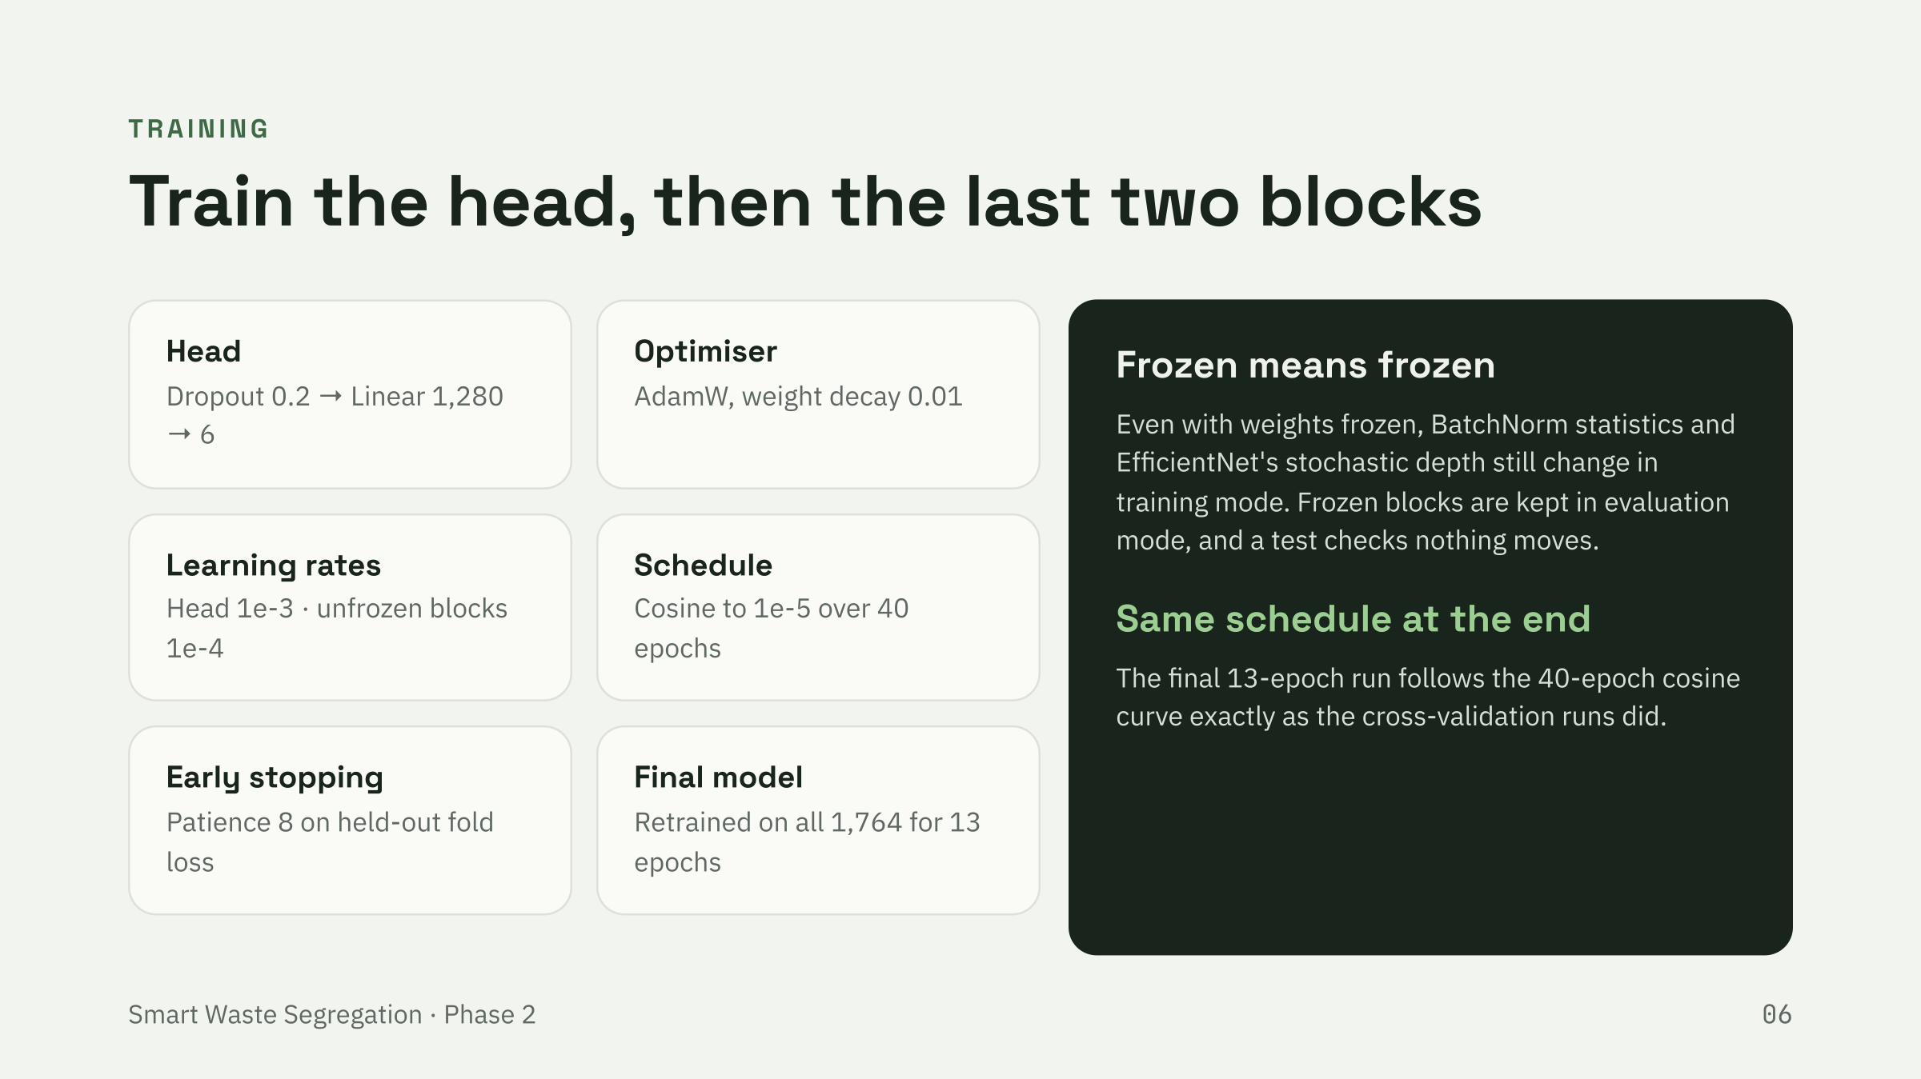
Notes:
Presenter: Shourya Bafna. Explain AdamW, cosine schedule, early stopping and differential learning rates.

Slide 7
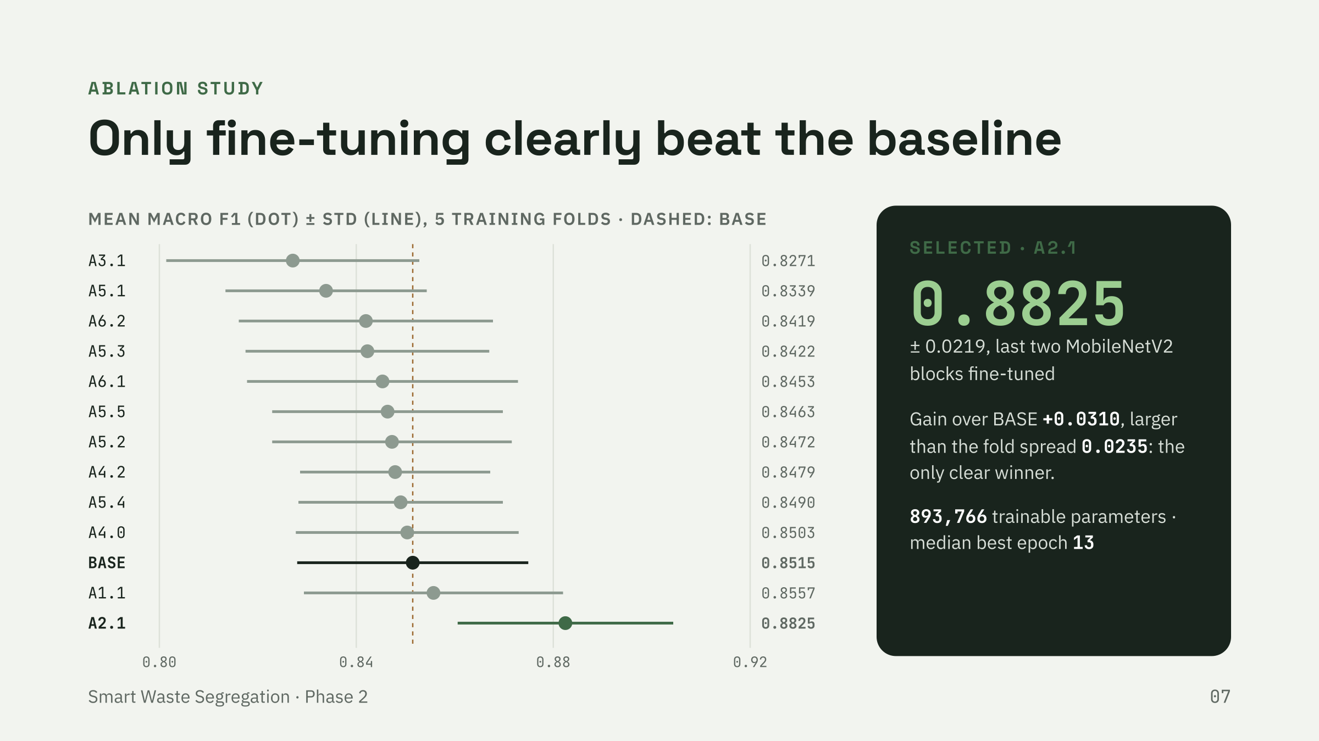
Notes:
Presenter: Aditya Bhardwaj. The plan was committed before any run; a variant wins only if its gain exceeds the fold standard deviation.

Slide 8
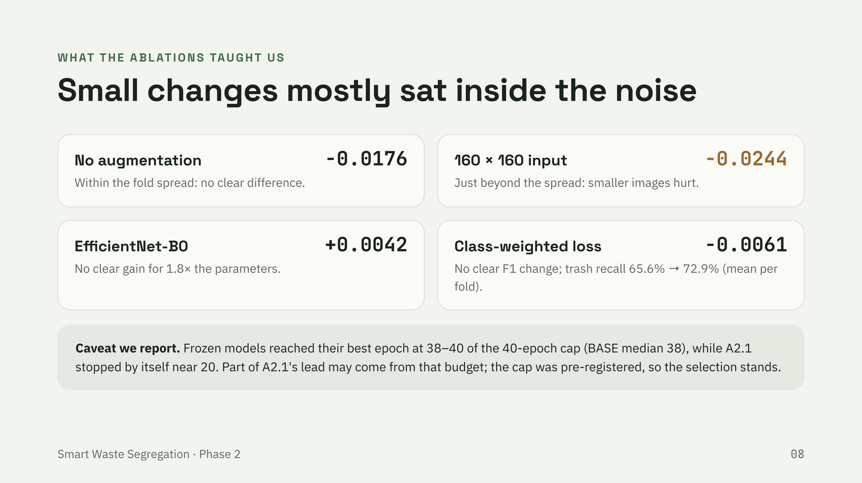
Notes:
Presenter: Aditya Bhardwaj. Differences are versus BASE; recall figures are mean per fold.

Slide 9
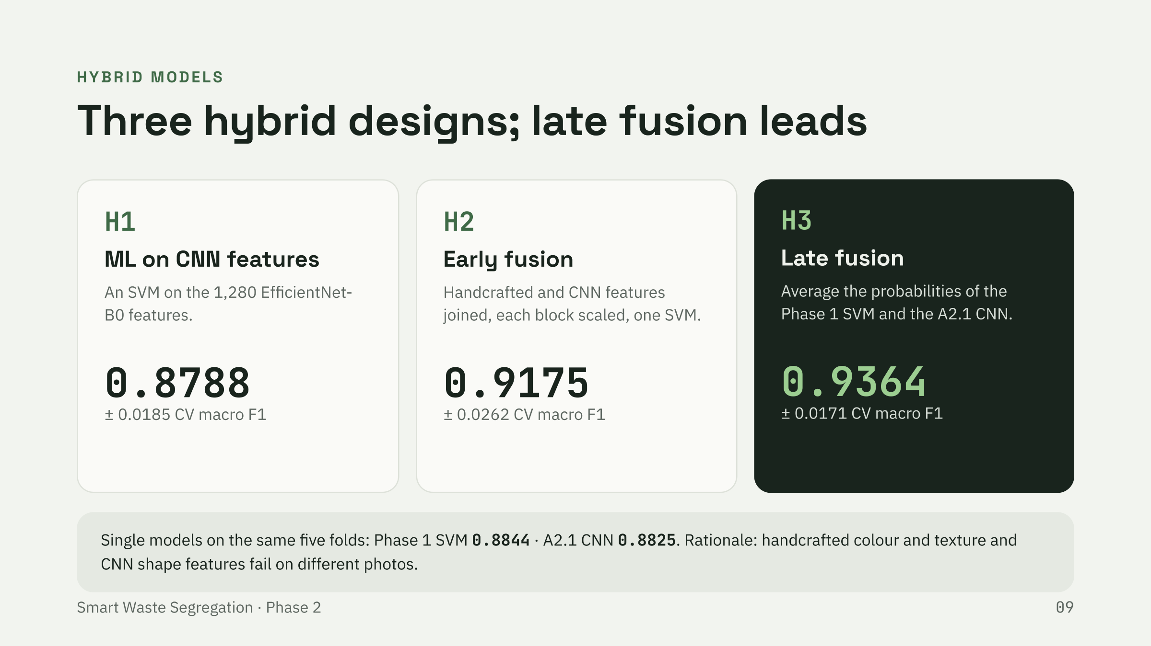
Notes:
Presenter: Daksh Batra. All cross-validation scores use the argmax of predicted probabilities.

Slide 10
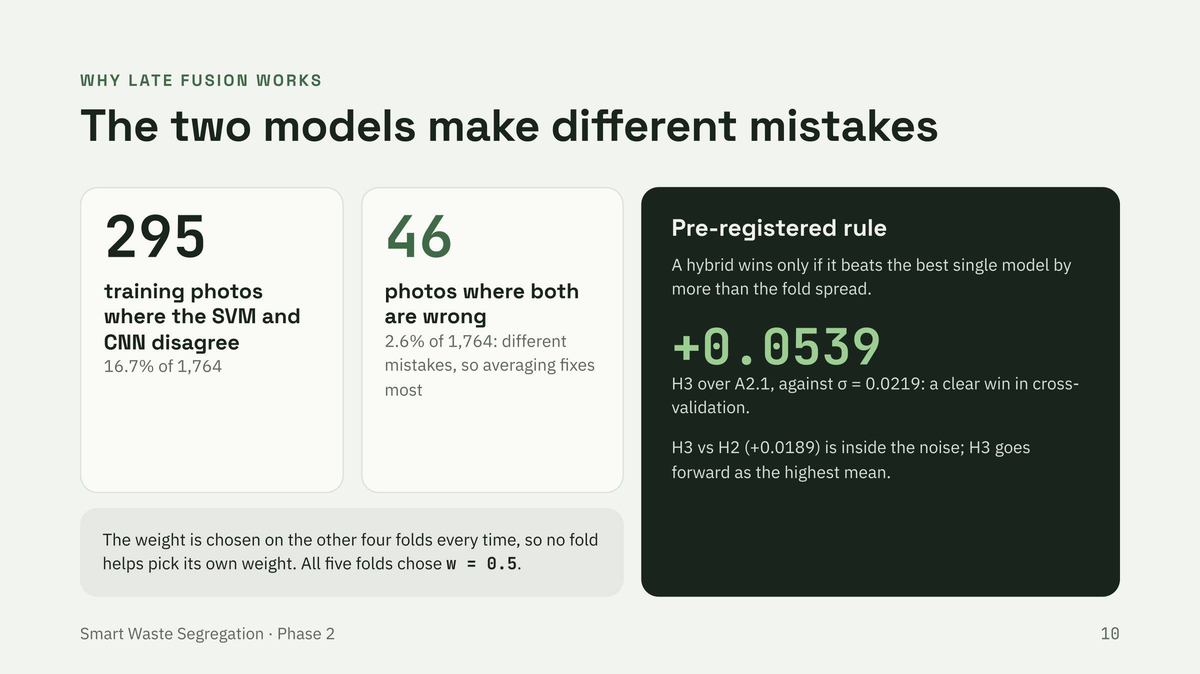
Notes:
Presenter: Daksh Batra. Disagreement counts are from the two out-of-fold prediction files.

Slide 11
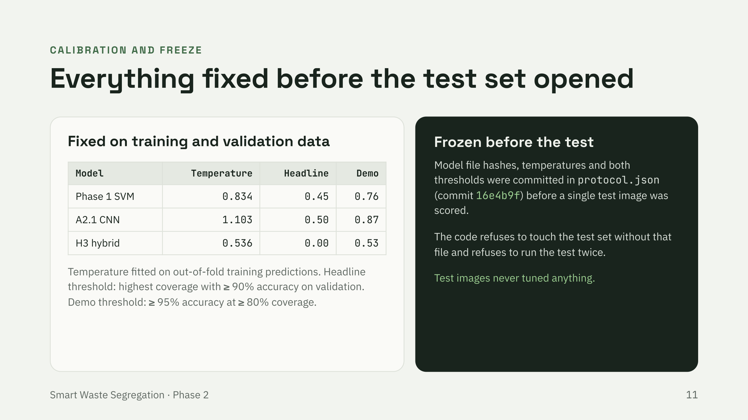
Notes:
Presenter: Prajjwal Tripathi. H3's headline threshold is 0.00 because it already exceeds 90% accuracy, so a stricter demo threshold was added before the freeze.

Slide 12
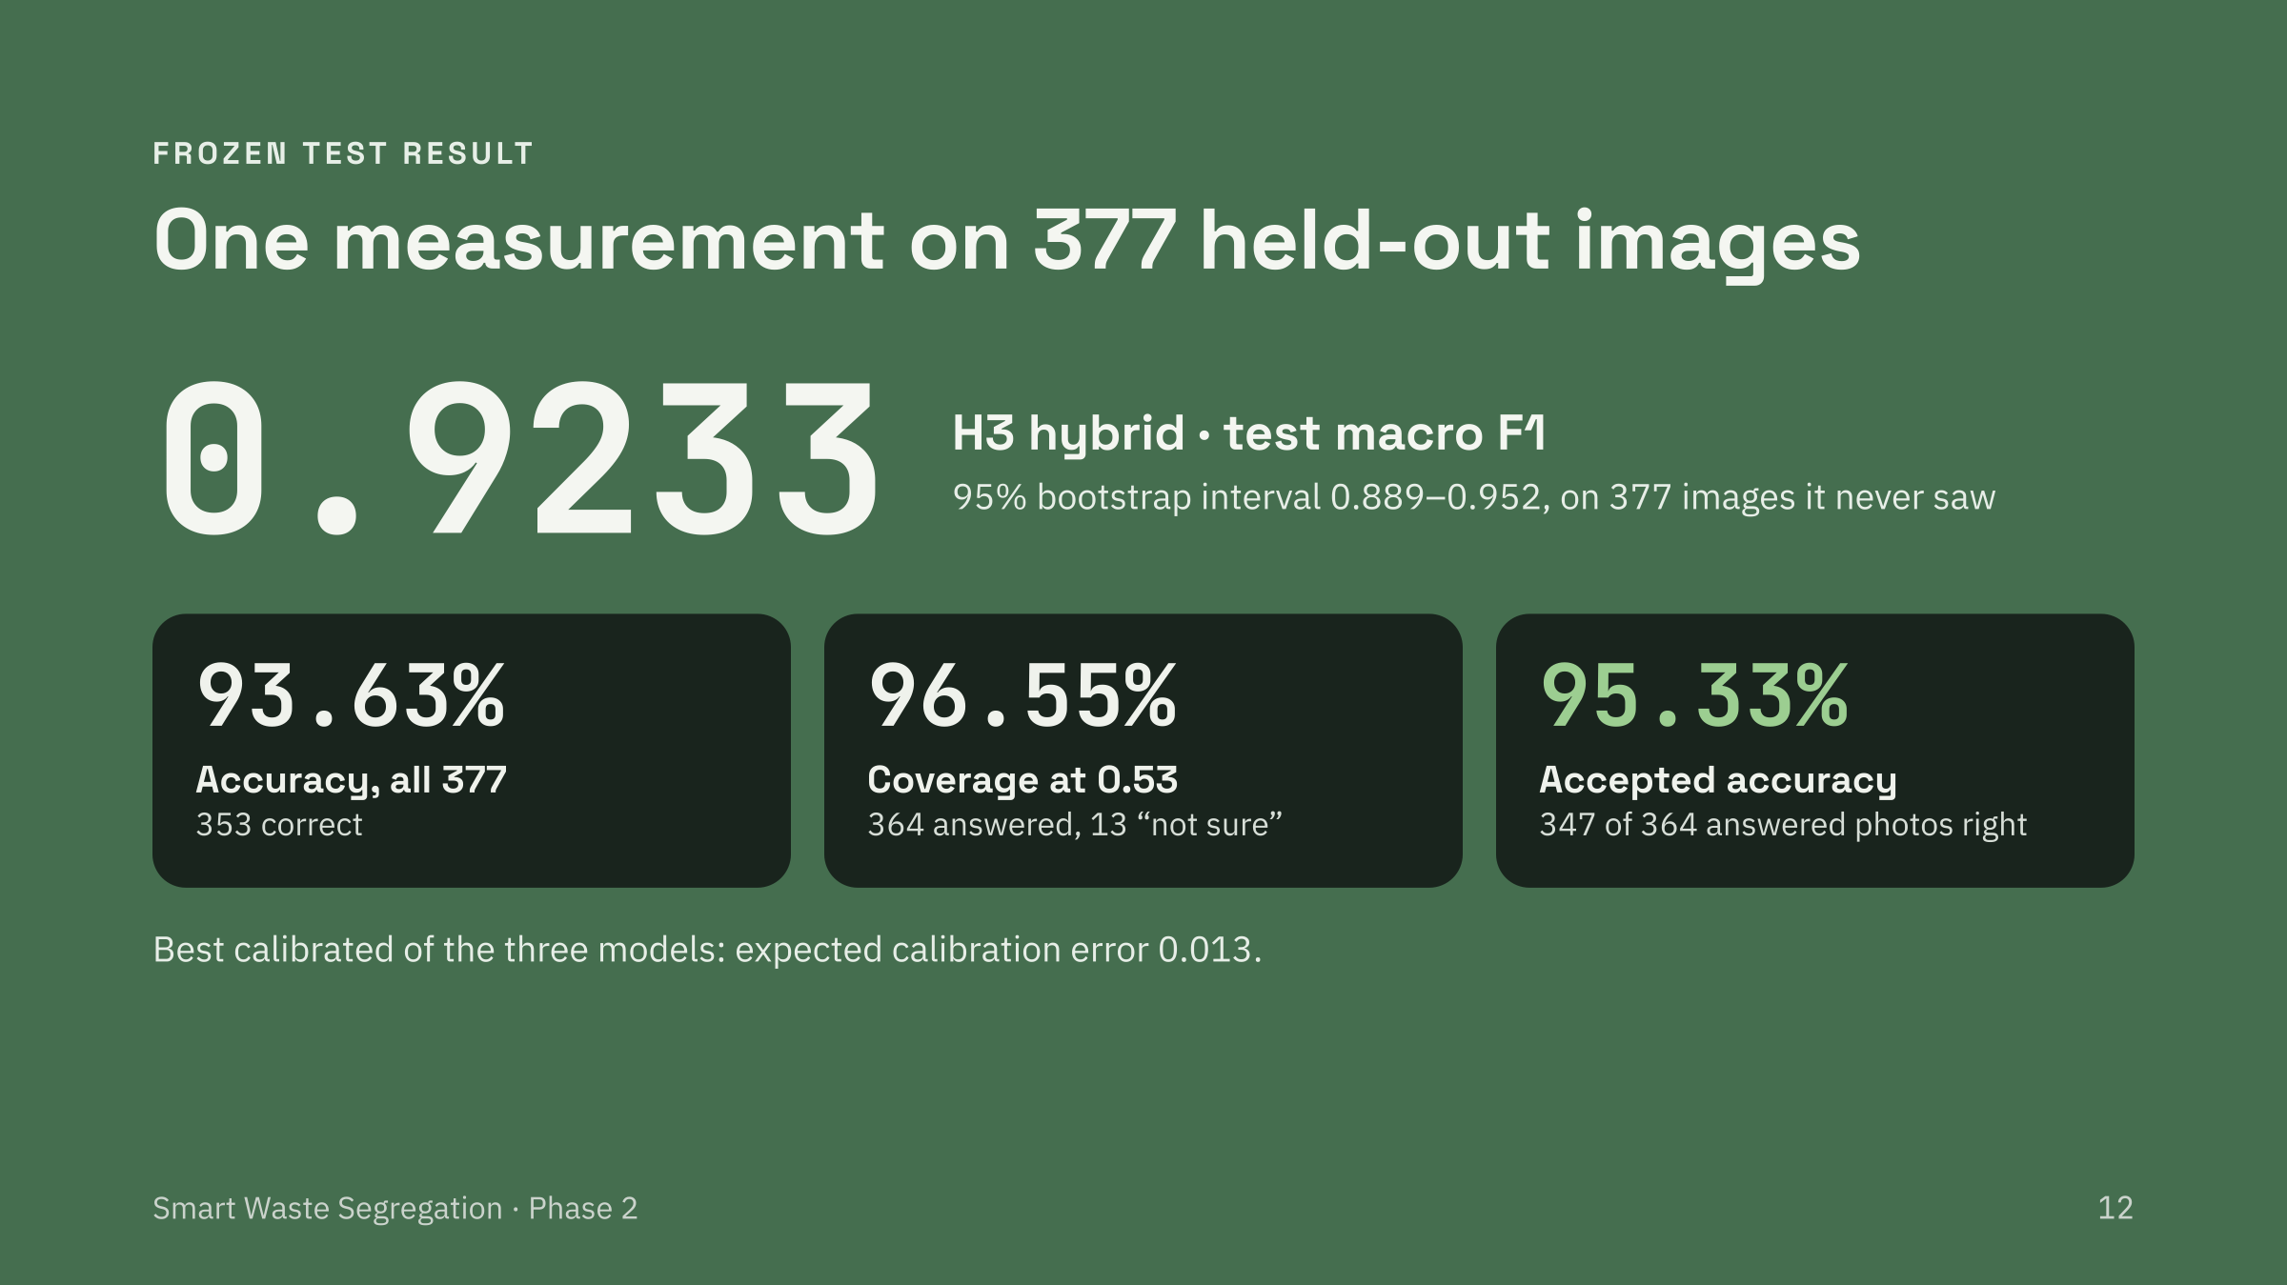
Notes:
Presenter: Prajjwal Tripathi. One run with the frozen protocol; every number comes from test-predictions.csv.

Slide 13
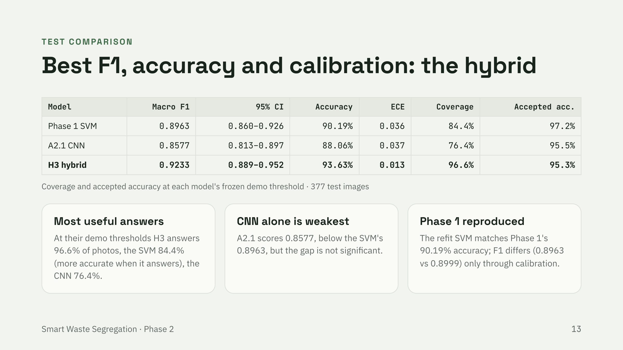
Notes:
Presenter: Prajjwal Tripathi. A2.1's demo threshold covered 76.4% of test photos, below the 80% it reached on validation.

Slide 14
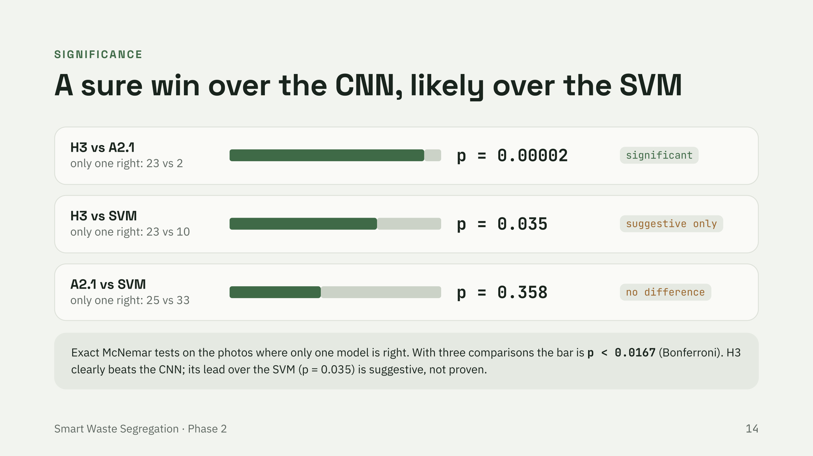
Notes:
Presenter: Prajjwal Tripathi. Green share of the bar = photos only the first model got right.

Slide 15
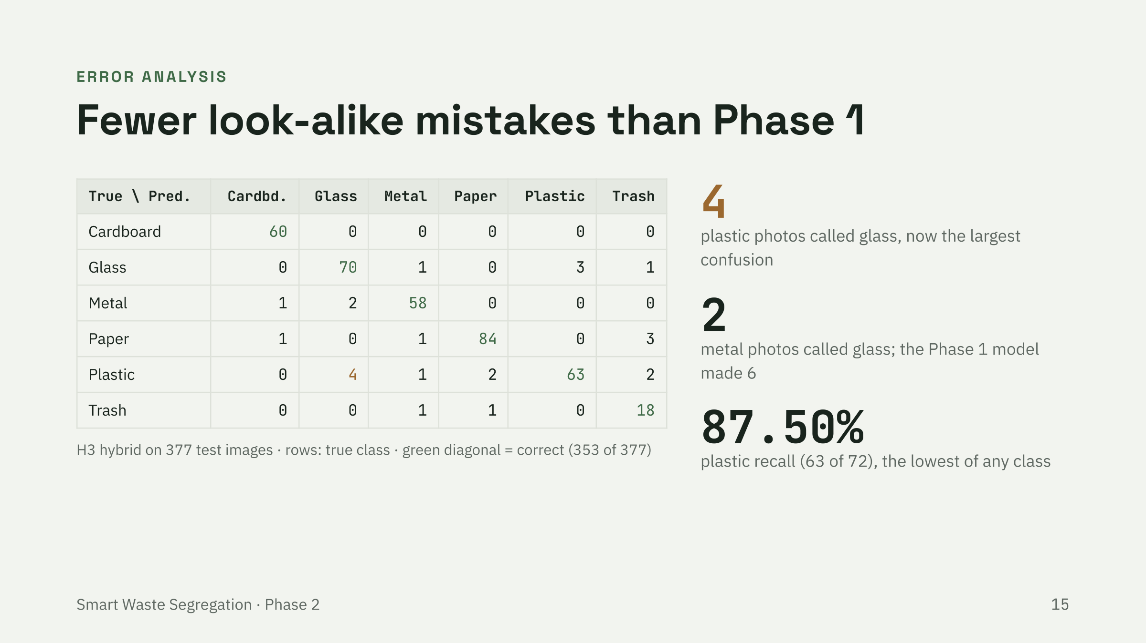
Notes:
Presenter: Prajjwal Tripathi. Counts are from test-predictions.csv.

Slide 16
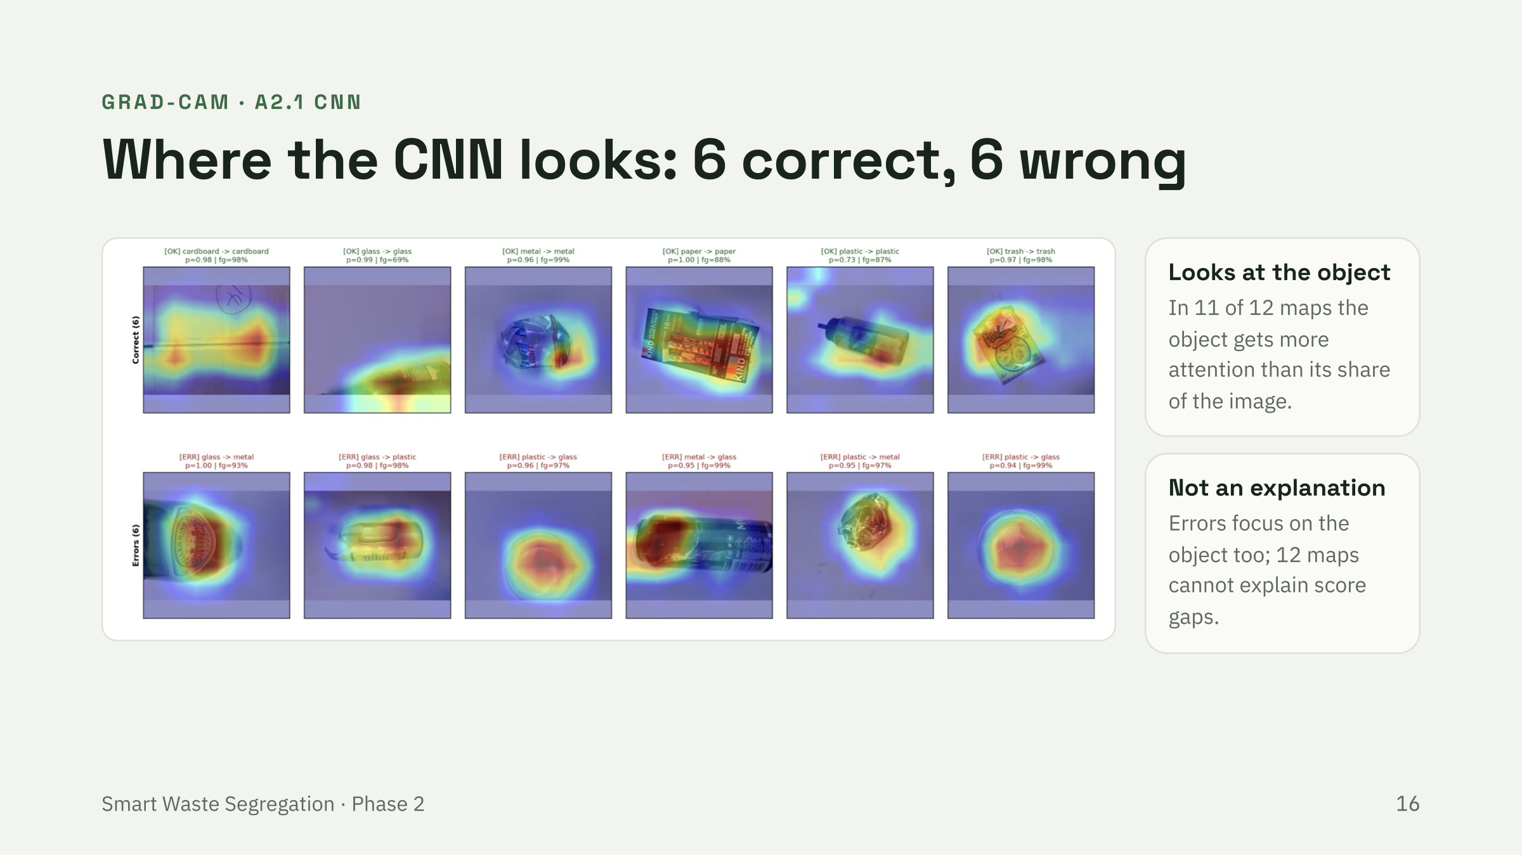
Notes:
Presenter: Prajjwal Tripathi. 'Object' is a colour heuristic (saturation > 0.12 or value < 0.92), not a hand-drawn mask.

Slide 17
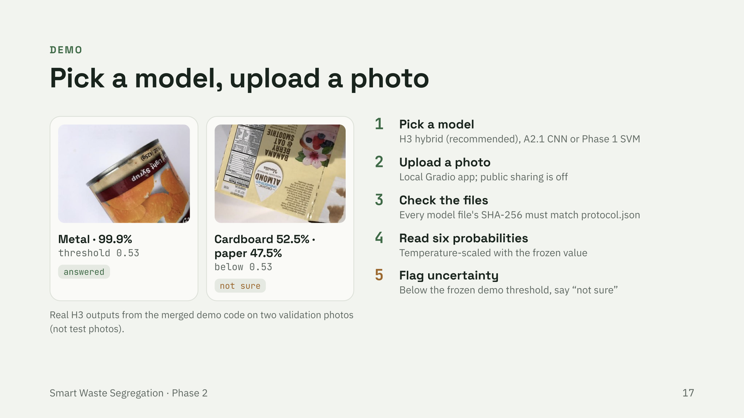
Notes:
Presenter: Saksham Miglani. The demo's probabilities match the evaluation code on validation images to within 4e-6.

Slide 18
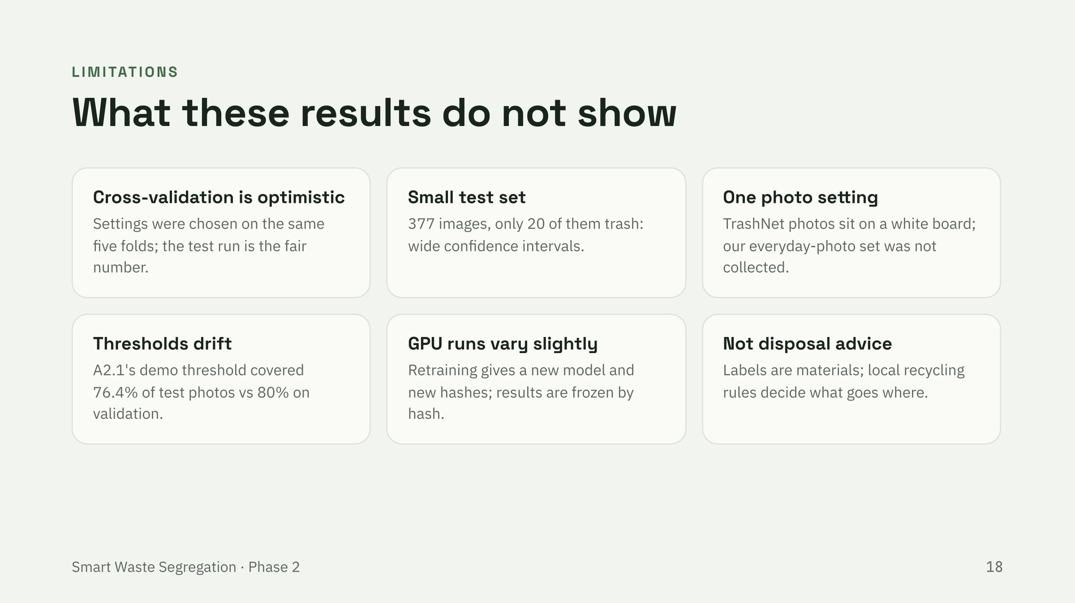
Notes:
Presenter: Saksham Miglani.

Slide 19
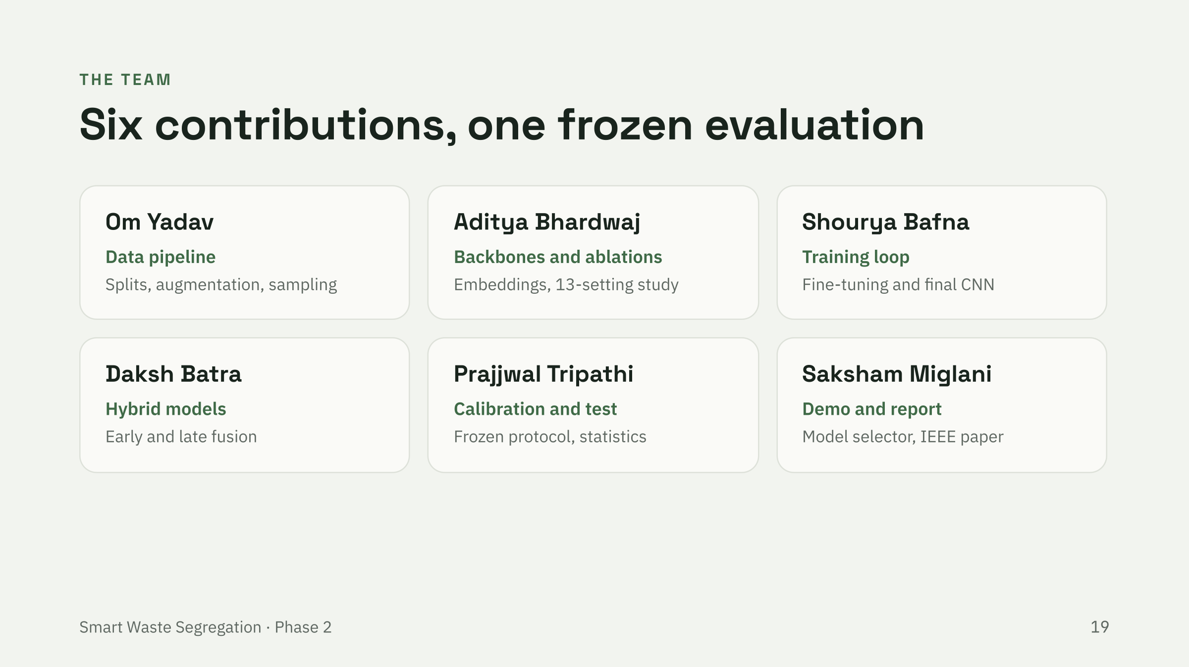
Notes:
Presenter: Shourya Bafna.

Slide 20
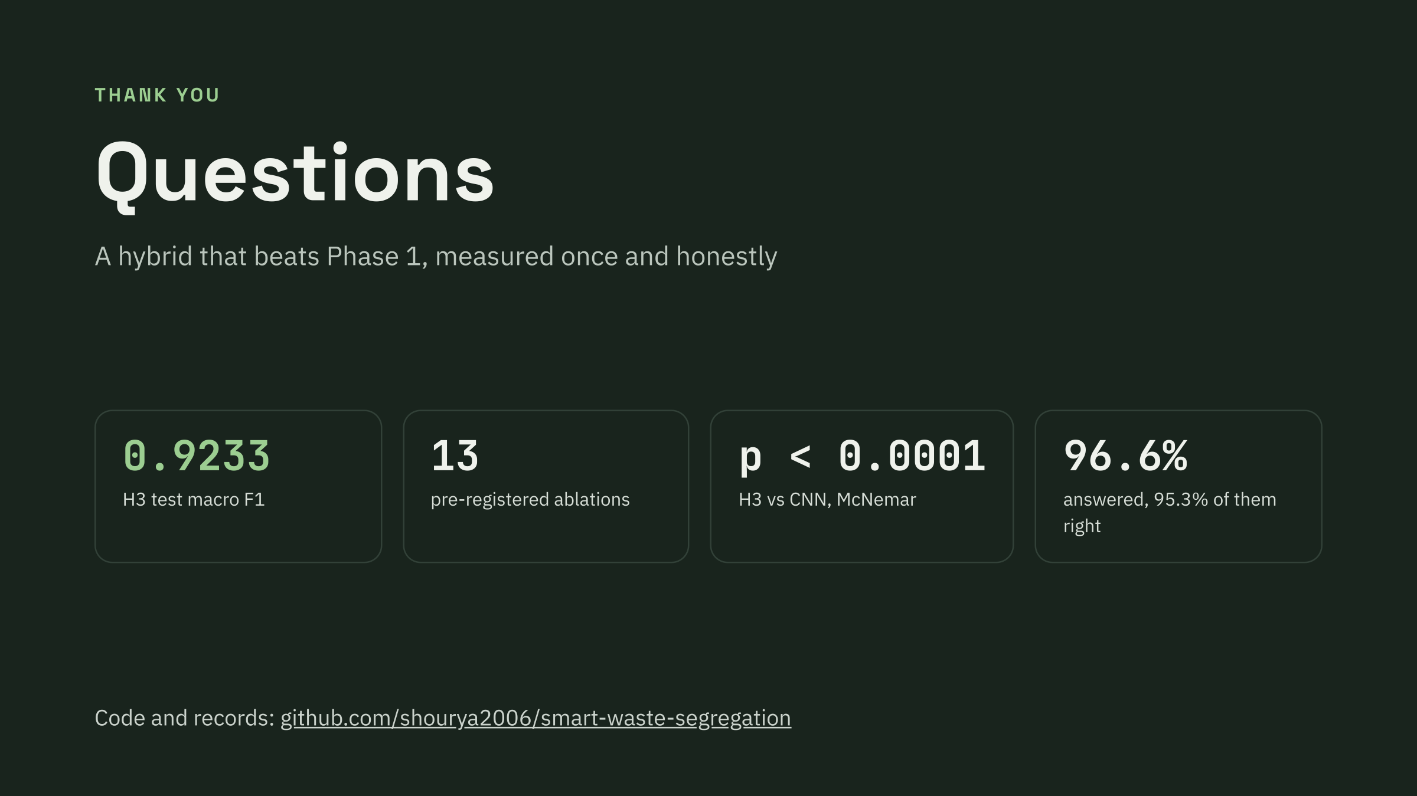
Notes:
Presenter: Shourya Bafna.

Slide 21
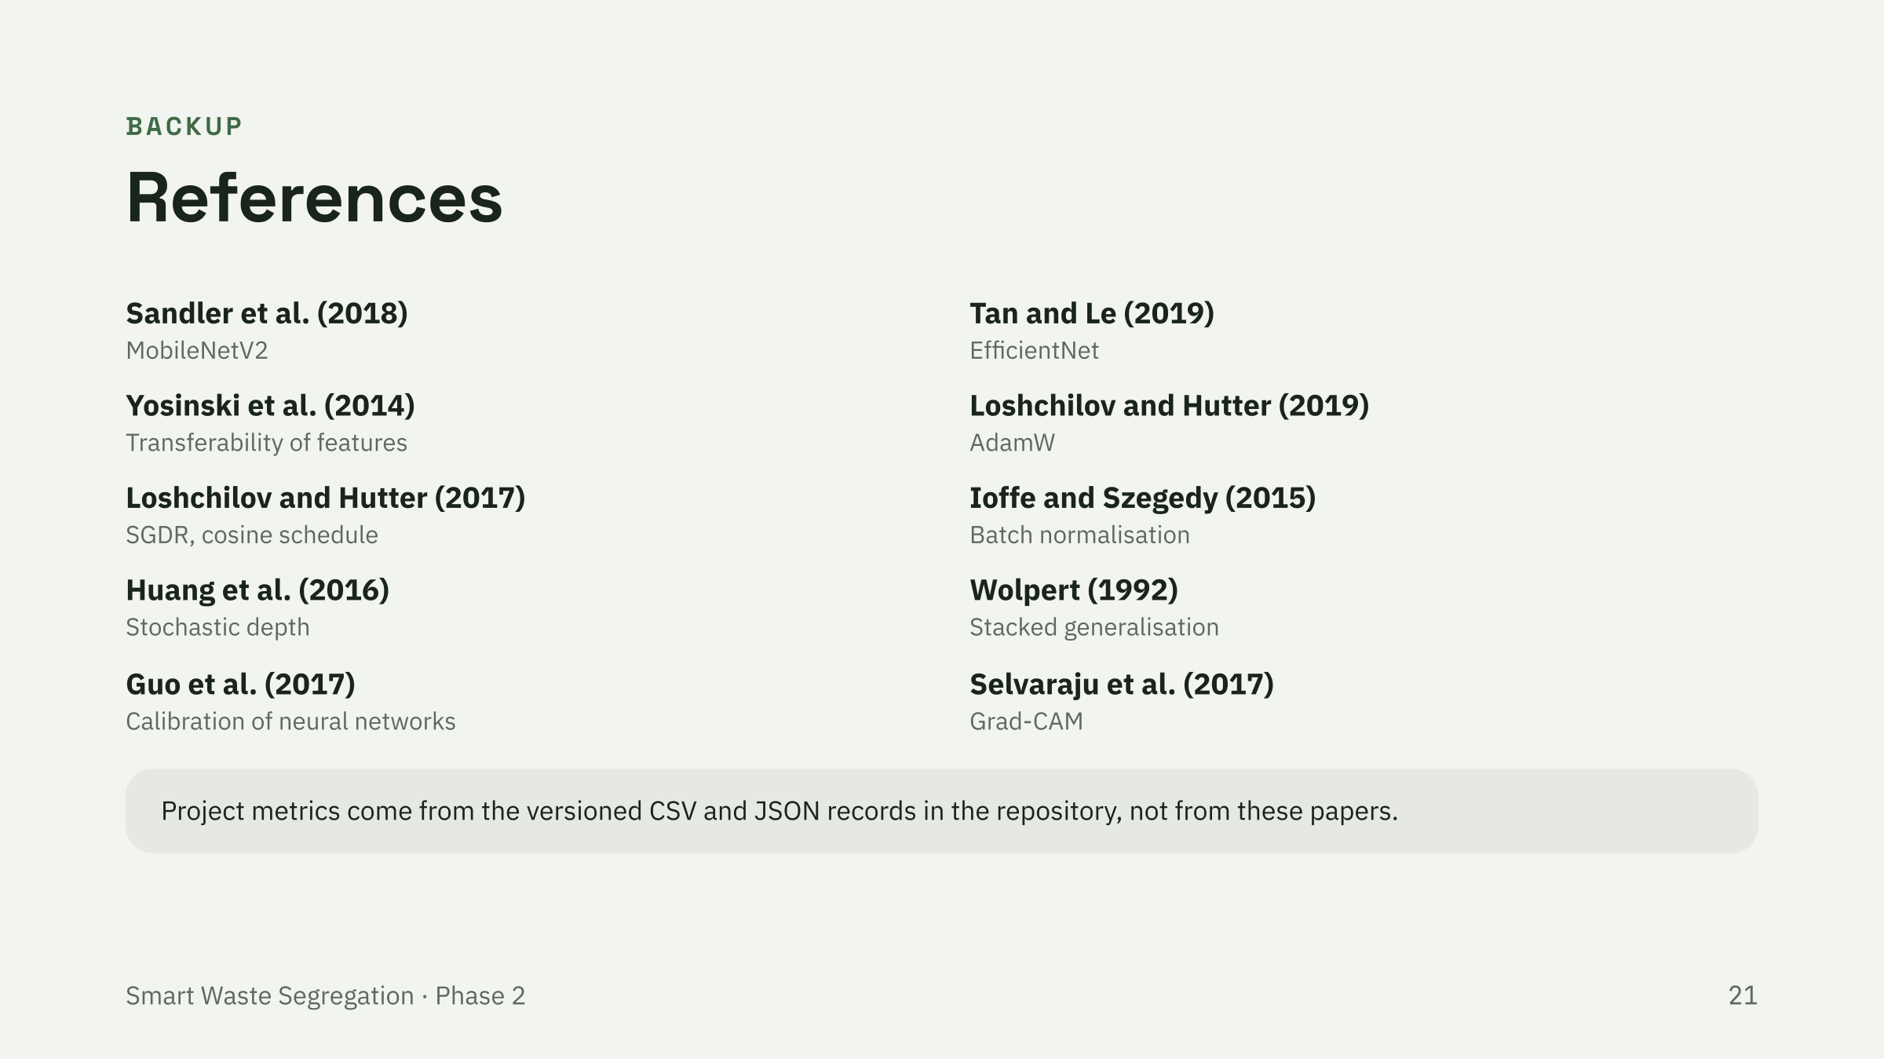
Notes:
Backup slide.

Slide 22
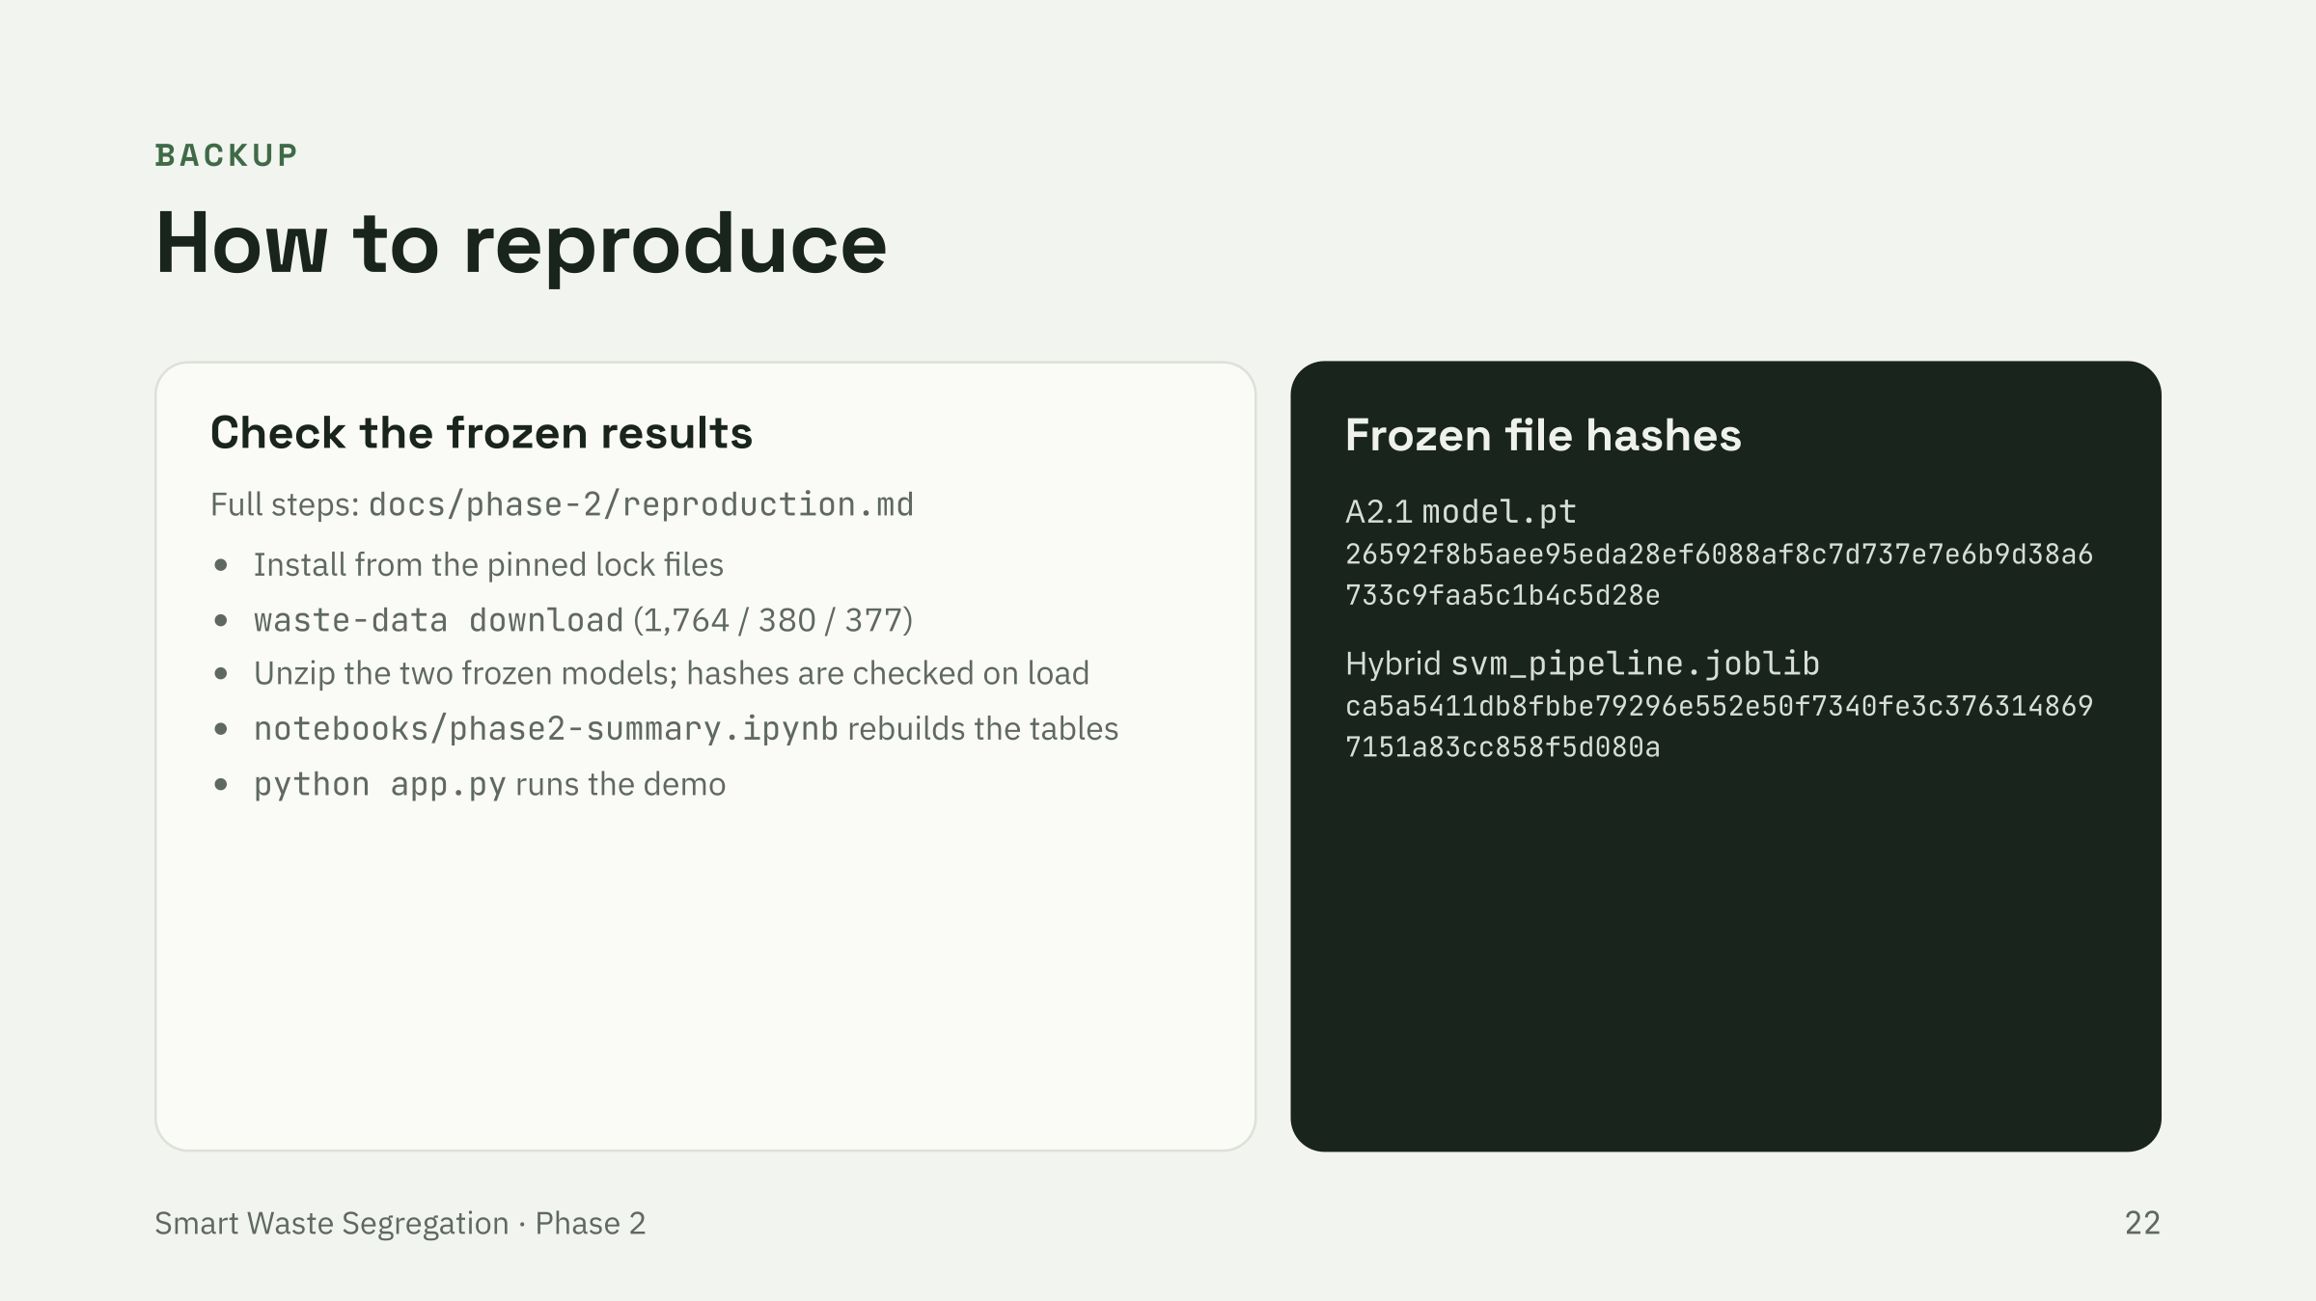
Notes:
Backup slide.

