Slide 1
A3i-Accel Frontend v2
Research, design and a working website concierge
Assignment 3
Implementation and evidence as of 19 October 2026
1 / 10
Notes:
Cover. Existing approved company name and logo. This deck reports current evidence rather than claiming all assignment work is complete.

Slide 2
The visitor’s decision
Understand the offering, then find relevant work
A growing portfolio needs a clear explanation.
A concrete task makes AI easier to evaluate.
A demo request needs a dependable next step.
2 / 10
Notes:
Source: assignment document and docs/PRD.md. Explain the business problem before showing animations. No conversion improvement has been measured.

Slide 3
Three visitor perspectives
Provisional personas to validate
SMB owner: reduce repetitive administration.
Operations leader: evaluate workflows and oversight.
Investor: understand the portfolio and business focus.
3 / 10
Notes:
Source: docs/research.md. These are assignment-derived hypotheses, not interview findings. Describe the distinct information each visitor needs.

Slide 4
Five benchmarks
Activities and examples make products easier to explore
LangChain: organize discovery around work stages.
Intercom and Notion: explain recognizable capabilities.
Linear and Zapier: connect products to workflows.
4 / 10
Notes:
Desk research, 19 October 2026: https://www.langchain.com/ ; https://www.intercom.com/ ; https://www.notion.com/product/ai ; https://linear.app/ ; https://zapier.com/ . See docs/research.md for individual teardowns and limitations. These observations are not claims of competitor conversion performance.

Slide 5
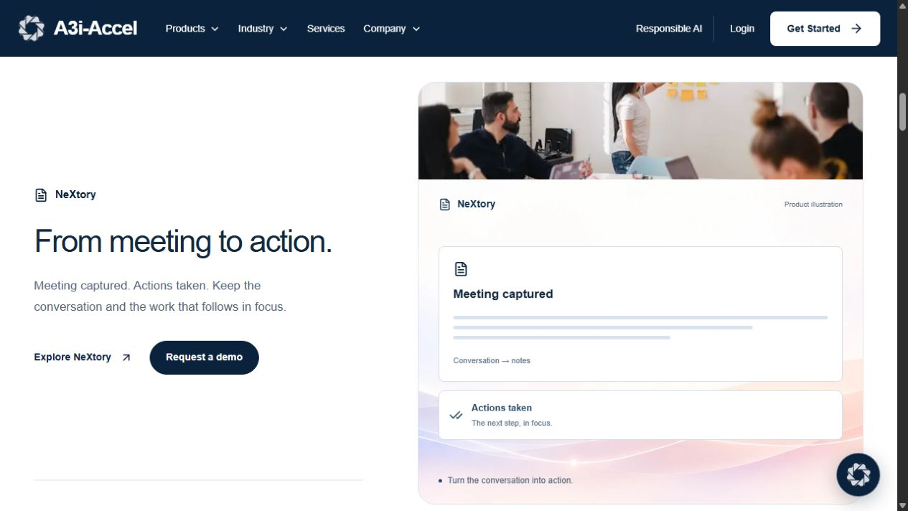
Homepage structure
The approved journey
Motto and platform introduction
Six products, Why A3i and workflow exploration
Apps / Ants / Agents, examples and demo CTA
5 / 10
Notes:
Source: src/components/home/home-preview.tsx and docs/DESIGN.md. Existing product names remain unchanged by user instruction. Figma creation is deferred. Illustration is an existing site screenshot, not a new design.

Slide 6
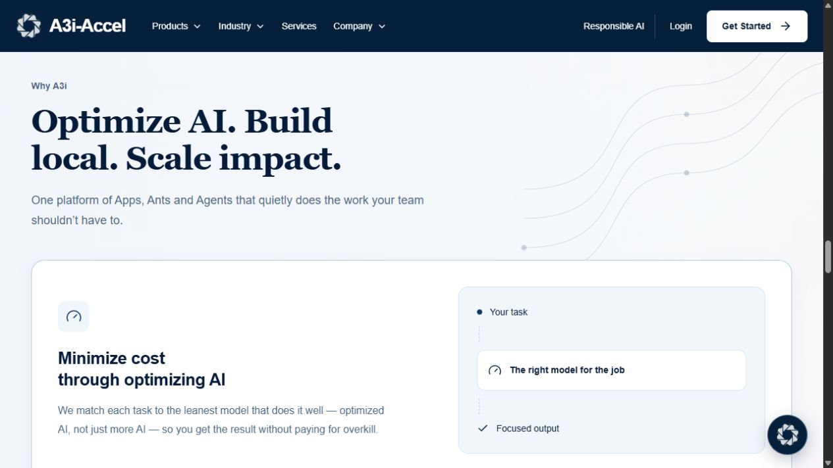
Responsive interaction
Readable content with optional motion
Keyboard controls and visible focus
Mobile stacking and natural text wrapping
Reduced-motion fallbacks and replay on scroll
6 / 10
Notes:
Source: existing Why A3i implementation and previous browser checks recorded in docs/MEMORY.md. Screenshot is previously captured implementation evidence. Full production accessibility acceptance still needs manual review.

Slide 7
Application architecture
Next.js frontend with a separate Python API
React, TypeScript and Tailwind render the site.
Server routes proxy chat and demo requests.
FastAPI connects retrieval, generation and storage.
7 / 10
Notes:
Source: package.json, src/lib/server/agent.ts, src/app/api and sibling Chatbot source. Browser -> /api/chat -> /chat/stream; browser -> /api/leads -> /leads. Model/search keys remain server-side. Netlify/GitHub publishing is deferred by user instruction.

Slide 8
Concierge and demo capture
Existing behavior and the proposed source boundary
Typed streamed replies and retry states exist.
Demo capture uses confirmed name, company and need.
Supplied-content grounding awaits proposal approval.
8 / 10
Notes:
Source: src/components/chat/chat-panel.tsx, src/components/forms/demo-form.tsx, sibling Chatbot main.py/agent.py/leads.py. Current factual answers use official-domain live search. Proposed approved-content retrieval and explicit intent routing are documented only. A saved lead is not a booked calendar appointment. Do not present an unstarted backend as working live.

Slide 9
Measured results
Mobile performance and answer coverage need work
Build, TypeScript, route checks and 44 tests pass.
Lighthouse accessibility reaches 100 after contrast fix.
Live answers: 7 pass, 2 partial, 1 fail; refusals pass.
9 / 10
Notes:
Local Lighthouse 13.5.0 baseline on 19 October 2026: desktop performance/accessibility 98/97, mobile 72/97. Fresh post-fix mobile accessibility-only audit on production port 3002 reaches 100, color-contrast passes. Raw reports in .tmp/assignment-lighthouse-*. No post-fix performance improvement claimed. Live ten-question baseline invokes agent.chat: seven pass, two partial, one fail, two additional refusals pass. See docs/agent-baseline-review.md and output/assignment/agent-baseline.json. Tests are not a factuality guarantee or deployed scores.

Slide 10
Submission and live demonstration
Remaining evidence and the next review
Pending: assistant changes and five participant tests.
Deferred: Figma, GitHub and Netlify deliverables.
Demo: explore a task, ask a question, request a demo.
10 / 10
Notes:
Source: docs/submission-plan.md, docs/evaluation.md and docs/agent-baseline-review.md. Current agent baseline is reviewed but does not meet ten correct answers. User deferred external deliverables and kept current names. Show actual service states. Complete the approved assistant changes, ten correct questions and five-second testing with five real participants before claiming acceptance. Intended business benefit is clearer discovery, not a measured conversion increase.

